Slide 1

Unit 6: FOOD AND DRINKS
Lesson 3.2
Page 85

Slide 2
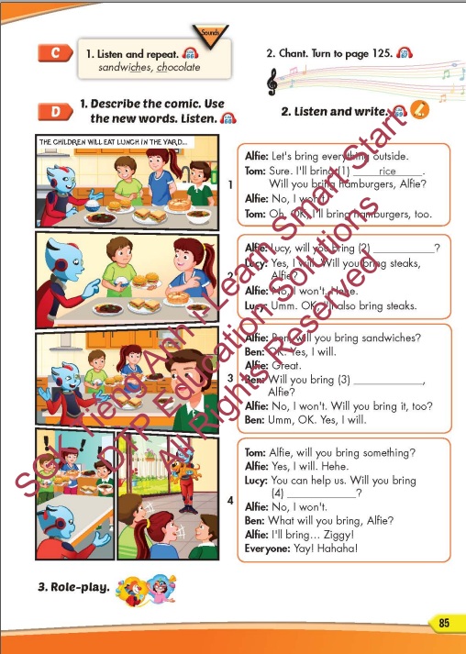
Lesson Outline
Warm-up
Listening
Speaking
Consolidation
Wrap-up

Slide 3
Objectives
By the end of this lesson, students will be able to practice the /tʃ/ sound and conversations about what food people
will bring.
Pronunciation: the /tʃ/ sound.
Structure: Will you bring hamburgers?
Yes, I will.
Will you bring pie?
No, I won't.

Slide 4

WARM-UP

Slide 5
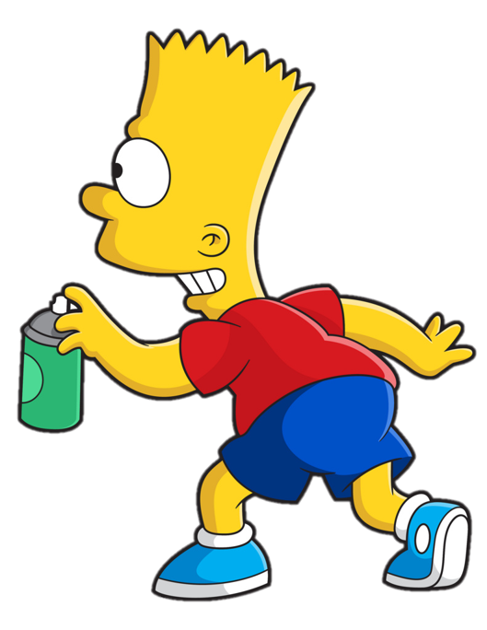


Slide 6












> Someone has deleted some words.
> Guess the deleted word within the time limit (12 seconds).

Slide 7

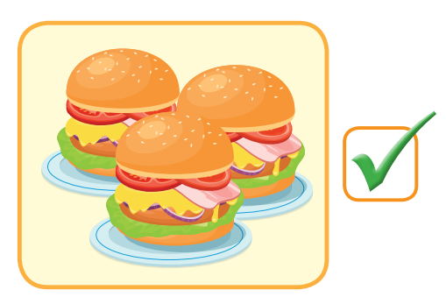
Y
Will you bring hamburgers?
Yes. I will.
CHECK
Notes:
7

Slide 8
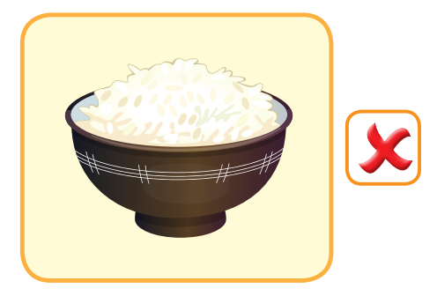
Will you bring rice?
No. I won’t.
CHECK
Notes:
8

Slide 9
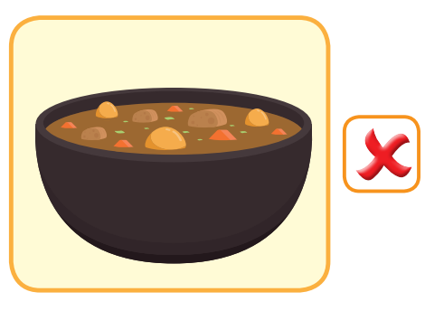
Will she bring curry?
No. She won’t.
CHECK
Notes:
9

Slide 10
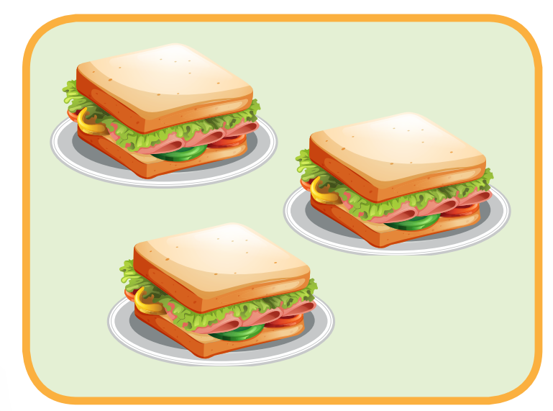

Y
Will he bring sandwiches?
Yes. He will.
CHECK
Notes:
10

Slide 11
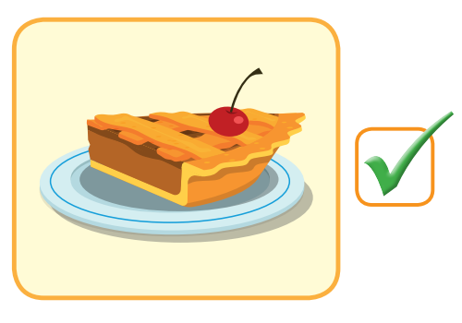
Y
Will he bring pie?
Yes. She will.
CHECK
Notes:
11

Slide 12

It’s time to learn …

Slide 13

Pronunciation
the /tʃ/ sound.

Slide 14

Presentation

Slide 15


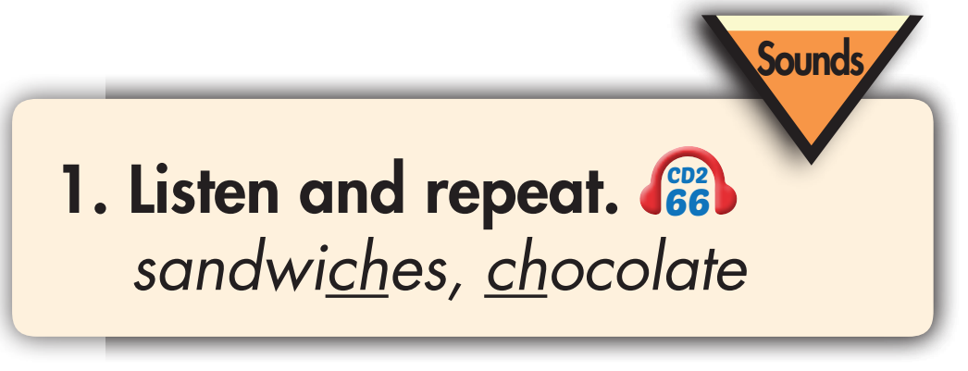
PRONUNCIATION
Click on the picture to hear the sound.

Slide 16
Practice

Slide 17

Click on the picture to hear the sound.

Slide 18


Slide 19

Structure
Will you bring hamburgers?
Yes, I will.
Will you bring pie?
No, I won't.

Slide 20
Speaking

Slide 21

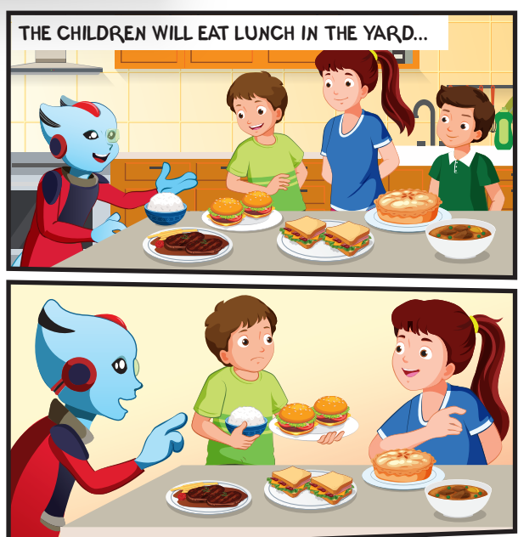
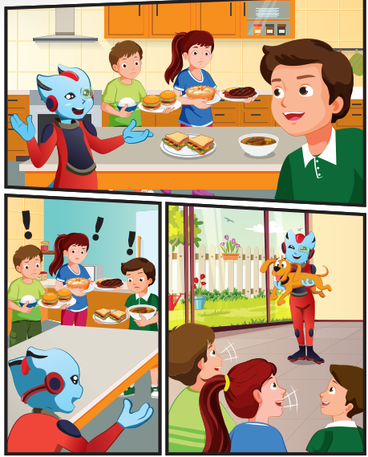
What food can you see?
Who is talking?
Where are they?

Slide 22

Listening

Slide 23

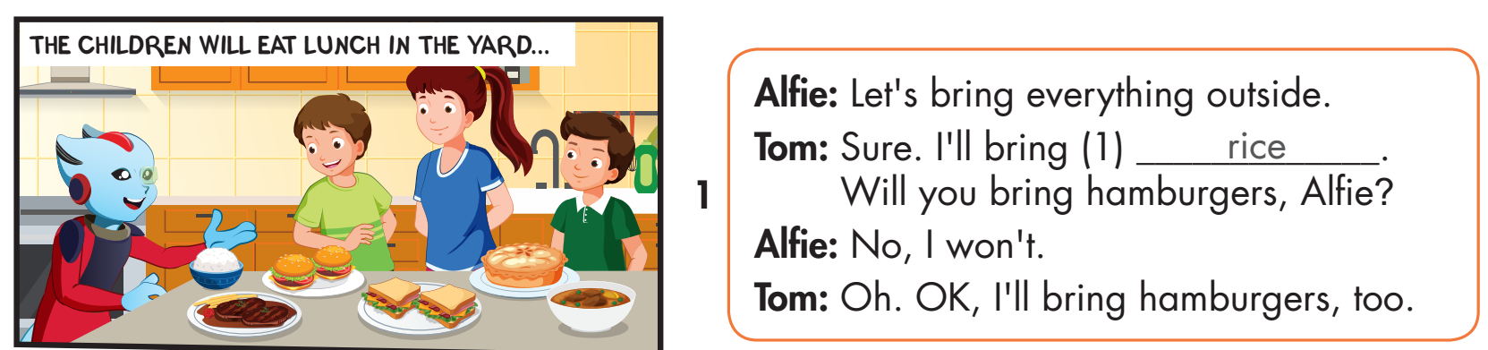
Click on the picture to hear the sound.

Slide 24
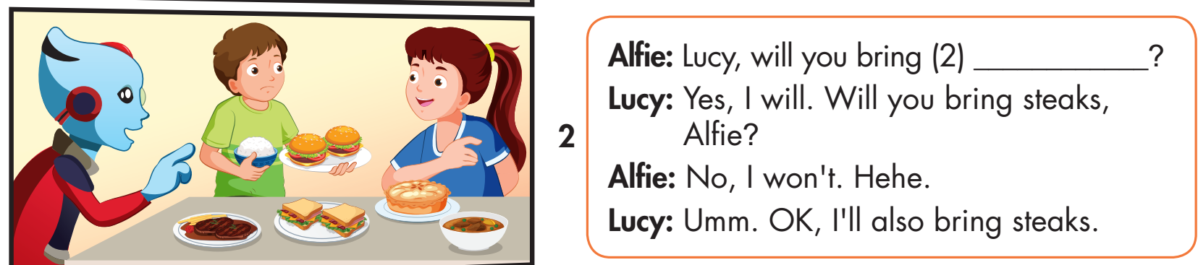
Click on the picture to hear the sound.

Slide 25
Click on the picture to hear the sound.
pie

Slide 26
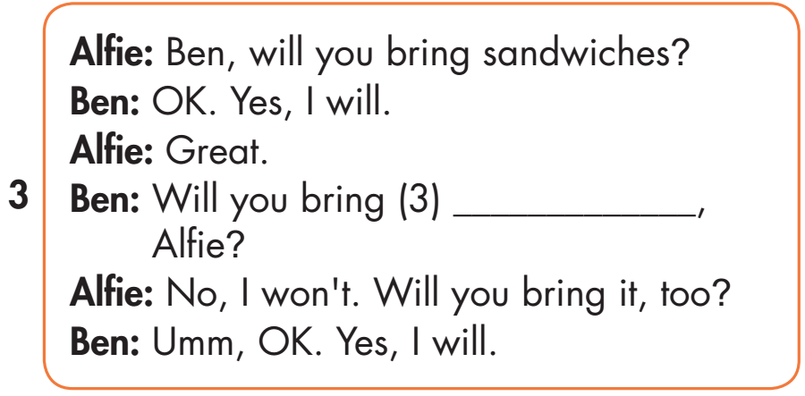
Click on the picture to hear the sound.
curry

Slide 27
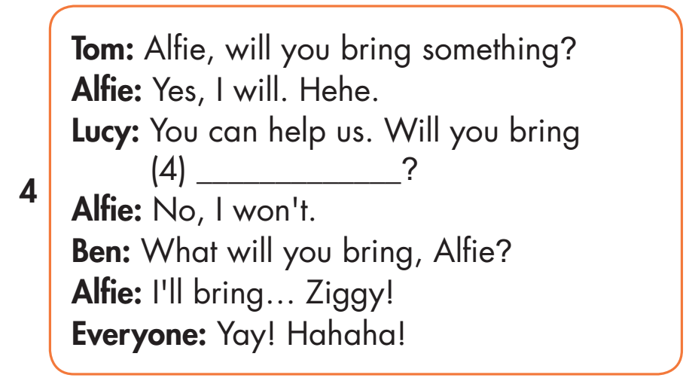
Click on the picture to hear the sound.
sandwiches

Slide 28

Speaking

Slide 29


Slide 30
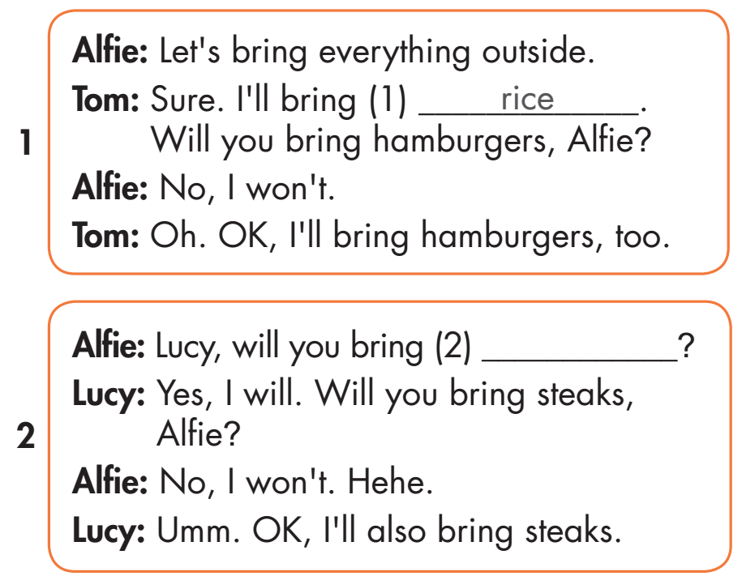
curry
pie
sandwiches

Slide 31

Production

Slide 32
MAKE YOUR OWN STORY

Slide 33

CONSOLIDATION

Slide 34

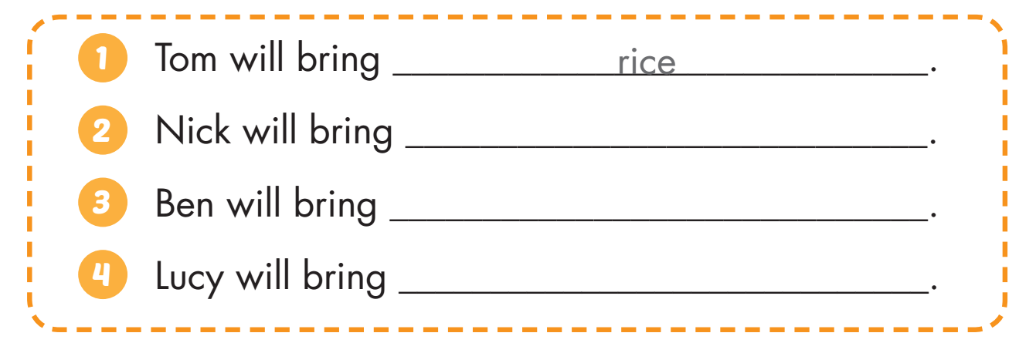
Extra Practice
WB, page 46
steak
curry
sandwiches

Slide 35
PRONUNCIATION PRACTICE
Choose the /tʃ/ sound.
CHEESE
SHE
SING

Slide 36
PRONUNCIATION PRACTICE
Choose the /tʃ/ sound.
JOGGING
CHEESE
SEA

Slide 37
PRONUNCIATION PRACTICE
Choose the /tʃ/ sound.
CURRY
TEA
CHOCOLATE

Slide 38
PRONUNCIATION PRACTICE
Choose the /tʃ/ sound.
CHERRY
SODA
STEAK

Slide 39

WRAP-UP

Slide 40
Today’s lesson
Pronunciation
the /tʃ/ sound.
Structures/ Sentence patterns
Will you bring hamburgers?
Yes, I will.
Will you bring pie?
No, I won't.

Slide 41
Homework
Practice the vocabularies and structure, and make sentences using them.
Do the exercises in Tiếng Anh 5 i-Learn Smart Start WB (page 57).
Do the exercises in Tiếng Anh 5 i-Learn Smart Start Notebook.
Prepare the next lesson (page 86 SB).
Play the consolidation games in Tiếng Anh 5 i-Learn Smart Start DHA App on www.eduhome.com.vn

Slide 42

Enjoy your day!

Slide 43

Lesson 3
Stay positive and have a nice day!

