Slide 1

Unit 5: HEALTH
Review 1
Page 76

Slide 2
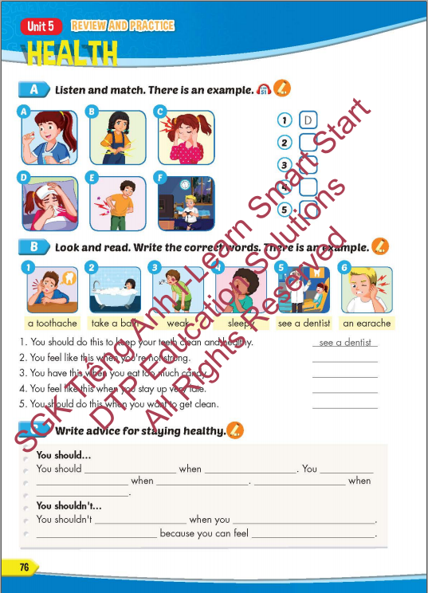
Lesson Outline
Warm-up
Listening
Reading
Writing
Wrap-up

Slide 3
Objectives
By the end of this lesson, students will be able to review the target language presented in unit 5 and practice Listening, Reading and Writing.
Vocabulary: unit 5
Structure: unit 5

Slide 4

WARM UP

Slide 5
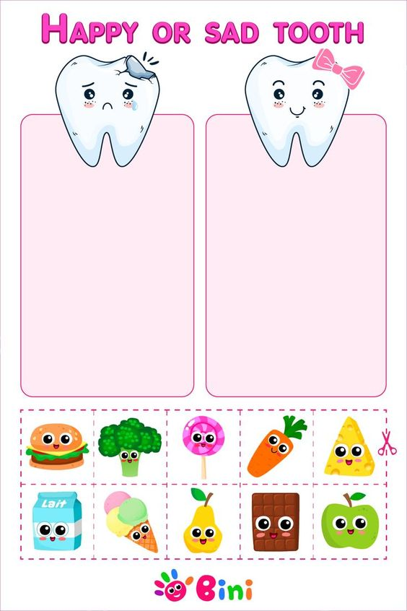
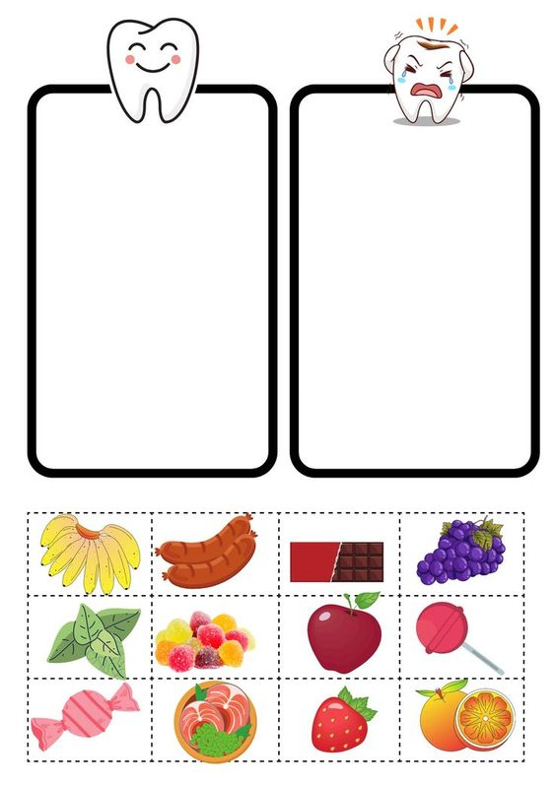

Slide 7

It’s time to learn …

Slide 8

Review

Slide 9

Listening

Slide 10

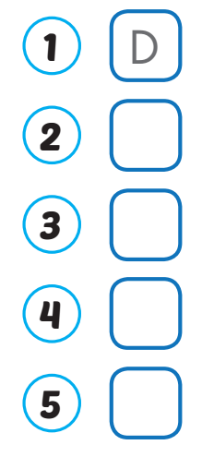
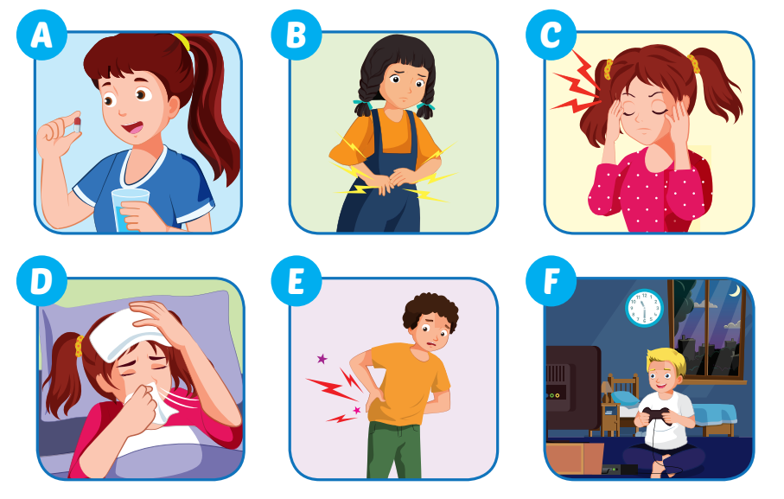
F
B
E
C

Slide 11

Reading

Slide 12
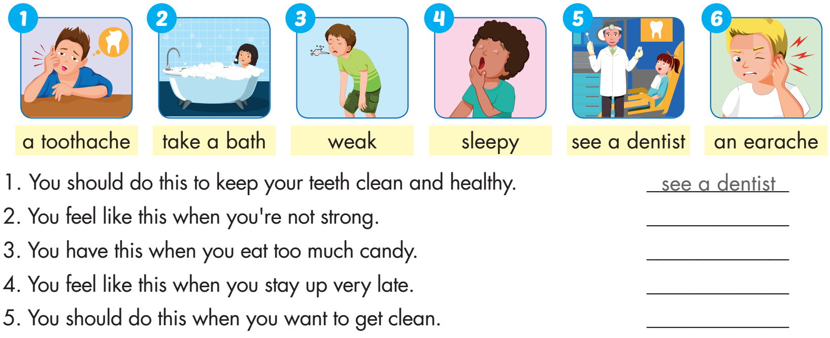
weak
a toothache
sleepy
take a bath

Slide 13
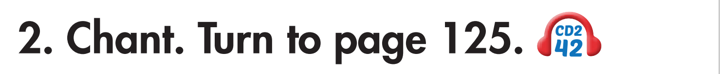


Slide 14

Writing

Slide 15

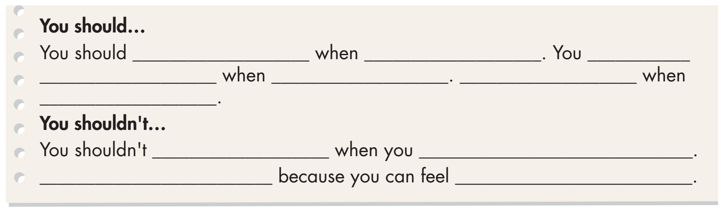
Examples:
see a dentist
you have a toothache
should
take some medicine
you are sick
You should get some rest
you feel terrible
stay up late
have school
You shouldn’t skip breakfast
weak

Slide 16

Production

Slide 17

Practice

Slide 18
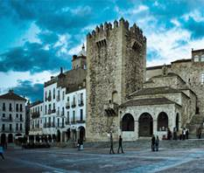
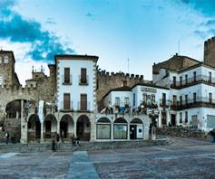
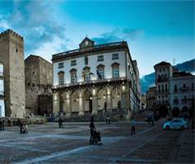

WHAT IS THIS PICTURE?
PHOTO PUZZLE

Slide 19

WHAT IS THIS PICTURE?
Turn around as many colored boxes as you can within the time limit (5 seconds) and say what it is in the picture.

Slide 20
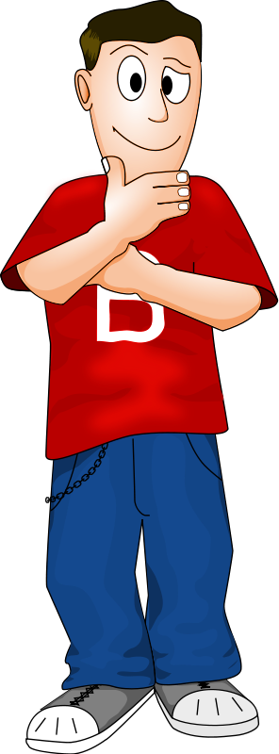
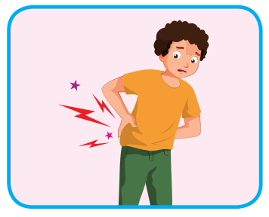
I feel sore.
T
I
M
E
I
S
U
P
CHECK
NEXT
Click on the colored boxes to turn them around

Slide 21
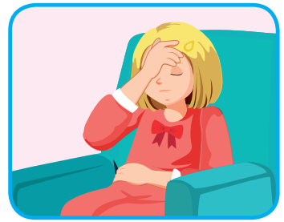
I feel stuffed up.
T
I
M
E
I
S
U
P
CHECK
NEXT
Click on the coloured boxes to turn them around

Slide 22
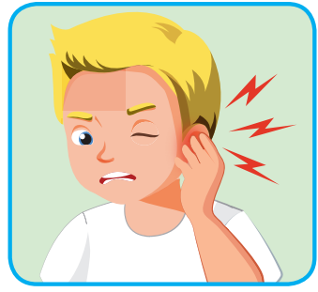
He has an earache.
T
I
M
E
I
S
U
P
CHECK
NEXT
Click on the colored boxes to turn them around

Slide 23
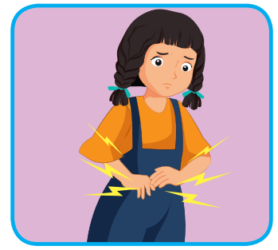
She has a stomachache.
What is it?
T
I
M
E
I
S
U
P
CHECK
NEXT
Click on the colored boxes to turn them around

Slide 24
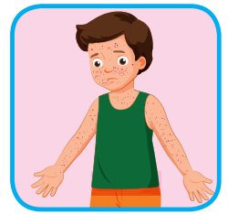
He has chickenpox.
T
I
M
E
I
S
U
P
CHECK
NEXT
Click on the colored boxes to turn them around

Slide 25
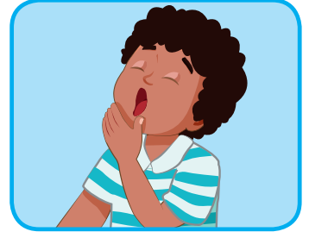
I feel sleepy.
T
I
M
E
I
S
U
P
CHECK
END
Click on the colored boxes to turn them around

Slide 26
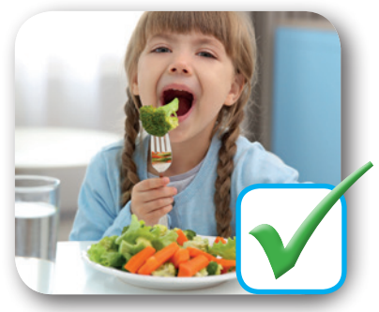
You should eat vegetables.
T
I
M
E
I
S
U
P
CHECK
END
Click on the colored boxes to turn them around

Slide 27

CONSOLIDATION

Slide 28
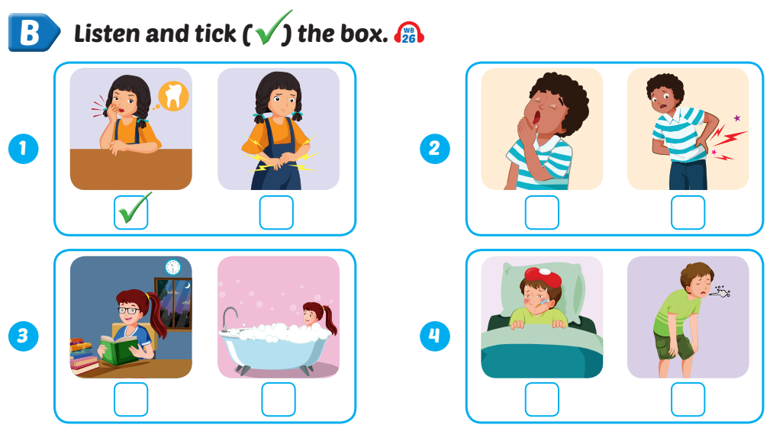

Extra Practice
WB, page 50

Slide 29

WRAP-UP

Slide 30
Today’s lesson
Vocabularies
Unit 5
Structures/ Sentence patterns
Unit 5

Slide 31
Homework
Practice the vocabularies and structure, and make sentences using them.
Do the exercises in Tiếng Anh 5 i-Learn Smart Start WB (page 50).
Do the exercises in Tiếng Anh 5 i-Learn Smart Start Notebook.
Prepare the next lesson (page 77 SB).
Play the consolidation games in Tiếng Anh 5 i-Learn Smart Start DHA App on www.eduhome.com.vn

Slide 32

Enjoy your day!

Slide 33

Lesson 3
Stay positive and have a nice day!

