Slide 1

Unit 1: HEALTH
CLIL - Lesson 2
Page 74

Slide 2
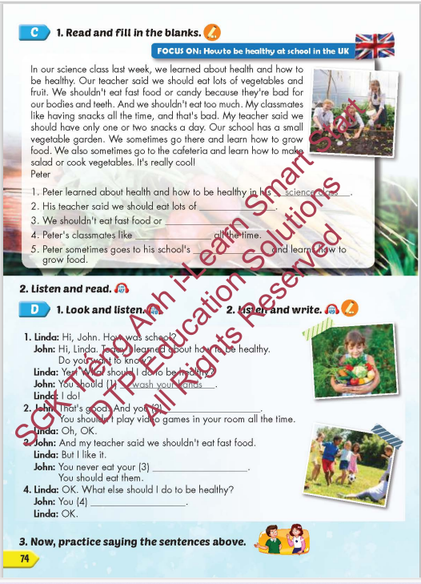
Lesson Outline
Warm-up
Reading
Listening
Speaking
Consolidation
Wrap-up

Slide 3
Objectives
By the end of this lesson, students will be able to review the target language and familiarize themselves with aspect how to be healthy at school in the UK and practice reading comprehension.
Vocabulary: do exercise, eat fast food, eat vegetables, wash your hands, play outside, eat too much.
Structure: What should I do to be healthy?
You should do exercise.
You shouldn't eat fast food.

Slide 4

WARM UP

Slide 5
Listen and choose. Then say.

Slide 6

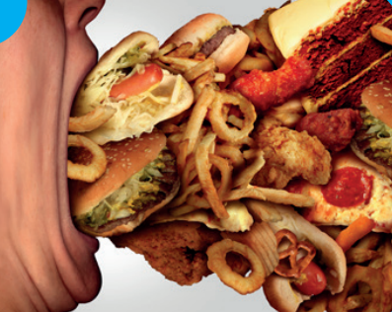
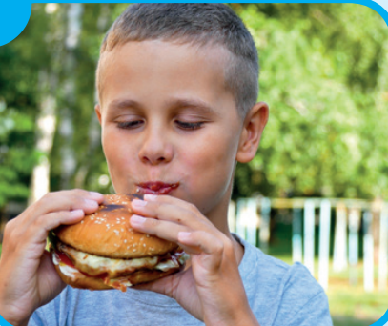


Listen and choose
A
B
C

Slide 7
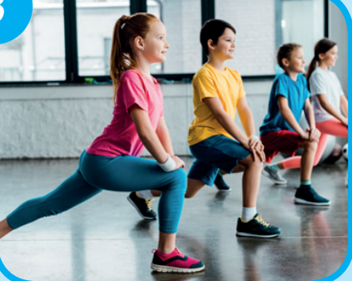
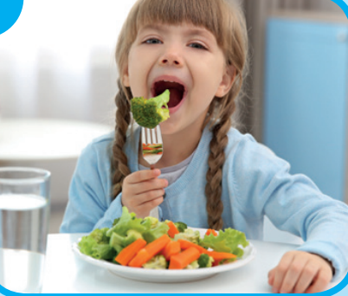

Listen and choose
A
B
C

Slide 8
Listen and choose
A
B
C

Slide 9
Listen and choose
A
C
A
B
B

Slide 10

It’s time to learn …

Slide 11

Lead-in

Slide 12

WHAT COUNTRY IS IT?
It’s the UK
The UK is known as the United Kingdom (UK).
The capital and largest city of the United Kingdom is London.

Slide 13
Practice

Slide 14

Reading

Slide 15

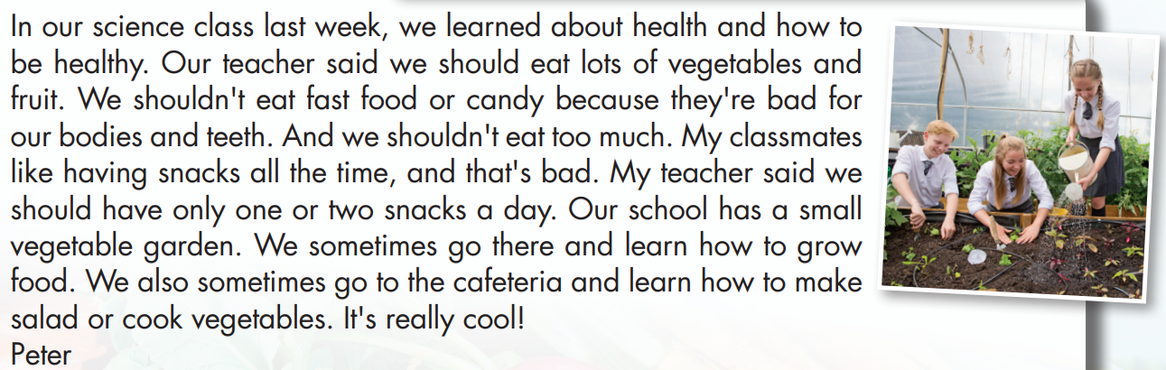

Slide 16
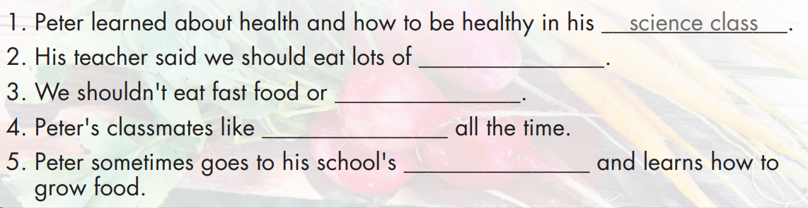
vegetables and fruit
candy
having snacks
vegetable garden

Slide 18
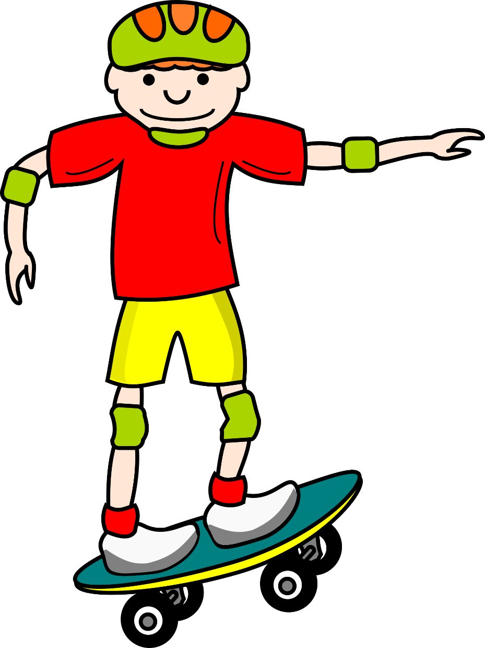
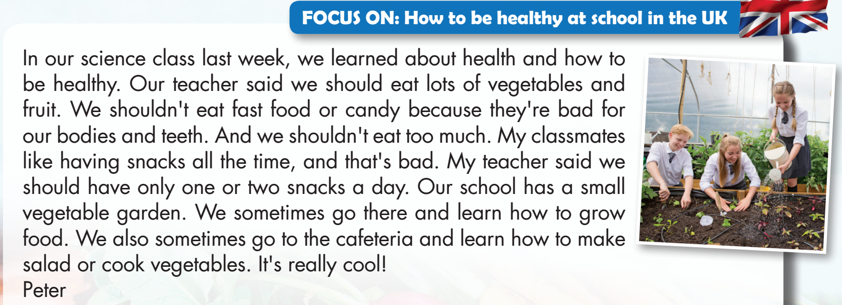
WHERE IS MY SKATEBOARD?
START

Slide 19
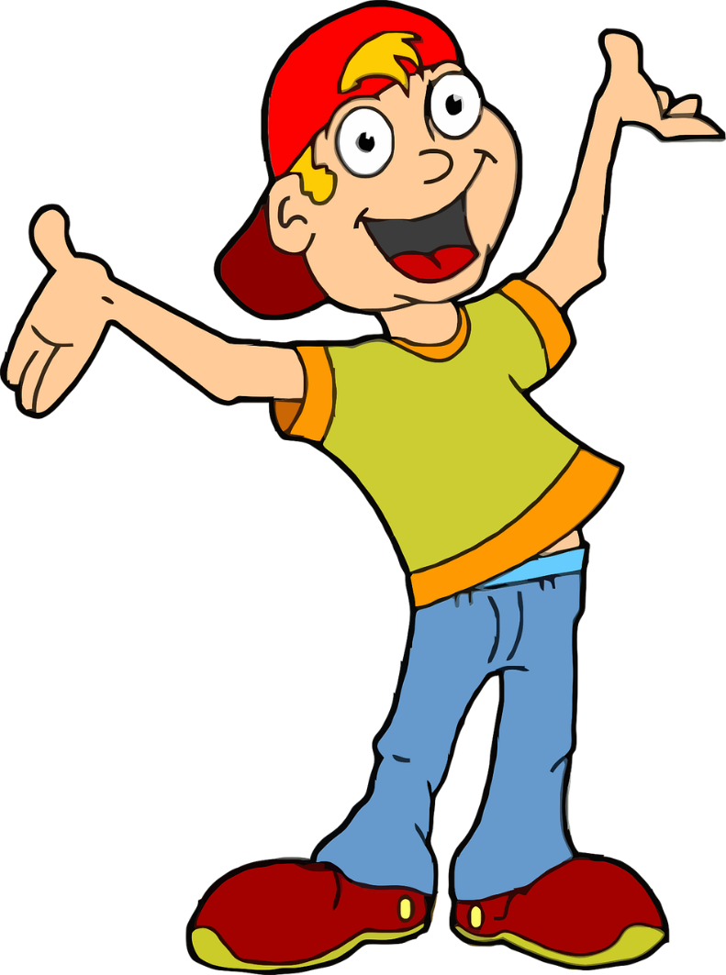

His teacher said we should eat lots of snacks.
TRUE
FALSE

Slide 20
WHERE IS MY SKATEBOARD?
START

Slide 21
We shouldn't eat fast food or candy.
TRUE
FALSE

Slide 22
WHERE IS MY SKATEBOARD?
START

Slide 23

Peter's classmates like having fast food all the time.
TRUE
FALSE

Slide 24
WHERE IS MY SKATEBOARD?
START

Slide 25
Peter sometimes goes to his school’s garden and learns how to grow food.
TRUE
FALSE

Slide 26
WHERE IS MY SKATEBOARD?
START

Slide 27

Listening

Slide 28

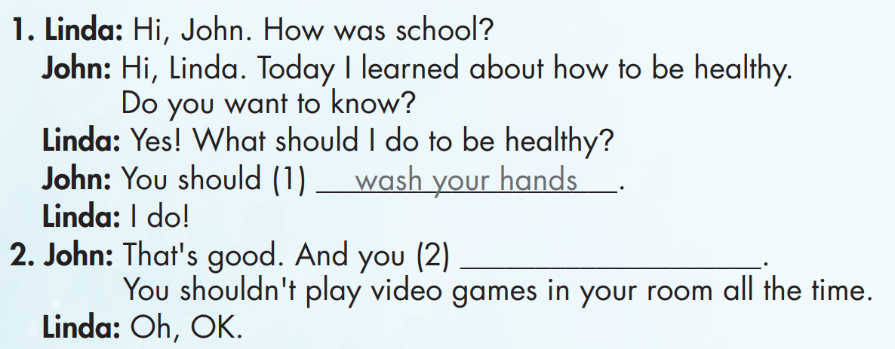
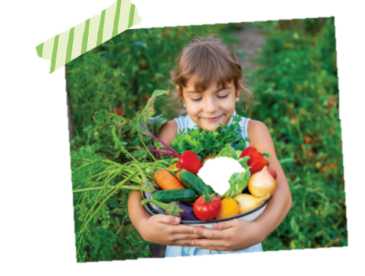
Click on D to hear the sound.

Slide 29
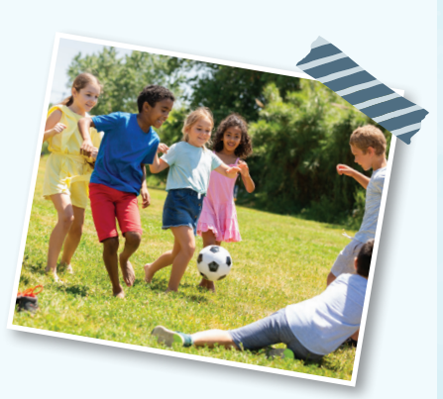
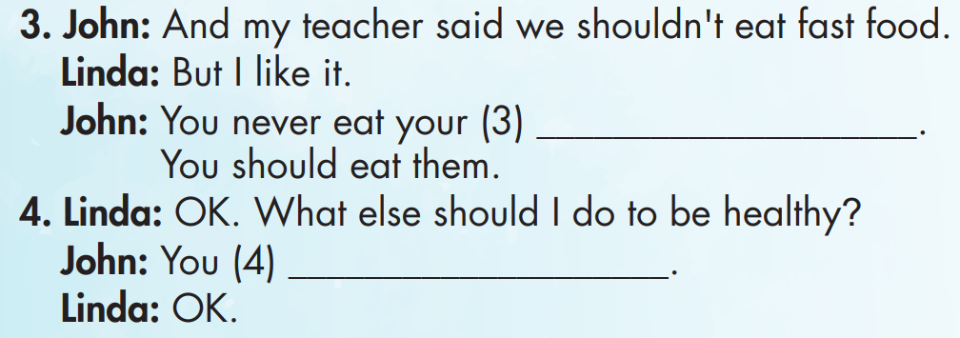
Click on D to hear the sound.

Slide 30

Writing

Slide 31
Click on D to hear the sound.
play outside

Slide 32
Click on D to hear the sound.
vegetables
should do exercise

Slide 33

Speaking

Slide 34

Production

Slide 35
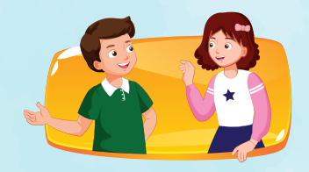
play outside
vegetables
should do exercise

Slide 36

CONSOLIDATION

Slide 37
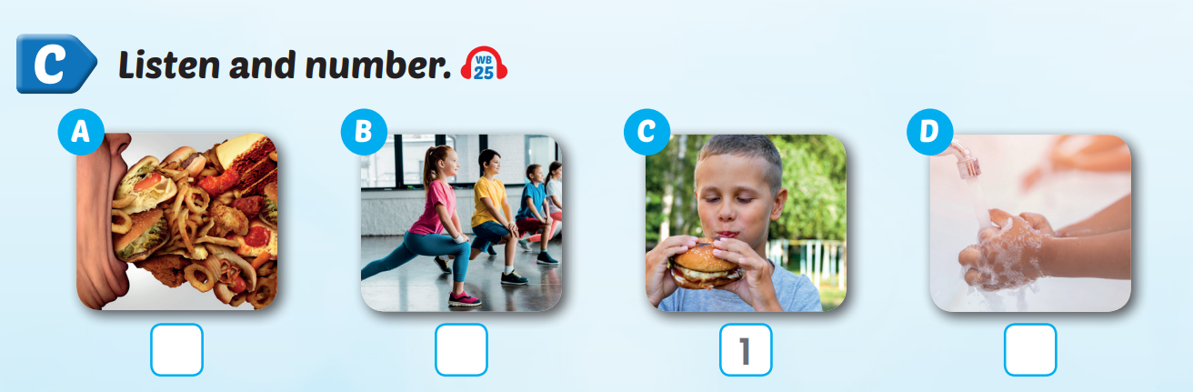
Extra Practice
WB, page 49
Click on C to hear the sound.
3
2
4

Slide 38

WRAP-UP

Slide 39
Today’s lesson
Vocabularies
do exercise, eat fast food, eat vegetables, wash your hands, play outside, eat too much.
Structures/ Sentence patterns
What should I do to be healthy?
You should do exercise.
You shouldn't eat fast food.

Slide 40
Homework
Practice the vocabularies and structure, and make sentences using them.
Do the exercises in Tiếng Anh 5 i-Learn Smart Start WB (page 49).
Do the exercises in Tiếng Anh 5 i-Learn Smart Start Notebook.
Prepare the next lesson (page 74 SB).
Play the consolidation games in Tiếng Anh 5 i-Learn Smart Start DHA App on www.eduhome.com.vn

Slide 41

Enjoy your day!

Slide 42

Lesson 3
Stay positive and have a nice day!

