Slide 1

Unit 5: HEALTH
CLIL - Lesson 1
Page 73

Slide 2
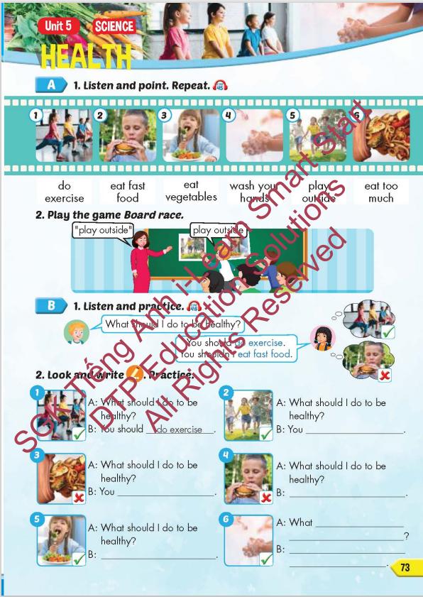
Lesson Outline
Warm-up
Vocabulary
Structure
Consolidation
Wrap-up

Slide 3
Objectives
By the end of this lesson, students will be able to give advice about how to be healthy.
Vocabulary: do exercise, eat fast food, eat vegetables, wash your hands, play outside, eat too much.
Structure: What should I do to be healthy?
You should do exercise.
You shouldn't eat fast food.

Slide 4

WARM UP

Slide 5
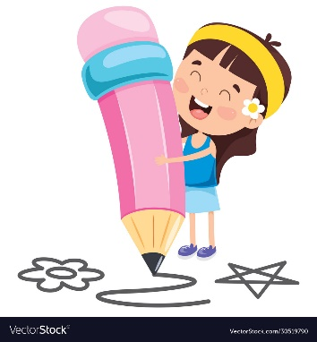





Guessing fast food restaurant’s logo
Domino’s pizza
McDonald’s
Popeyes
Jollibee
KFC

Slide 6

It’s time to learn …

Slide 7

New words
do exercise, eat fast food, eat vegetables, wash your hands, play outside, eat too much.

Slide 8

Presentation

Slide 9


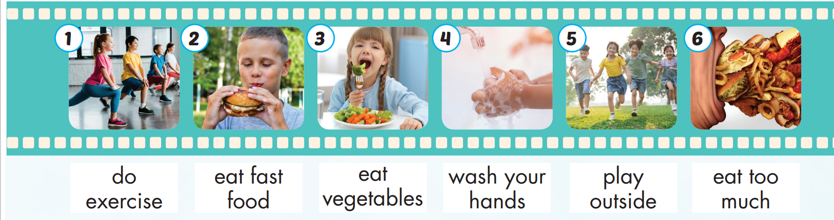
Click on A to hear the sound.
/duː/
/ˈek.sɚ.saɪz/
tập thể dục
/iːt/ /fæst/
/fuːd/
ăn thức ăn nhanh
/iːt/
/ˈvedʒ.tə.bəlz/
ăn rau củ quả
/wɑːʃ/ /jʊr/
/hændz/
rửa tay
/pleɪ/
/ˈaʊt.saɪd/
ra ngoài chơi
/iːt/ /tuː/
/mʌtʃ/
ăn quá nhiều
Notes:
Click vào hình A. 1. Listen and point. Repeat để cho cả audio full chạy

Slide 10
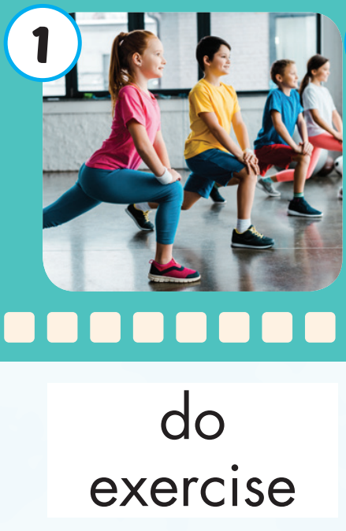
Click on the picture to hear the sound.
do exercise (v)
/duː/ /ˈek.sɚ.saɪz/
tập thể dục

Slide 11
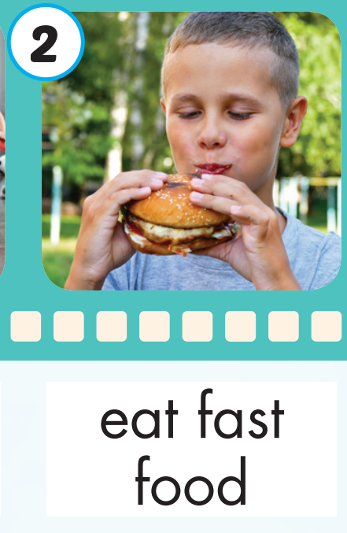
Click on the picture to hear the sound.
eat fast food (v)
/iːt/ /fæst/ /fuːd/
ăn thức ăn nhanh

Slide 12
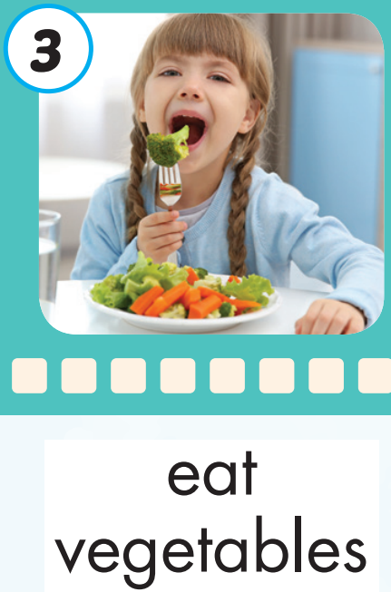
Click on the picture to hear the sound.
eat vegetables (v)
/iːt/ /ˈvedʒ.tə.bəlz/
ăn rau củ quả

Slide 13
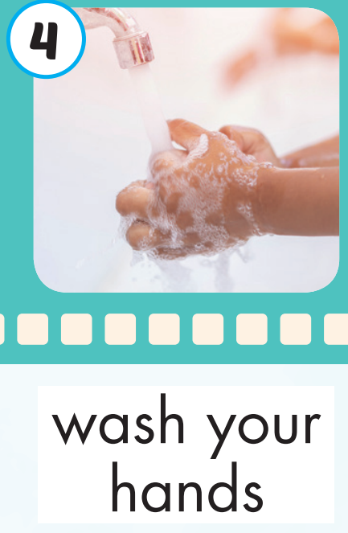
Click on the picture to hear the sound.
wash your hands (v)
/wɑːʃ/ /jʊr/ /hændz/
rửa tay

Slide 14

Click on the picture to hear the sound.
play outside(v)
/pleɪ/ /ˈaʊt.saɪd/
ra ngoài chơi

Slide 15
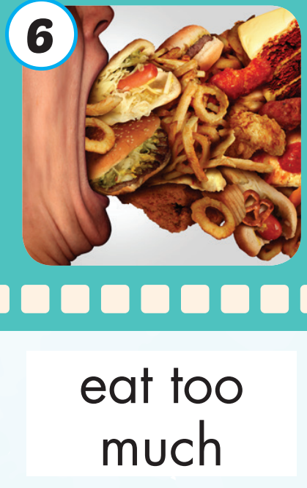
Click on the picture to hear the sound.
eat too much (v)
/iːt/ /tuː/ /mʌtʃ/
ăn quá nhiều

Slide 16
Practice

Slide 17
Listen and choose. Then say.

Slide 18
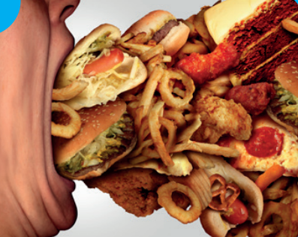
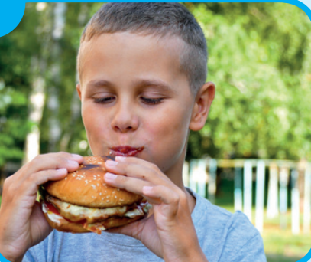


Listen and choose
A
B
C

Slide 19
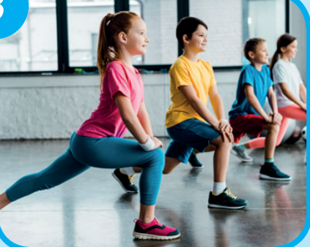
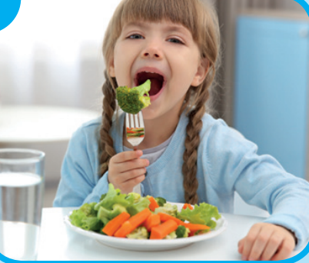
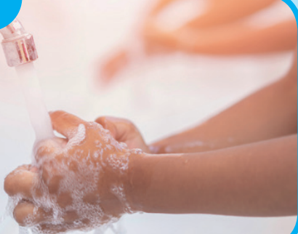
Listen and choose
A
B
C

Slide 20
Listen and choose
A
B
C

Slide 21
Listen and choose
A
C
A
B
B

Slide 22
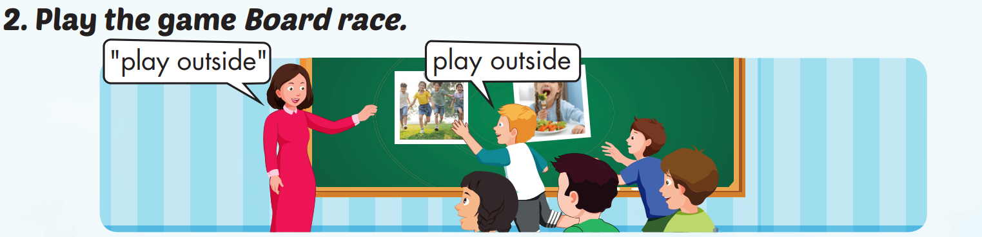

Slide 23
Structure
What should I do to be healthy?
You should do exercise.
You shouldn't eat fast food.

Slide 24
Presentation

Slide 25
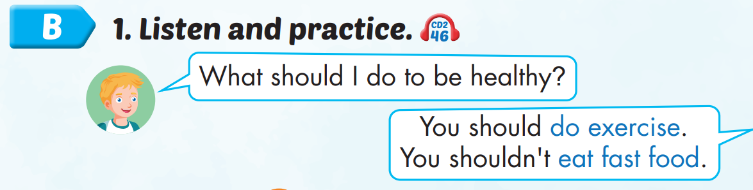
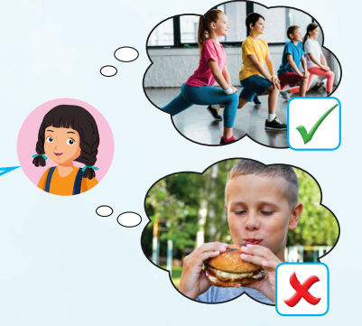
Structure

Slide 26

Listening

Slide 27
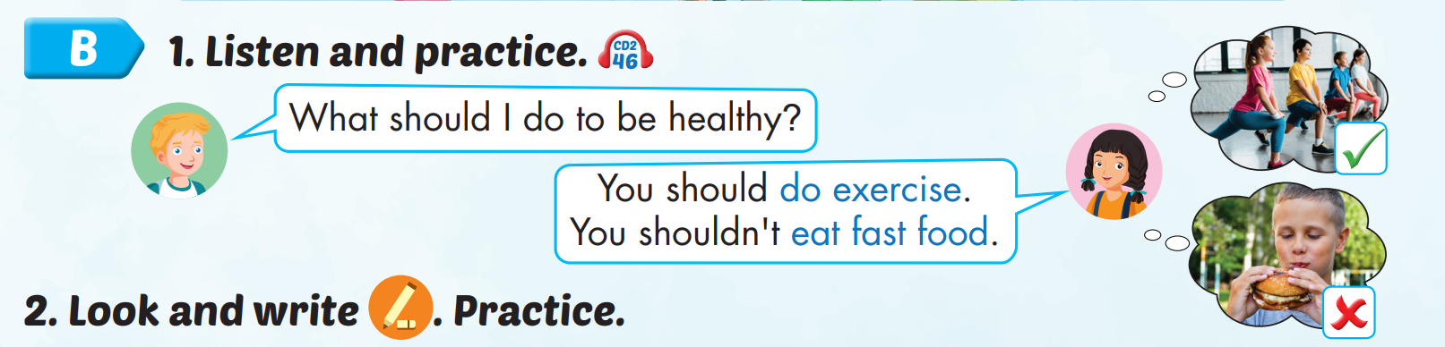
Click on B to hear the sound.

Slide 28

Practice

Slide 29

Writing

Slide 30
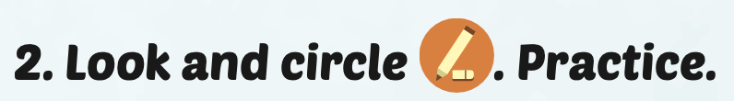
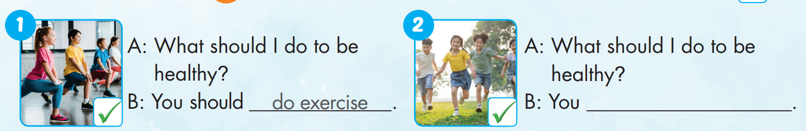
should play outside

Slide 31
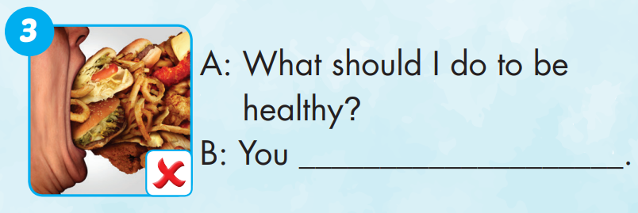
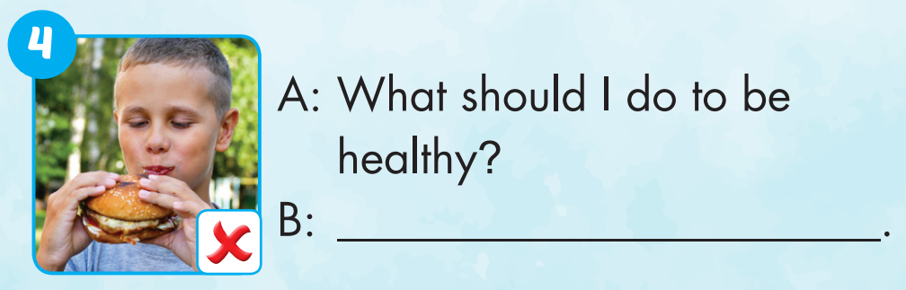
shouldn’t eat too much
You shouldn’t eat fast food

Slide 32
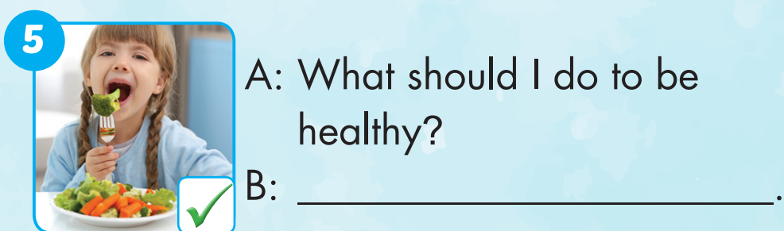
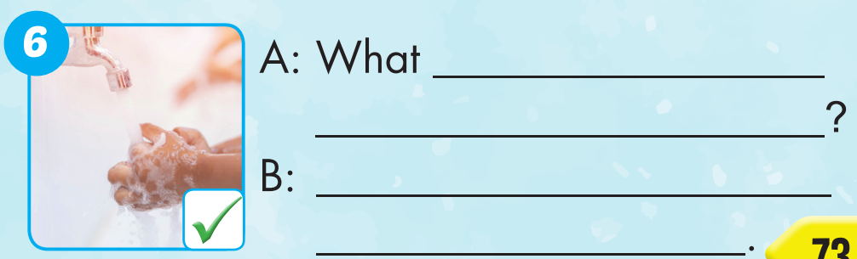
You should eat vegetables
should I do to
be healthy
You should wash your hands

Slide 33

Production

Slide 34

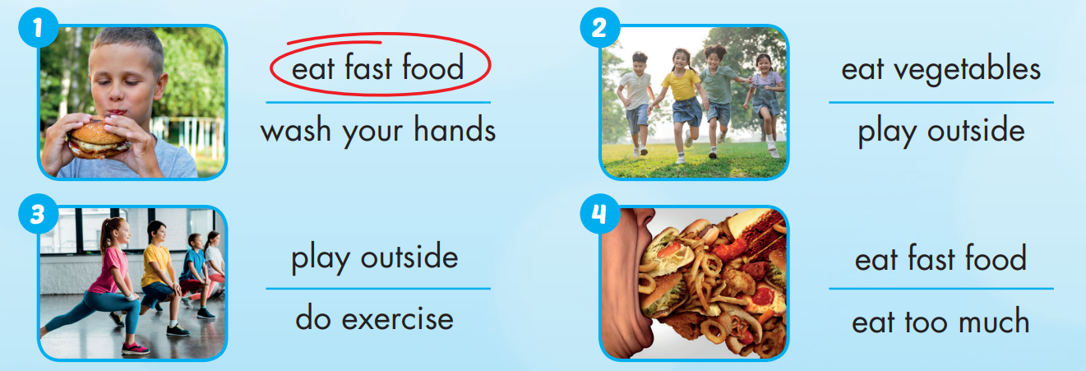
Extra Practice
WB, page 48

Slide 35
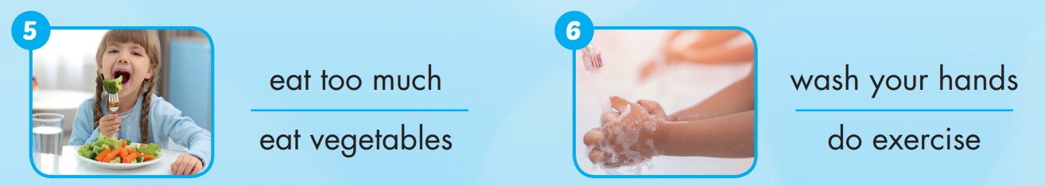
Extra Practice
WB, page 48

Slide 36

CONSOLIDATION

Slide 37

Let’s play!
Let’s Dance Game

Slide 38
How To Play
Students must take turns make sentence use “should” or “shouldn’t” then, read the words in order.
Each time a student can choose to say the words in 1 square, 2 squares or a maximum of 3 squares.
The student who says the last word must dance!

Slide 39
stay up late
eat fast food
wake up early
do exercise
drink water
smoke
see a doctor
drink medicine
get some rest
play outside
wash your hands
sleep early
DANCE!!
eat too much
take a bath
Skip breakfast
see a dentist
Eat vegetables
Play sport
eat fruit
drink water
eat fast food
stay up late
take a bath
Wash your hands
eat too much
skip breakfast
play sport
see a dentist
get some rest
drink water

Slide 40

WRAP-UP

Slide 41
Today’s lesson
Vocabularies
do exercise, eat fast food, eat vegetables, wash your hands, play outside, eat too much
Structures/ Sentence patterns
What should I do to be healthy?
You should do exercise.
You shouldn't eat fast food.

Slide 42
Homework
Practice the vocabularies and structure, and make sentences using them.
Do the exercises in Tiếng Anh 5 i-Learn Smart Start WB (page 48).
Do the exercises in Tiếng Anh 5 i-Learn Smart Start Notebook.
Prepare the next lesson (page 74 SB).
Play the consolidation games in Tiếng Anh 5 i-Learn Smart Start DHA App on www.eduhome.com.vn

Slide 43

Enjoy your day!

Slide 44

Lesson 3
Stay positive and have a nice day!

