Slide 1

Unit 6: FOOD AND DRINKS
Lesson 1.1
Page 78

Slide 2
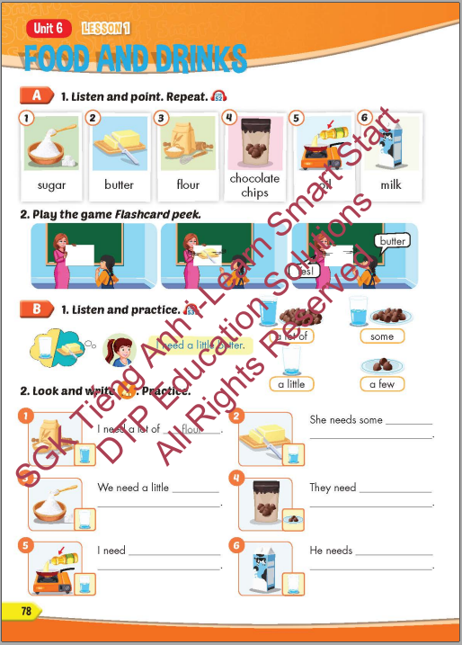
Lesson Outline
Warm-up
Vocabulary
Structure
Consolidation
Wrap-up

Slide 3
Objectives
By the end of this lesson, students will be able to recognize vocabulary expressing food and drinks and say what they need to cook something.
Vocabulary: sugar, butter, flour, chocolate chips, oil, milk.
Sentence pattern: I need a little butter.

Slide 4

WARM-UP

Slide 5


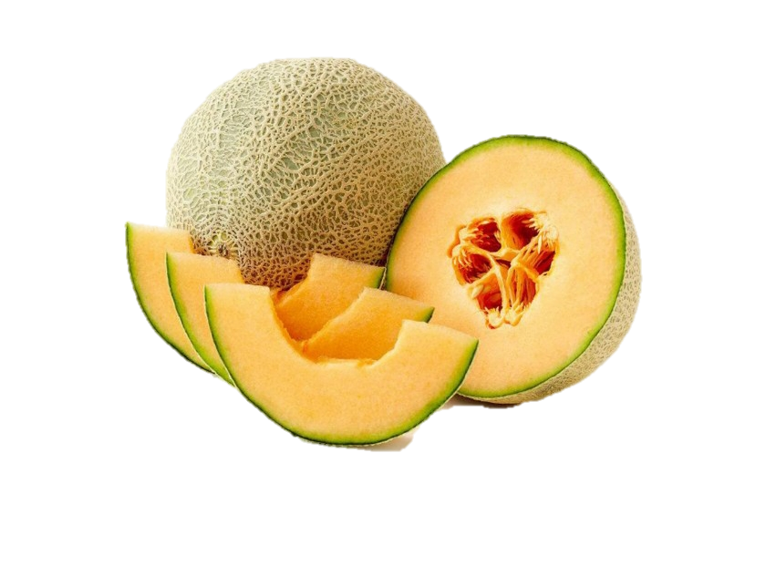
Catch the words
water
a melon
a watermelon

Slide 6



Catch the words
a moon
a cake
a mooncake

Slide 7
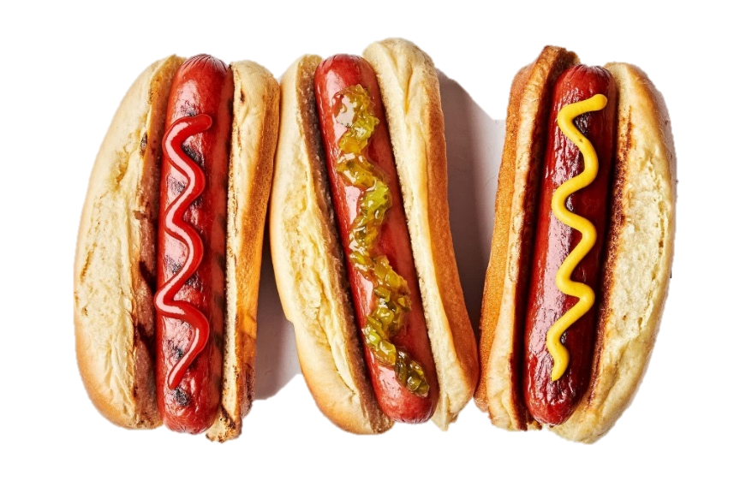


Catch the words
hot
a dog
a hot dog

Slide 8



Catch the words
milk
shake
milkshake

Slide 9
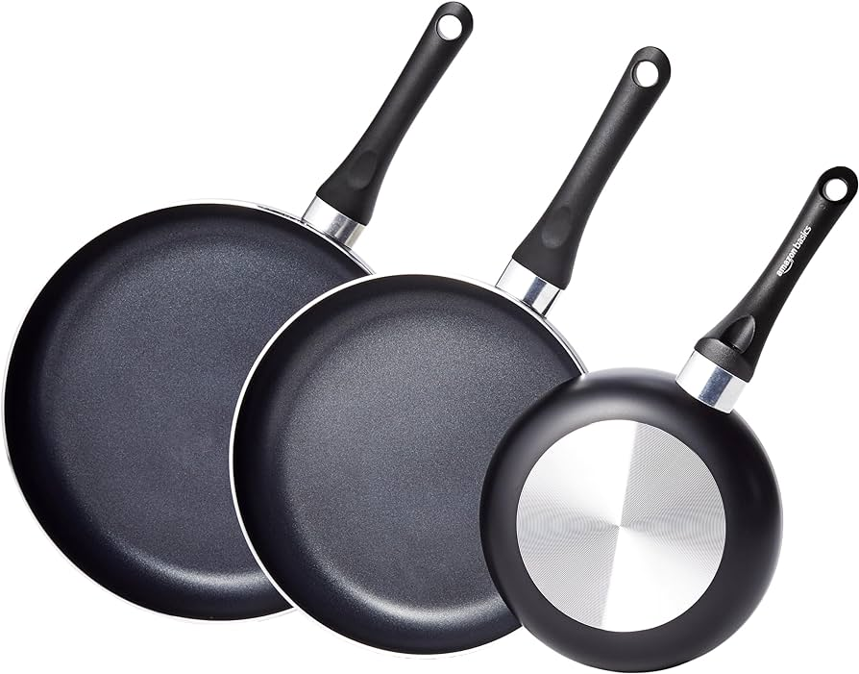
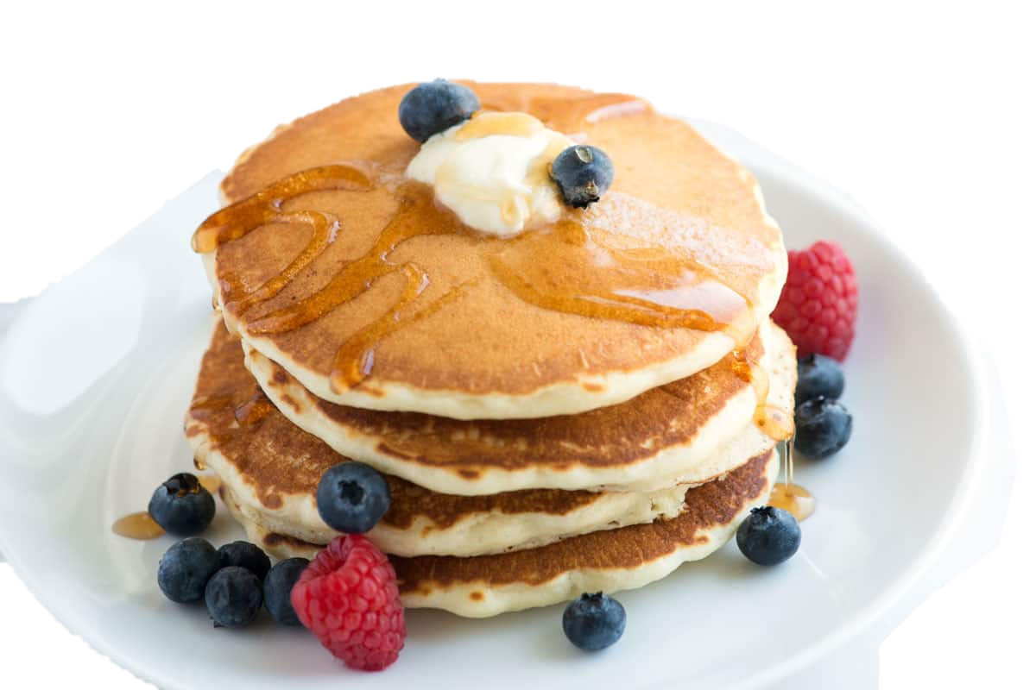
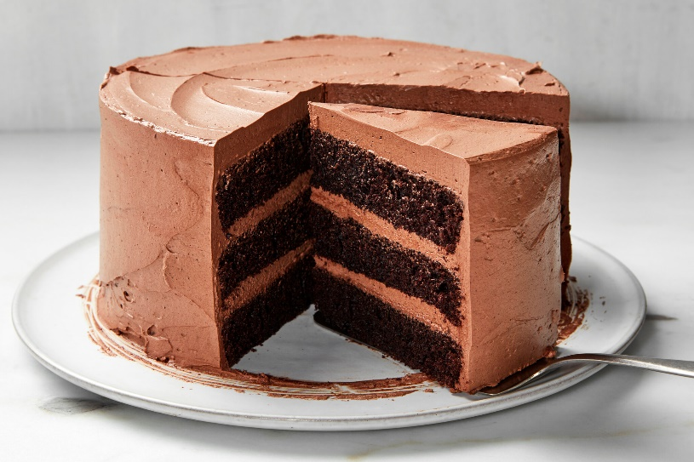
Catch the words
a pan
a cake
a pancake

Slide 10
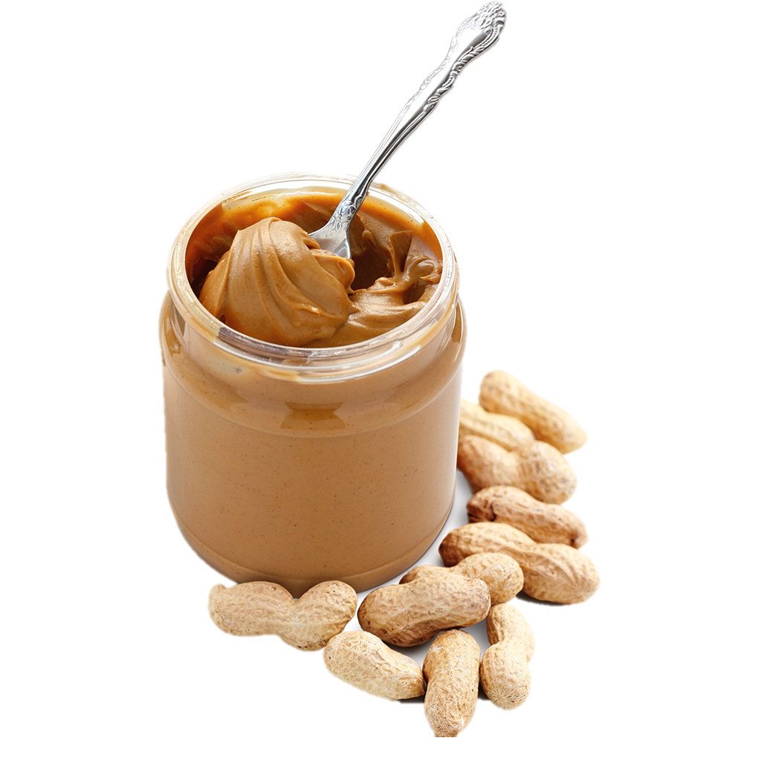
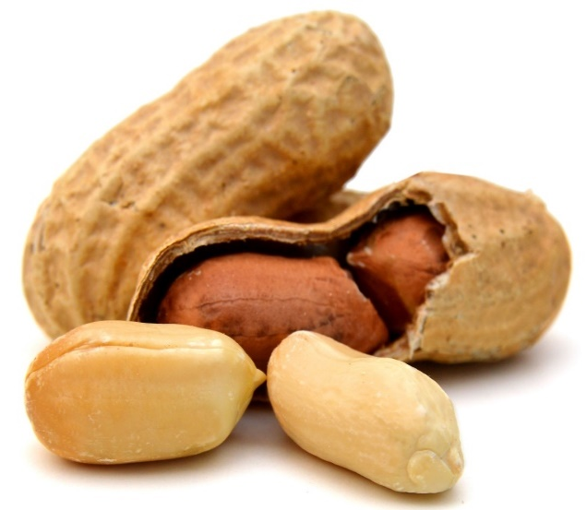
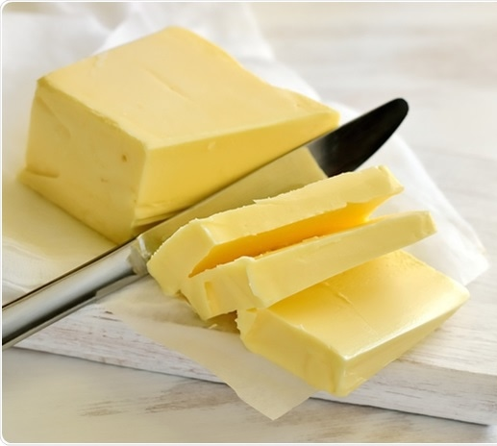
Catch the words
a peanut
butter
peanut butter

Slide 11

It’s time to learn …

Slide 12

New words
sugar, butter, flour, chocolate chips, oil, milk.

Slide 13

Presentation

Slide 14


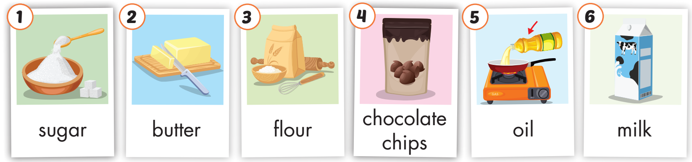
Click on A to hear the sound.
/ˈʃʊɡ.ɚ/
đường
/ˈbʌt̬.ɚ/
bơ
/ˈflaʊ.ɚ/
bột
/ˌtʃɑːk.lət ˈʧɪp/
kẹo viên socola
/ɔɪl/ dầu ăn
/mɪlk/ sữa
Notes:
Click vào hình A. 1. Listen and point. Repeat để cho cả audio full chạy

Slide 15

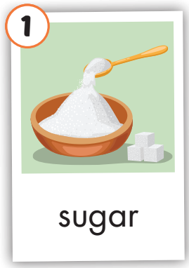
Click on the picture to hear the sound.
sugar
/ˈʃʊɡɚ/
đường

Slide 16
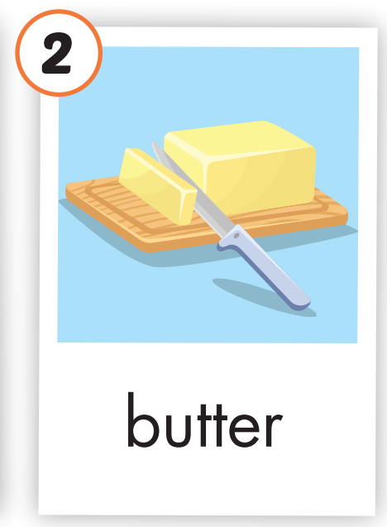
Click on the picture to hear the sound.
butter
/ˈbʌt̬.ɚ/
bơ

Slide 17
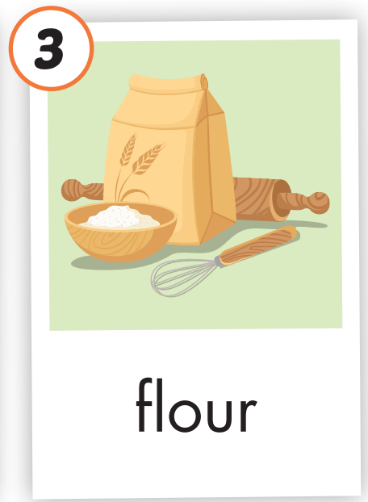
Click on the picture to hear the sound.
flour
/ˈflaʊ.ɚ/
bột

Slide 18
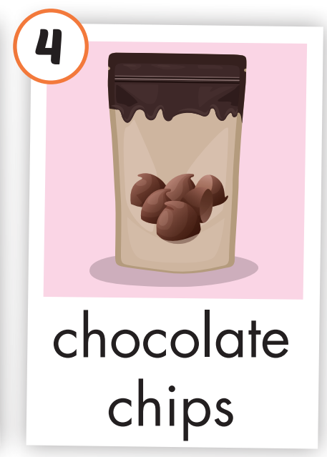
Click on the picture to hear the sound.
chocolate chips
/ˌtʃɑːk.lət ˈʧɪp/
kẹo viên socola

Slide 19
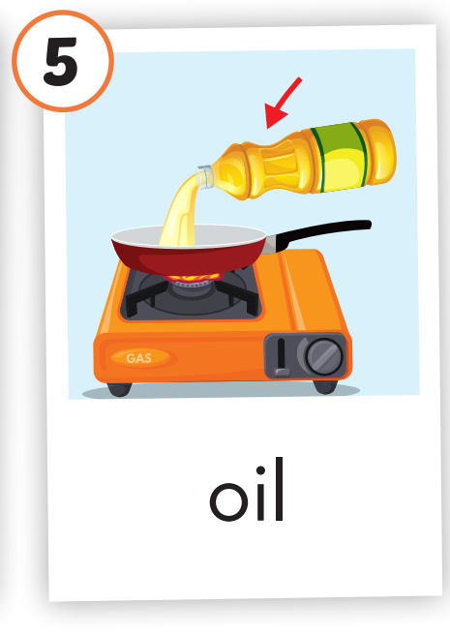
Click on the picture to hear the sound.
oil
/ɔɪl/ dầu ăn

Slide 20
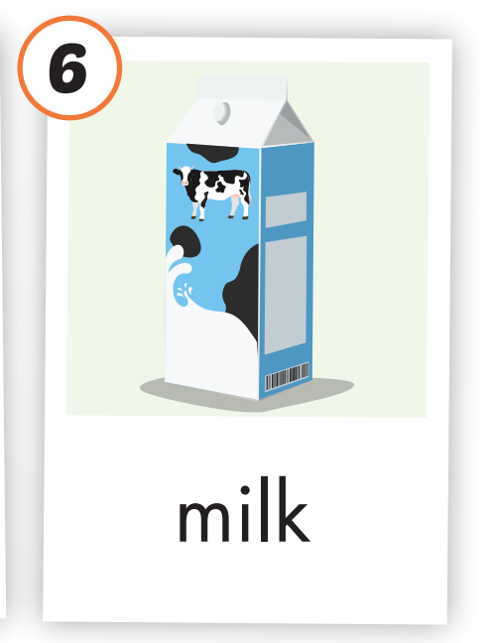
Click on the picture to hear the sound.
milk
/mɪlk/ sữa

Slide 21
Practice

Slide 22
Listen and choose. Then say.

Slide 23

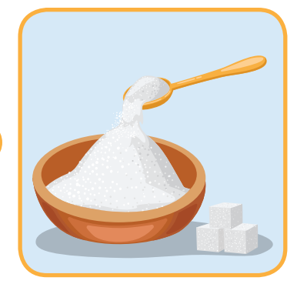


Listen and choose
A
B
C

Slide 24
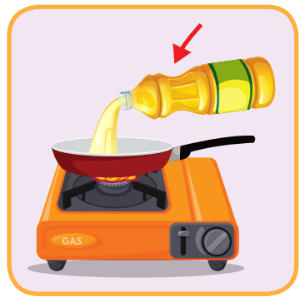
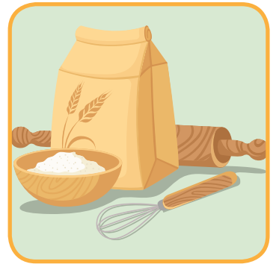

Listen and choose
A
B
C

Slide 25
Listen and choose
A
B
C

Slide 26
Listen and choose
A
B
C

Slide 27
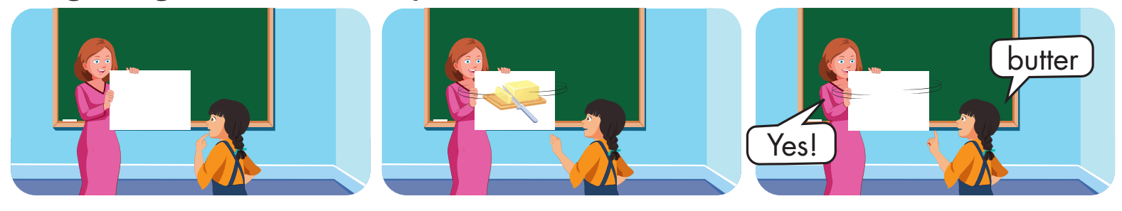

Slide 28
Structure
I need a little butter.

Slide 29
Presentation

Slide 30
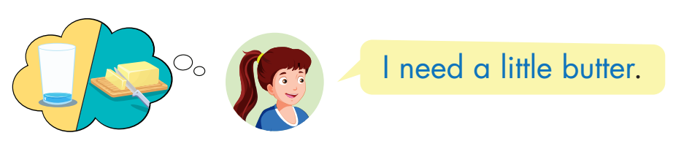
Structure
Click on the picture to hear the sound.

Slide 31

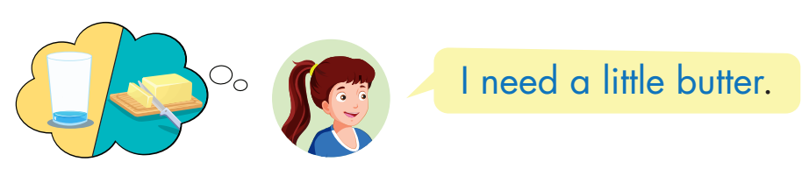
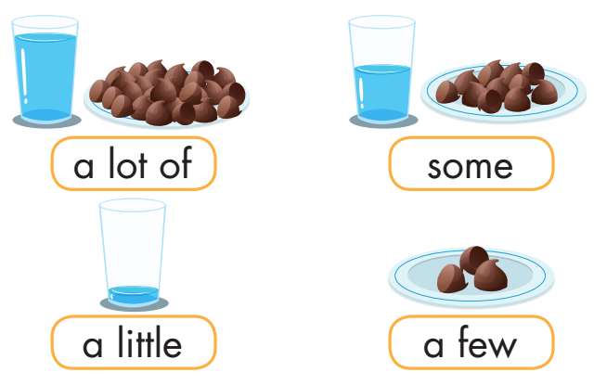
Click on B to hear the sound.

Slide 32
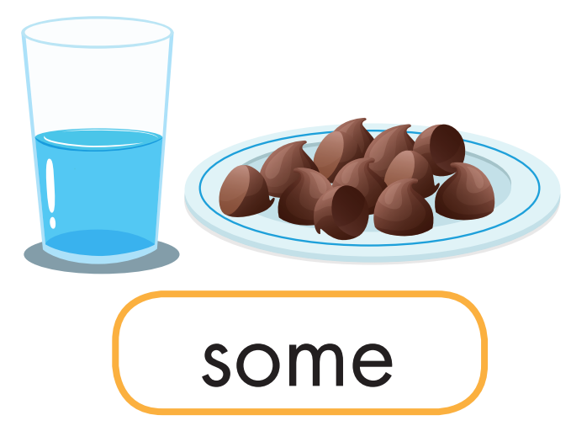
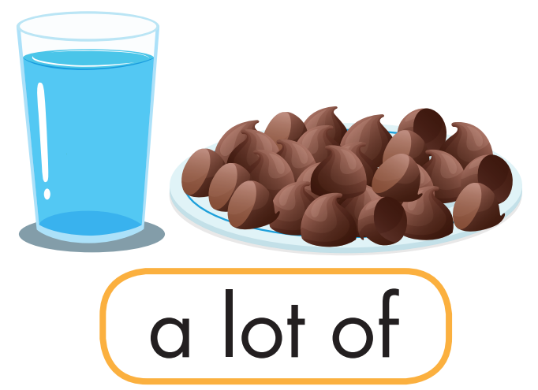
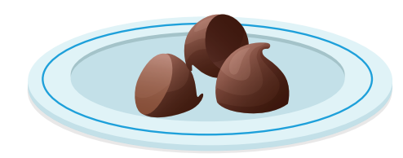


Match.

Slide 33

Practice

Slide 34

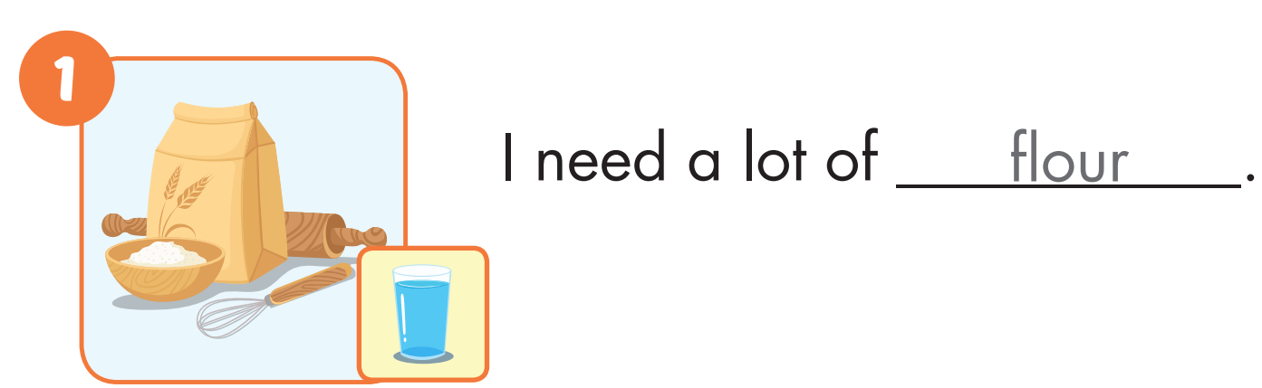

Slide 35
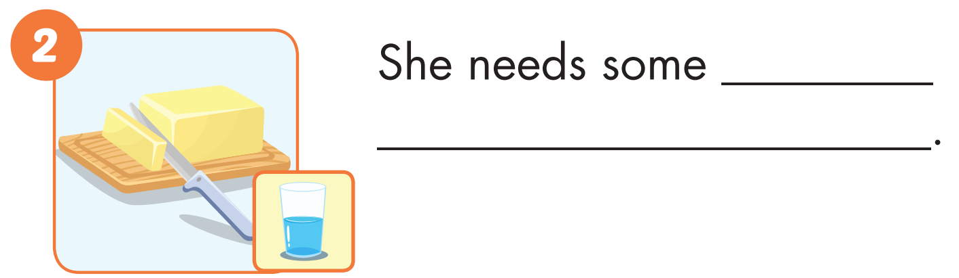
butter

Slide 36
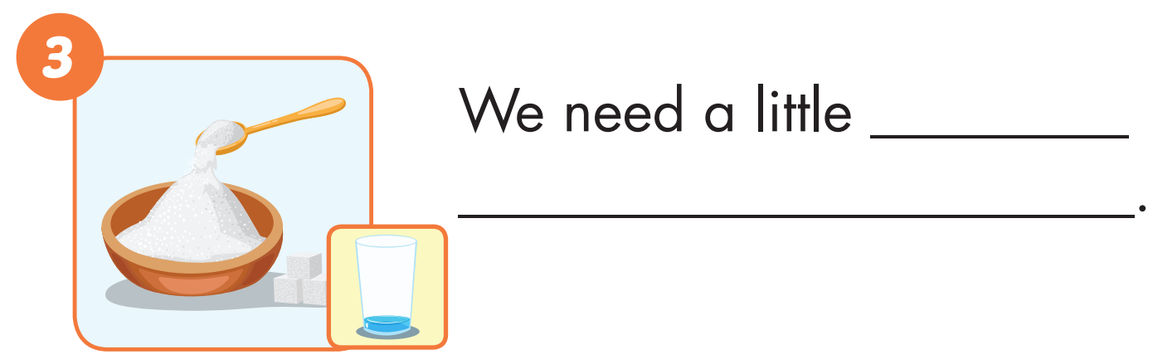
sugar

Slide 37
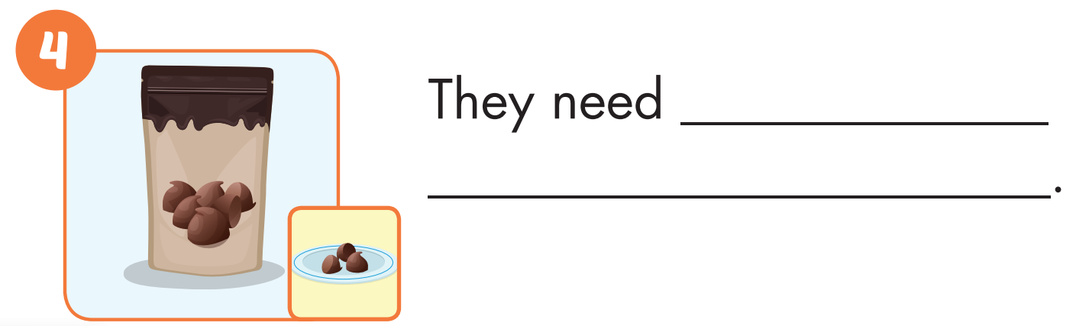
a few
chocolate chips

Slide 38
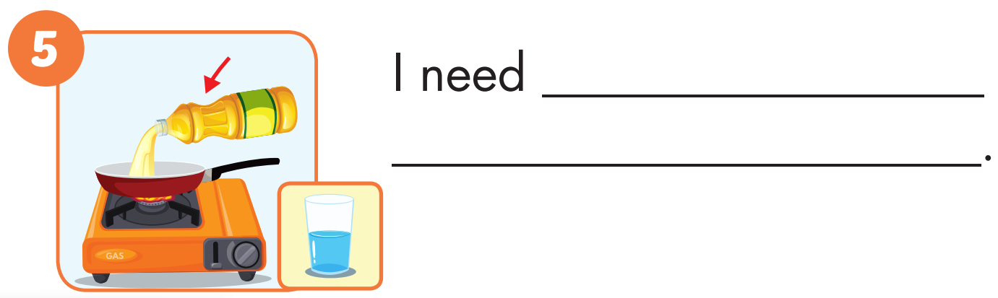
some oil

Slide 39
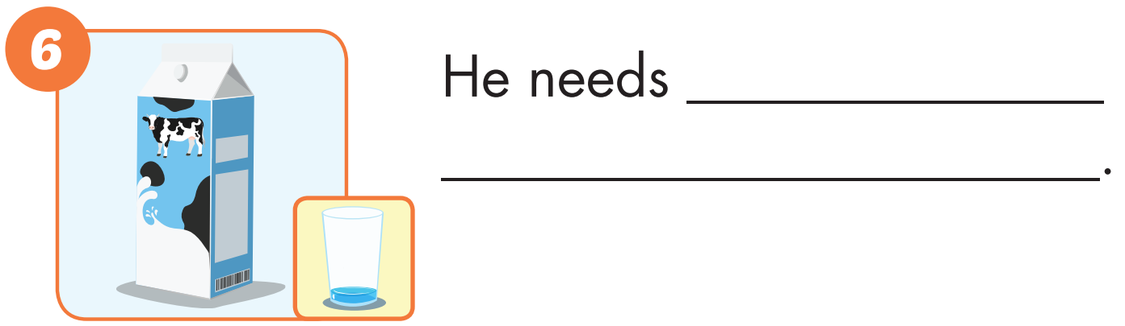
a little milk

Slide 40

Production

Slide 41
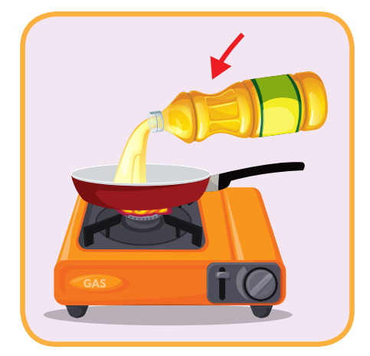
oil
SHOW

Slide 42

milk
SHOW

Slide 43
butter
SHOW

Slide 44
chocolate chips
SHOW

Slide 45
sugar
SHOW

Slide 46
flour
SHOW

Slide 47

CONSOLIDATION

Slide 48

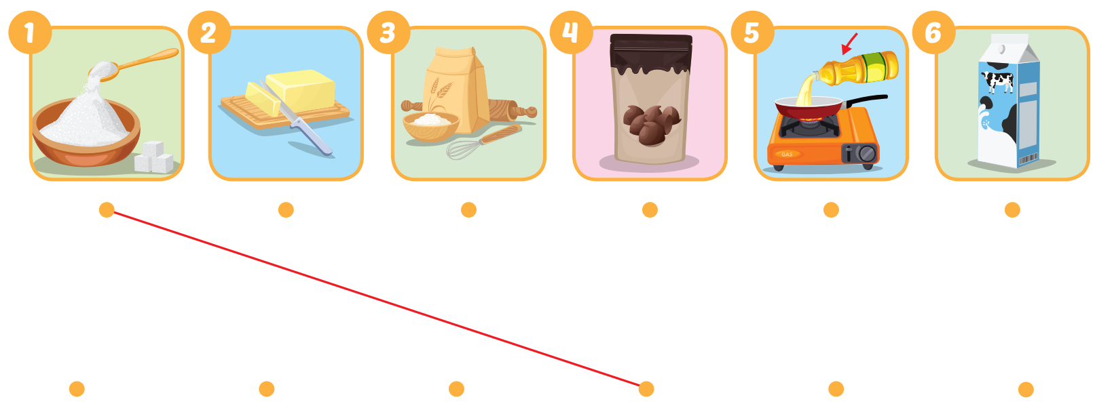
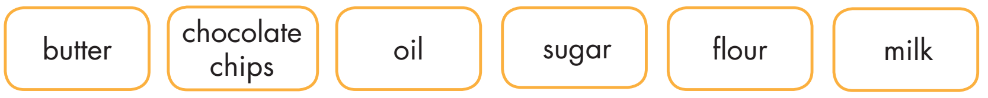
Extra Practice
WB, page 52

Slide 49

WRAP-UP

Slide 50
Today’s lesson
Vocabularies
sugar, butter, flour, chocolate chips, oil, milk.
Structures/ Sentence patterns
I need a little butter.

Slide 51
Homework
Practice the vocabularies and structure, and make sentences using them.
Do the exercises in Tiếng Anh 5 i-Learn Smart Start WB (page 52).
Do the exercises in Tiếng Anh 5 i-Learn Smart Start Notebook.
Prepare the next lesson (page 79 SB).
Play the consolidation games in Tiếng Anh 5 i-Learn Smart Start DHA App on www.eduhome.com.vn

Slide 52

Enjoy your day!

Slide 53

Lesson 3
Stay positive and have a nice day!

