Slide 1

Unit 4: HOME
Review & Practice 1
Page 64

Slide 2
Lesson Outline
Warm-up
Listening
Reading
Consolidation
Wrap-up

Slide 3
Objectives
By the end of this lesson, students will be able to review asking where people are, asking what people are doing, asking where things are and talking about their homes, using the target language.

Slide 4

WARM UP

Slide 5
How To Play
Students must take turns reading the words in order.
Each time a student can choose to say the words in 1 square, 2 squares or a maximum of 3 squares.
The student who says the last word must dance!

Slide 6

living room
box
tables
sleeping
closet
beds
sofas
bedroom
picture
yard
chair
desks
DANCE!!
cleaning
bed
eating
boxes
bathroom
house
closets
sofa
kitchen
mirror
desk
pictures
cooking
mirrors
table
playing
TV
chairs

Slide 7

It’s time to learn …

Slide 8

Listening

Slide 9

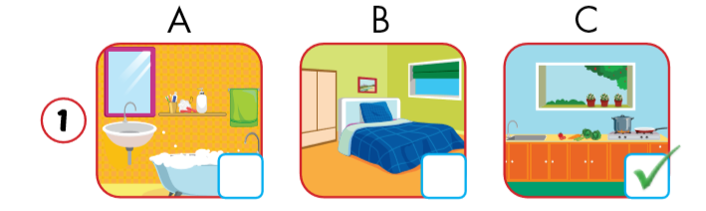
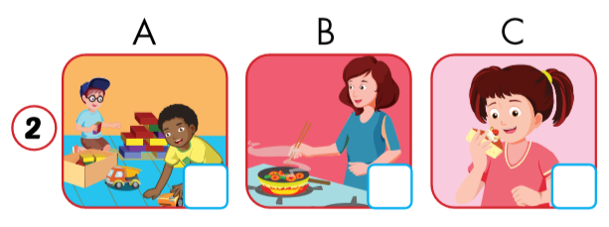

Click on the earphone to hear the sound.

Slide 10
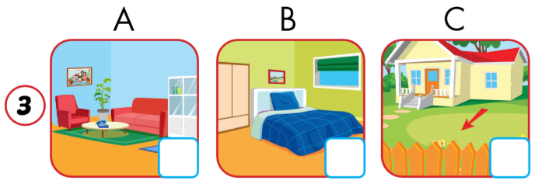
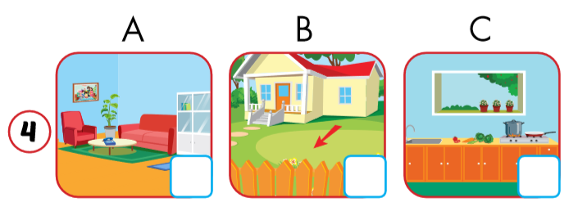
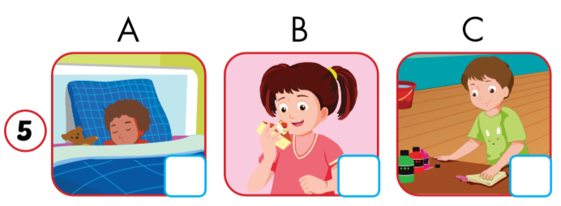
Click on the earphone to hear the sound.

Slide 11
Make up sentences.
My mother _______.
My mother is cooking.
My bedroom has______.
My bedroom has a picture (in it).
Notes:
Teacher can make use of these pictures to say the sentences (e.g. : 3. Ben is in the yard) and students give their answer C. Then ask students to work in pairs to do the same.

Slide 12
Make up sentences.
My kitchen _______.
My kitchen is blue./
My kitchen has a picture.
Hưng _______.
Hưng is cleaning.

Slide 13

Reading

Slide 14

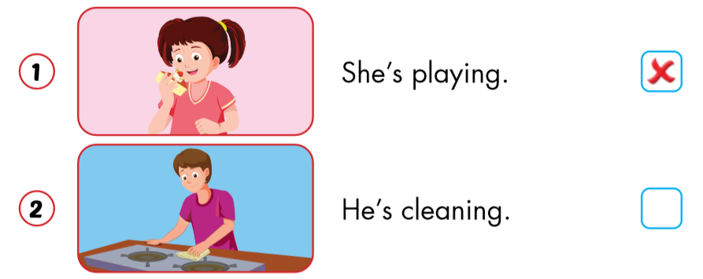

Slide 15
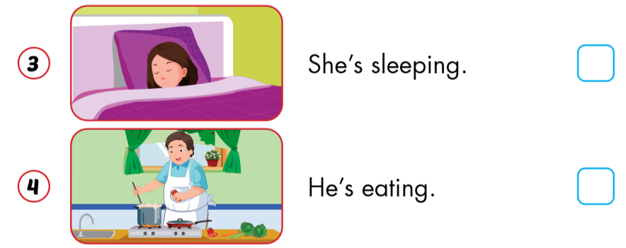


Slide 16

Practice
Notes:
Workbook p. 44

Slide 17
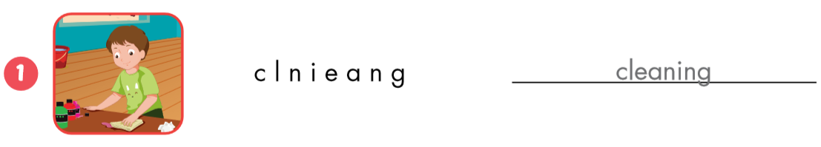
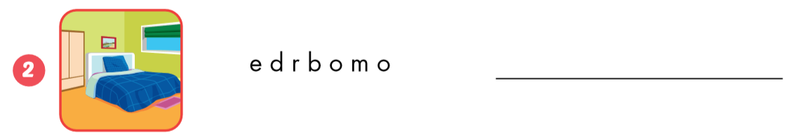
cleaning
bedroom

Slide 18
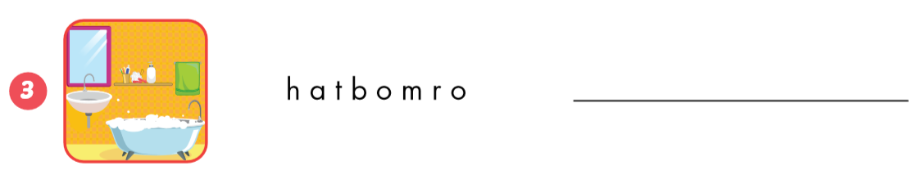
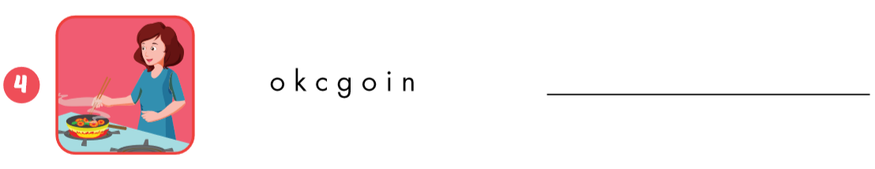
bathroom
cooking

Slide 19
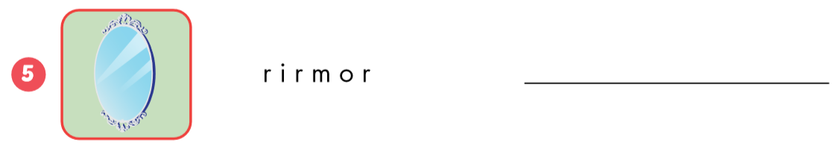
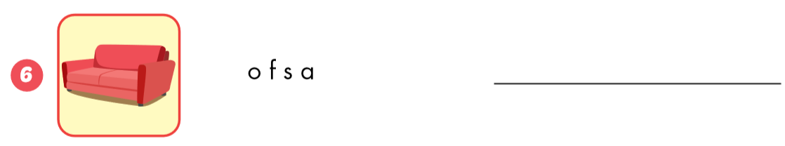
mirror
sofa

Slide 20

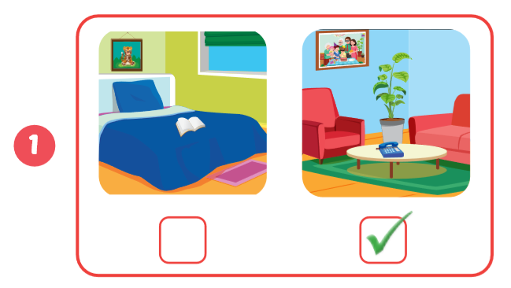
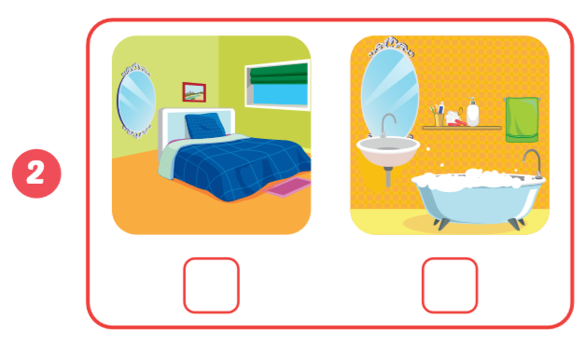
Click on the earphone to listen.

Slide 21
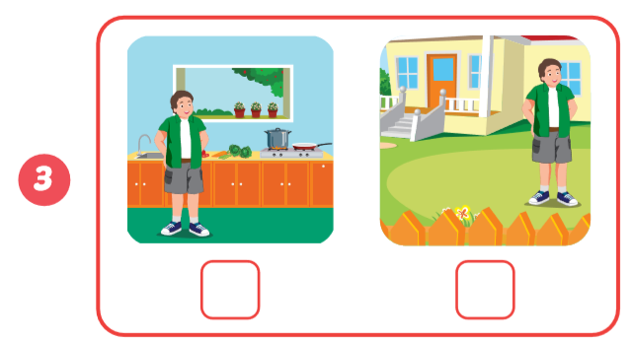
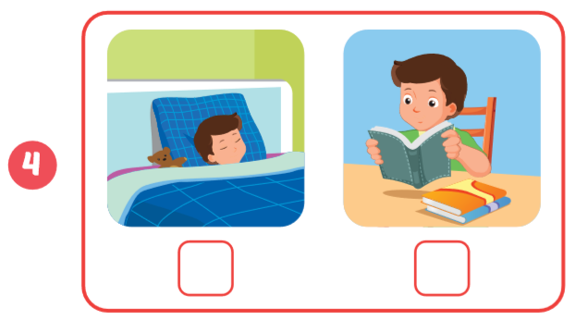
Click on the earphone to listen.

Slide 22

CONSOLIDATION

Slide 23
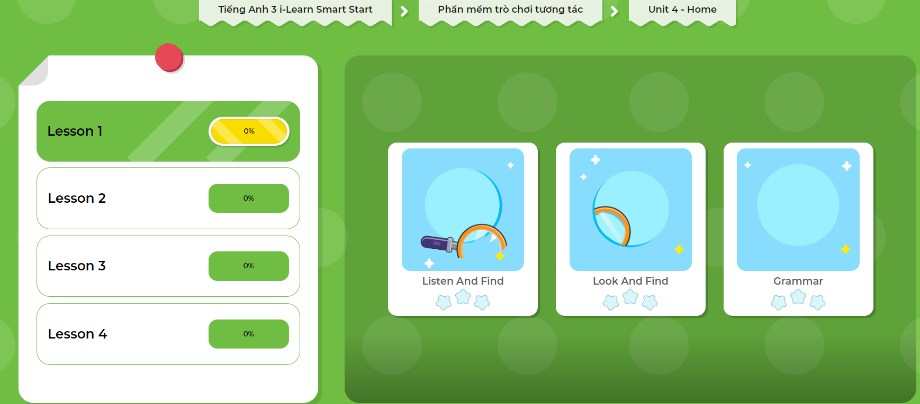
Extra Practice
DHA App
Let’s play!
Click here to play the game

Slide 24

WRAP-UP

Slide 25
Homework
Review the vocabularies and sentence patterns. Make sentences using them.
Do the exercises on page 46 (WB)
Prepare the next lesson (page 65 SB)
Play the consolidation games in Tiếng Anh 3 i-Learn Smart Start DHA App on www.eduhome.com.vn
Do the exercises in Tiếng Anh 3 i-Learn Smart Start Notebook on page 32.

Slide 26

Have a nice day!

