Slide 1

Unit 4: Travel
Review and Practice 2
Page 61

Slide 2
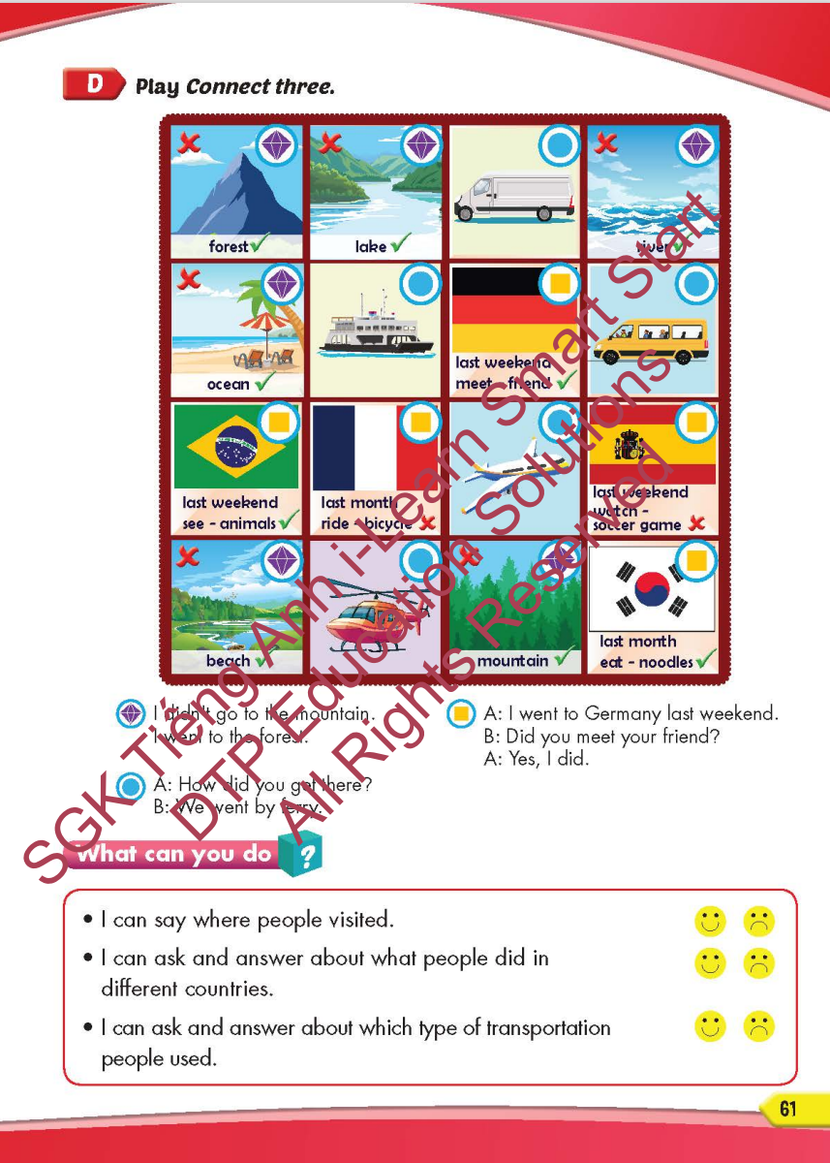
Lesson Outline
Warm-up
Speaking
Consolidation
Wrap-up

Slide 3
Objectives
By the end of this lesson, students will be able to…
Vocabulary: Review: mountain, lake, river, beach, ocean, forest, Canada, France, South Korea, Brazil, Germany, Spain, ferry, minibus, plane, helicopter, van, speedboat, Laos, Cambodia, China, Thailand, Singapore, Indonesia.
Structure: I didn't go to the river. I went to the beach; I went to South Korea last month. - Did you sing karaoke? - Yes, I did. /No, I didn't; How did you get there? - We went by helicopter; I went to Laos last month. - What did you do there? - I watched a soccer game.

Slide 4

WARM-UP

Slide 5
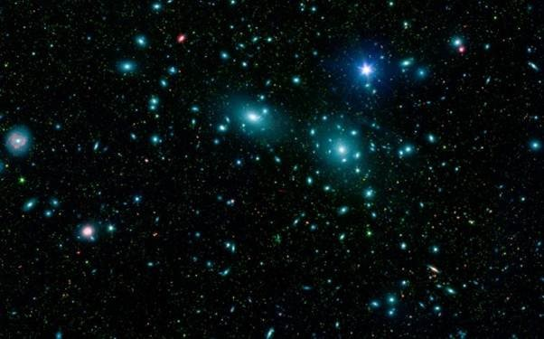



ENGINE
SPEED
FUEL
LOADING

Slide 6

China

Slide 7





______________.
Canada

Slide 8




______________.
South Korea
ENGINE
SPEED
FUEL
LOADING

Slide 9




______________.
France
ENGINE
SPEED
FUEL
LOADING

Slide 10


______________.
Indonesia

Slide 11



______________.
Cambodia
ENGINE
SPEED
FUEL
LOADING

Slide 12


______________.
China
ENGINE
SPEED
FUEL
LOADING

Slide 13


______________.
Thailand
ENGINE
SPEED
FUEL
LOADING

Slide 14



______________.
Laos

Slide 15




______________.
Singapore
ENGINE
SPEED
FUEL
LOADING

Slide 16

It’s time to learn …

Slide 17

Speaking

Slide 18

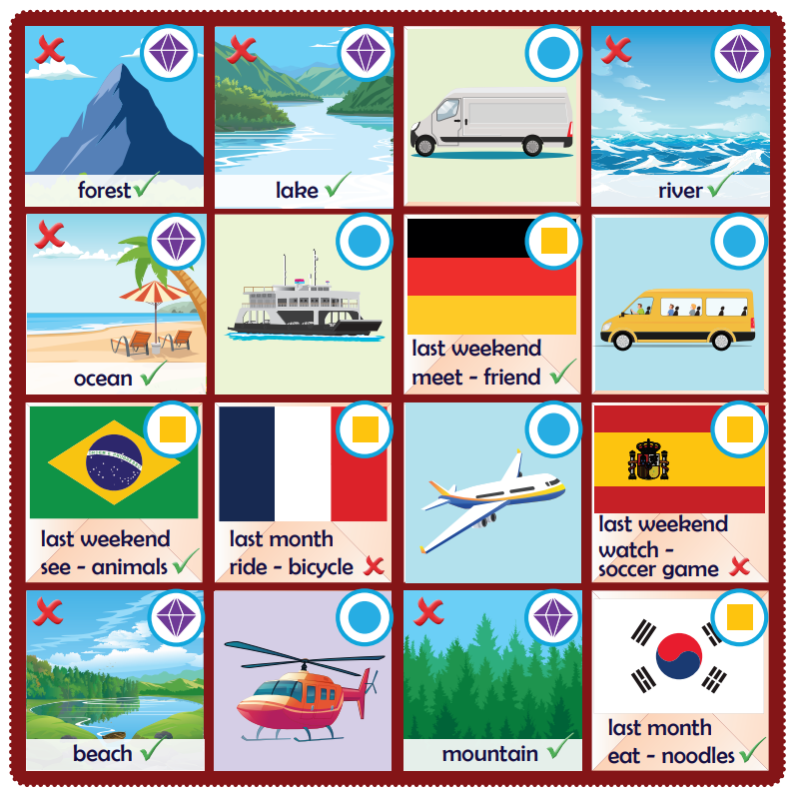
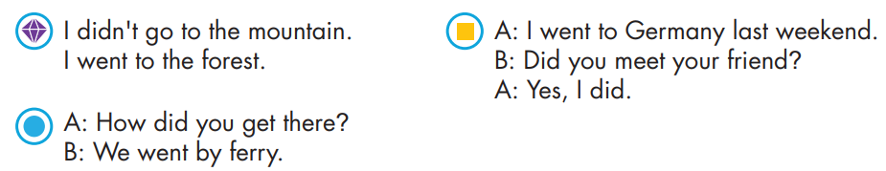

Slide 19

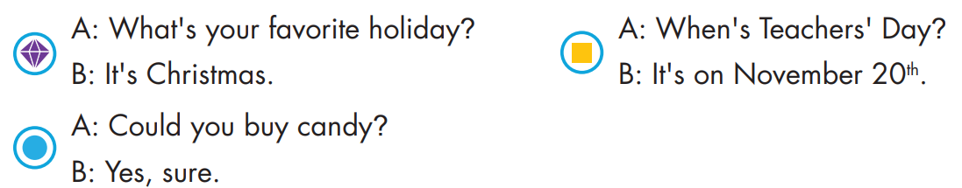
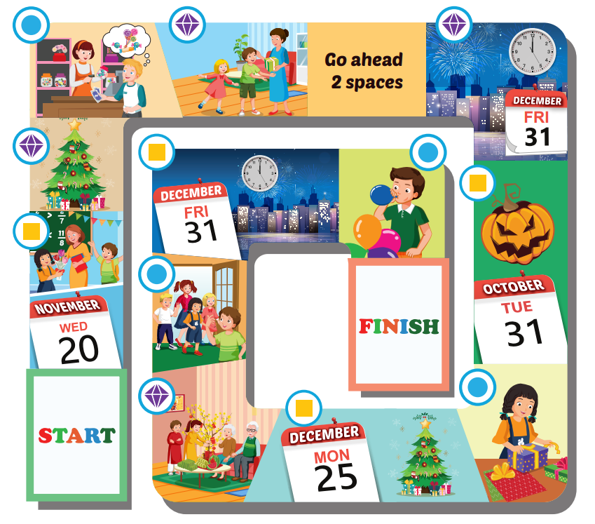

Slide 22

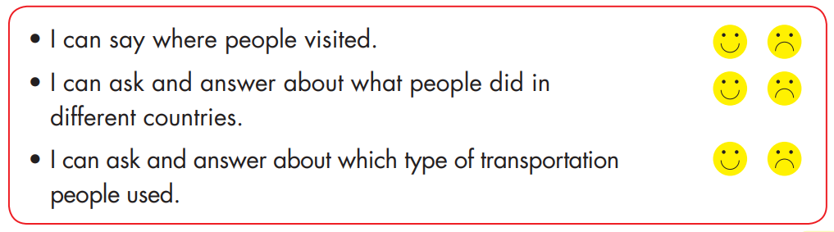

Slide 23

Listening

Slide 24


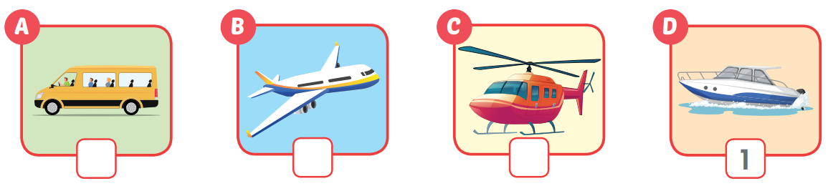
Extra Practice
WB, page 41
2
3
4

Slide 25
Production

Slide 26

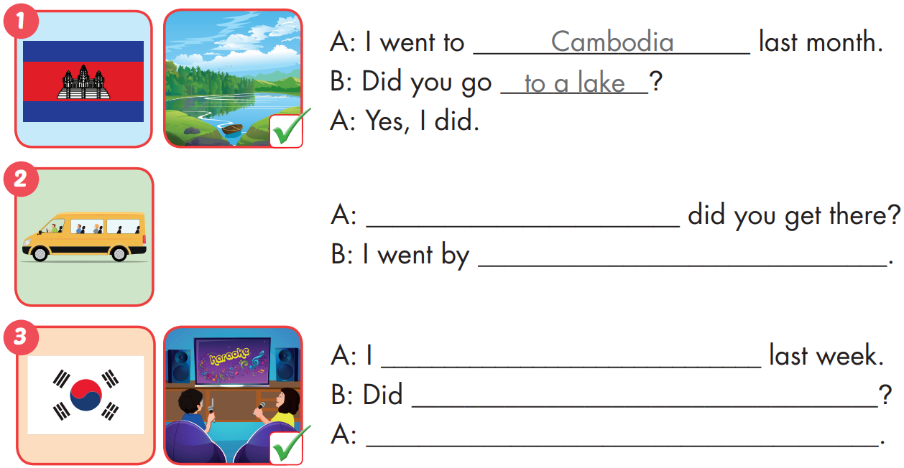
Extra Practice
WB, page 41
How
minibus
went to South Korea
you sing karaoke
Yes, I did

Slide 27
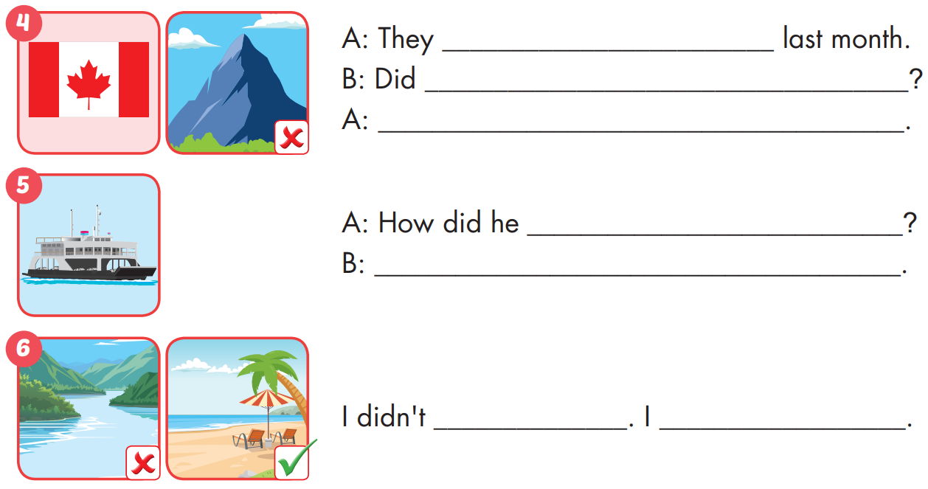
Extra Practice
WB, page 41
went to Canada
they go to the mountain
No, they didn't
get there
He went by ferry
go to the river. went to the beach.

Slide 28

CONSOLIDATION

Slide 29
Read and answer
Hi Nam!
I went to Cambodia with my family last month. We went by minibus, and I saw the ocean and moutains. It was very exciting. We visited Angkor Wat and walked a lot. Angkor Wat was really beautiful. We then went to a lake. We went around the lake on a speedboat and had a cooking lesson. It was really fun, and the food was delicious. We also visited Phnom Penh and went to a market. It was a bit noisy at the market, but there were lots of cool things.
See you soon!
Nga
She went to Cambodia
1. Where did Nga go? _______________________________________.
She went with her family
2. Who did she go with? _______________________________________.
She went there last month
3. When did she go to Cambodia? _______________________________________.
They went by minibus
4. How did they get there? _______________________________________.
5. What did they see? _______________________________.
They saw the ocean and moutains

Slide 30

WRAP-UP

Slide 31
Structures/ Sentence patterns
I didn't go to the river. I went to the beach;
I went to South Korea last month.
- Did you sing karaoke?
- Yes, I did. /No, I didn't.
How did you get there?
- We went by helicopter;
I went to Laos last month.
- What did you do there?
- I watched a soccer game.
Today’s lesson
Vocabularies
mountain, lake, river, beach, ocean, forest, Canada, France, South Korea, Brazil, Germany, Spain, ferry, minibus, plane, helicopter, van, speedboat, Laos, Cambodia, China, Thailand, Singapore, Indonesia.

Slide 32
Homework
Practice the vocabularies and structure; and make sentences using them.
Do the exercises in Tiếng Anh 5 i-Learn Smart Start WB (page 41)
Do the exercises in Tiếng Anh 5 i-Learn Smart Start Notebook (page 27)
Prepare the next lesson (page 62 SB)
Play the consolidation games in Tiếng Anh 5 i-Learn Smart Start DHA App on www.eduhome.com.vn

Slide 33

Enjoy your day!

Slide 34

Lesson 3
Stay positive and have a nice day!

