Slide 1

Unit 4: Travel
Review and Practice 1
Page 60

Slide 2
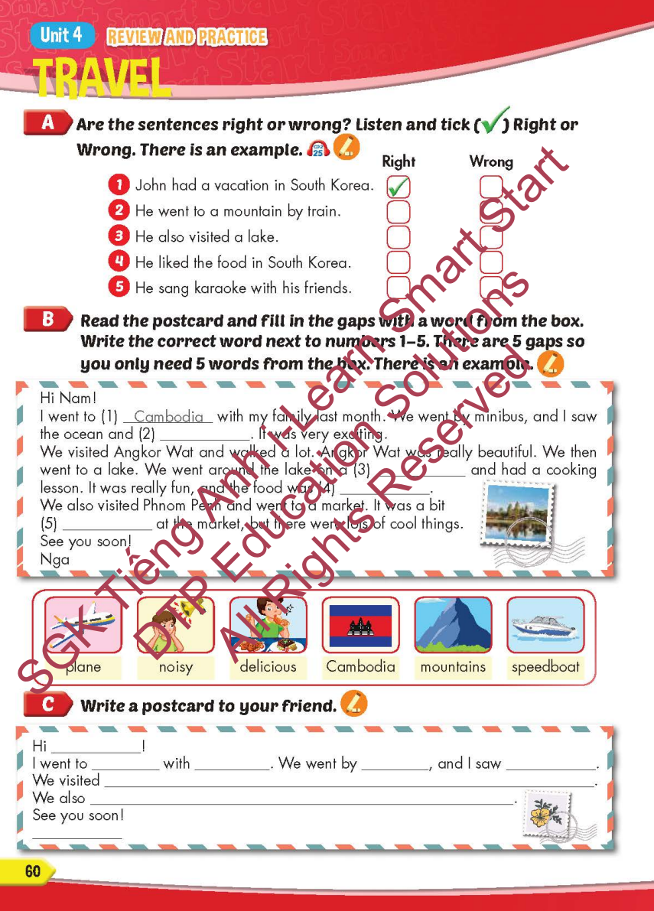
Lesson Outline
Warm-up
Reading
Listening
Consolidation
Wrap-up

Slide 3
Objectives
By the end of this lesson, students will be able to…
Vocabulary: Review: mountain, lake, river, beach, ocean, forest, Canada, France, South Korea, Brazil, Germany, Spain, ferry, minibus, plane, helicopter, van, speedboat, Laos, Cambodia, China, Thailand, Singapore, Indonesia.
Structure: I didn't go to the river. I went to the beach; I went to South Korea last month. - Did you sing karaoke? - Yes, I did. /No, I didn't; How did you get there? - We went by helicopter; I went to Laos last month. - What did you do there? - I watched a soccer game.

Slide 4

WARM-UP

Slide 5

JERRY’S
DOOR
START

Slide 6


Where did you go?
CHECK
I went to Canada.

Slide 7

Where did you go?
CHECK
I went to France.

Slide 8

Where did you go?
CHECK
I went to South Korea.

Slide 9

Where did you go?
CHECK
I went to Brazil.

Slide 10

Where did you go?
CHECK
I went to Germany.

Slide 11

Where did you go?
CHECK
I went to Spain.

Slide 12

Where did you go?
CHECK
I went to Laos.

Slide 13

Where did you go?
CHECK
I went to Cambodia.

Slide 14

Where did you go?
CHECK
I went to China.

Slide 15

Where did you go?
CHECK
I went to Thailand.

Slide 16

Where did you go?
CHECK
I went to Singapore.

Slide 17

Where did you go?
CHECK
I went to Indonesia.

Slide 18

It’s time to learn …

Slide 19

Listening

Slide 20


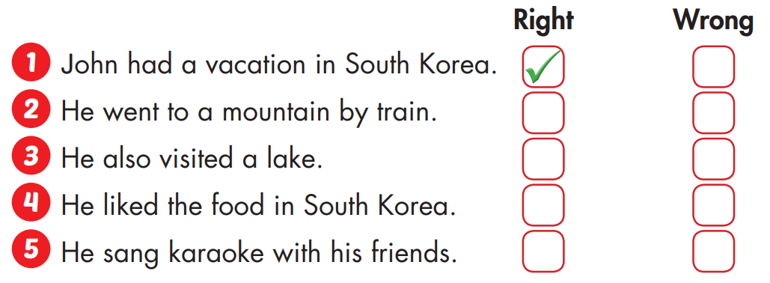


Slide 21

Reading

Slide 22
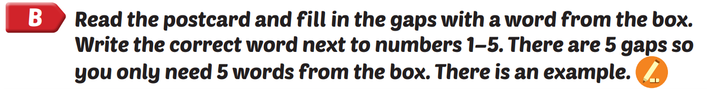
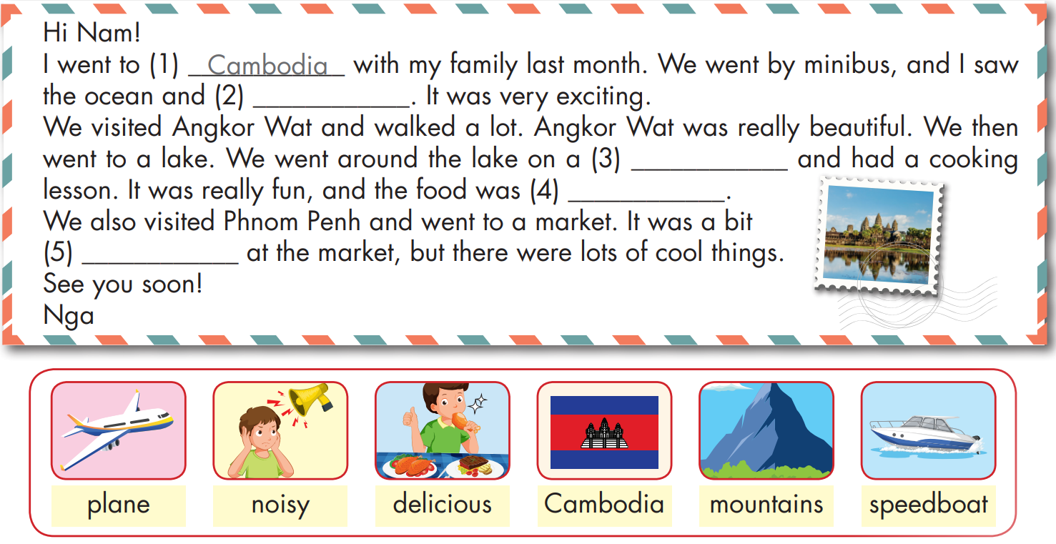
mountains
speedboat
delicous
noisy

Slide 23

Production

Slide 24
1. What's your friend's name?
2. Where did you go?
3. Who did you go with?
4. How did you get there?
5. What did you do there?
Sample writing:
Hi Ly!
My family went to Thailand. We went by plane. We went to the beach and swam in the ocean. It was beautiful. We also ate lots of delicious food. I'm having a great time.
See you soon.
My

Slide 25
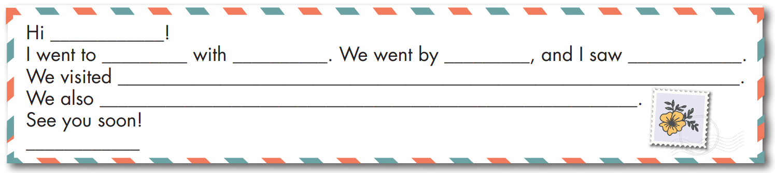

Slide 26

CONSOLIDATION

Slide 27
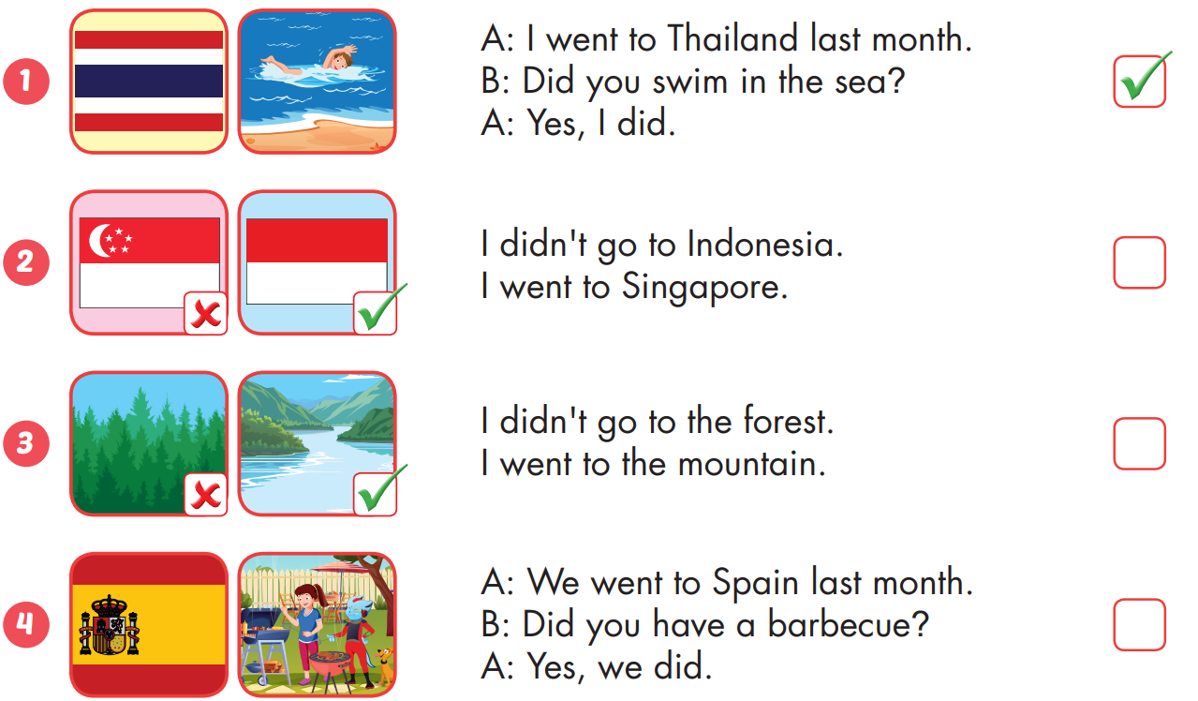

Extra Practice
WB, page 40

Slide 28
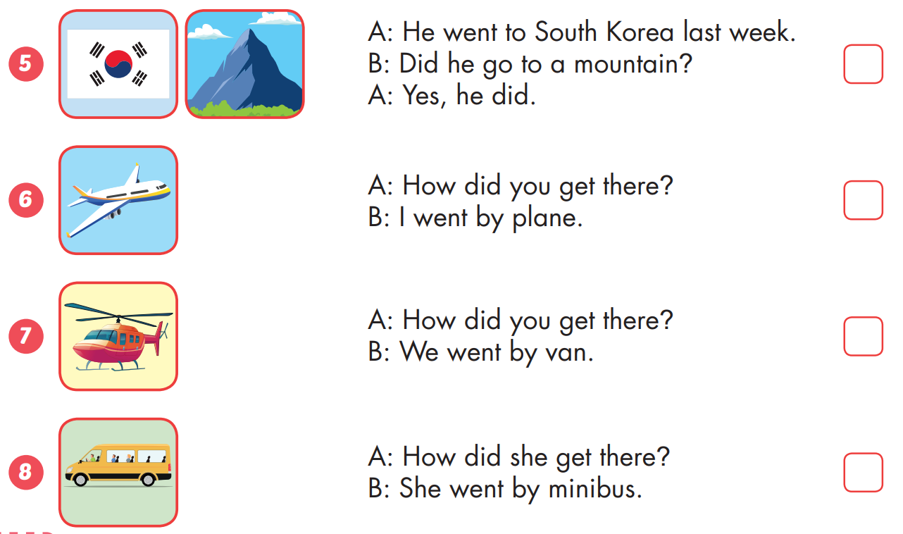
Extra Practice
WB, page 40

Slide 29
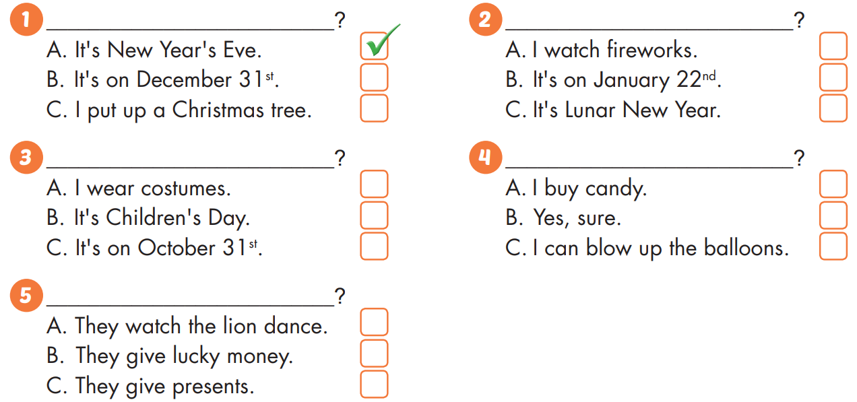

Slide 30

WRAP-UP

Slide 31
Structures/ Sentence patterns
I didn't go to the river. I went to the beach;
I went to South Korea last month.
- Did you sing karaoke?
- Yes, I did. /No, I didn't.
How did you get there?
- We went by helicopter;
I went to Laos last month.
- What did you do there?
- I watched a soccer game.
Today’s lesson
Vocabularies
mountain, lake, river, beach, ocean, forest, Canada, France, South Korea, Brazil, Germany, Spain, ferry, minibus, plane, helicopter, van, speedboat, Laos, Cambodia, China, Thailand, Singapore, Indonesia.

Slide 32
Homework
Practice the vocabularies and structure; and make sentences using them.
Do the exercises in Tiếng Anh 5 i-Learn Smart Start WB (page 40)
Do the exercises in Tiếng Anh 5 i-Learn Smart Start Notebook (page 26)
Prepare the next lesson (page 61 SB)
Play the consolidation games in Tiếng Anh 5 i-Learn Smart Start DHA App on www.eduhome.com.vn

Slide 33

Enjoy your day!

Slide 34

Lesson 3
Stay positive and have a nice day!

