Slide 1

Unit 4: HOME
Lesson 4.2
Page 62

Slide 2
Lesson Outline
Warm-up
Reading
Listening
Consolidation
Wrap-up

Slide 3
Objectives
By the end of this lesson, students will be able to talk about their homes and ask and answer about what in their house is.
Vocabulary: houseboat, canal.
Structure: Who do you live with? - I live with my mother.
What’s your home like? - It’s great.
What’s it like? - It’s orange.

Slide 4

WARM UP

Slide 5

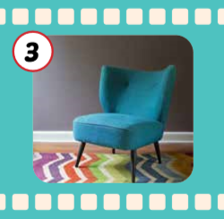
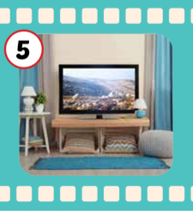
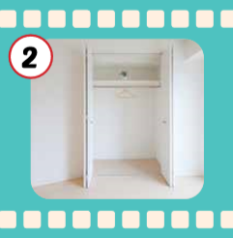
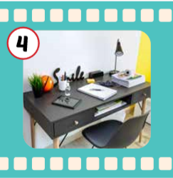
Matching.
1. bed
Cái ghế
2. closet
Cái bàn
3. chair
Cái ti-vi
4. desk
Cái tủ quần áo
Cái giường
5. TV

Slide 6

Make up sentences.
My bedroom has ______.

Slide 7
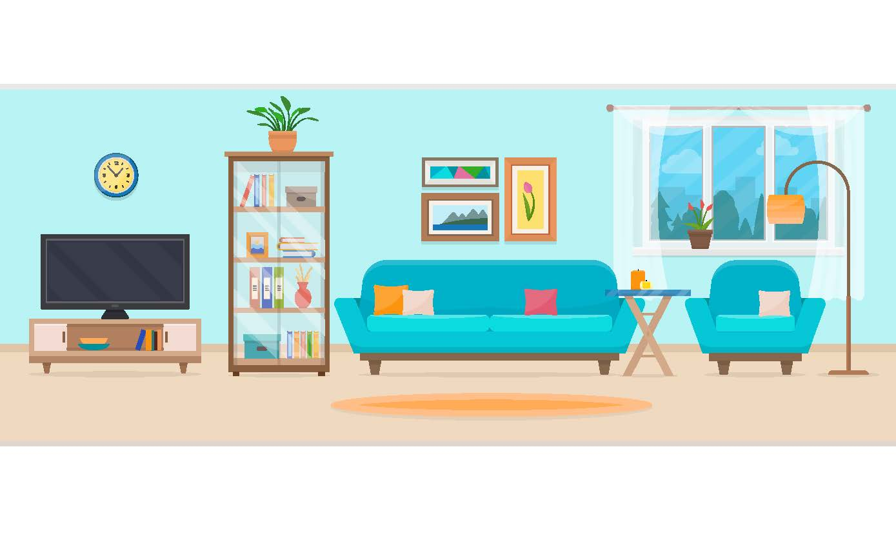
Make up sentences.
My living room has ______.

Slide 8

It’s time to learn …

Slide 9

Reading

Slide 10

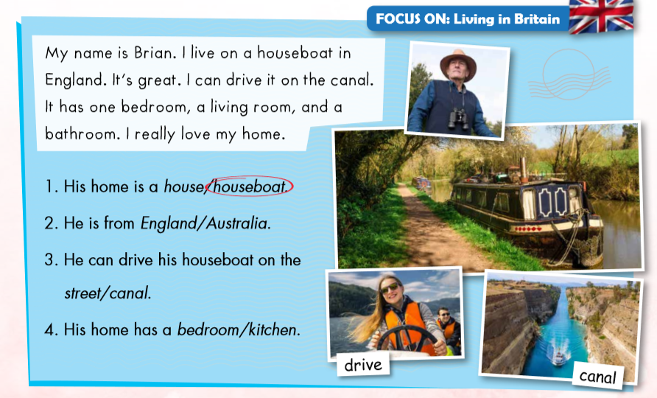

Slide 15

Listening

Slide 16

Click on the earphone to listen.
Alex: Where do you live, Mia?
Mia: I live on (1)_______ Street in London.
Alex: Cool. Who do you live with?
Mia: I live with my mother, father, and two (2)______ .
Red
brothers

Slide 17

Listening
Writing

Slide 18

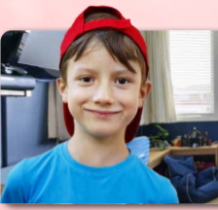

Click on the earphone to listen.
Where do you live, Mia?
Red
I live on street in London.
Cool.
Who do you live with?
I live with my mother, father, and two
brothers.

Slide 19
Click on the earphone to listen.
What’s your home like, Alex?
It’s great. I love my bedroom.
What’s it like?
orange.
It’s
It has a closet, a and a TV.
desk
Wow.
That sounds nice.

Slide 20

Alex: Where do you live, Mia?
Mia: I live on Red Street in London.
Alex: Cool. Who do you live with?
Mia: I live with my mother, father, and two brothers.

Slide 21
Mia: What’s your home like, Alex?
Alex: It’s great. I love my bedroom.
Mia: What’s it like?
Alex: It’s orange. It has a closet, a desk, and a TV in it.
Mia: Wow. That sounds nice.

Slide 22

Practice
Notes:
Workbook p. 45

Slide 23

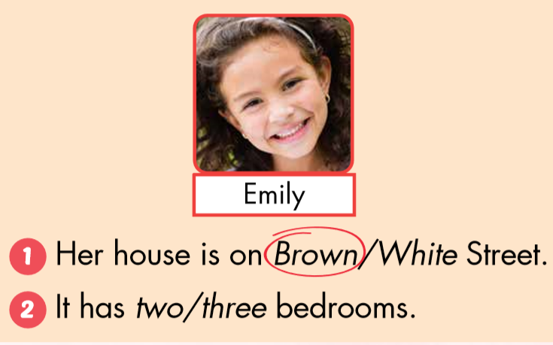
Click on the earphone to listen.

Slide 24
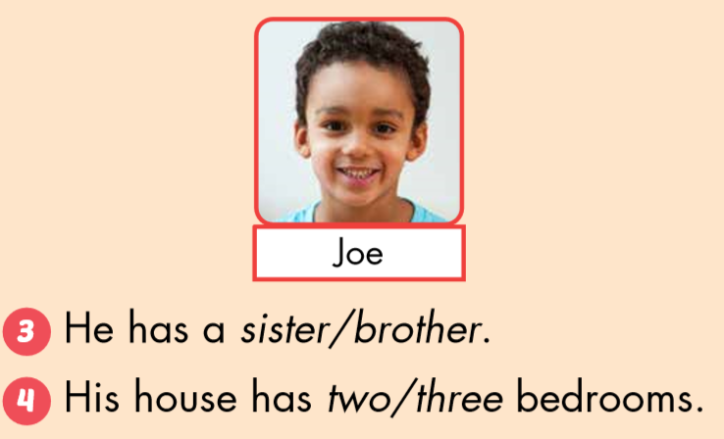

Slide 25

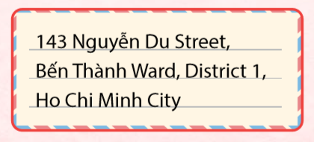


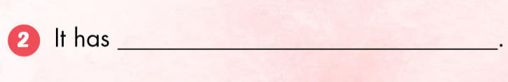
Nguyễn Du Street.
a sofa and a mirror in it.

Slide 26
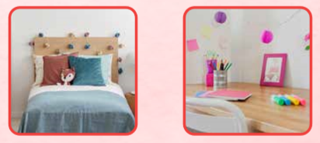
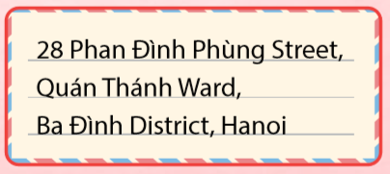
has a bed and a desk in it.
Ba Đình District, Hanoi.

Slide 27

CONSOLIDATION

Slide 28
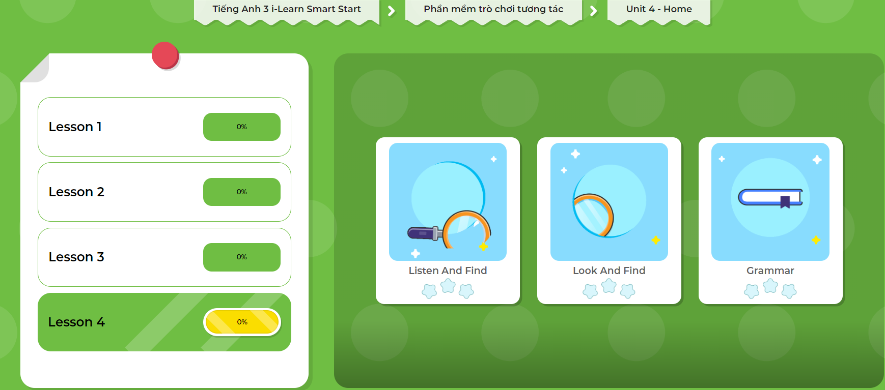
LET’S PLAY!
Click here to play the games!

Slide 29
56 Minh Cầu Street, Hoàng Văn Thụ Ward, Thái Nguyên City
I live on Minh Cầu Street
in Thái Nguyên.

Slide 30
125 Lương Ngọc Quyến Street, Bắc Ninh
I live on Lương Ngọc Quyến Street
in Bắc Ninh.

Slide 31
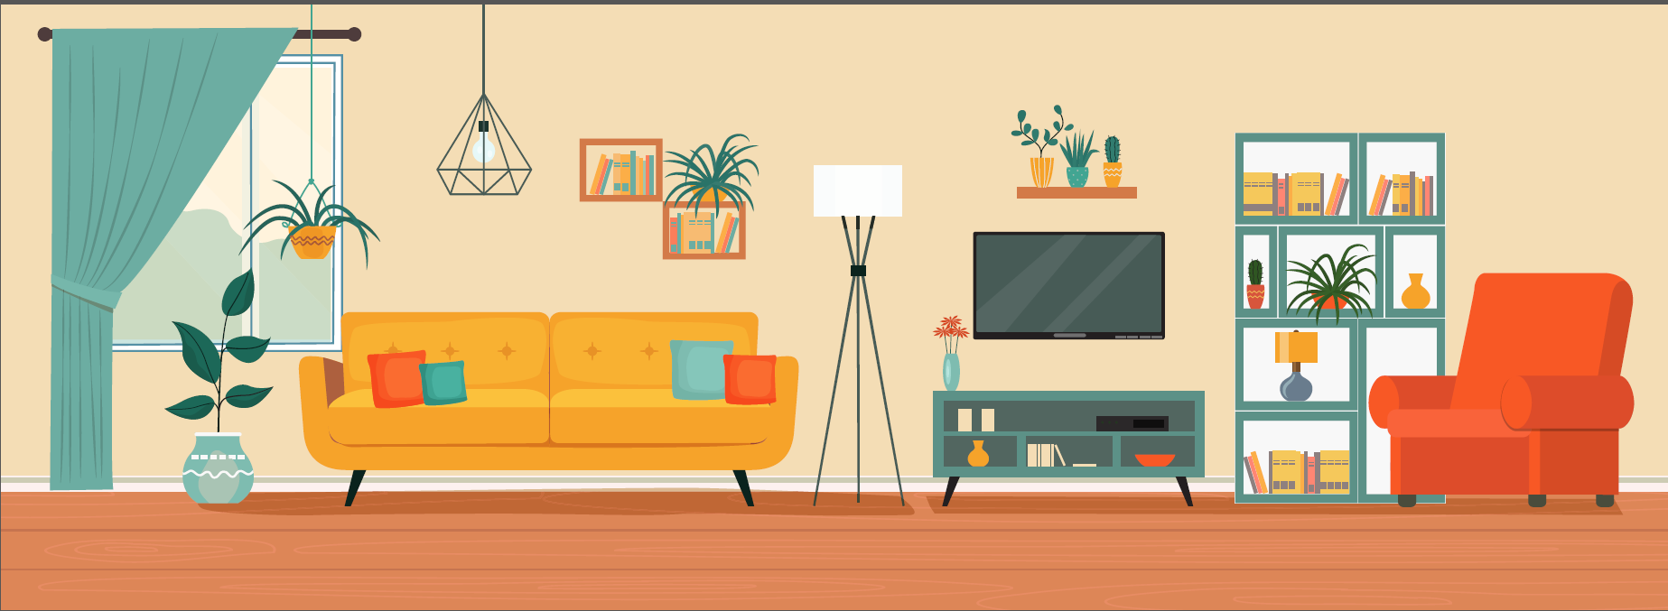
My house has a living room.
It has a sofa and a TV.
It has a picture and a TV.

Slide 32

WRAP-UP

Slide 33
Lesson 3
Today’s lesson
Structures/ Sentence patterns
Where do you live, Mia?
I live on Red Street in London.
His home has a bedroom.

Slide 34
Homework
Review the vocabularies and sentence patterns. Make sentences using them.
Do the exercises on page 45 (WB)
Prepare the next lesson (page 63 SB)
Play the consolidation games in Tiếng Anh 3 i-Learn Smart Start DHA App on www.eduhome.com.vn
Do the exercises in Tiếng Anh 3 i-Learn Smart Start Notebook (page 31)

Slide 35

Have a nice day!

