Slide 1

Unit 5: HEALTH
Lesson 2.3
Page 69

Slide 2

Lesson Outline
Warm-up
Practice
Speaking
Consolidation
Wrap-up

Slide 3
Objectives
By the end of this lesson, students will be able to ask and answer about how they feel correctly.
Vocabulary: terrible, sleepy, weak, sick, sore, stuffed up.
Structure: How do you feel?
- I feel weak.
- That's too bad.

Slide 4

WARM UP

Slide 5
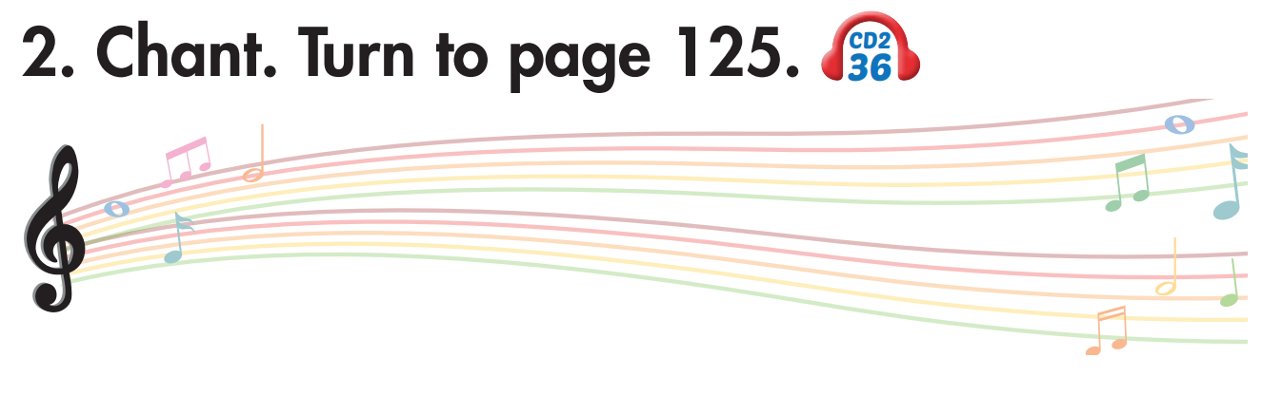

Click on 2 to hear the sound.

Slide 6


Slide 7

New words
terrible, sleepy, weak, sick, sore, stuffed up.

Slide 8
Listen and choose. Then say.

Slide 9
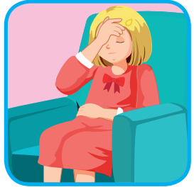
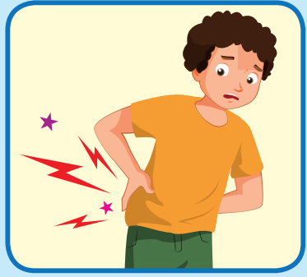
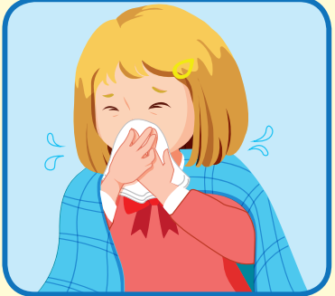

Listen and choose
A
B
C
I feel terrible.

Slide 10
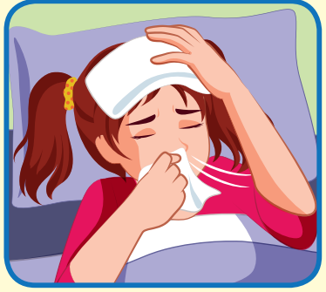
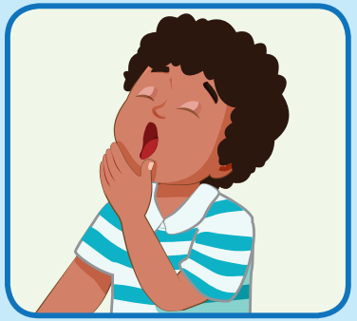
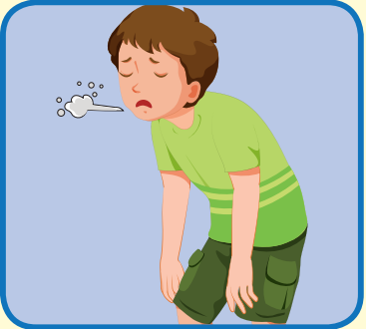
Listen and choose
A
B
C
I feel sleepy.

Slide 11
Listen and choose
A
B
C
I feel sick

Slide 12
Listen and choose
A
C
B
I feel sore.

Slide 13
Structure
How do you feel?
- I feel weak.
- That's too bad.

Slide 14

Practice

Slide 15
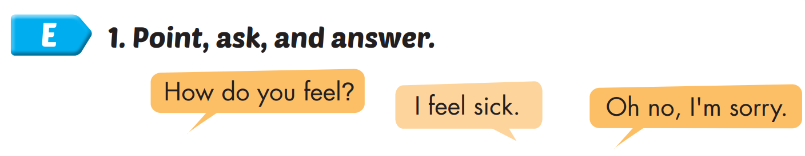
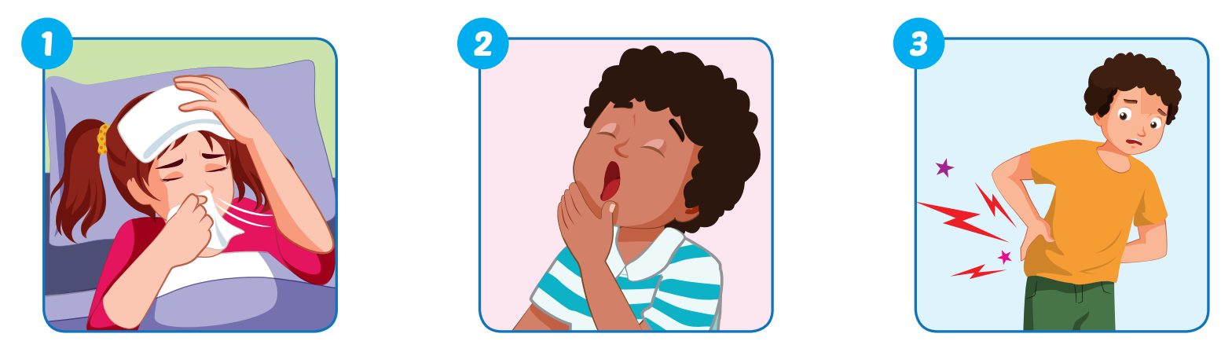
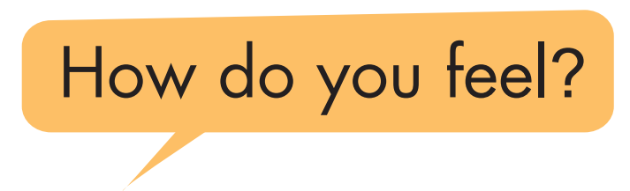
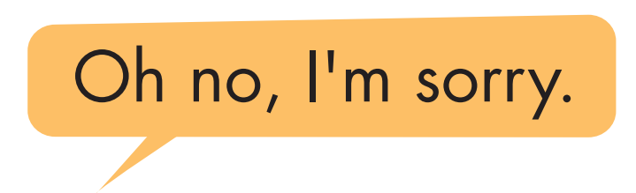

Slide 16
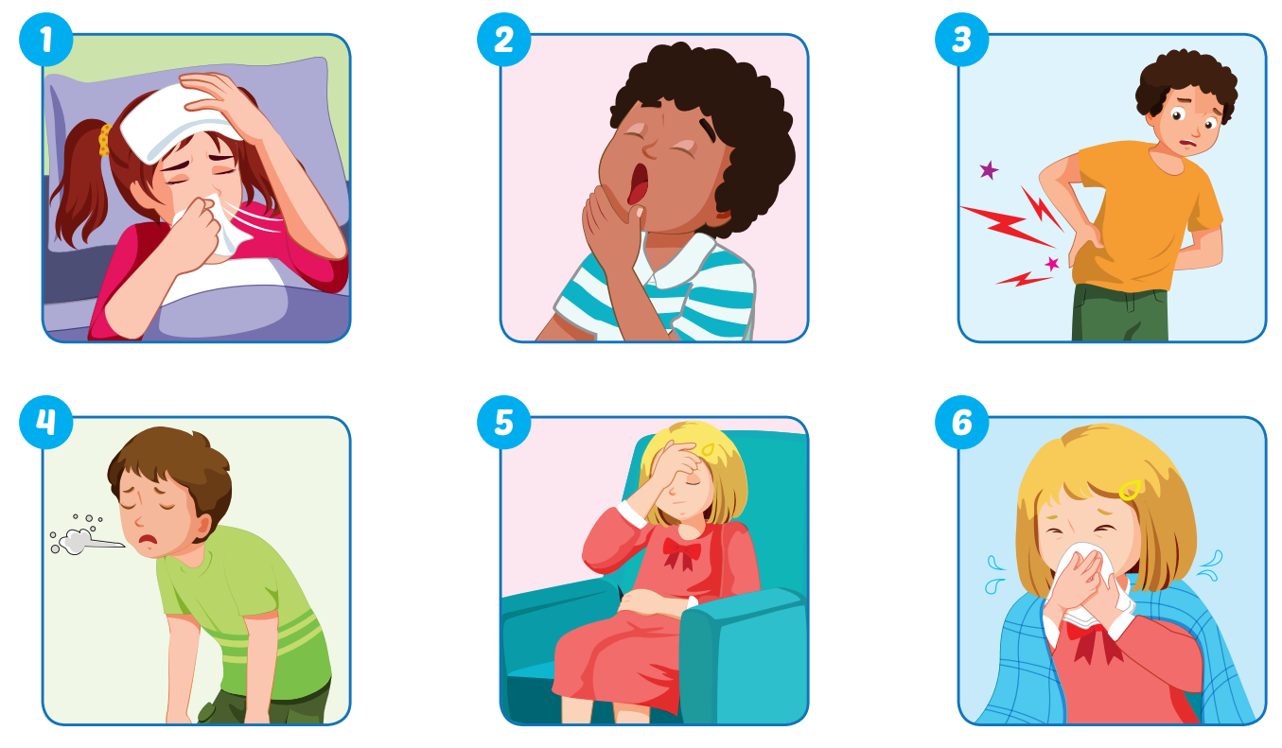

Slide 17

Speaking

Slide 18
I feel sleepy.

Slide 19
I feel sore.

Slide 20
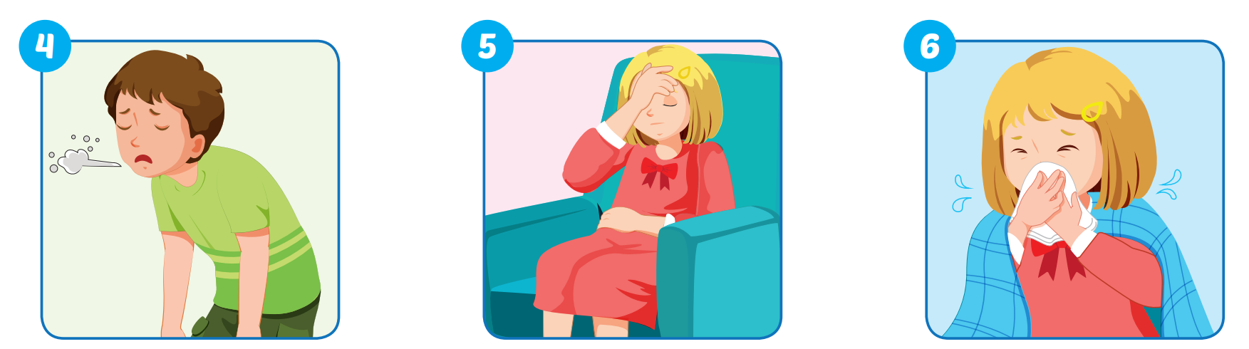
I feel weak.

Slide 21
I feel terrible.

Slide 22
I feel stuffed up.

Slide 23

Production

Slide 24
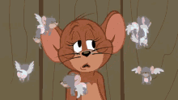
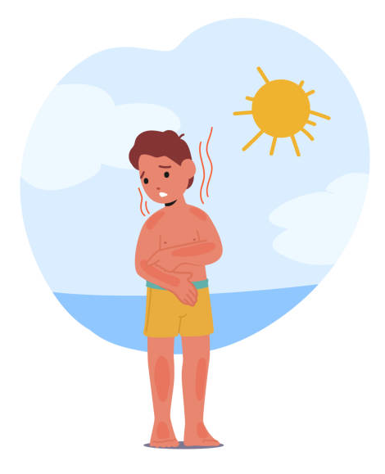
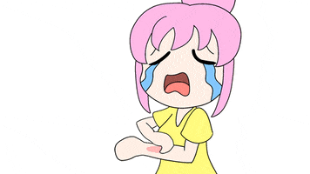
I feel dizzy.
I feel itchy.
I feel sunburned.

Slide 25
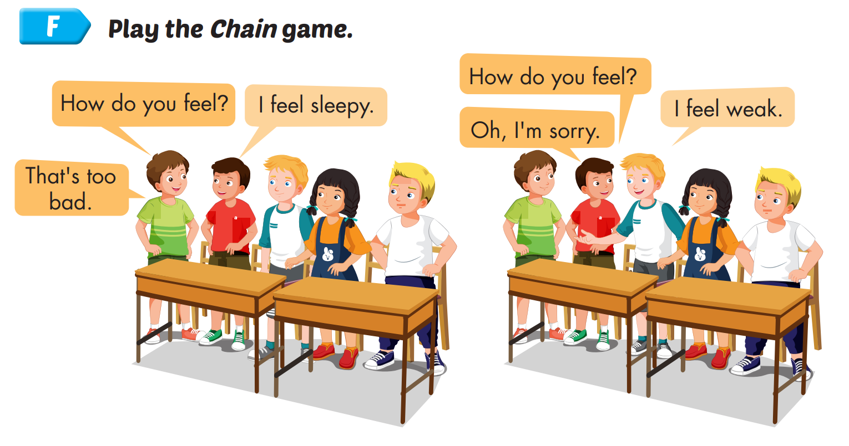

Slide 26

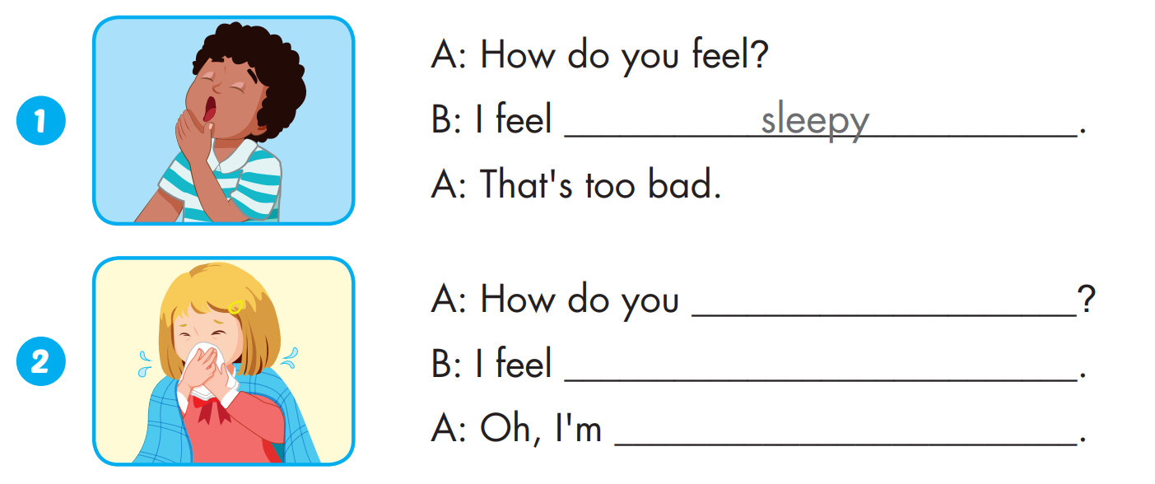
Extra Practice
WB, page 45
feel
stuffed up.
sorry.

Slide 27
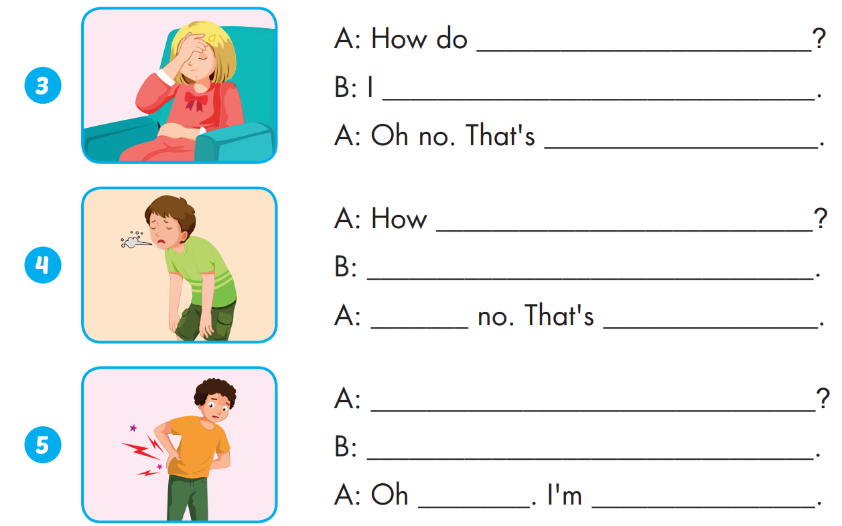
Extra Practice
WB, page 45
you feel
feel terrible.
too bad.
do you feel
I feel weak.
Oh
too bad

Slide 28
Extra Practice
WB, page 45
How do you feel
I feel sore.
no
sorry.

Slide 29

CONSOLIDATION

Slide 30



Slide 31

NEXT
Help me please!

Slide 32


1
NEXT
How do you feel?
- …….................
I feel weak.
ANSWER

Slide 33
1
NEXT
2
How do you feel?
- …….................
I feel stuffed up.
ANSWER

Slide 34
1
NEXT
2
3
How do you feel?
- …….................
I feel sick.
ANSWER

Slide 35
1
NEXT
2
3
I feel sore.
4
…….................
Oh, no. I’m sorry.
ANSWER

Slide 36
1
NEXT
2
3
I feel terrible.
4
…….................
- Oh, no. That’s to bad.
5
ANSWER

Slide 37

1
END
2
Hurray!
We found the treasure!
THANK YOU!
3
4
5
ANSWER

Slide 38

WRAP-UP

Slide 39
Today’s lesson
Vocabularies
terrible, sleepy, weak, sick, sore, stuffed up.
Structures/ Sentence patterns
How do you feel?
- I feel weak.
- That's too bad.

Slide 40
Homework
Practice the vocabularies and structure, and make sentences using them.
Do the exercises in Tiếng Anh 5 i-Learn Smart Start WB (page 45).
Do the exercises in Tiếng Anh 5 i-Learn Smart Start Notebook.
Prepare the next lesson (page 70 SB).
Play the consolidation games in Tiếng Anh 5 i-Learn Smart Start DHA App on www.eduhome.com.vn

Slide 41

Enjoy your day!

Slide 42

Lesson 3
Stay positive and have a nice day!

