Slide 1

Unit 5: HEALTH
Lesson 2.1
Page 67

Slide 2
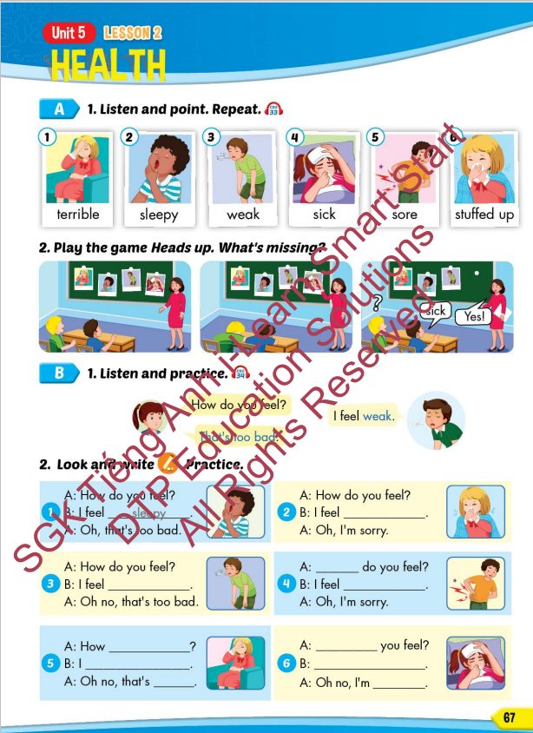
Lesson Outline
Warm-up
Vocabulary
Structure
Consolidation
Wrap-up

Slide 3
Objectives
By the end of this lesson, students will be able to recognize the vocabulary and get to know the structure asking and answering about how they feel.
Vocabulary: terrible, sleepy, weak, sick, sore, stuffed up
Structure: How do you feel?
- I feel weak.
- That's too bad.

Slide 4

WARM UP

Slide 5

Guess the HEALTH PROBLEMS

Slide 6

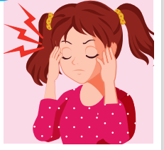
a pain you feel inside your head.
HEADACHE

Slide 7
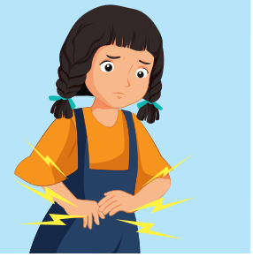
I ate too much and I had a terrible _____________.
STOMACHACHE

Slide 8
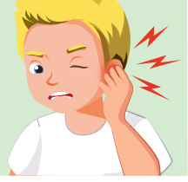
The pain inside part of your ear.
EARACHE

Slide 9
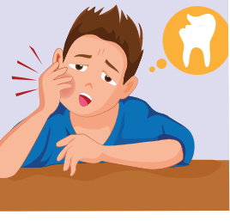
the pain caused by something being wrong with one of your teeth.
TOOTHACHE

Slide 10
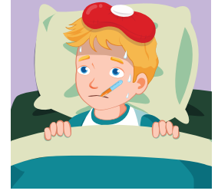
She's very hot and shivery, so I think she must have ______.
THE FLU

Slide 11

an infectious disease that causes a slight fever and red spots on the skin.
CHICKENPOX

Slide 12

It’s time to learn …

Slide 13

New words
terrible, sleepy, weak, sick, sore, stuffed up

Slide 14

Presentation

Slide 15
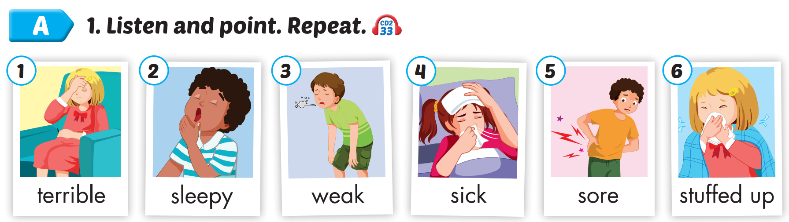

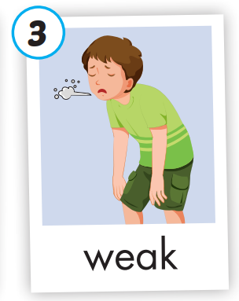
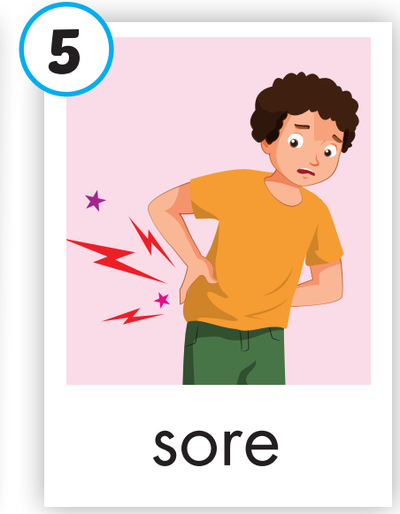
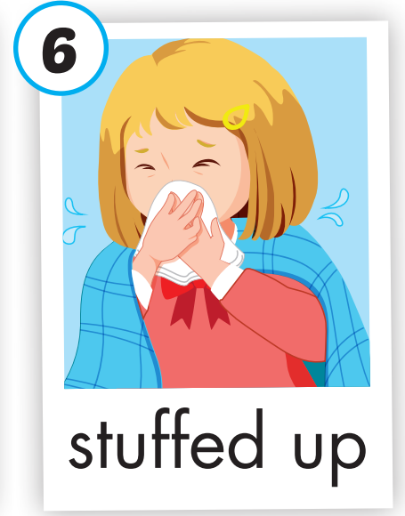
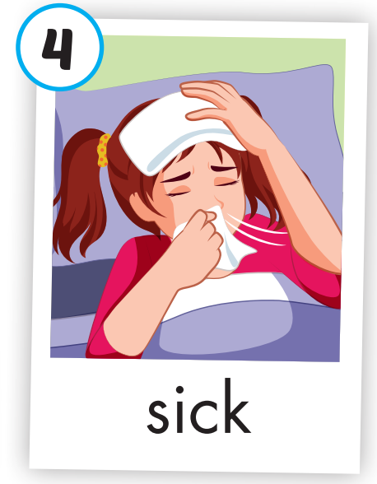
Click on A to hear the sound.
/ˈterəbl/
(adj)
tồi tệ
/ˈsliːpi/
(adj)
buồn ngủ
/wiːk/
(adj)
yếu
/sɪk/
(adj)
bệnh
/sɔːr/
(adj)
đau
/ˌstʌft ˈʌp/
(adj)
nghẹt mũi
Notes:
Click vào hình A. 1. Listen and point. Repeat để cho cả audio full chạy

Slide 16
Click on the picture to hear the sound.
terrible
/ˈterəbl/
(adj)
tồi tệ

Slide 17
Click on the picture to hear the sound.
sleepy
/ˈsliːpi/
(adj)
buồn ngủ

Slide 18
Click on the picture to hear the sound.
weak
/wiːk/
(adj)
yếu

Slide 19
Click on the picture to hear the sound.
sick
/sɪk/
(adj)
bệnh

Slide 20
Click on the picture to hear the sound.
sore
/sɔːr/
(adj)
đau

Slide 21
Click on the picture to hear the sound.
stuffed up
/ˌstʌft ˈʌp/
(adj)
nghẹt mũi

Slide 22
Practice

Slide 23
Read and choose. Then say.

Slide 24

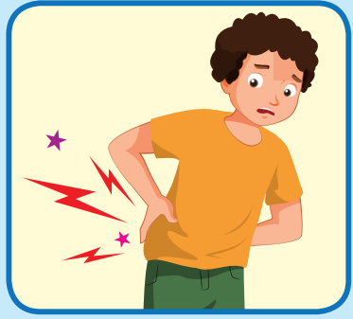
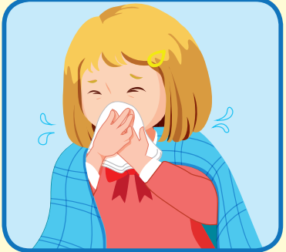

Read and choose
A
B
C
terrible

Slide 25
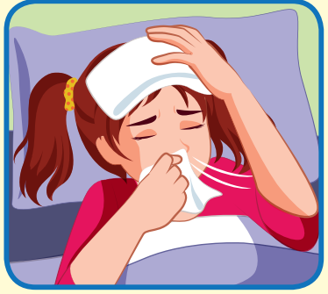
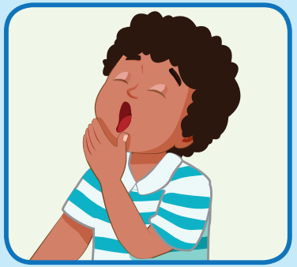
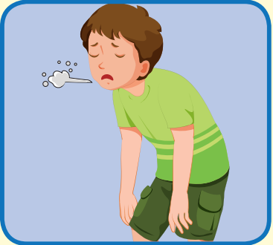
Read and choose
A
B
C
sick

Slide 26
Read and choose
A
B
C
sleepy

Slide 27
Read and choose
A
B
C
sore

Slide 28

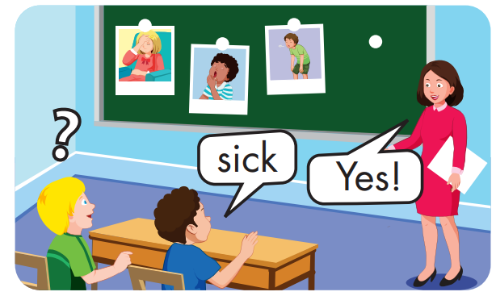

Slide 29
Structure
How do you feel?
- I feel weak.
- That's too bad

Slide 30
Presentation

Slide 31
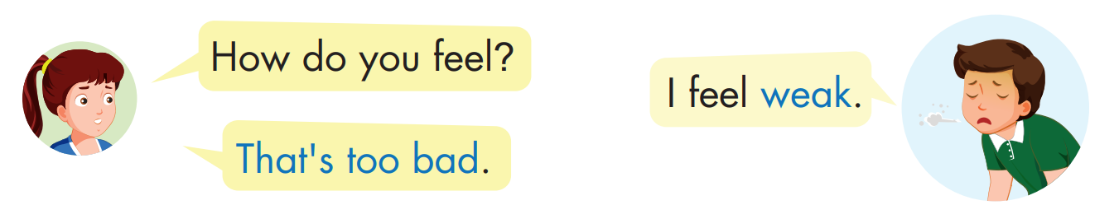
Structure

Slide 32

Practice

Slide 33


Click on B to hear the sound.

Slide 34

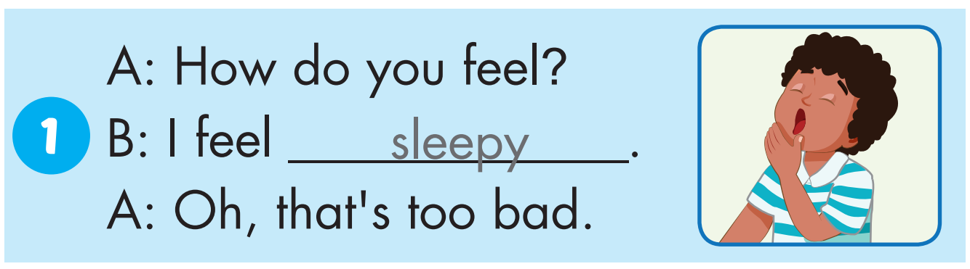

Slide 35
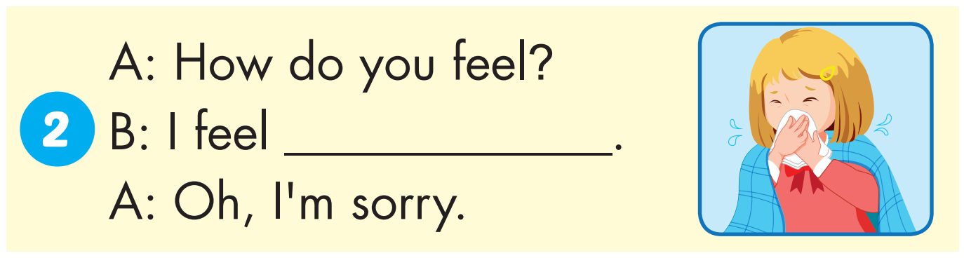
stuffed up

Slide 36
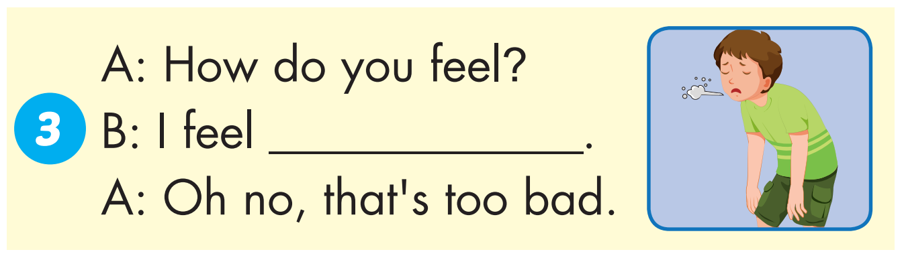
weak

Slide 37
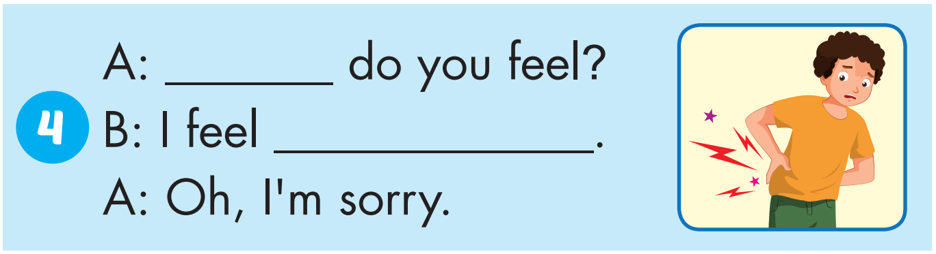
How
sore

Slide 38
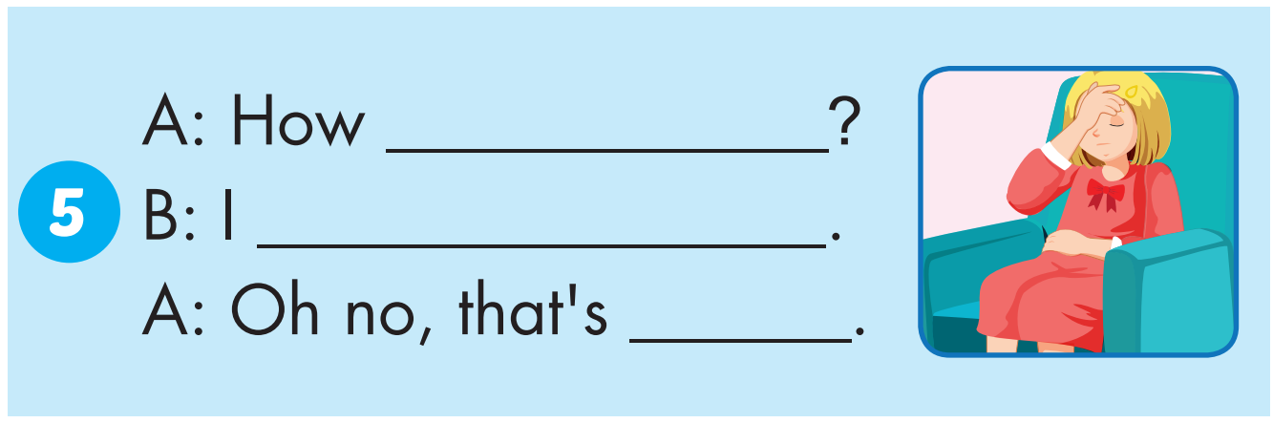
do you feel
feel terrible
too bad

Slide 39
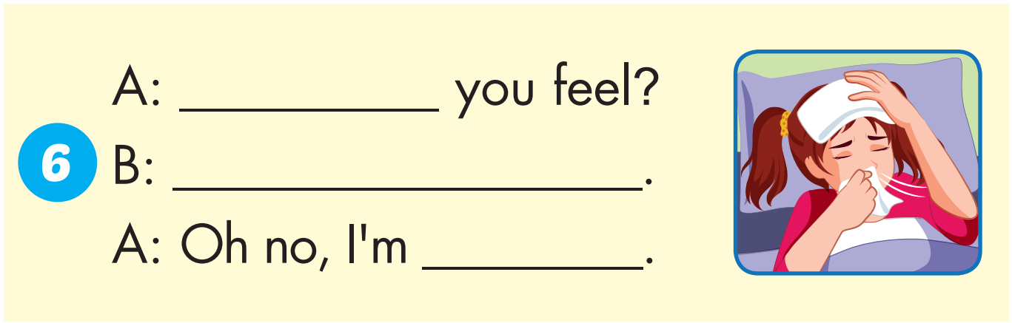
How do
I feel sick
sorry

Slide 40

Production

Slide 41
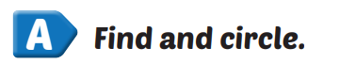
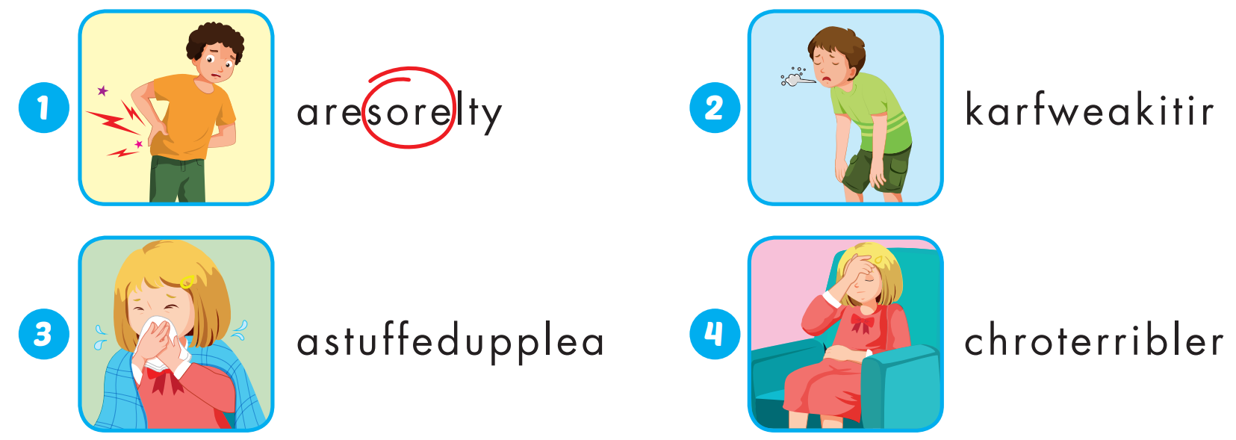
Extra Practice
WB, page 44

Slide 42
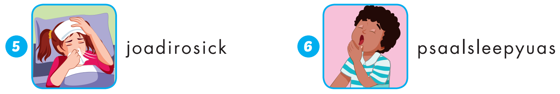
Extra Practice
WB, page 44

Slide 43
sore |  | sick
 | terrible
weak |  | sleepy
 | stuffed up
1
2
3
4
5
6
7
8
9
10
11
12

Slide 44

CONSOLIDATION

Slide 45

WRAP-UP

Slide 46
Today’s lesson
Vocabularies
terrible, sleepy, weak, sick, sore, stuffed up.
Structures/ Sentence patterns
How do you feel?
I feel weak.
That's too bad.

Slide 47
Homework
Practice the vocabularies and structure, and make sentences using them.
Do the exercises in Tiếng Anh 5 i-Learn Smart Start WB (page 44).
Do the exercises in Tiếng Anh 5 i-Learn Smart Start Notebook.
Prepare the next lesson (page 68 SB).
Play the consolidation games in Tiếng Anh 5 i-Learn Smart Start DHA App on www.eduhome.com.vn

Slide 48

Enjoy your day!

Slide 49

Lesson 3
Stay positive and have a nice day!

