Slide 1
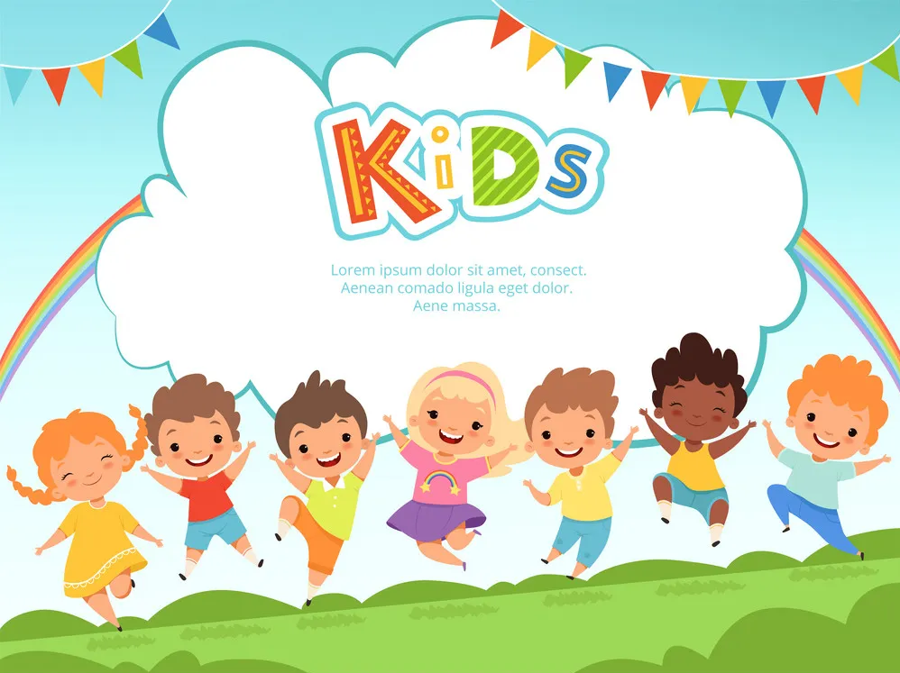


Shining with b1
English Contest

Slide 2

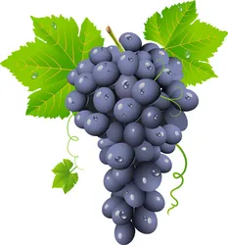
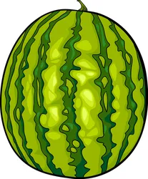
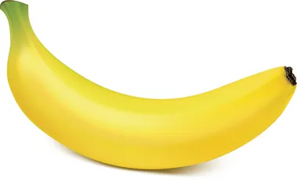
Q1: Which fruit is it? It is purple. It’s small, round and very sweet.
A
B
C
Banana
Grape
Watermelon

Slide 3



Q2: This shape has no side. It’s round. What is it?
A
B
C
Rectangle
Circle
Triangle

Slide 4
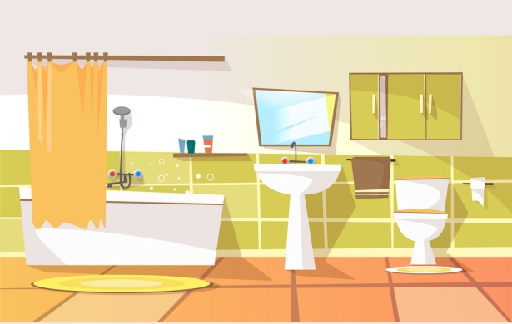
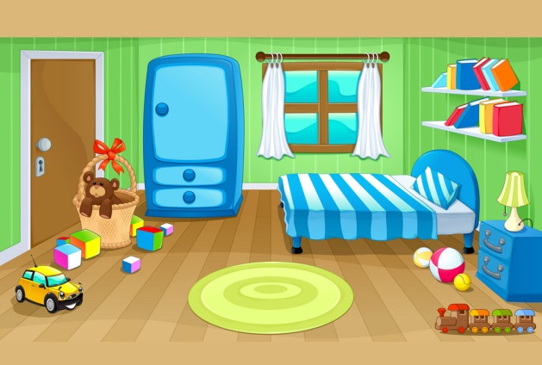
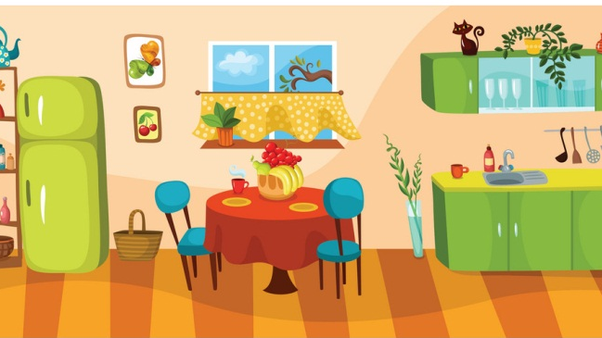
Q3: My mum is cooking soup. Where is she?
A
B
C
In the kitchen
In the bathroom
In the bedroom

Slide 5
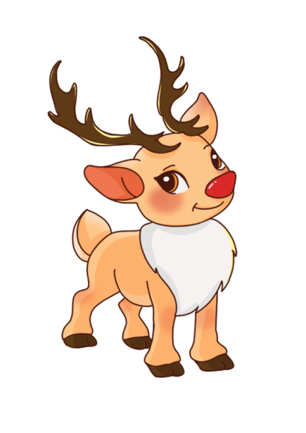
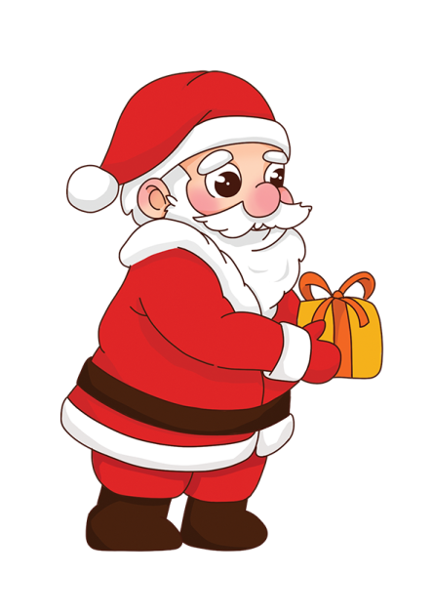
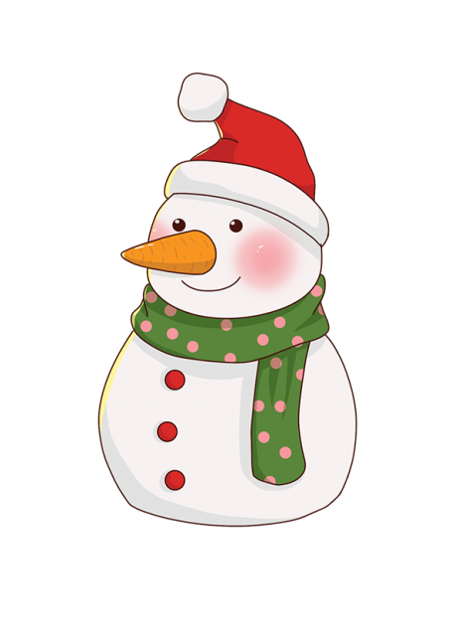
Q4: He has a red coat and white beard. He gives children presents. Who is he?
A
B
C
Reindeer
Santa
Snowman

Slide 6
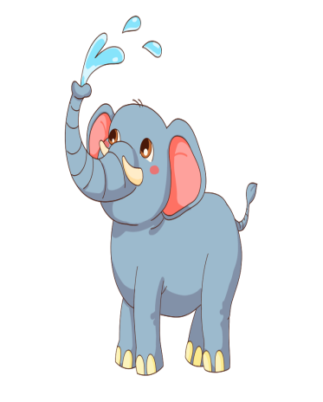

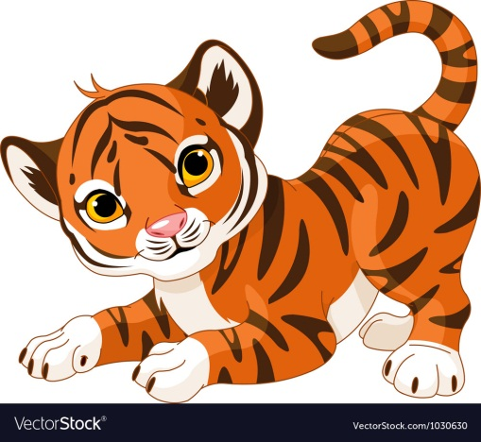
Q5: Which animal often pulls Santa’s sleigh?
A
B
C
Tiger
Elephant
Reindeer

Slide 7

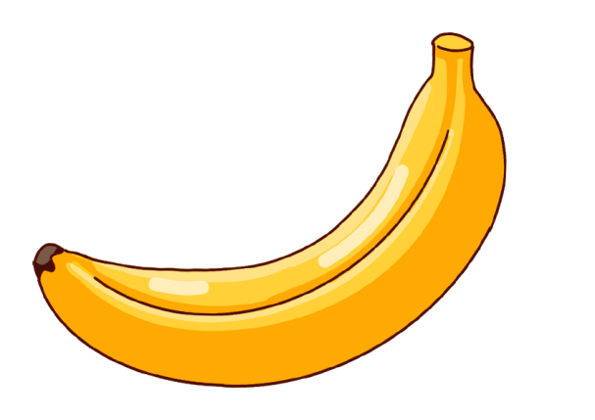

Q6: This is a long yellow fruit. Monkeys love to eat them.
A
B
C
Banana
Orange
Apple

Slide 8
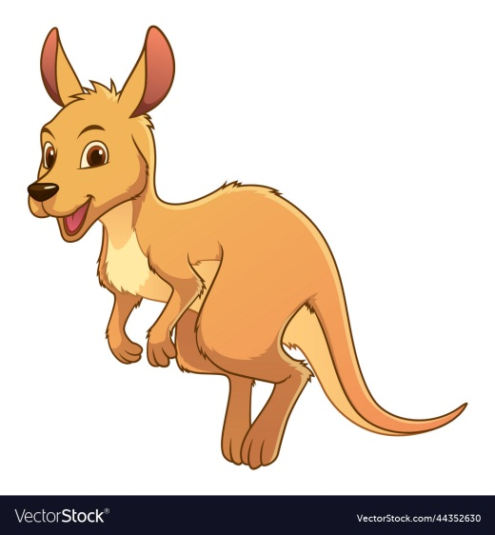
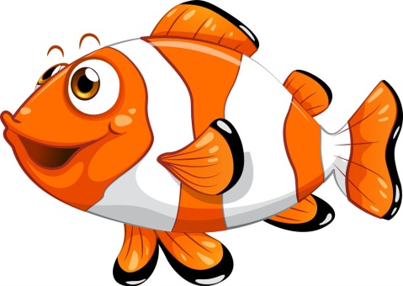
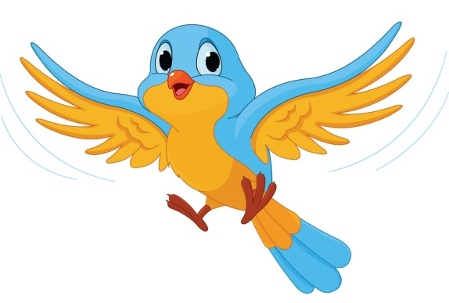
Q7: Which of these following animals can fly?
A
B
C
Kangaroo
Fish
Bird

Slide 9
Q8: A farmer went to the market and he bought 1 cow and 5 pigs. How many animals does he have?
A
B
C
4
6
7
Four
Six
Seven

Slide 10
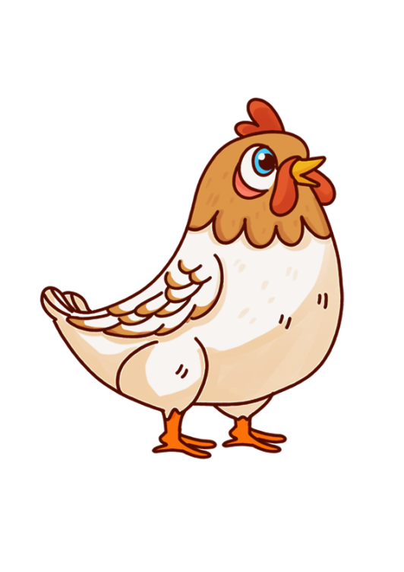
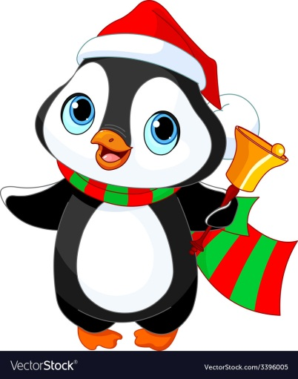
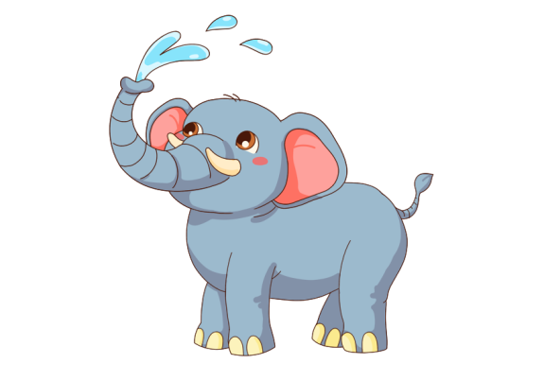
Q9: I am a bird. I can swim but I can not fly. I’m black and white. What am I?
A
B
C
Penguin
Chicken
Elephant

Slide 11


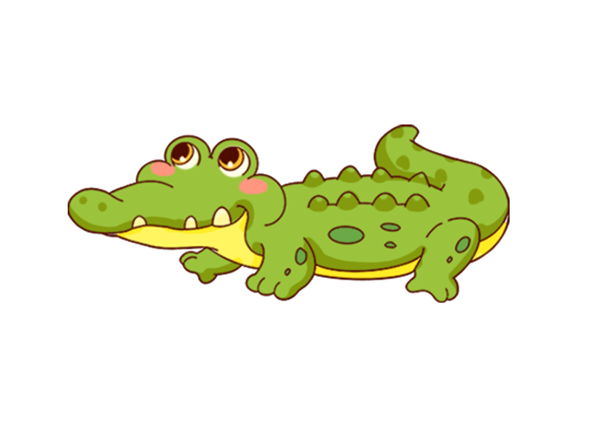
Q10: I have big ears and a long trunk. I can spray water with my trunk. What am I?
A
B
C
Tiger
Elephant
Crocodile

Slide 12
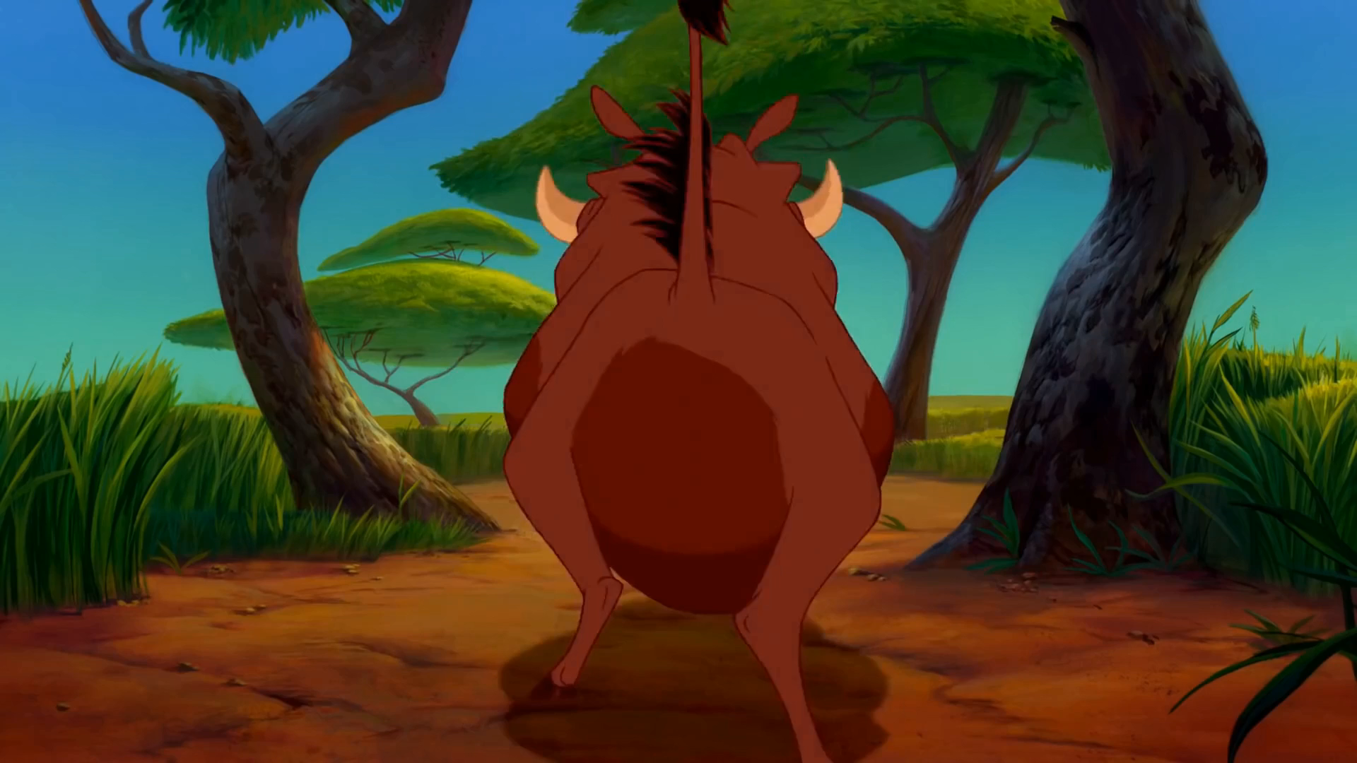
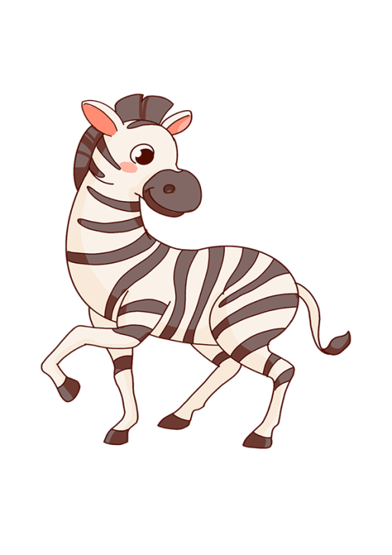
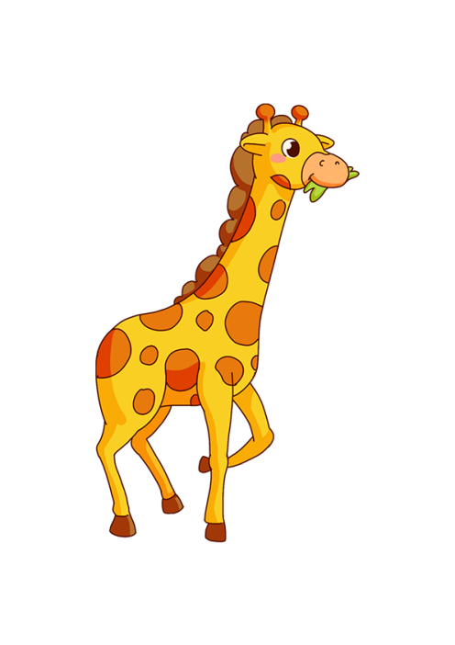

Q11: Let’s watch the film. Which animals can’t you see in the video?
A
B
C
Zebra
Tiger
Giraffe
Notes:
https://www.youtube.com/watch?v=mzABW42AIhM, cắt từ phút 1.50-2.07-lion king

Slide 13
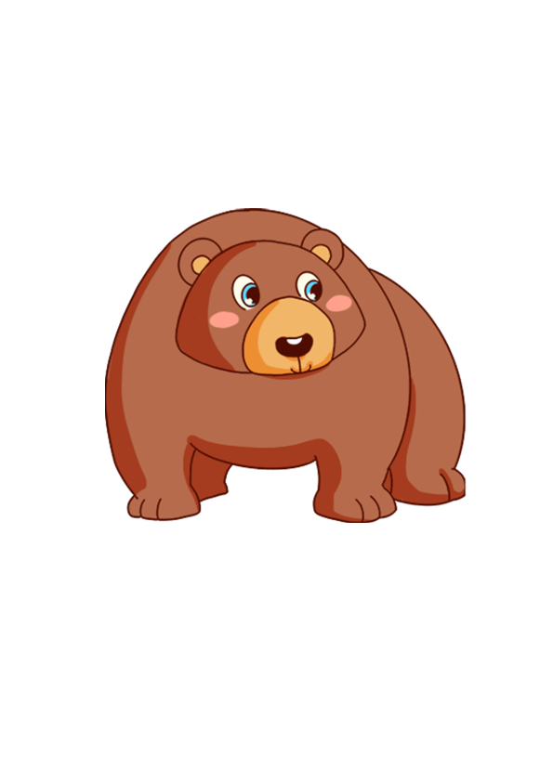
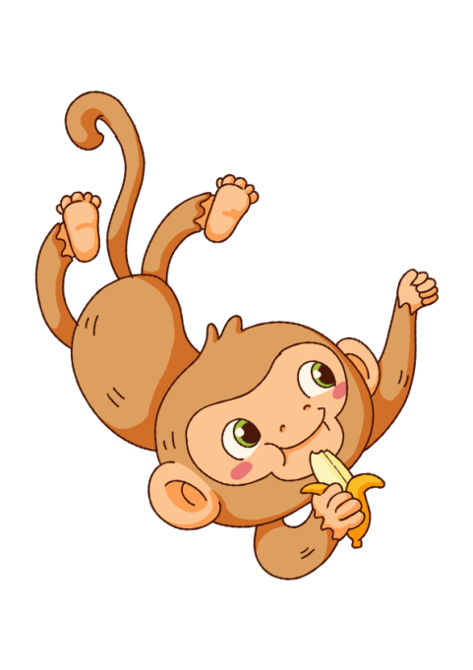
Q12: I have 2 arms, 2 legs and a tail. I like to eat bananas. I can swing from trees. What am I?
A
B
C
Monkey
Bear
Crocodile

Slide 14
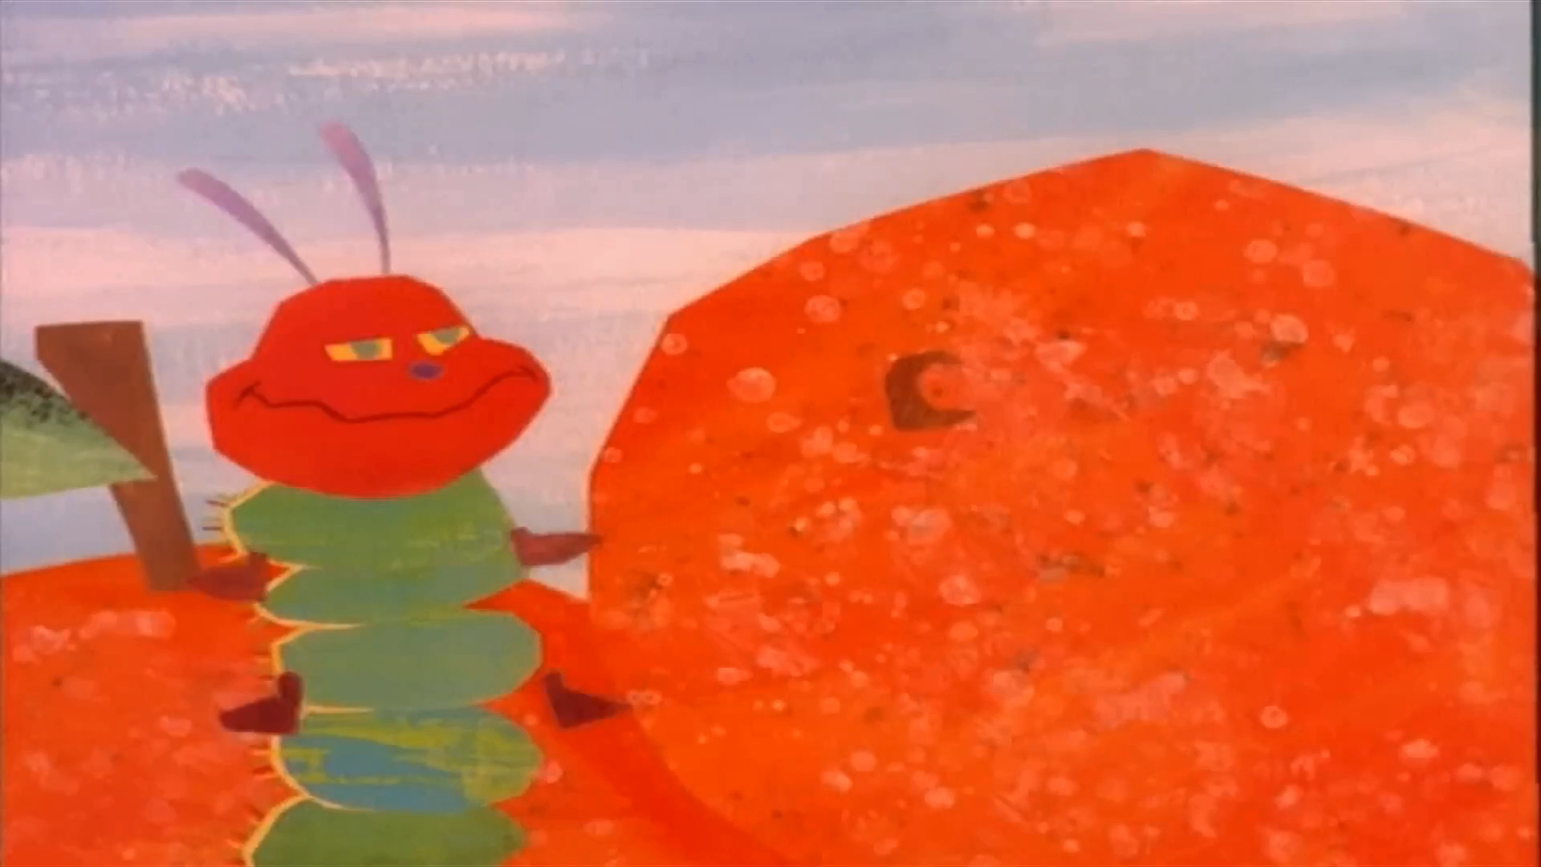
Q13: How many oranges does the caterpillar eat?
A
B
C
4
5
6
Four
Five
Six
Notes:
The hungry caterpillar cắt 3.20-3.57) https://www.youtube.com/watch?v=75NQK-Sm1YY&t=335s

Slide 15
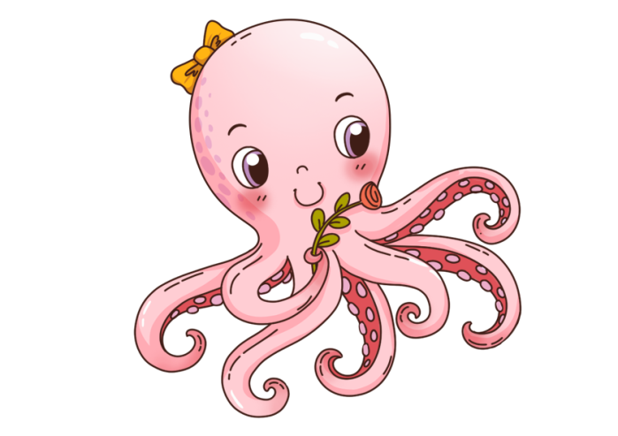
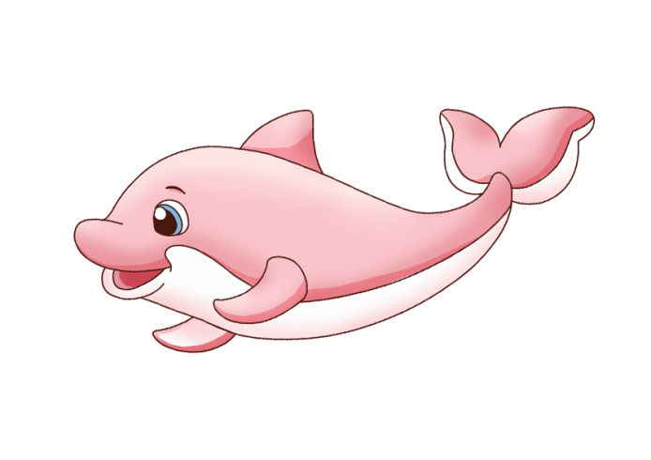

Q14: I live in the ocean. I have 8 legs and swim very well. What am I?
A
B
C
Octopus
Fish
Dolphin

Slide 16
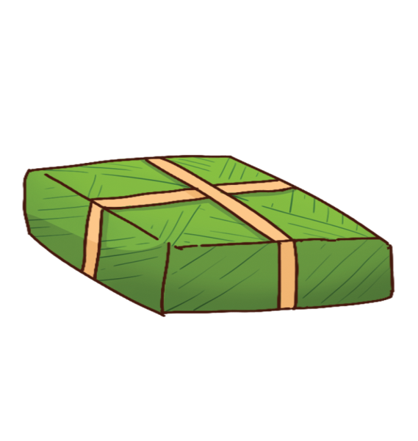

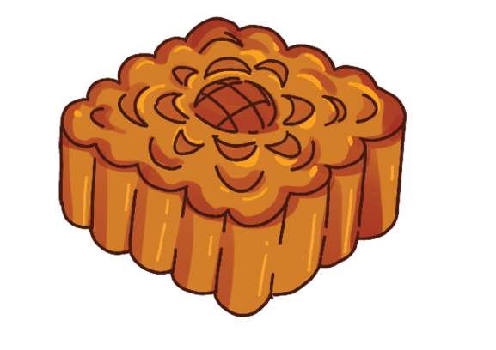
Q15: It is a special cake in Mid-autumn festival. What is it?
A
B
C
Chung cake
Moon cake
Cupcake

Slide 17
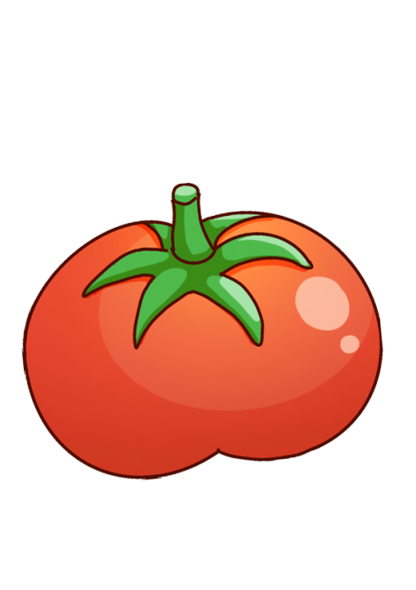
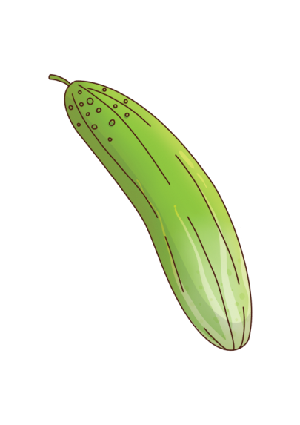
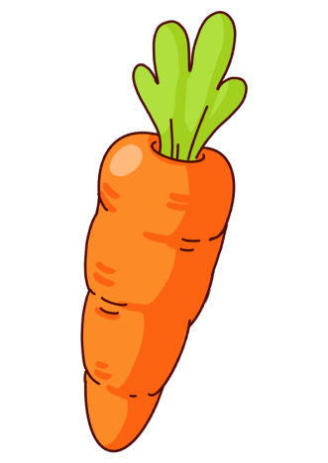
Q16: It’s a kind of vegetable. It’s long and orange. It’s underground. What is it?
A
B
C
Tomato
Carrot
Cucumber

Slide 18
Q17: My house has 1 living room, 2 bedrooms, 1 kitchen and 1 bathroom. How many rooms are there in my house?
A
B
C
4
5
6
Four
Five
Six

Slide 19
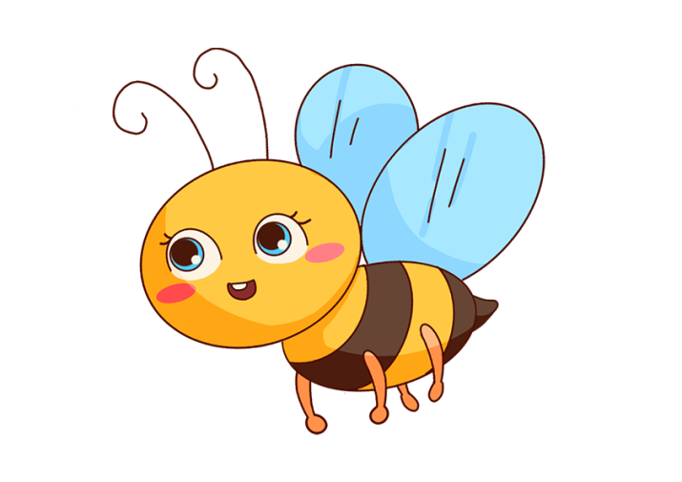


Q18: I don’t like bees. I don’t like elephants. I like an animal which can fly and sing very well. So what is my favorite animal?
A
B
C
Bee
Elephant
Bird

Slide 20
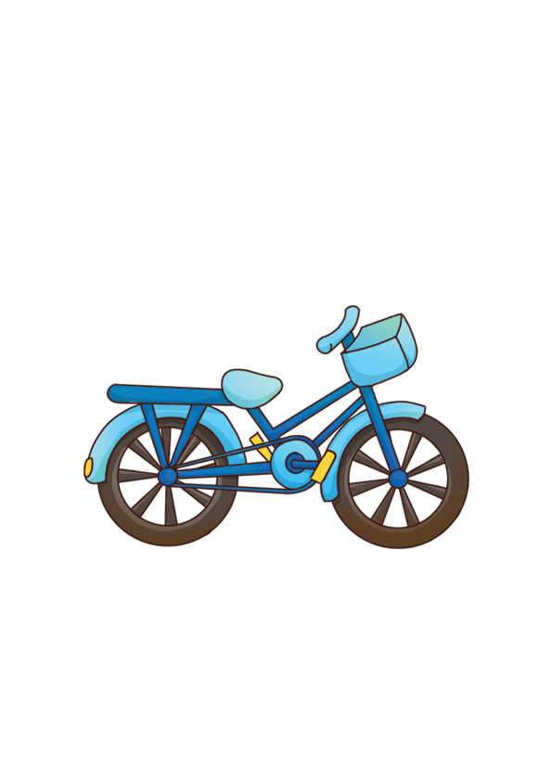

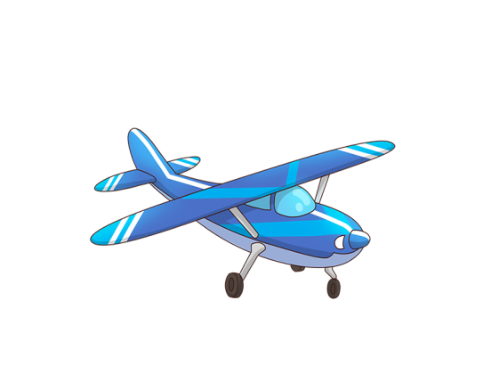
Q19: Which means of transportation can fly in the sky?
A
B
C
Bicycle
Car
Plane

Slide 21
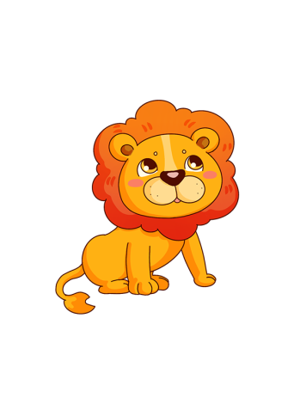


Q20: Which of these following animal lays eggs?
A
B
C
Chicken
Elephant
Lion

