Slide 1

Unit 1: Animals
Lesson 2.2
Page 10

Slide 2
Objectives
By the end of this lesson, students will be able to…
Vocabulary: Pronounce and use the words related to the topic properly: panda, giraffe, lion, dolphin, tiger, zebra.
Structure: What's this? - It's a panda.
What's that? - It's a dolphin.
Phonics: Draw attention to the initial/f inal/medial /f/ sound. and practice the conversations.

Slide 3

It’s time to learn …

Slide 4

Phonics
/f/

Slide 5
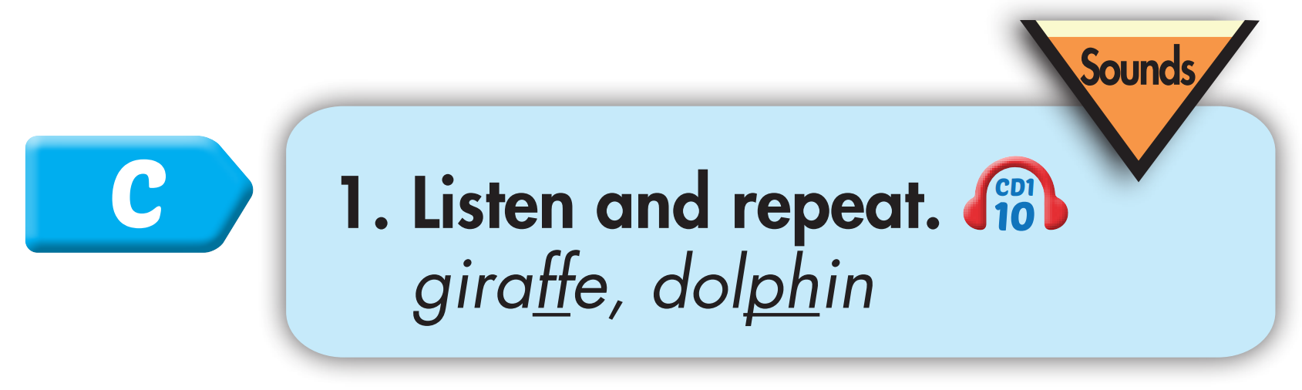
Click CD1 track 10 to hear the sound.
f f giraffe
f f dolphin
Notes:
Bấm vô CD-48 sẽ ra âm thanh

Slide 6

coffee
elephant
List the words with the same sound /f/. Practice saying them with a partner.
off
phone
staff
photo
scoff
alphabet
Notes:
Tìm từ tận cùng bằng ts đã học và tạo chant giống từ donuts

Slide 7
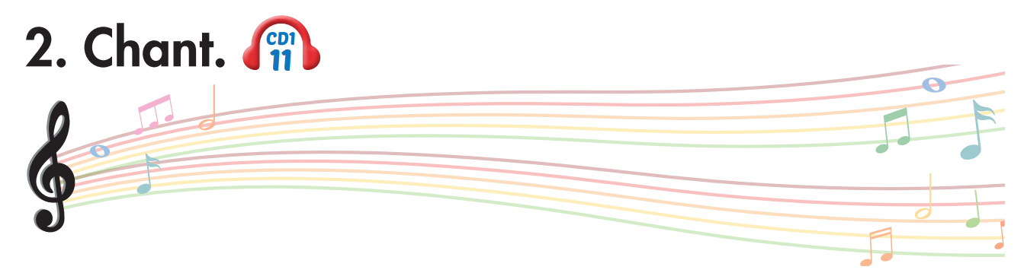
Track 11
Who likes dolphins?
Who likes dolphins?
We like dolphins!
We like dolphins!
Who likes giraffes?
Who likes giraffes?
We like giraffes!
We like giraffes!
We all love friendly animals.
We all love friendly animals.
Click on the music note to hear the sound.

Slide 8

Listening

Slide 9

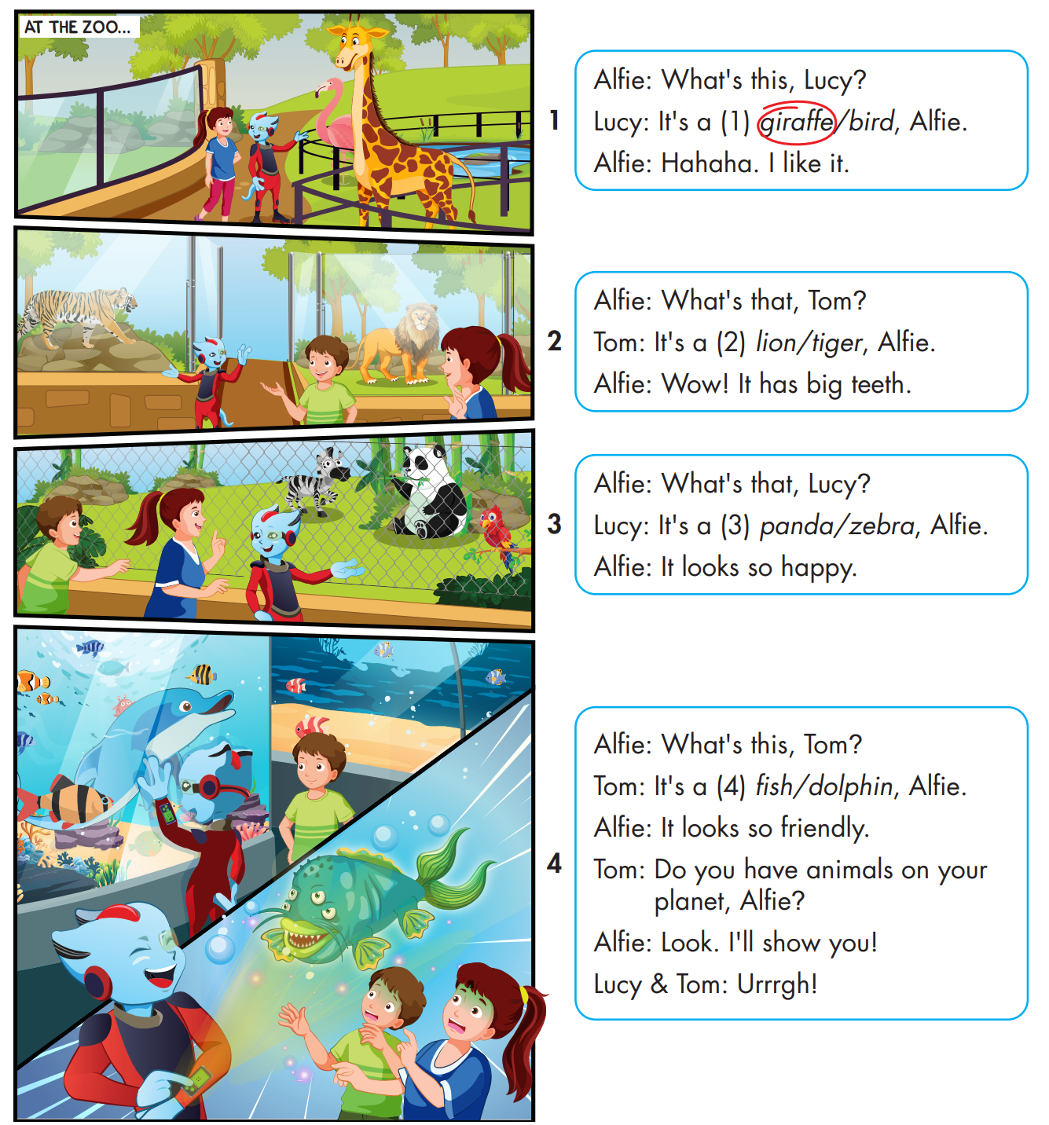

While-Listening

Slide 10
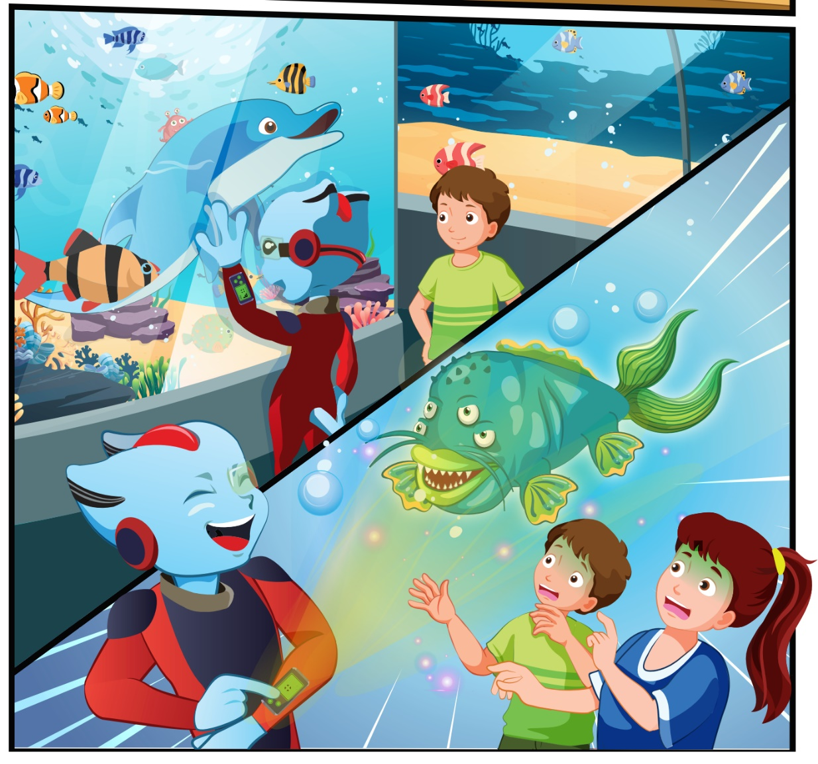
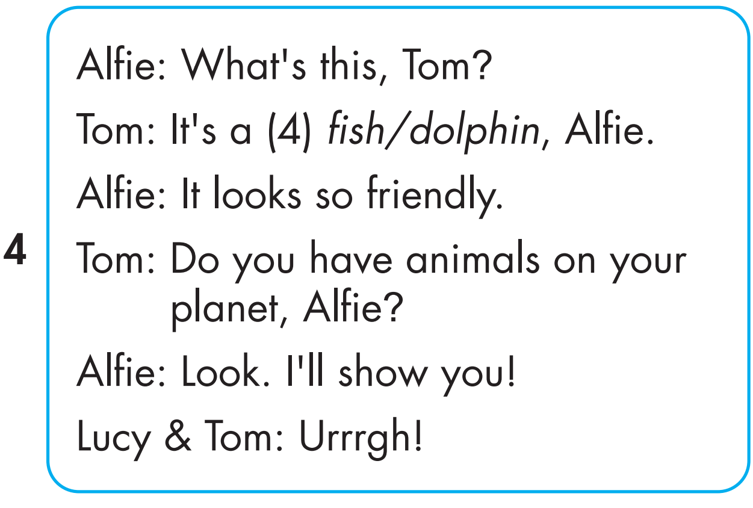
While-Listening

Slide 11

Early Production

Slide 12


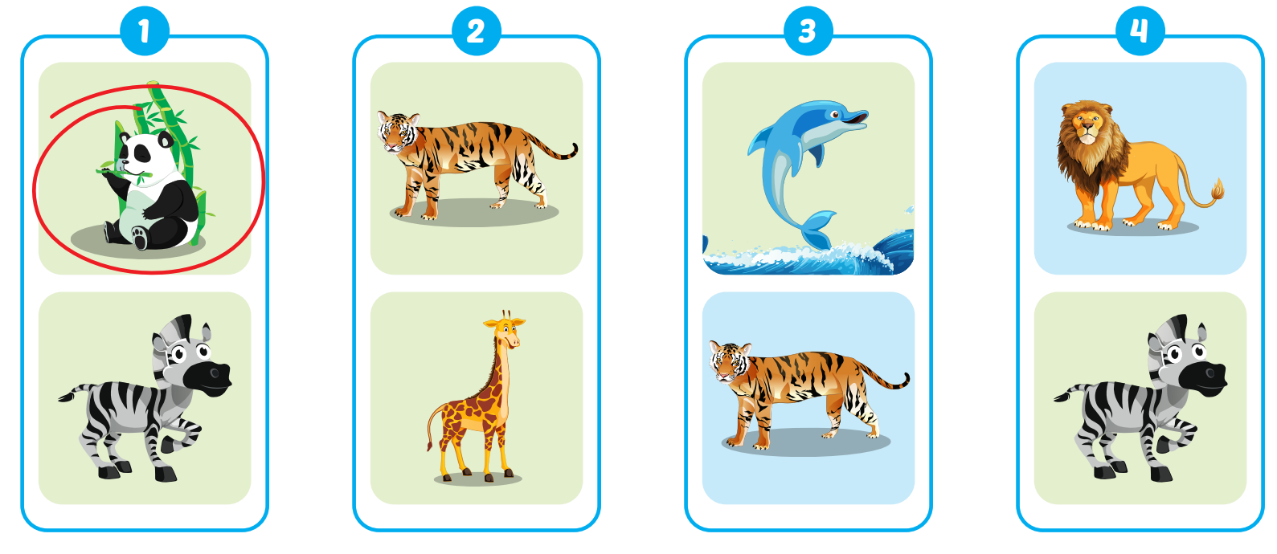
Extra Practice
WB, P. 5

Slide 13

CONSOLIDATION

Slide 14
Today’s lesson
Vocabularies
panda, giraffe, lion, dolphin, tiger, zebra.
Structures/ Sentence patterns
What's this? - It's a panda.
What's that? - It's a dolphin.
Phonics
Draw attention to the initial/f inal/medial /f/ sound. and practice the conversations.

