Slide 1

Unit 4: ACTIVITIES
Lesson 4
Page 59

Slide 2
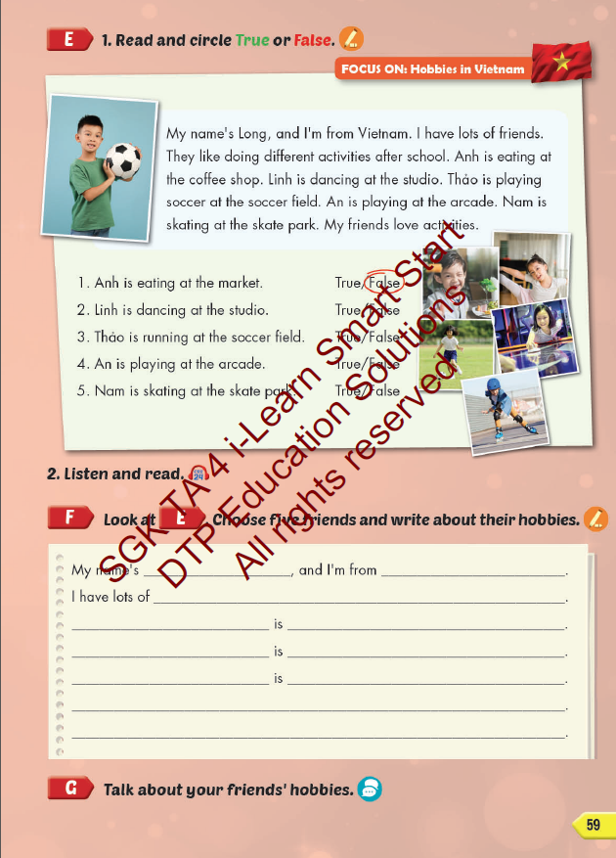
Lesson Outline
Warm-up
Reading
Writing
Consolidation
Wrap-up

Slide 3
Objectives
By the end of this lesson, students will be able to read hobbies in Vietnam, write and talk about their hobbies.
Vocabulary: studio, soccer field, arcade, skate park, coffee shop.
Structure:
What's she doing?
She's dancing at the studio.
What are they doing?
They're playing soccer at the soccer field.

Slide 4

WARM UP

Slide 5

REVIEW 1
Look and say.

Slide 6

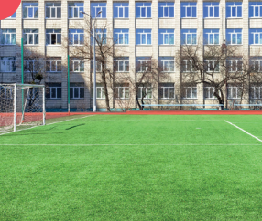
REVIEW 1
Look and say.
START
CHECK
soccer field

Slide 7
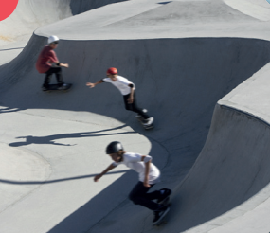
REVIEW 1
Look and say.
START
CHECK
skate park

Slide 8

REVIEW 1
Look and say.
START
CHECK
skate park

Slide 9

REVIEW 1
Look and say.
START
CHECK
skate park

Slide 10
REVIEW 2
Look and complete.
1
I’m skating at the __________.
skate park
studio

Slide 11
REVIEW 2
Look and complete.
2
He’s playing games at the __________.
library
arcade

Slide 12
REVIEW 2
Look and complete.
3
I’m flying kite at __________.
soccer field
arcade

Slide 13
REVIEW 2
Look and complete.
4
They’re reading at the __________.
skate park
coffee shop

Slide 14

It’s time to learn …

Slide 15

Reading

Slide 16



Underline keywords in each statement.
Read the text carefully and find information.

Slide 17

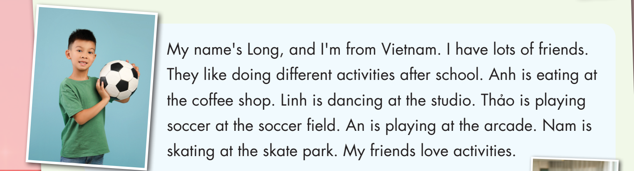

Slide 18

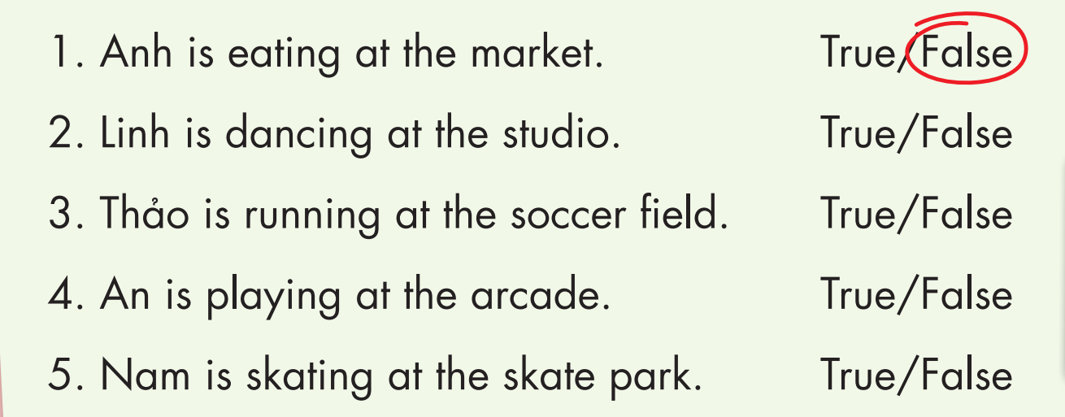

Slide 20



Slide 21
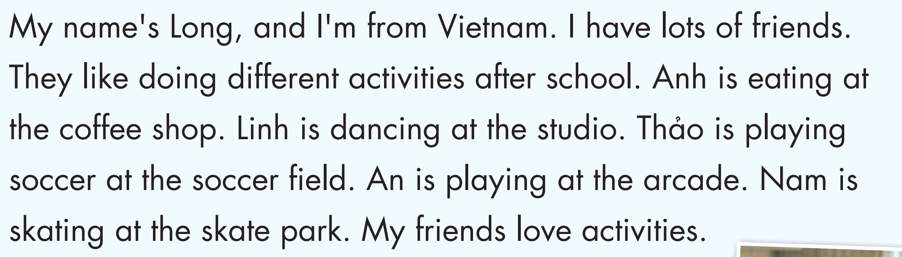
READ AND COMPLETE
Long
Vietnam
friends
doing
eating
coffee shop
studio
soccer field
arcade
skate park

Slide 22
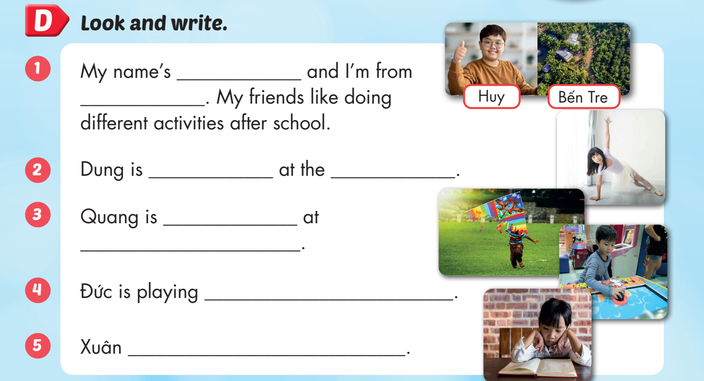
Huy
Bến Tre
dancing
studio
flying a kite
soccer field
games at the arcade
is reading at home

Slide 23

Production

Slide 24
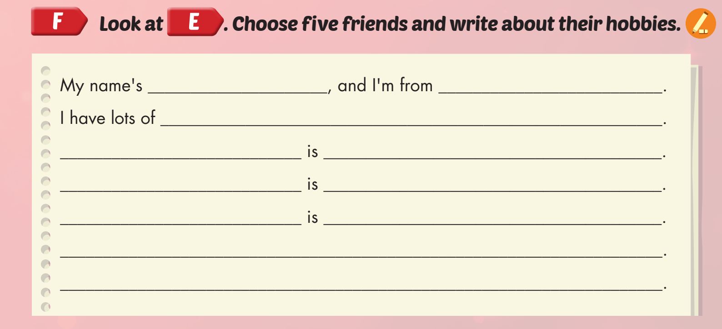

Slide 25

CONSOLIDATION

Slide 26



Slide 27

WRAP-UP

Slide 28
Today’s lesson
Vocabularies
studio, soccer field, arcade, skate park, coffee shop.
Structures/ Sentence patterns
What is she doing?
She’s dancing at the studio.
What are they doing?
They are playing soccer at the soccer field.

Slide 29
Homework
Practice the vocabularies and structure; and make sentences using them.
Do the exercises in Tiếng Anh 4 i-Learn Smart Start WB (page 39)
Do the exercises in Tiếng Anh 4 i-Learn Smart Start Notebook (page 25).
Prepare the next lesson (page 60 SB)
Play the consolidation games in Tiếng Anh 4 i-Learn Smart Start DHA App on www.eduhome.com.vn

Slide 30

Enjoy your day!

