Slide 1

Unit 4: ACTIVITIES
Lesson 4
Page 58

Slide 2
Objectives
By the end of this lesson, students will be able to read and listen about where people do some different activities that are popular in their culture.
Vocabulary: studio, soccer field, arcade, skate park, coffee shop.
Structure:
What's she doing?
She's dancing at the studio.
What are they doing?
They're playing soccer at the soccer field.

Slide 3

It’s time to learn …

Slide 4

Reading

Slide 5



Underline key words in each statement.
Read the text carefully and find information.

Slide 6
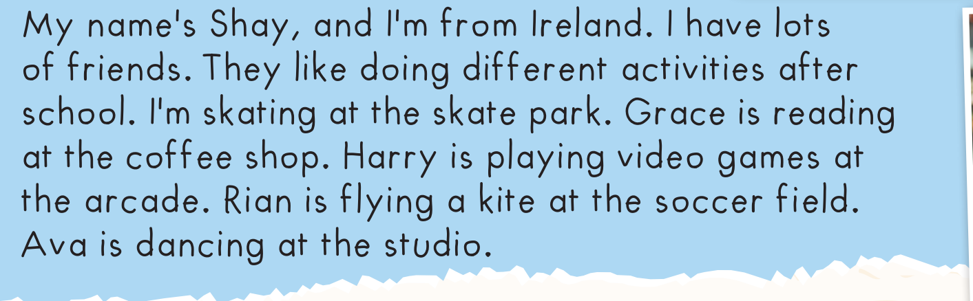

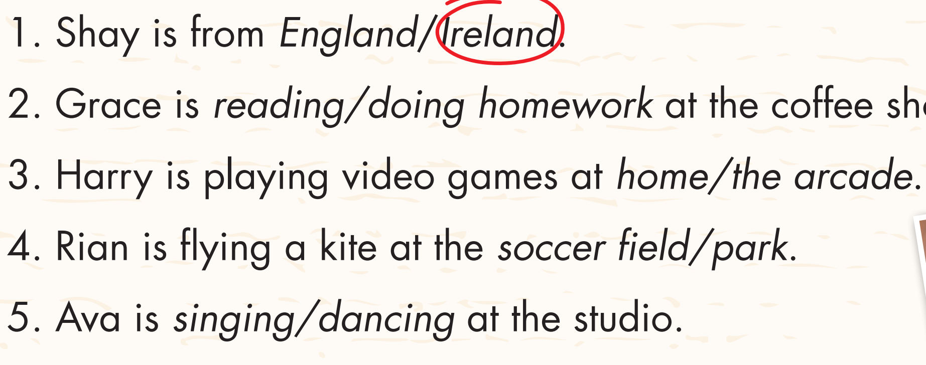

Slide 7
1. Shay is from England/ Ireland.
2. Grace is reading/doing homework at the coffee shop.
3. Harry is playing video games at home/the arcade.
4. Rian is playing a kite at the soccer field/park.
5. Ava is singing/dancing at the studio.

Slide 8
1. Shay is from England/ Ireland.
2. Grace is reading/doing homework at the coffee shop.
3. Harry is playing video games at home/the arcade.
4. Rian is playing a kite at the soccer field/park.
5. Ava is singing/dancing at the studio.

Slide 9



Slide 10
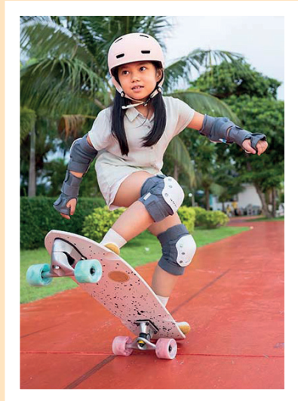
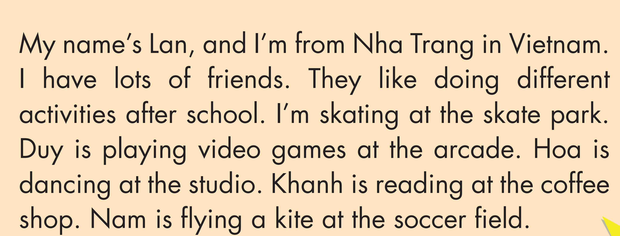
3. Read and complete.
skating
arcade
dancing
soccer field
skating
arcade
dancing
soccer field

Slide 11

Listening

Slide 12

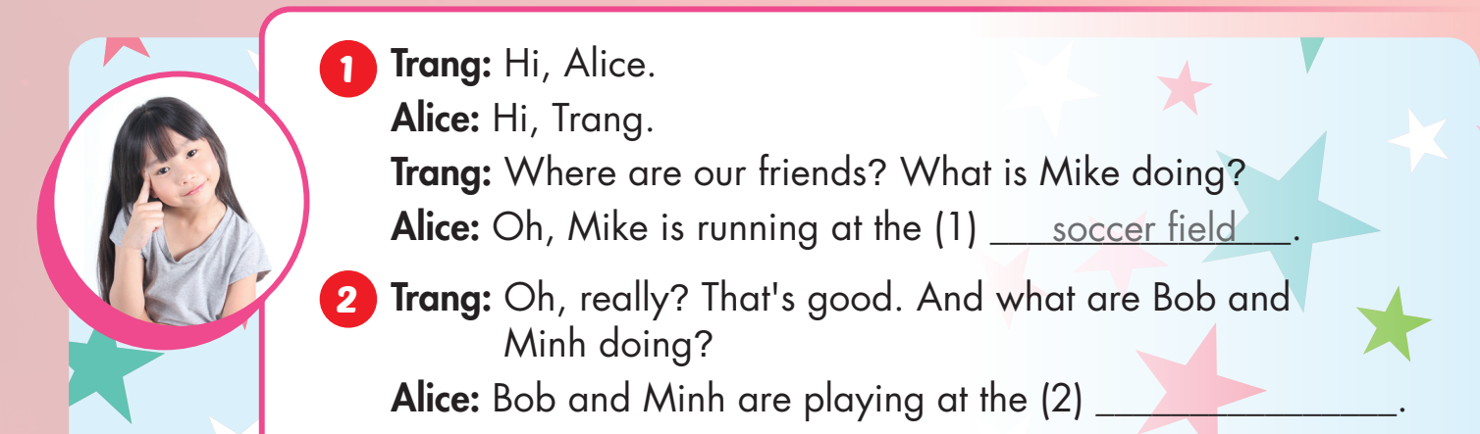

Slide 13
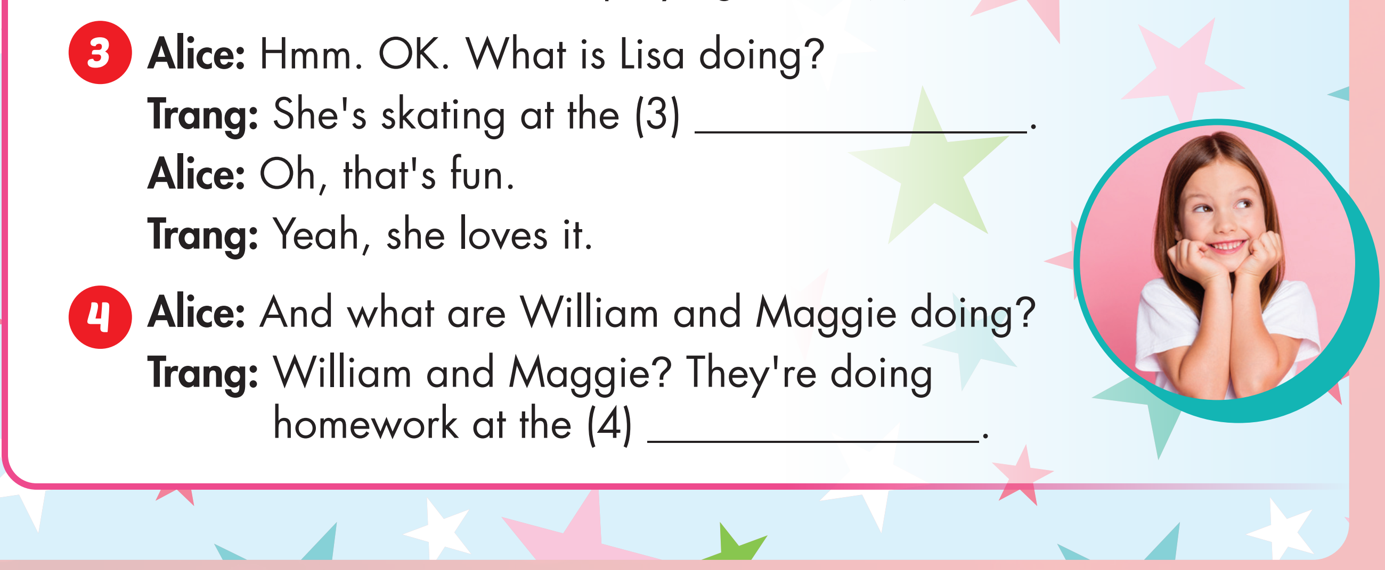

Slide 14
arcade

Slide 15
arcade
arcade

Slide 16

Production

Slide 17


Slide 18

CONSOLIDATION

Slide 19
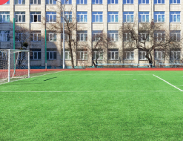

What are they doing?
They’re playing soccer at the soccer field.

Slide 20

What are they doing?
They’re dancing at the studio.

Slide 21
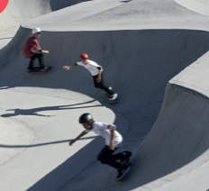
What are they doing?
They’re playing skating at the skate park.

Slide 22

What is he doing?
He’s playing games at the arcade.

Slide 23

What are they doing?
They’re chatting at the coffee shop.

Slide 24

WRAP-UP

Slide 25
Today’s lesson
Vocabularies
studio, soccer field, arcade, skate park, coffee shop.
Structures/ Sentence patterns
What is she doing?
She’s dancing at the studio.
What are they doing?
They are playing soccer at the soccer field.

Slide 26
Homework
Practice the vocabularies and structure; and make sentences using them.
Do the exercises in Tiếng Anh 4 i-Learn Smart Start WB (page 39)
Do the exercises in Tiếng Anh 4 i-Learn Smart Start Notebook (page 25).
Prepare the next lesson (page 51 SB)
Play the consolidation games in Tiếng Anh 4 i-Learn Smart Start DHA App on www.eduhome.com.vn

Slide 27

Enjoy your day!

