Slide 1

Unit 4: ACTIVITIES
Lesson 4
Page 57

Slide 2
Objectives
By the end of this lesson, students will be able to learn vocabulary and structure to talk about where they do some different activities that are popular in their culture.
Vocabulary: studio, soccer field, arcade, skate park, coffee shop.
Structure:
What is she doing?
She’s dancing at the studio.
What are they doing?
They are playing soccer at the soccer field.

Slide 3

WARM UP

Slide 4

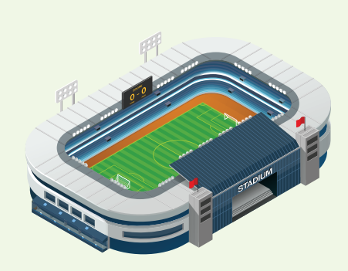
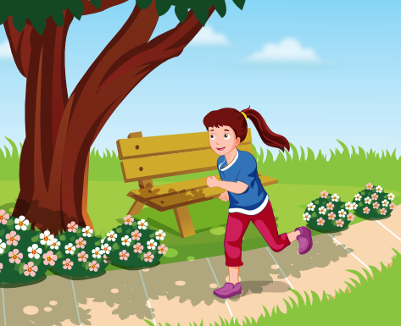
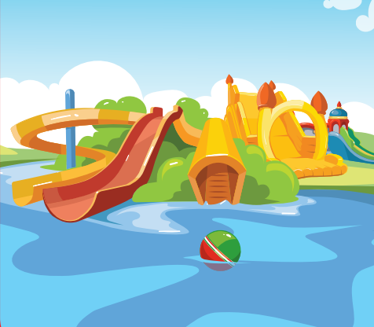
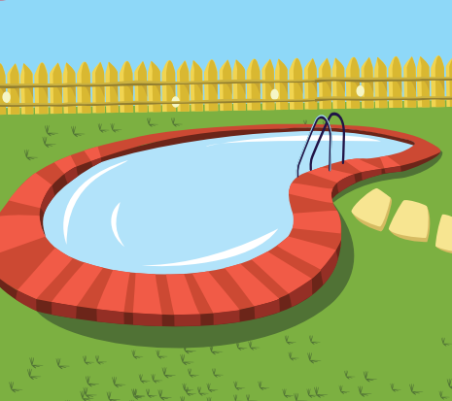
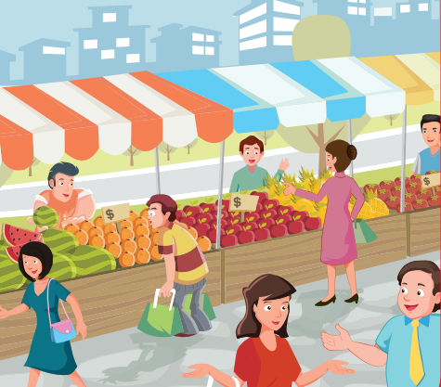
REVIEW 1
library
stadium
park
water park
swimming pool
market

Slide 5
REVIEW 2
What’s next?
?
?

Slide 6
REVIEW 2
What’s next?
?
?

Slide 7
REVIEW 2
What’s next?
?
?

Slide 8

It’s time to learn …

Slide 9

New words
studio, soccer field, arcade, skate park, coffee shop.

Slide 10

Presentation

Slide 11

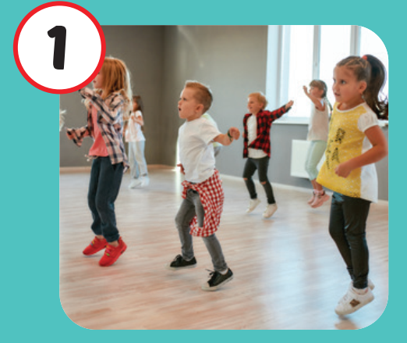
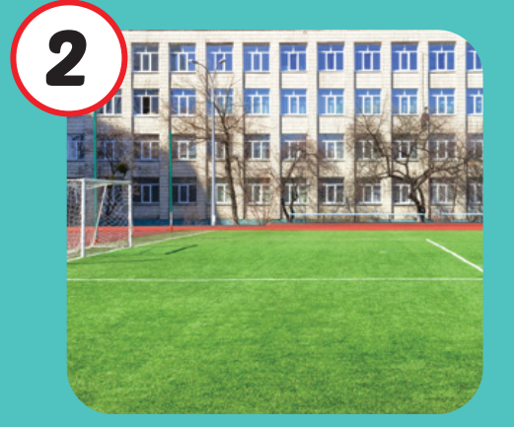
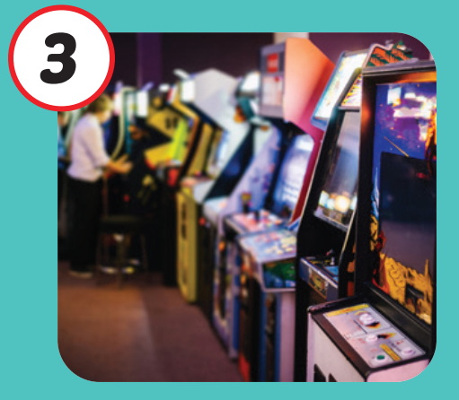

Click on each English word to hear the sound.
studio
soccer field
arcade
/ˈstuːdioʊ/
phòng tập
/ˈsɑːkər fiːld/
sân đá bóng
/ɑːrˈkeɪd/ khu vực máy giải trí

Slide 12

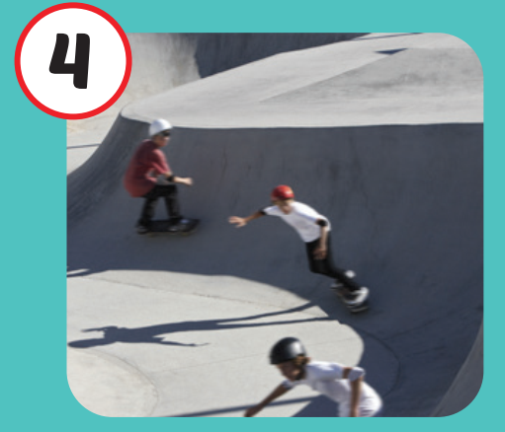

Click on each English word to hear the sound.
skate park
coffee shop
/skeɪt pɑːrk/ khu trượt ván
/ˈkɑːfi ʃɑːp/
quán cà phê

Slide 13

Practice

Slide 14
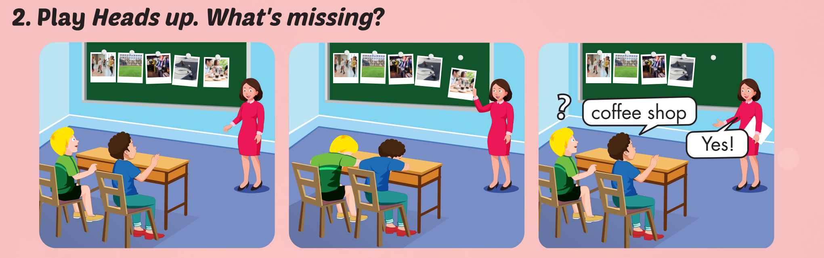

Slide 15
Structures
What is she doing?
She’s dancing at the studio.
What are they doing?
They’re playing soccer at the soccer field.

Slide 16

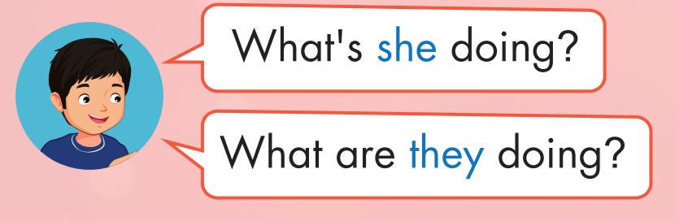
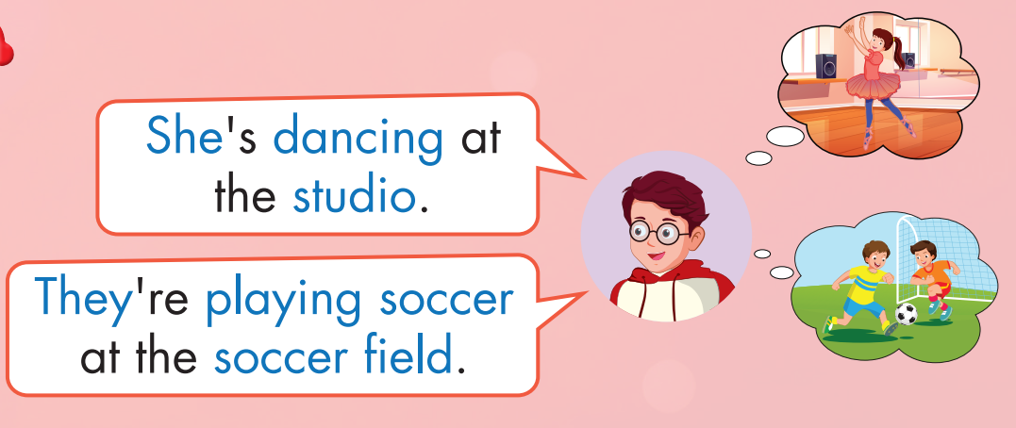
Click on the headphone icon to hear the sound.

Slide 17
Practice

Slide 18

CONSOLIDATION

Slide 19
Today’s lesson
Vocabularies
studio, soccer field, arcade, skate park, coffee shop.
Structures/ Sentence patterns
What is she doing?
She’s dancing at the studio.
What are they doing?
They are playing soccer at the soccer field.

Slide 20
Homework
Practice the vocabulary and structure, and make sentences using them.
Do the exercises in Tiếng Anh 4 i-Learn Smart Start WB (page 38)
Do the exercises in Tiếng Anh 4 i-Learn Smart Start Notebook (page 25)
Prepare the next lesson (page 58 SB)
Play the consolidation games in Tiếng Anh 4 i-Learn Smart Start DHA App on www.eduhome.com.vn

