Slide 1

Unit 3: WEATHER
Lesson 2.2
Page 38

Slide 2
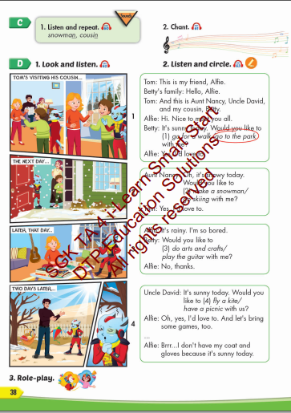
Lesson Outline
Warm-up
Listening
Consolidation
Wrap-up

Slide 3
Objectives
By the end of this lesson, students will be able to the weather like today.
Vocabulary: snowman, cousin.
Structure: It's windy today.
Would you like to fly a kite with me?
Yes, I'd love to./ No, thanks.

Slide 4

WARM UP

Slide 5
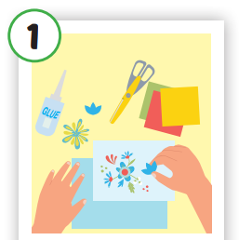
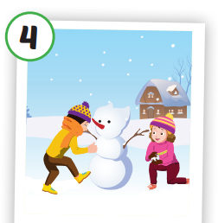
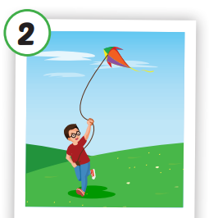
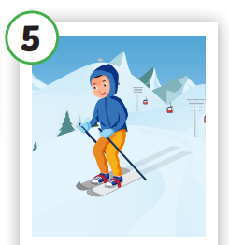
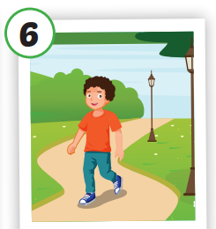
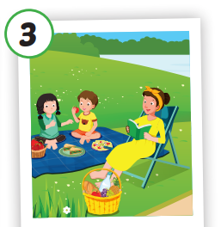
6
1
SPIN
5
2
4
3

Slide 6

It’s time to learn …

Slide 7

Listening

Slide 8




Click each English word to hear the sound.
snowman
cousin
/ˈsnoʊmæn/
người tuyết
/ˈkəzn/
Anh em họ

Slide 9


Click the earphone to hear the sound.
Would you like to make a snowman with my cousin and me?
Yes, I’d love to.
That’s sound nice.
Would you like to play badminton with my cousin and me?
No, thanks. I’m sorry.
I’m busy today

Slide 10

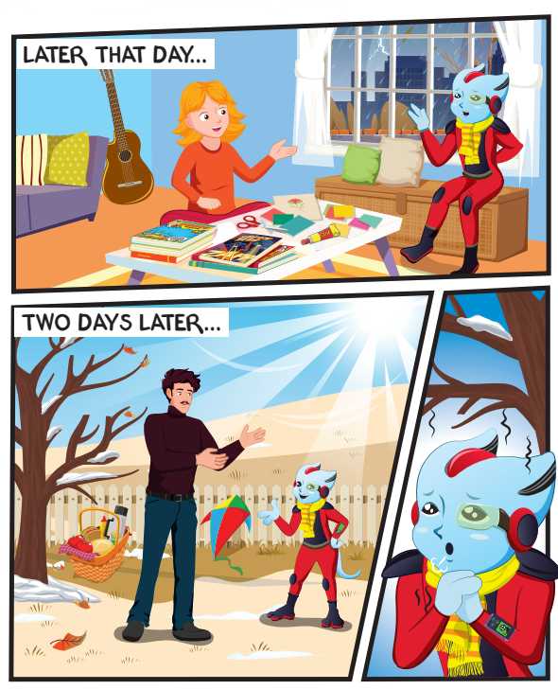
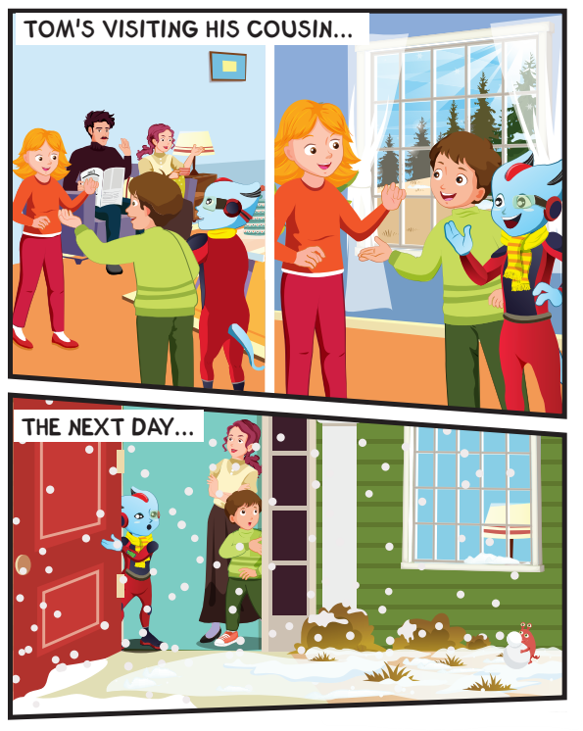

Slide 11

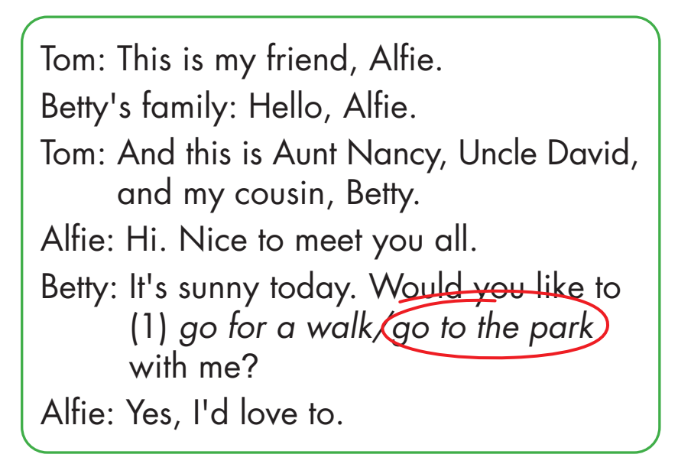

Slide 12

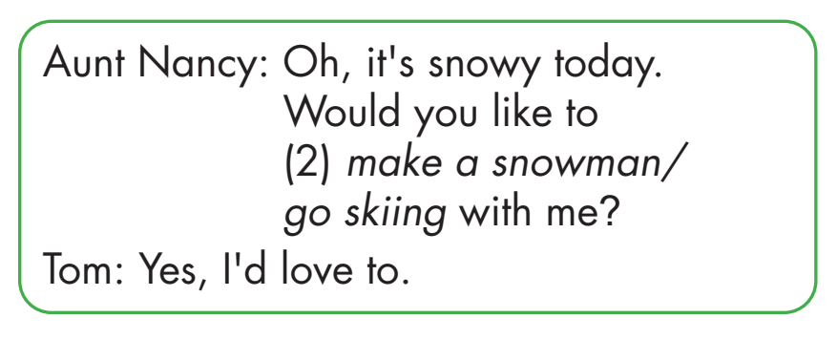

Slide 13

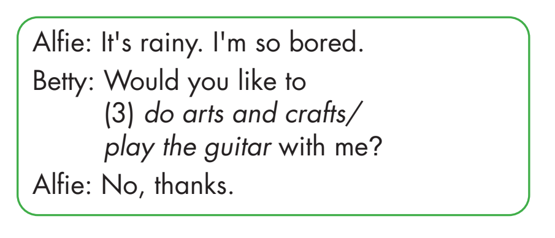
Click each English word to hear the sound.

Slide 14

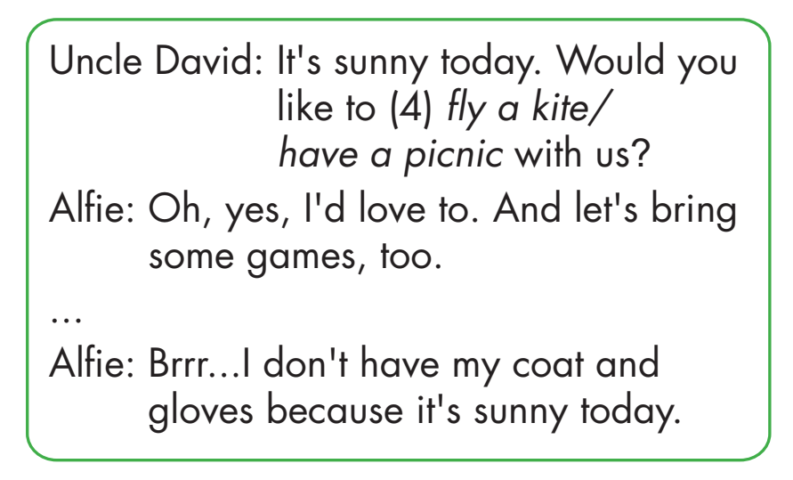
Click each English word to hear the sound.

Slide 15

Practice

Slide 16



Hey, it's snowy today.
No, thanks
Would you like to go skiing with me?

Slide 17
Oh, it’s sunny today.
Would you like to fly a kite with me?
Yes, I’d love to.
Let's go!

Slide 18
It's rainy. I'm so bored.
Would you like to do arts and crafts with me?
No, I don’t like it.

Slide 19
Dad, it's snowy today.
That's OK, let's go!
Would you like to make a snowman with me?

Slide 20

CONSOLIDATION

Slide 21
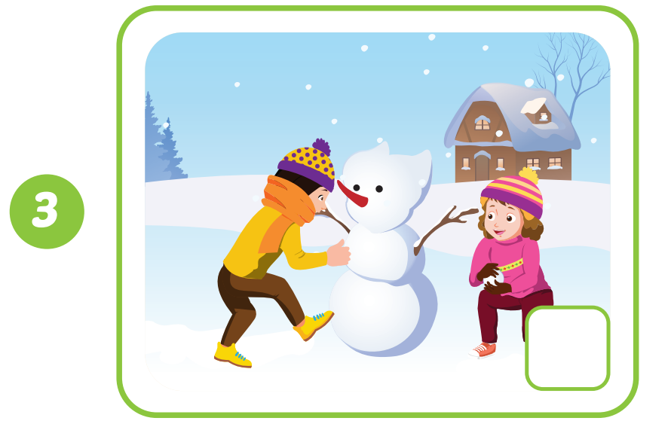
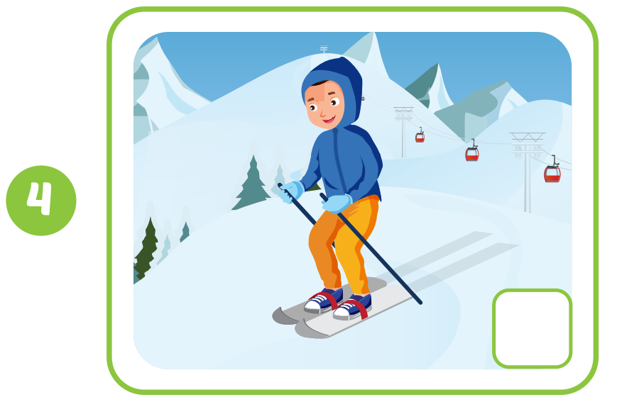

Click the earphone to hear the sound.

Slide 22

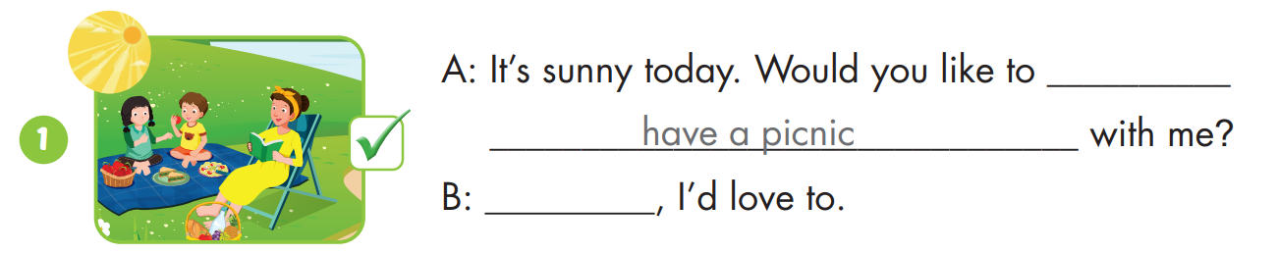
Yes

Slide 23
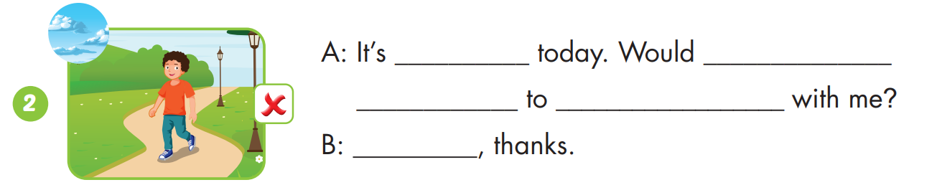
cloudy
you like
go for a walk
No

Slide 24
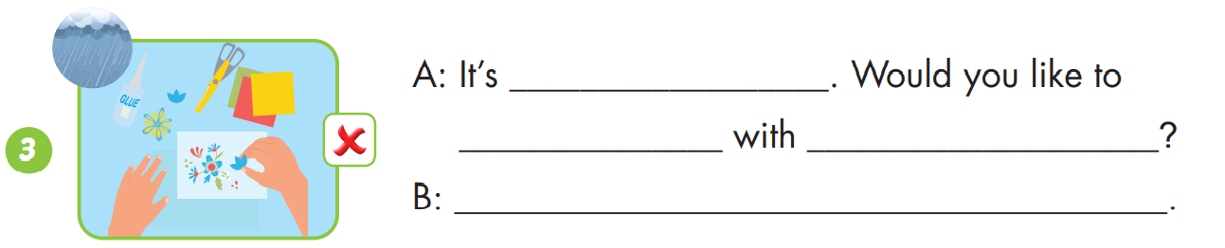
rainy
do arts and crafts
me
No, thanks

Slide 25
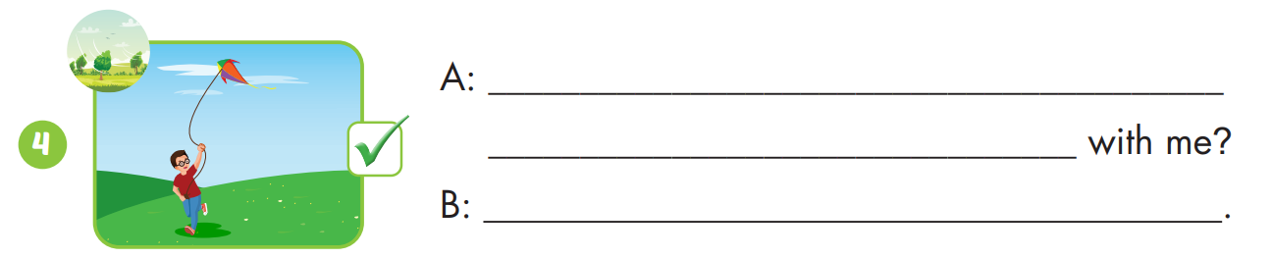
It’s windy. Would you like to fly a kite
Yes, I’d love to

Slide 26

WRAP-UP

Slide 27
Today’s lesson
Vocabularies
snowman, cousin.
Structures/ Sentence patterns
It's windy today.
Would you like to fly a kite with me?
Yes, I'd love to./ No, thanks.

Slide 28
Homework
Practice the vocabularies and structure; and make sentences using them.
Do the exercises in Tiếng Anh 4 i-Learn Smart Start WB (page 25).
Do the exercises in Tiếng Anh 4 i-Learn Smart Start Notebook (page 17).
Prepare the next lesson (page 39 SB).
Play the consolidation games in Tiếng Anh 4 i-Learn Smart Start DHA App on www.eduhome.com.vn

Slide 29

Have a nice day!

