Slide 1

Unit 3: WEATHER
Lesson 1.3
Page 36

Slide 2

Lesson Outline
Warm-up
Practice
Speaking
Consolidation
Wrap-up

Slide 3
Objectives
By the end of this lesson, students will be able to describe different types of weather.
Structure: What's the weather like today?
It’s cloudy./ It's rainy./It's snowy.

Slide 4

WARM UP

Slide 5
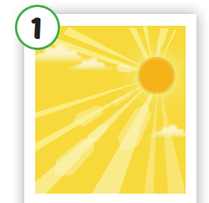




Click on the right word
A. rainy
B. cloudy
C. sunny

Slide 6
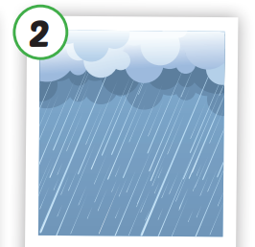
Click on the right word
A. snowy
B. rainy
C. foggy

Slide 7
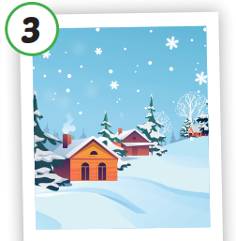
Click on the right word
A. cloudy
A. cloudy
B. sunny
B. sunny
C. snowy
C. snowy

Slide 8
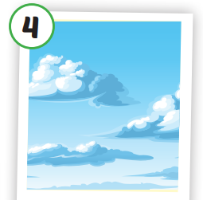
Click on the right word
A. rainy
B. cloudy
C. foggy

Slide 9
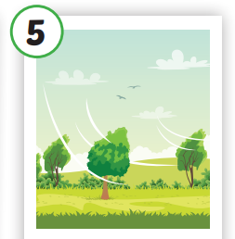
Click on the right word
A. rainy
B. windy
C. sunny

Slide 10

Click on the right word
A. snowy
B. sunny
C. foggy

Slide 11

Practice

Slide 12

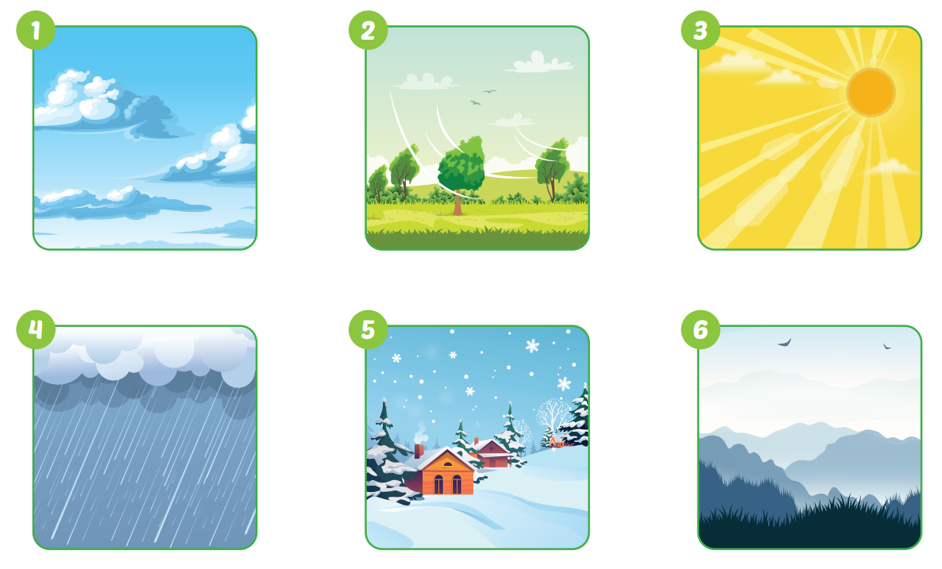
What's the weather like
today?
It's cloudy.

Slide 13

What's the weather like today?
It's cloudy.

Slide 14
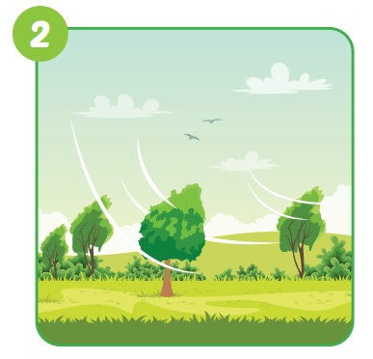
What's the weather like today?
It's windy.

Slide 15

What's the weather like today?
It’s sunny.

Slide 16
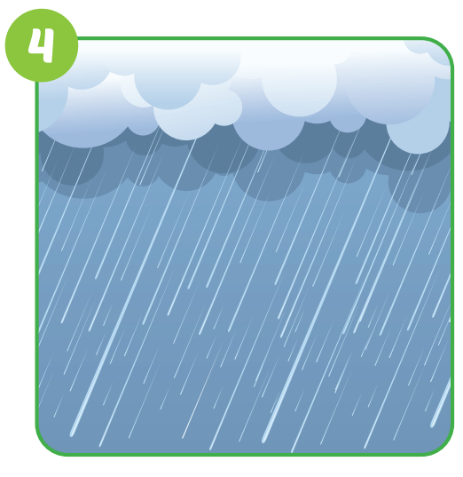
What's the weather like today?
It’s rainy.

Slide 17

What's the weather like?
It’s snowy.

Slide 18

What's the weather like?
It’s foggy.

Slide 19

Speaking

Slide 20

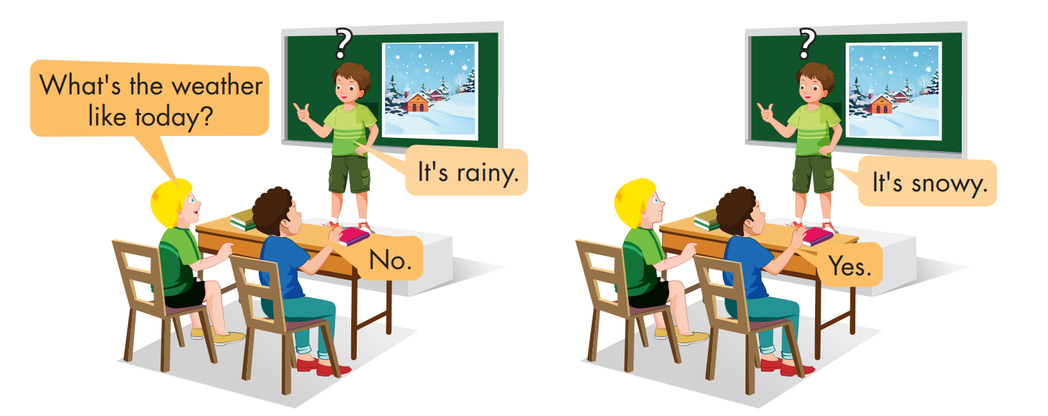

Slide 21

CONSOLIDATION

Slide 22

Choose a letter to fill in.
_ _ _ _ _ _
c l o u d
y
a
b
c
d
y
f
g
e
i
j
k
l
m

Slide 23
Choose a letter to fill in.
w
_ _ _ _ _
i n d y
a
b
c
d
e
o
g
l
i
j
k
w
m

Slide 24
Choose a letter to fill in.
u
s n n y
_ _ _ _ _
a
b
c
d
k
f
g
h
i
j
u
l
m

Slide 25
Choose a letter to fill in.
r i n y
a
_ _ _ _ _
n
b
c
d
e
f
g
h
i
j
k
l
a

Slide 26
Choose a letter to fill in.
It’s snowy.
s o w y
n
_ _ _ _ _
a
b
c
d
k
f
g
h
i
j
n
l
m

Slide 27
Choose a letter to fill in.
f g g y
o
_ _ _ _ _
n
b
c
d
a
f
g
h
i
j
k
l
o

Slide 28

WRAP-UP

Slide 29
Lesson 3
Today’s lesson
Vocabularies
rainy, snowy.
Structures/ Sentence patterns
What's the weather like today?
It's sunny.

Slide 30
Lesson 3
Homework
Practice the vocabularies and structure; and make sentences using them.
Do the exercises in Tiếng Anh 4 i-Learn Smart Start WB (page 23).
Prepare the next lesson (page 37 SB).
Play the consolidation games in Tiếng Anh 4 i-Learn Smart Start DHA App on www.eduhome.com.vn

Slide 31

Have a nice day!

