Slide 1

Unit 3: WEATHER
Lesson 1.2
Page 35

Slide 2
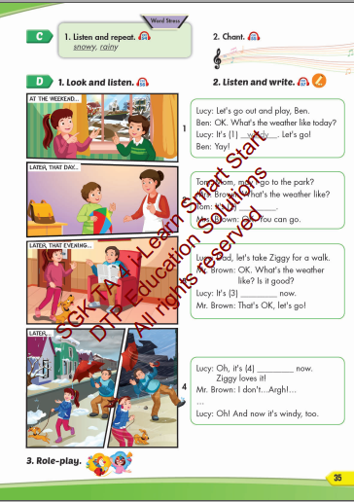
Lesson Outline
Warm-up
Listening
Consolidation
Wrap-up

Slide 3
Objectives
By the end of this lesson, students will be able to pronounce the vocabulary about the weather; listen, write and practice the dialogues.
Vocabulary: rainy, snowy.
Structure: What's the weather like today?
It's sunny.

Slide 4

WARM UP

Slide 5

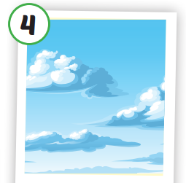
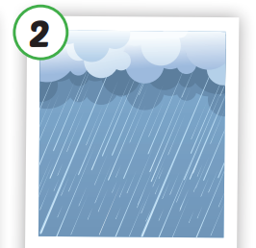
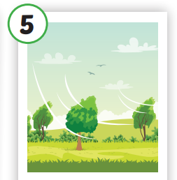
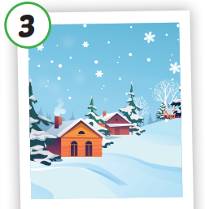

1
4
6
1
2
SPIN
5
5
2
3
4
3
6

Slide 6
Unscramble the letters.
sunny
1
s
n
y
n
u
rainy
2
i
a
r
n
y
cloudy
3
o
l
y
d
c
u
windy
4
i
n
d
y
w
foggy
5
g
g
y
f
o
snowy
5
w
n
y
o
s

Slide 7

It’s time to learn …

Slide 8

Phonics

Slide 9




Click each English word to hear the sound.
rainy
snowy

Slide 10


Click the earphone to hear the sound.
/ What's the weather like today?/
It’s snowy, today.
It’s snowy.
It’s snowy.
/ What's the weather like today?/
It’s snowy, today.

Slide 11

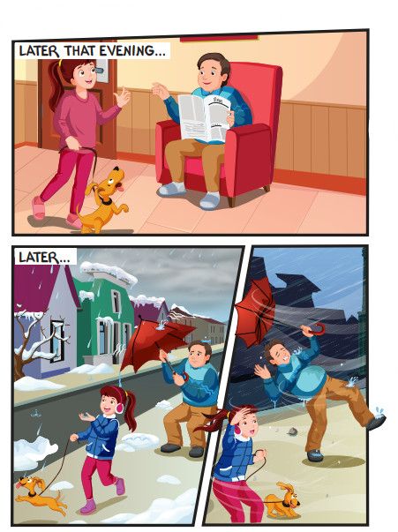
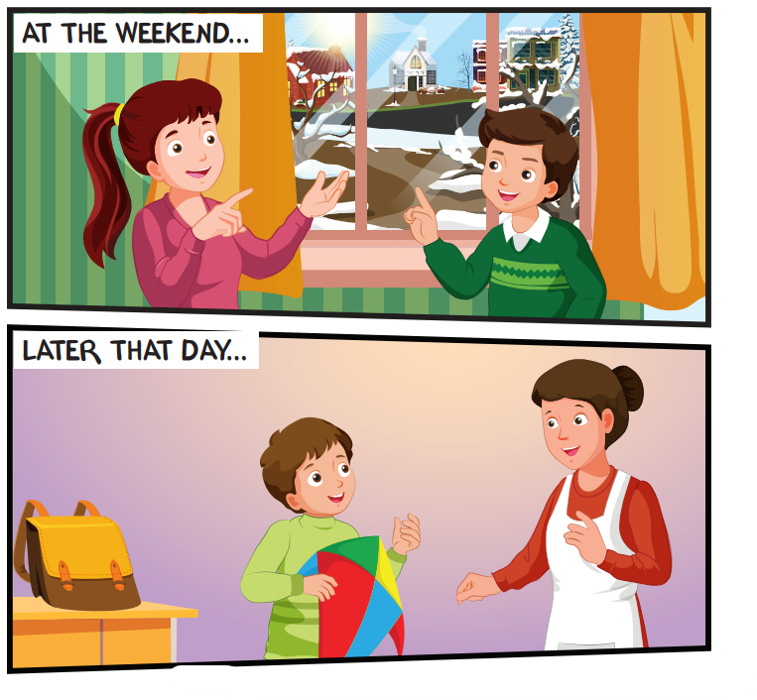

Slide 12

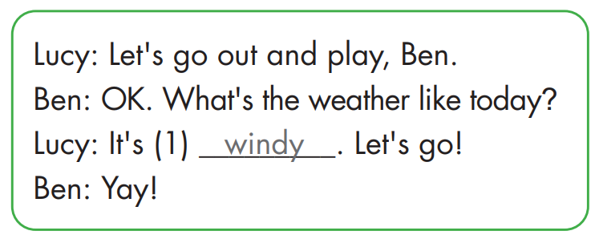
windy

Slide 13
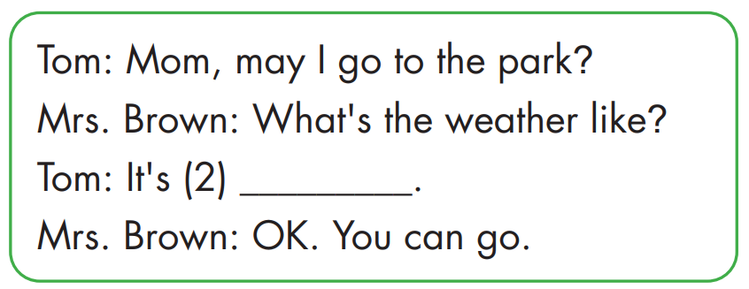
sunny

Slide 14
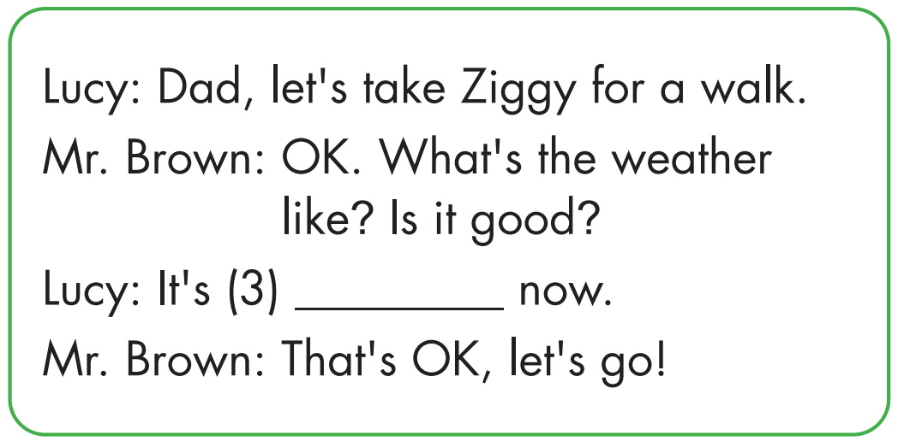
snowy

Slide 15
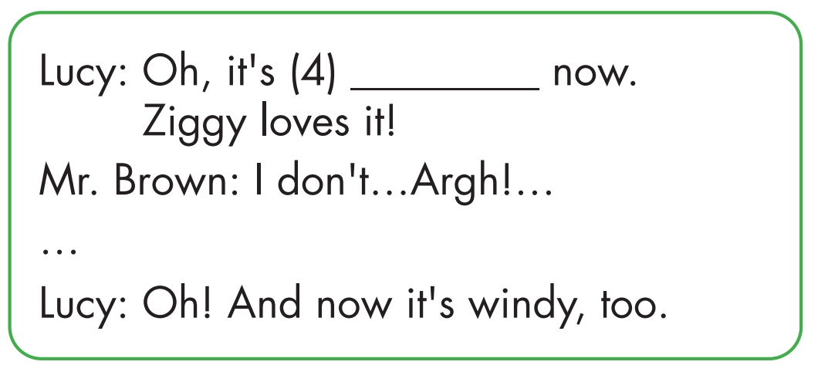
Click each English word to hear the sound.
rainy

Slide 16

Practice

Slide 17



Let's go out and play, Ben.
OK. What's the weather like today?
It’s windy. Let's go!
Yay!

Slide 18
Mom, may I go to the park?
What's the weather like?
It’s sunny.
OK. You can go.

Slide 19
Dad, let's take Ziggy for a walk.
OK. What's the weather
like? Is it good?
It’s snowy now.
That's OK, let's go!

Slide 20
Oh, it’s rainy now.
Ziggy loves it!
I don't…Argh!…
Oh! And now it's windy, too.

Slide 21

CONSOLIDATION

Slide 22
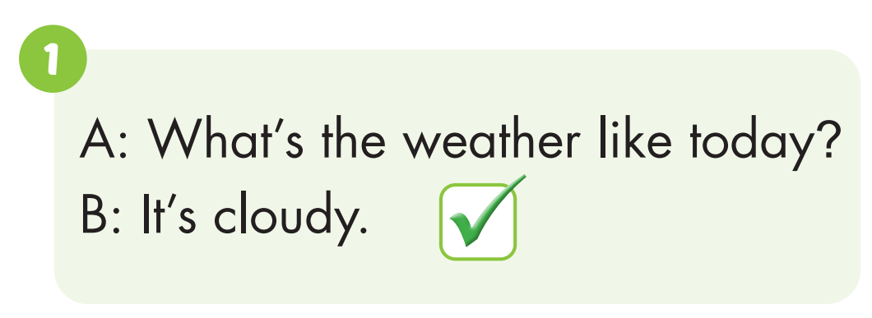
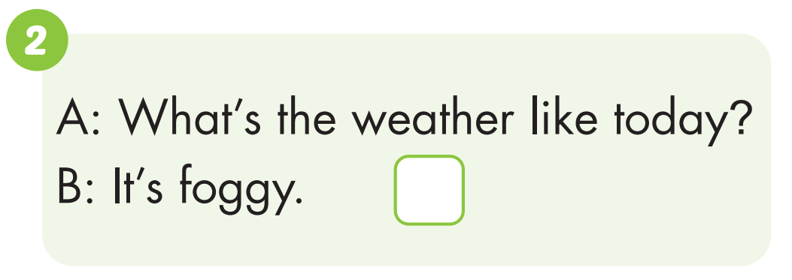

Click the earphone to hear the sound.

Slide 23
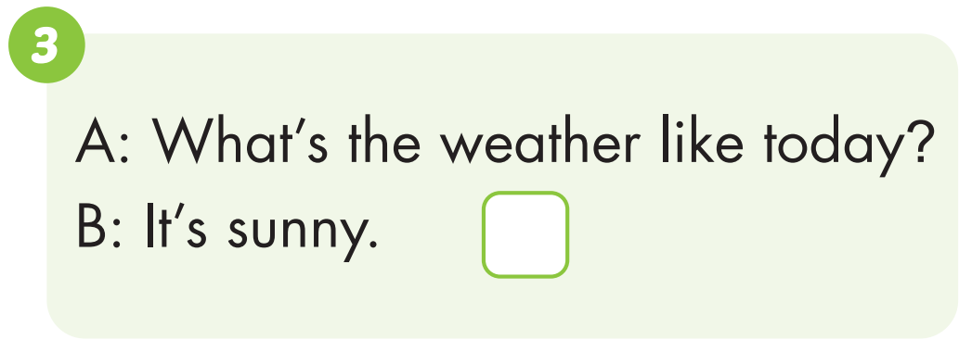
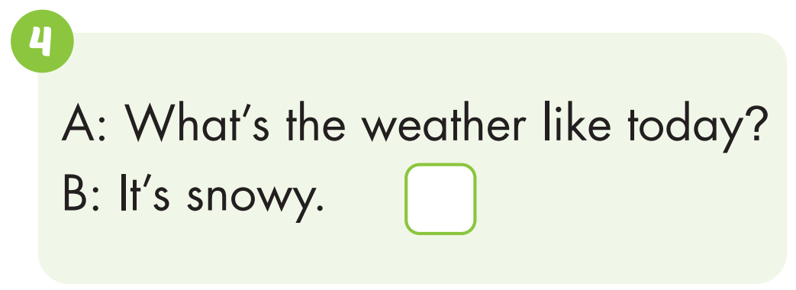

Click the earphone to hear the sound.

Slide 24

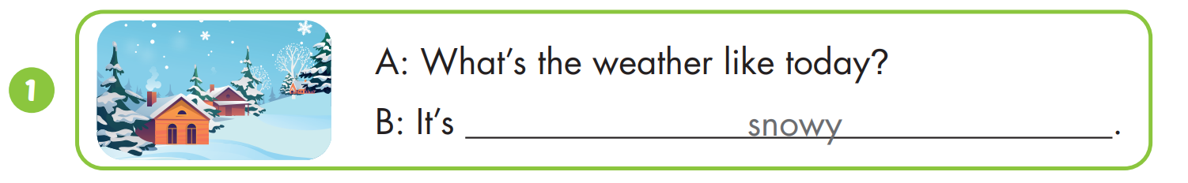
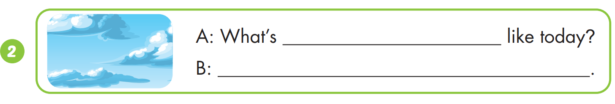
snowy
the weather
It’s cloudy.

Slide 25
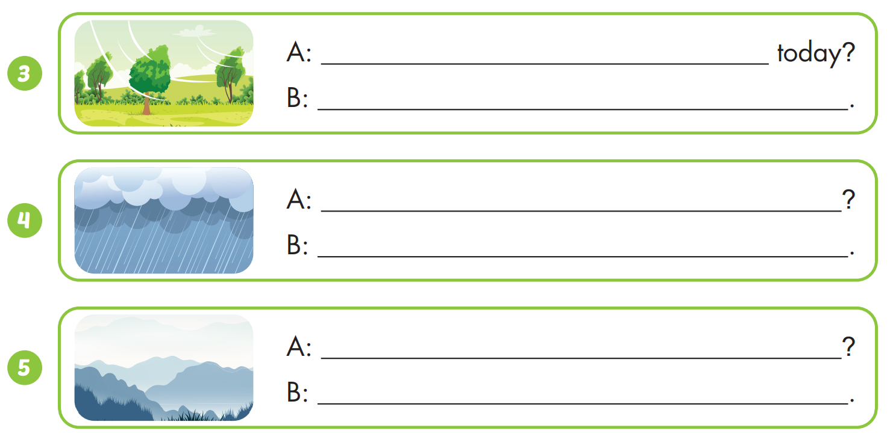
What’s the weather like
It’s windy.
What’s the weather like today
It’s rainy.
What’s the weather like today
It’s foggy.

Slide 26

WRAP-UP

Slide 27
Today’s lesson
Vocabularies
rainy, snowy.
Structures/ Sentence patterns
What's the weather like today?
It's sunny.

Slide 28
Homework
Practice the vocabularies and structure; and make sentences using them.
Do the exercises in Tiếng Anh 4 i-Learn Smart Start WB (page 23).
Do the exercises in Tiếng Anh 4 i-Learn Smart Start WB (page 16).
Prepare the next lesson (page 36 SB).
Play the consolidation games in Tiếng Anh 4 i-Learn Smart Start DHA App on www.eduhome.com.vn

Slide 29

Have a nice day!

