Slide 1

Unit 4: ACTIVITIES
Lesson 3
Page 55

Slide 2
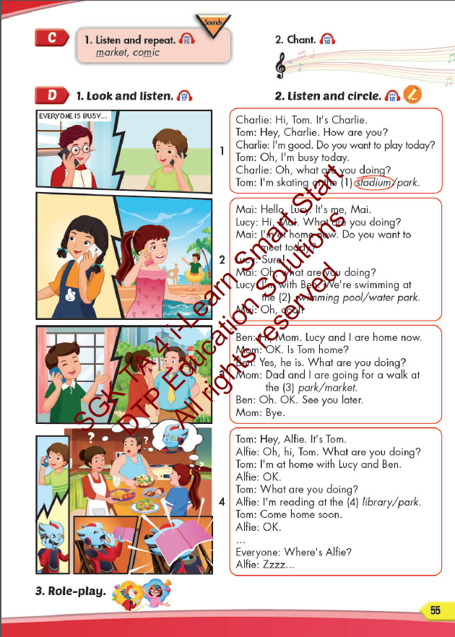
Lesson Outline
Warm-up
Listening
Consolidation
Wrap-up

Slide 3
Objectives
By the end of this lesson, students will be able to pronounce the sound /m/; and practice asking and answering what they are doing at some different places.
Vocabulary: library, stadium, park, water park, market, swimming pool.
Structure:
What are you doing?
I’m swimming at the pool.
What are you doing?
We are reading at the library.
Phonics: /m/, market, comic.

Slide 4

It’s time to learn …

Slide 5

Phonics
/m/

Slide 6
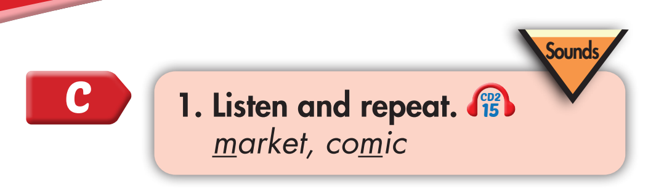
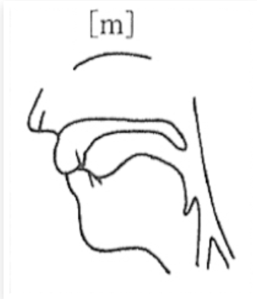

m, m, market
m, m, comic

Slide 7

I’m reading a comic book at home
What are you doing, Lucy?
I’m reading a comic book at home.
What are you doing, Tom?
I’m swimming the swimming pool.
What are you doing, Mom and Dad?
We’re walking at the market.
Notes:
1. Listen.
2. Listen and chant.

Slide 8

Listen. Hop and repeat when you hear /m/ sound.
Notes:
T says
Chess
Market
Comic
Library
Park
Swimming pool
Stadium
music

Slide 9

Listening

Slide 10

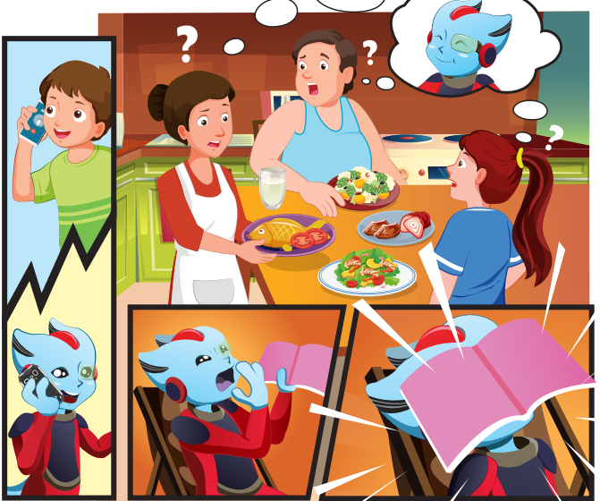

Slide 11

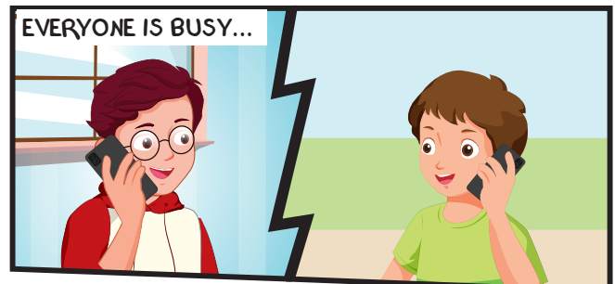
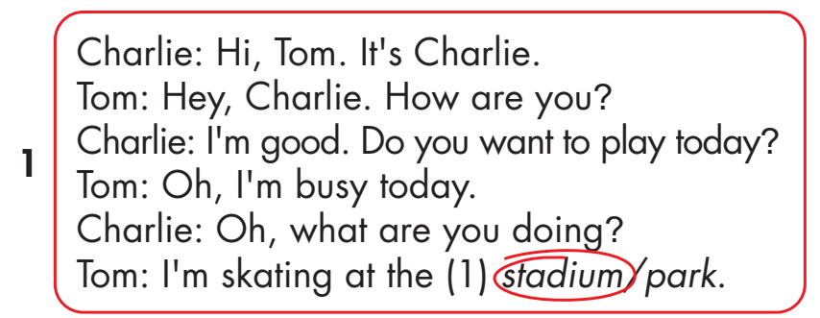
Click on the headphone icon to hear the sound.
Click on number 1
to show the answer.

Slide 12
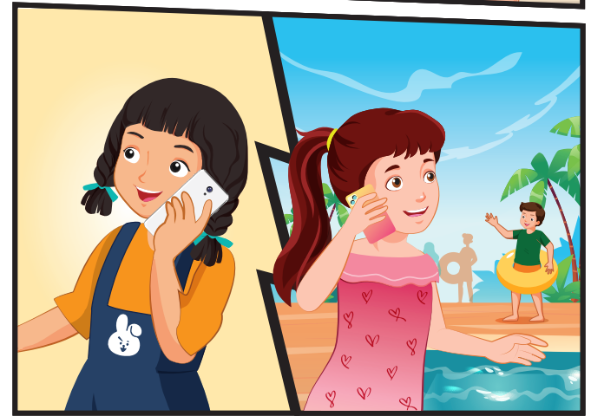
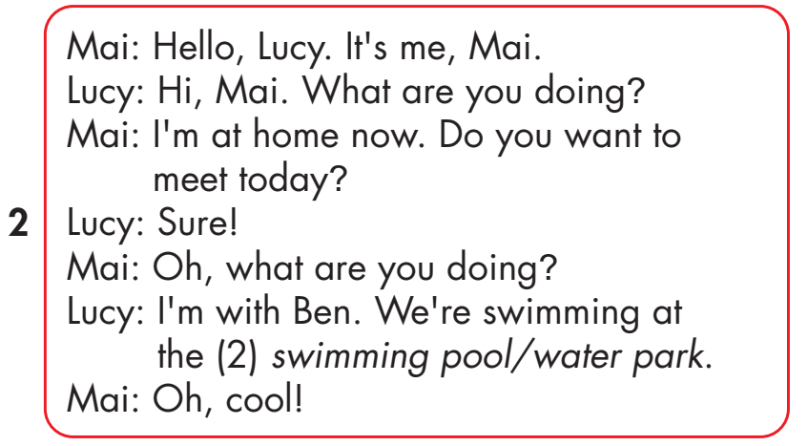
Click on the headphone icon to hear the sound.
Click on number 2
to show the answer.

Slide 13
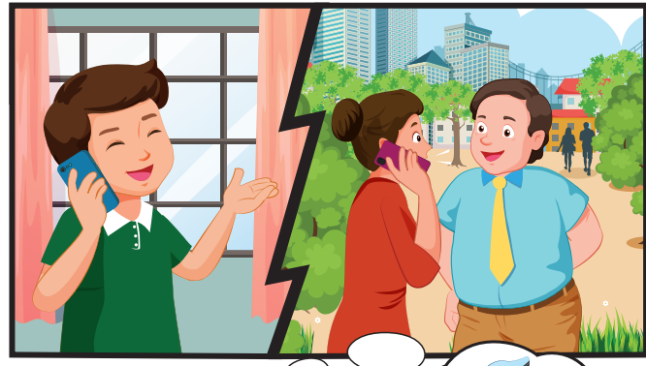
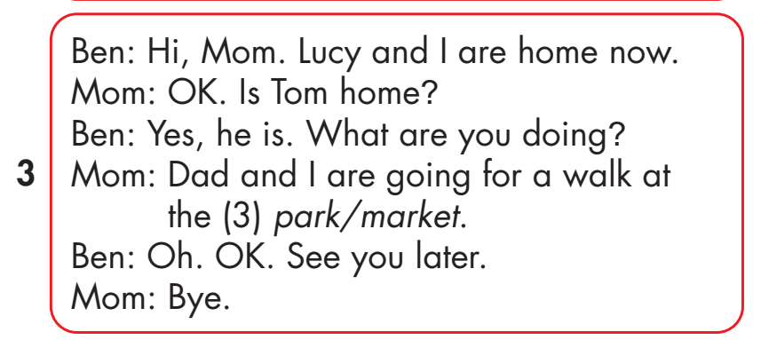
Click on the headphone icon to hear the sound.
Click on number 3
to show the answer.

Slide 14
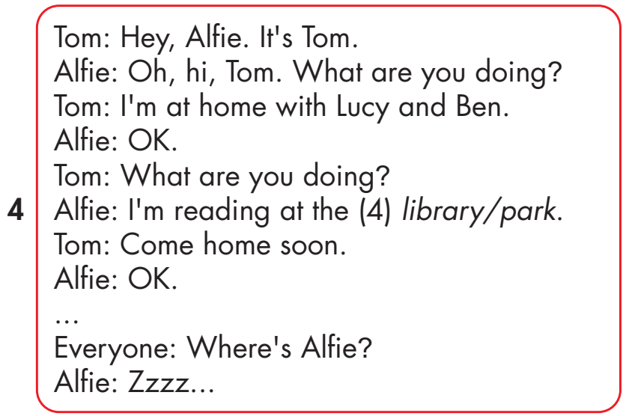
Click on the headphone icon to hear the sound.
Click on number 4
to show the answer.

Slide 15

Practice

Slide 16
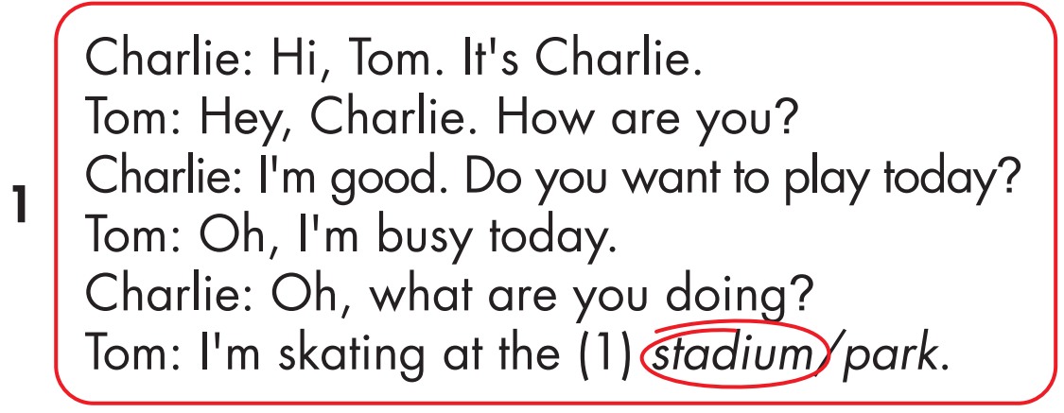

Slide 20


Slide 21

CONSOLIDATION

Slide 22

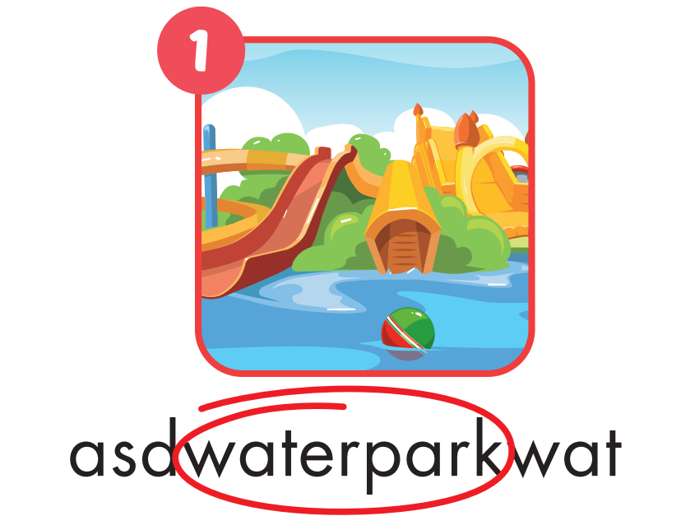
Notes:
WB page 32

Slide 23

Notes:
WB page 32

Slide 24

Notes:
WB page 32

Slide 25

Notes:
WB page 32

Slide 26

Notes:
WB page 32

Slide 27

Notes:
WB page 32

Slide 28

WRAP-UP

Slide 29
Today’s lesson
Vocabularies
library, stadium, park, water park, market, swimming pool.
Structures/ Sentence patterns
What are you doing?
I’m swimming at the pool.
What are you doing?
We are reading at the library.

Slide 30
Homework
Practice the vocabularies and structure, and make sentences using them.
Do the exercises in Tiếng Anh 4 i-Learn Smart Start WB (page 37)
Do the exercises in Tiếng Anh 4 i-Learn Smart Start Notebook (page 24).
Prepare the next lesson (page 56 SB)
Play the consolidation games in Tiếng Anh 4 i-Learn Smart Start DHA App on www.eduhome.com.vn

Slide 31

Lesson 3
Stay positive and have a nice day!

