Slide 1

Unit 4: ACTIVITIES
Lesson 3
Page 54

Slide 2
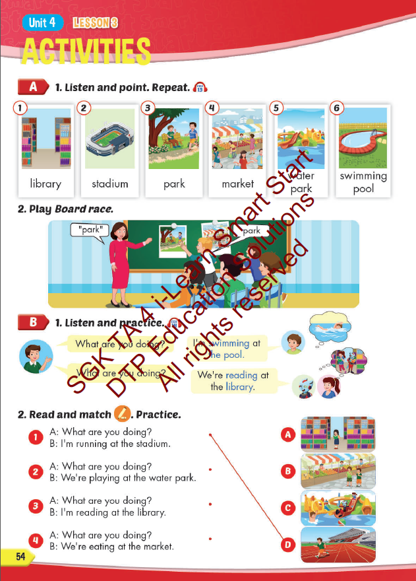
Lesson Outline
Warm-up
Vocabulary
Structure
Consolidation
Wrap-up

Slide 3
Objectives
By the end of this lesson, students will be able to learn vocabulary and structure to talk about what they are doing.
Vocabulary: library, stadium, park, water park, market, swimming pool.
Structure:
What are you doing?
I’m swimming at the pool.
What are you doing?
We are reading at the library.

Slide 4

WARM UP

Slide 5



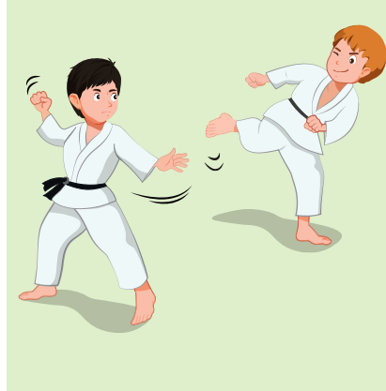
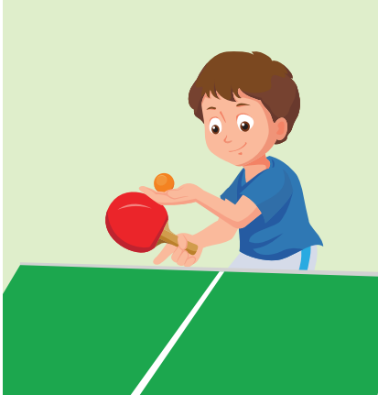
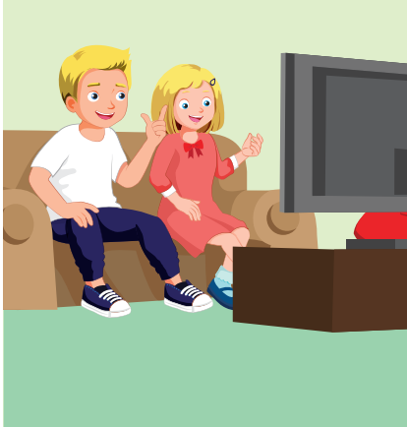
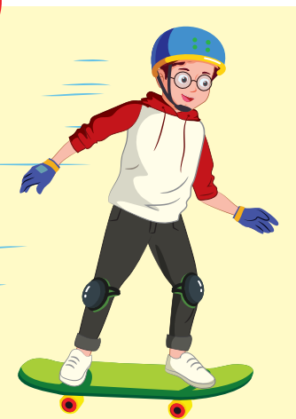
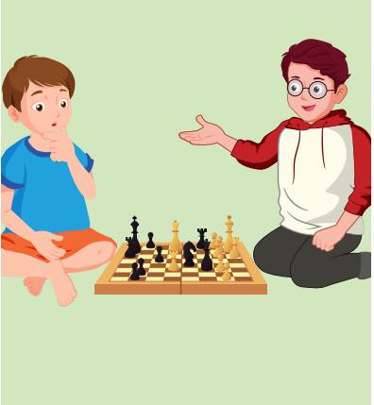
Listen and choose.
REVIEW 1
GREAT
Click the headphone icon to hear the sound.

Slide 6
Listen and choose.
REVIEW 1
GREAT
Click the headphone icon to hear the sound

Slide 7
Listen and choose.
REVIEW 1
GREAT

Slide 8
Listen and choose.
REVIEW 1
GREAT
Click the headphone icon to hear the sound

Slide 9
Listen and choose.
REVIEW 1
GREAT
Click the headphone icon to hear the sound

Slide 10

It’s time to learn …

Slide 11

New words
park, market
library, stadium
water park
swimming pool

Slide 12

Presentation

Slide 13

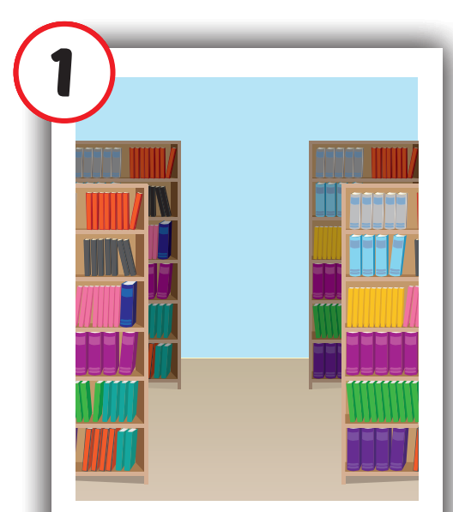
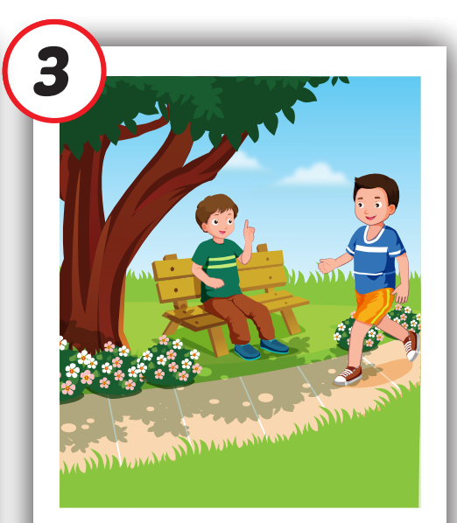
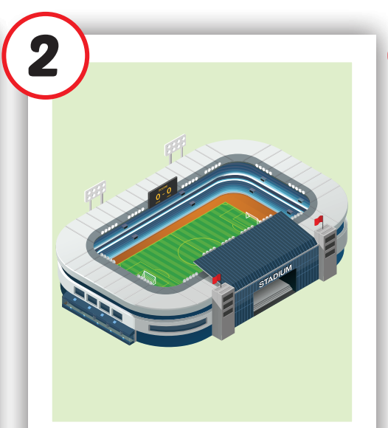
Click on each English word to hear the sound.
library
stadium
park
/ˈlaɪbreri/
thư viện
/ˈsteɪdiəm/
sân vận động
/pɑːrk/ công viên

Slide 14

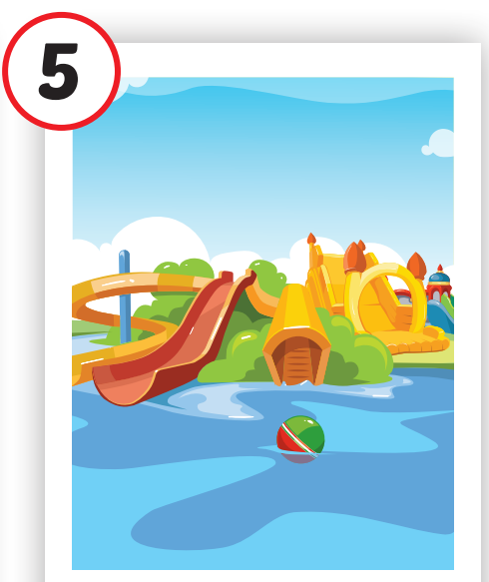
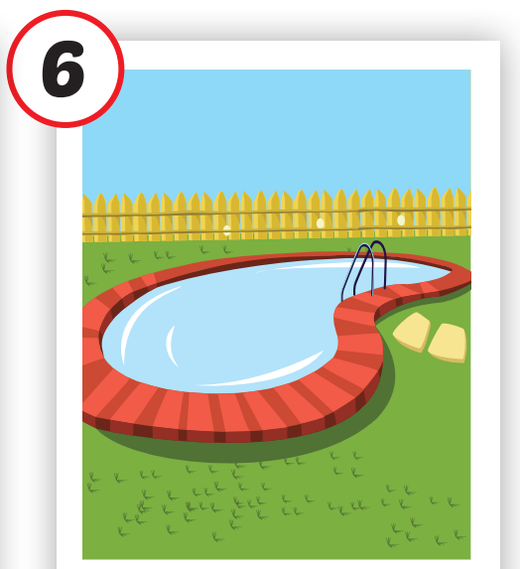
Click on each English word to hear the sound.
swimming
pool
market
water park
/ˈmɑːrkɪt/ chợ
/ˈwɑːtər ˌpɑːrk/
công viên nước
/ˈswɪmɪŋ ˌpuːl/ bể bơi

Slide 15

Practice

Slide 16
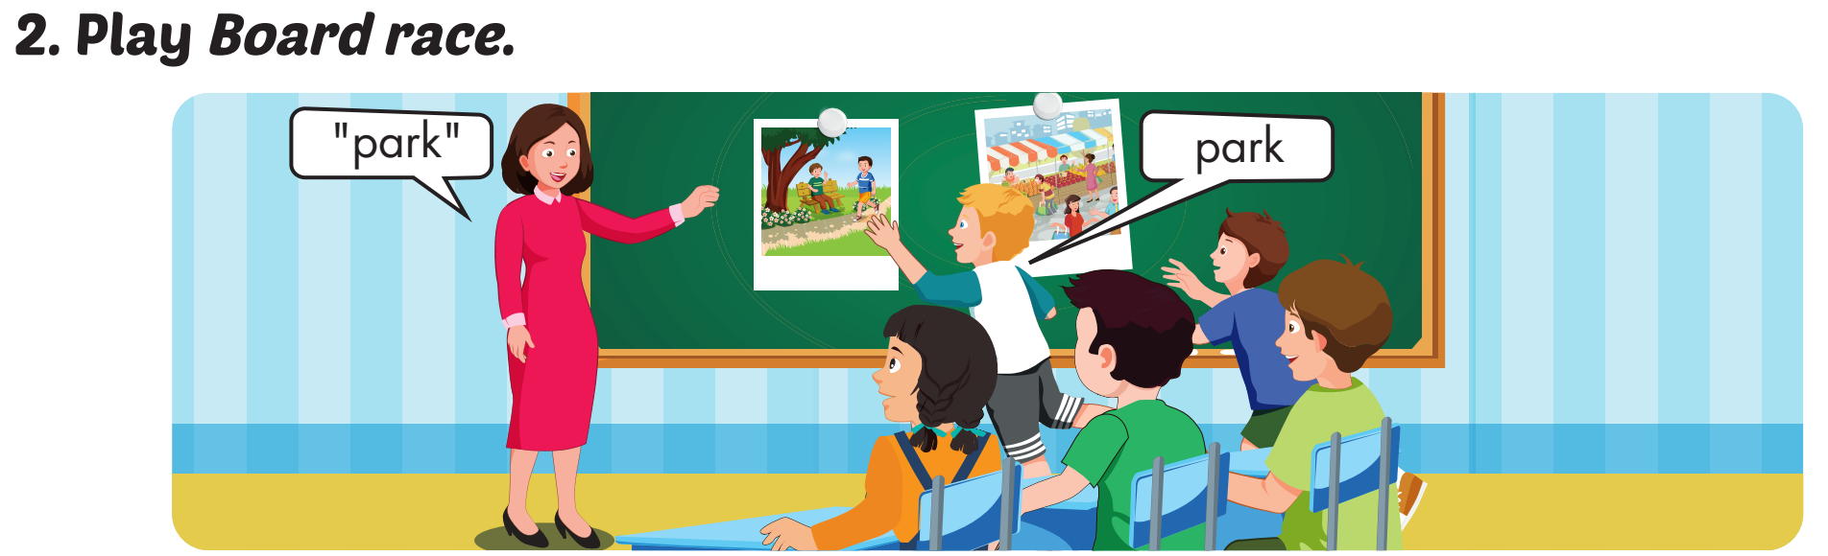

Slide 17

WHAT IS IN THE CLOCK?
HOW TO PLAY
Press START to play.
Click CHECK to show the answer.

Slide 18

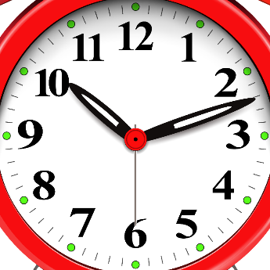

START
CHECK

Slide 19
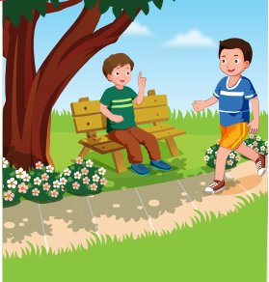
START
CHECK

Slide 20
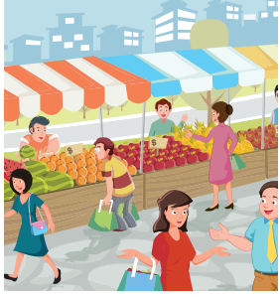
START
CHECK

Slide 21
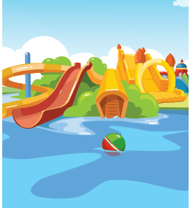
START
CHECK

Slide 22
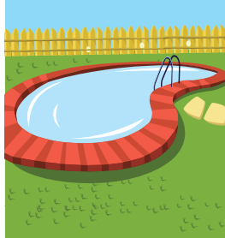
START
CHECK

Slide 23

START
CHECK

Slide 24
WHAT’S MISSING?
stadium
market
swimming pool
library
library
water park
water park
water park
market
library
swimming pool
swimming pool
stadium
water park
market
water park
market
library
stadium
library
swimming pool
stadium
swimming pool

Slide 25
Structures
What are you doing? – I’m swimming at the pool.
What are you doing? – We’re swimming at the library.

Slide 26
Presentation

Slide 27
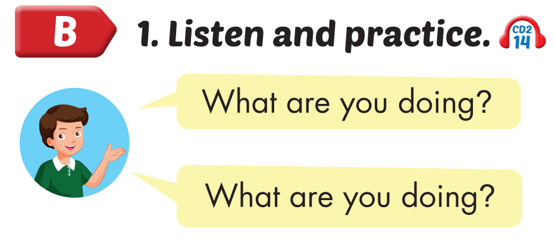
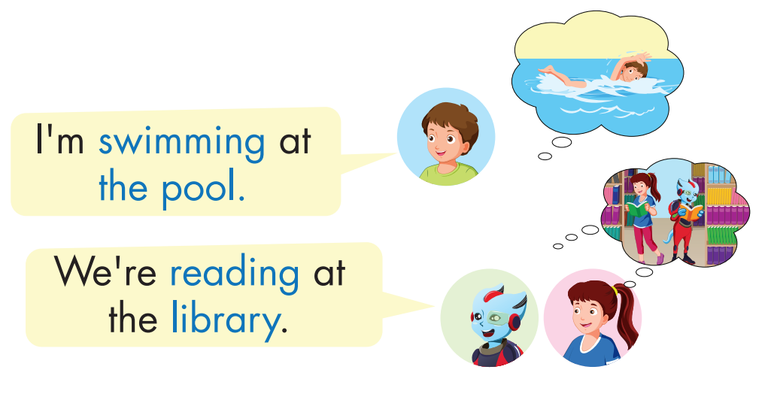
Click on the headphone icon to hear the sound.

Slide 28
Practice

Slide 29



What are you doing?
I’m reading books at the library.

Slide 30
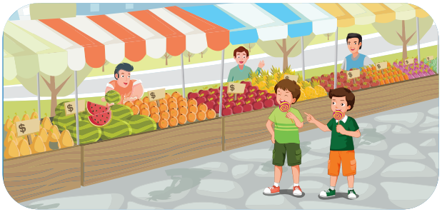
What are you doing?
We’re eating at the market.

Slide 31
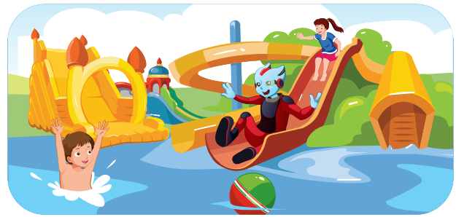
What are you doing?
I’m playing at the water park.

Slide 32
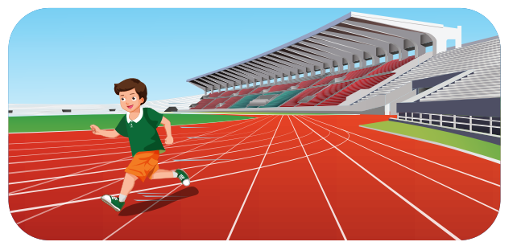
What are you doing?
I’m running at the stadium.

Slide 33

CONSOLIDATION

Slide 34
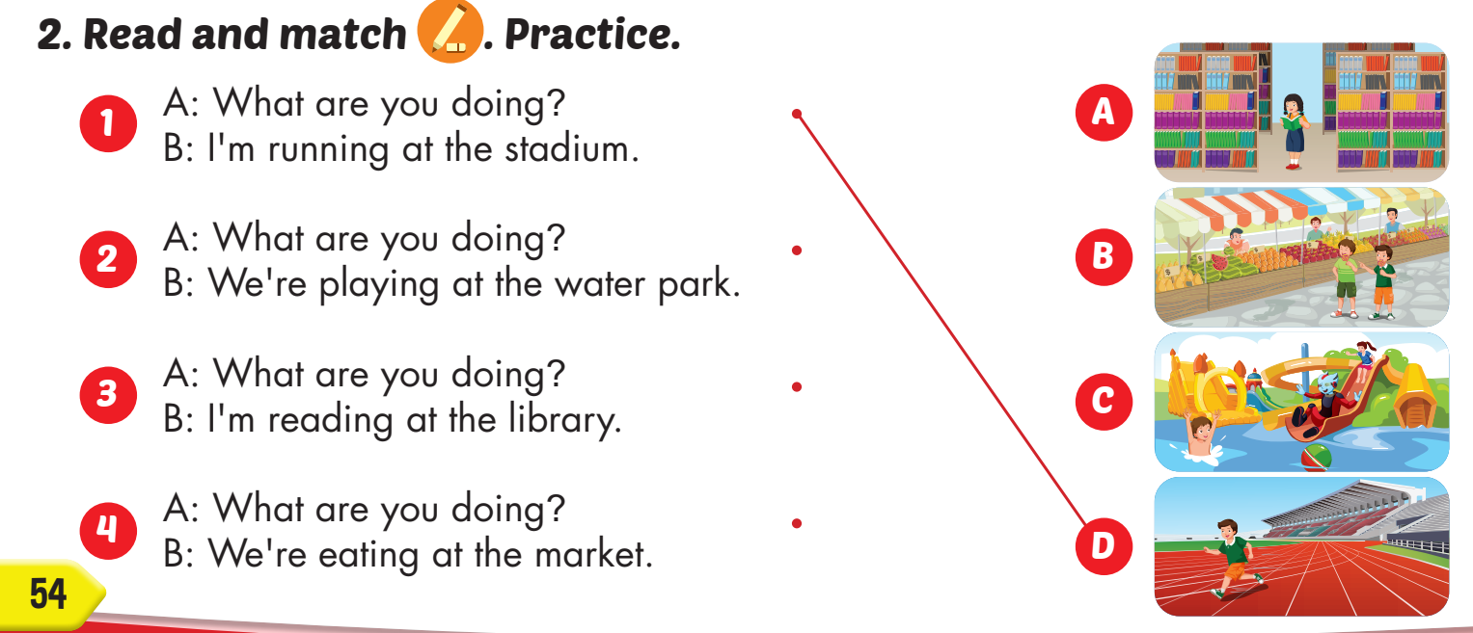

Slide 35

WRAP-UP

Slide 36
Today’s lesson
Vocabularies
library, stadium, park, water park, market, swimming pool.
Structures/ Sentence patterns
What are you doing?
I’m swimming at the pool.
What are you doing?
We are reading at the library.

Slide 37
Homework
Practice the vocabulary and structure, and make sentences using them.
Do the exercises in Tiếng Anh 4 i-Learn Smart Start WB (page 36)
Do the exercises in Tiếng Anh 4 i-Learn Smart Start Notebook (page 24).
Prepare the next lesson (page 49 SB)
Play the consolidation games in Tiếng Anh 4 i-Learn Smart Start DHA App on www.eduhome.com.vn

Slide 38
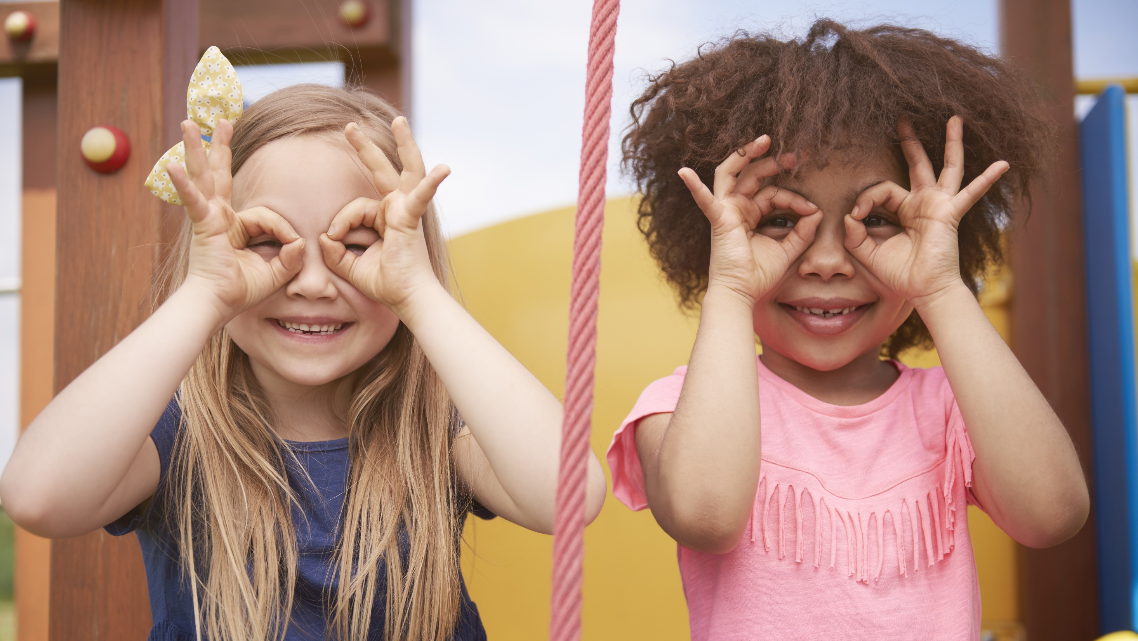
Enjoy your day!

