Slide 1
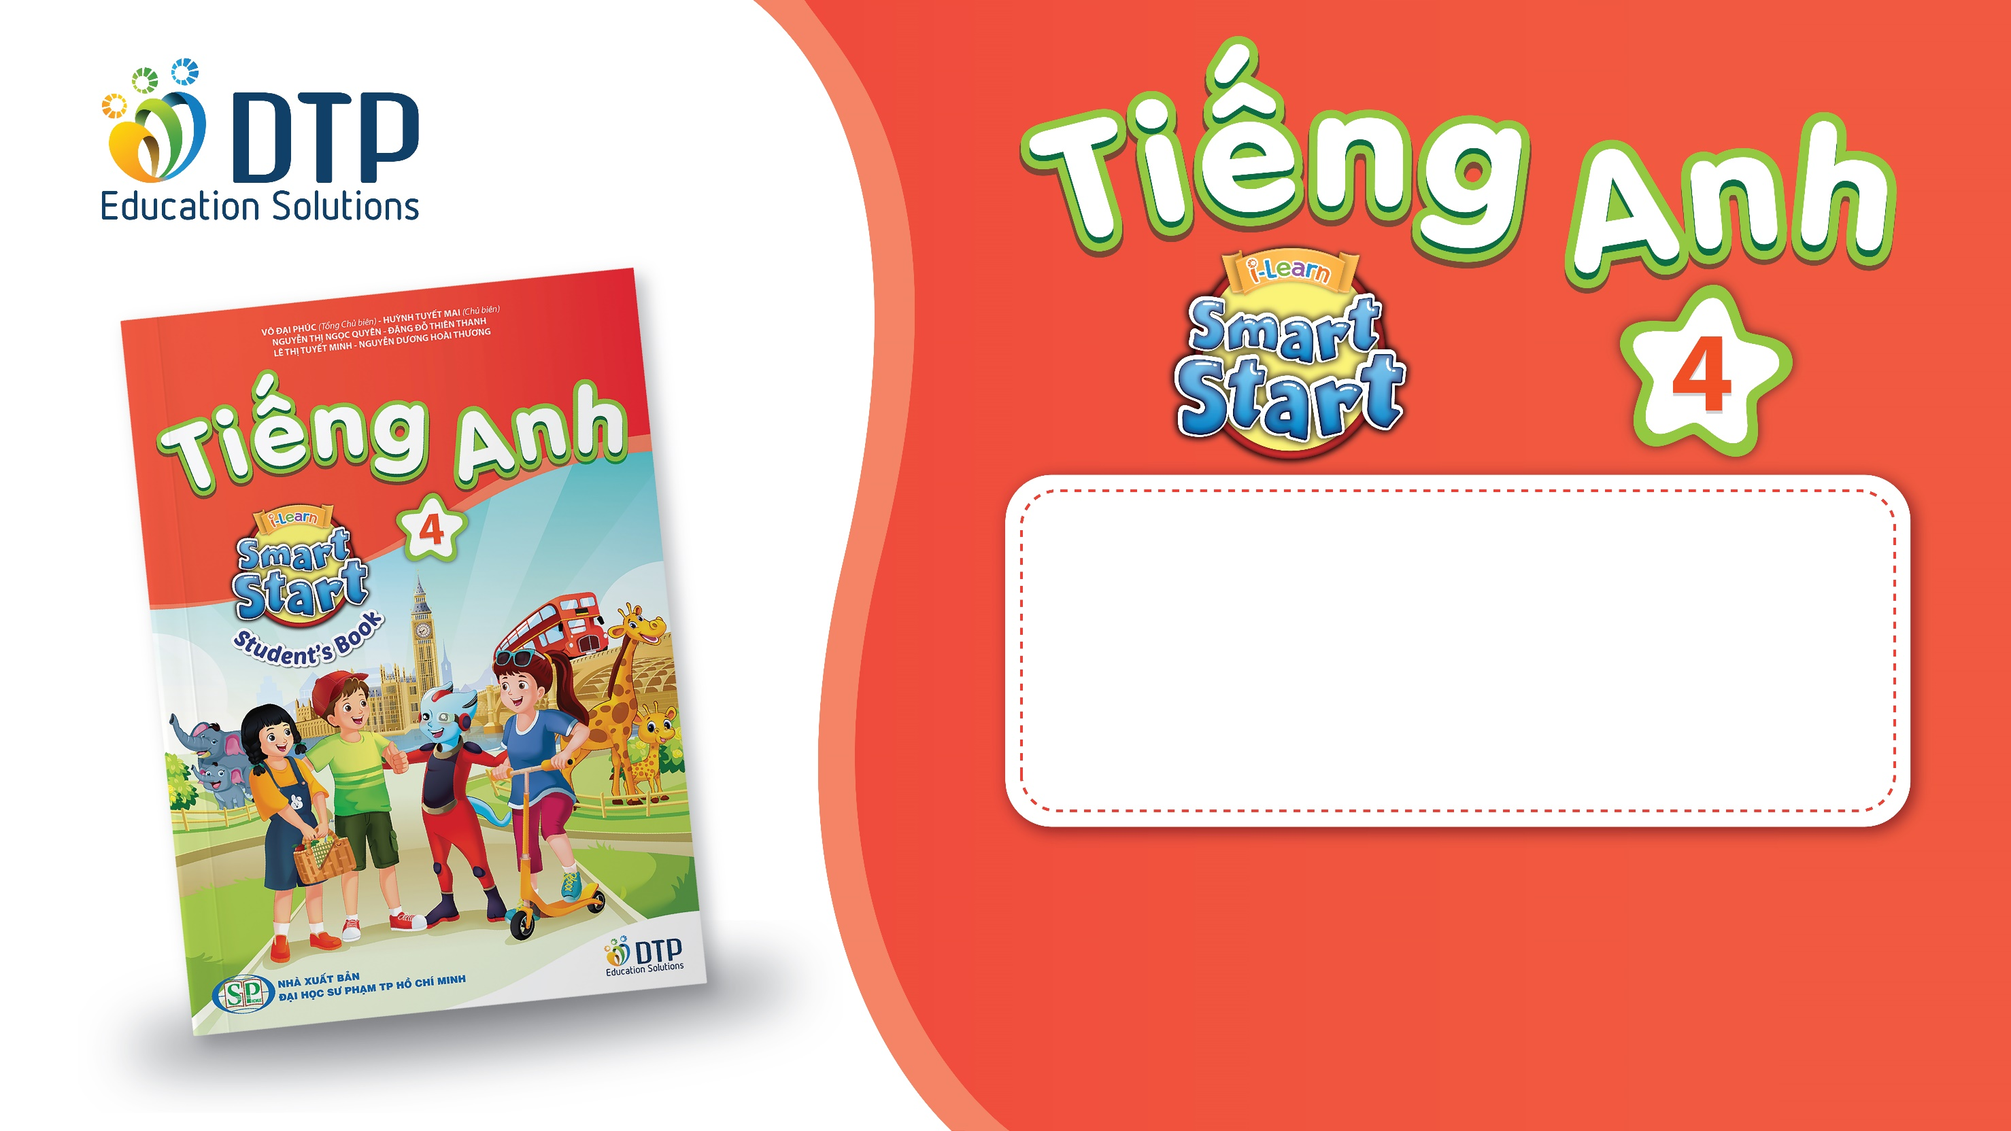
Unit 4: ACTIVITIES
Lesson 2.3
Page 53

Slide 2
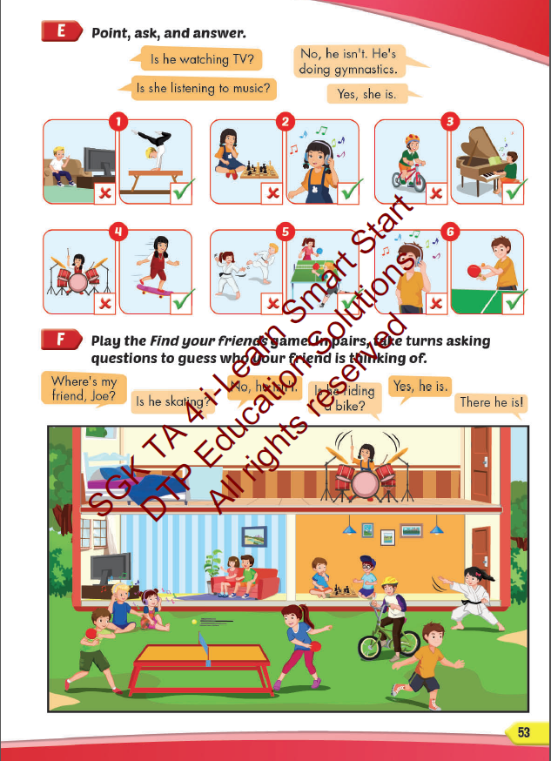
Lesson Outline
Warm-up
Practice
Speaking
Consolidation
Wrap-up

Slide 3
Objectives
By the end of this lesson, students will be able to ask and answer about what people are doing.
Vocabulary: listen to music, watch television, play table tennis, do martial arts, skate, play chess.
Structure:
Is he playing chess?
– Yes, he is.
Are they doing martial arts?
- No, they aren’t. They’re skating.

Slide 4

WARM UP

Slide 5

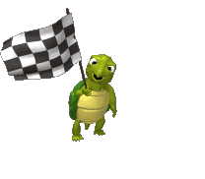



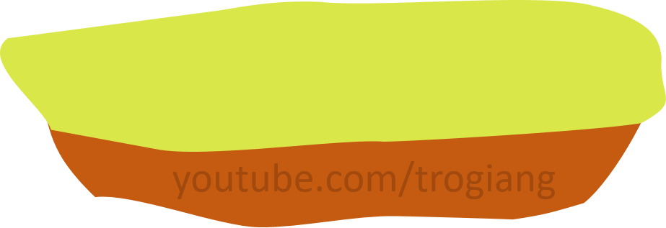

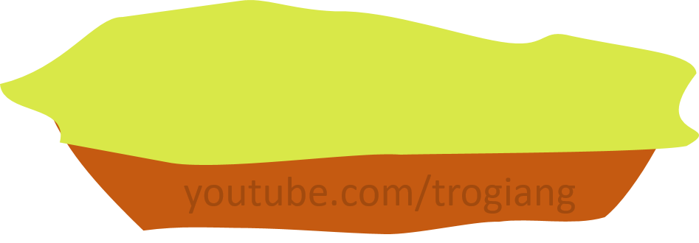


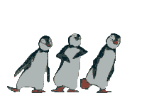
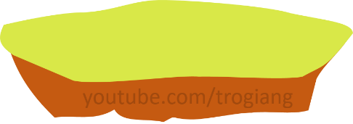
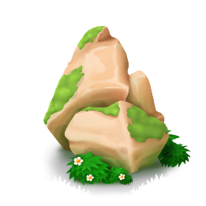

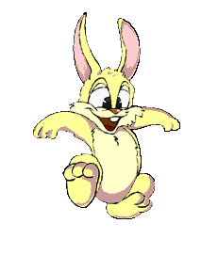

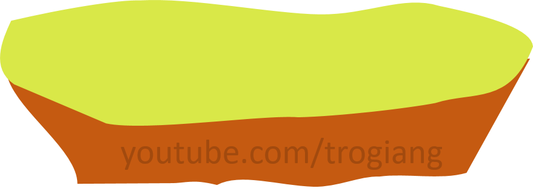


5
CONGRATULATIONS TIGER TEAM
5
CONGRATULATIONS RABBIT TEAM
4
4
3
3
2
2
overtop
1
1
Notes:
T divides Ss into 2 teams.
Each team has a leader.
Team leaders have to play Rock, Scissors, Paper for each question.
The winner will get a turn to answer the question.
Ss can step once for a correct answer.

Slide 6
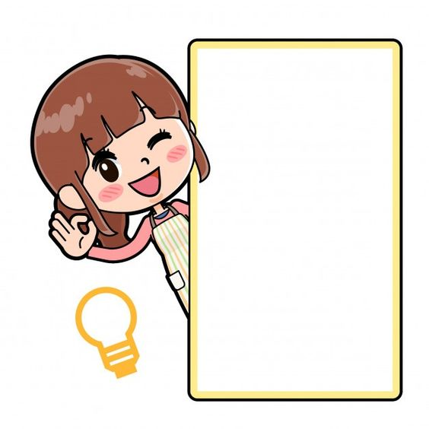
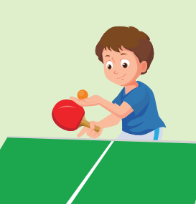

Click on each sentence to check the correct answer.
Is he playing table tennis?
1
A
Yes, he does.
B
Yes, he is.
C
Yes, he isn’t .

Slide 7
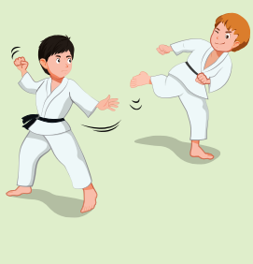
Click on each sentence to check the correct answer.
Are they watching television?
2
A
Yes, they are.
B
No, they aren’t.
C
No, they do.

Slide 8
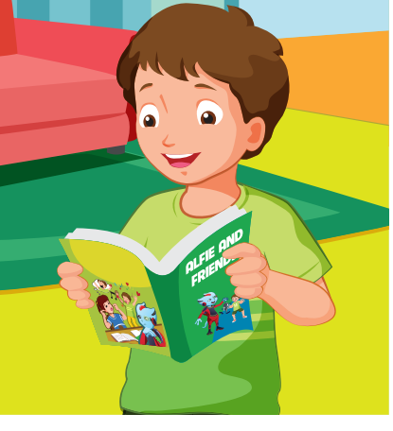
Click on each sentence to check the correct answer.
Are you playing video games?
3
A
No, he isn’t. He’s reading a comic book.
B
Yes, I am.
C
No, I’m not. I’m reading a comic book.

Slide 9
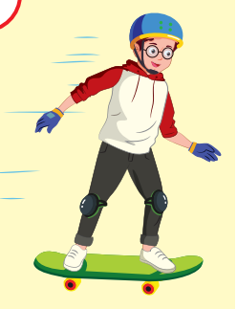
Click on each sentence to check the correct answer.
Is he playing chess?
4
A
Yes, he is.
B
No, he isn’t.
C
Yes, I am.

Slide 10
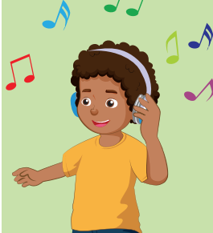
Click on each sentence to check the correct answer.
Is he listening to music?
5
A
Yes, he is.
B
Yes, he isn’t.
C
Yes, he does.

Slide 11

It’s time to learn …

Slide 12
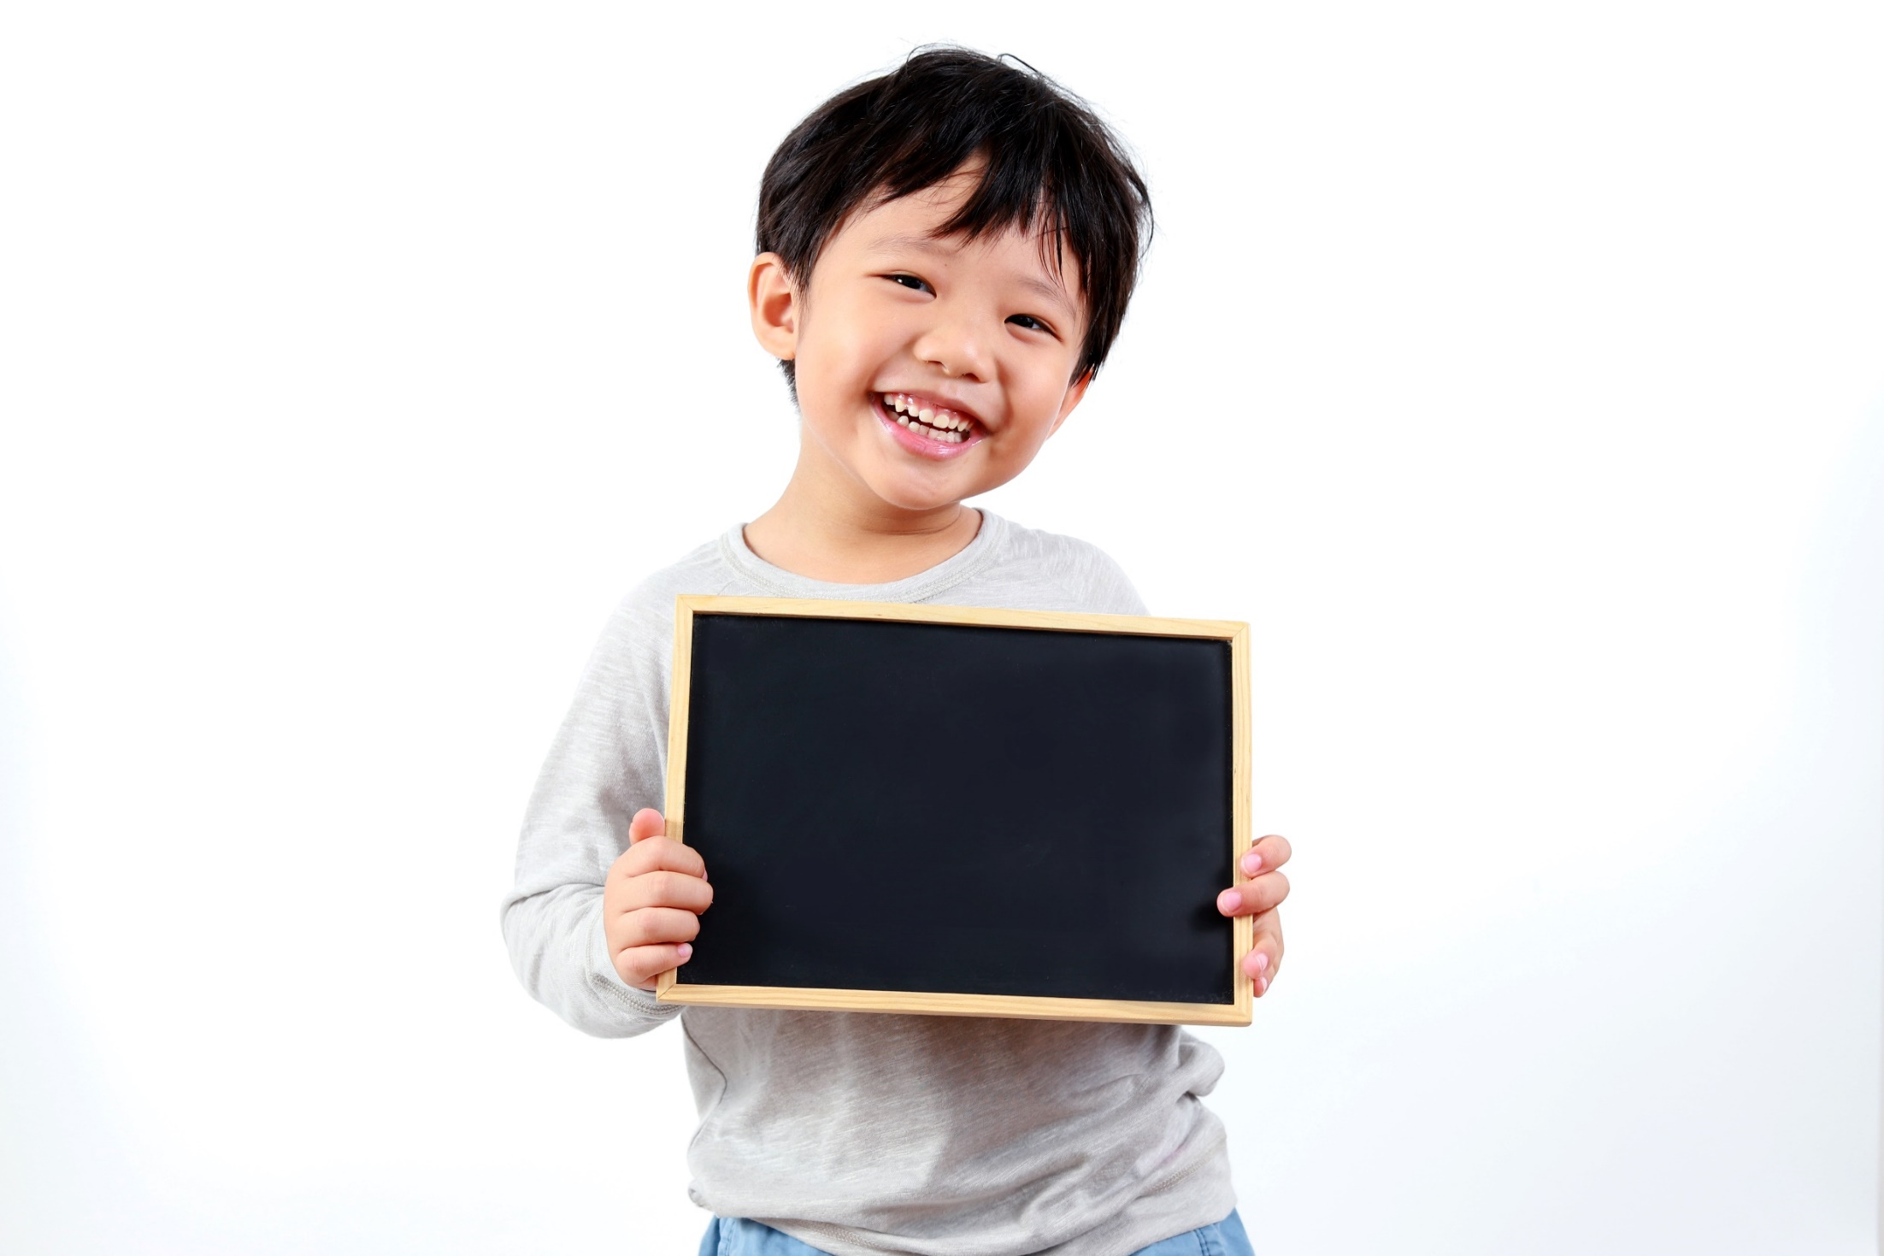
Practice

Slide 13

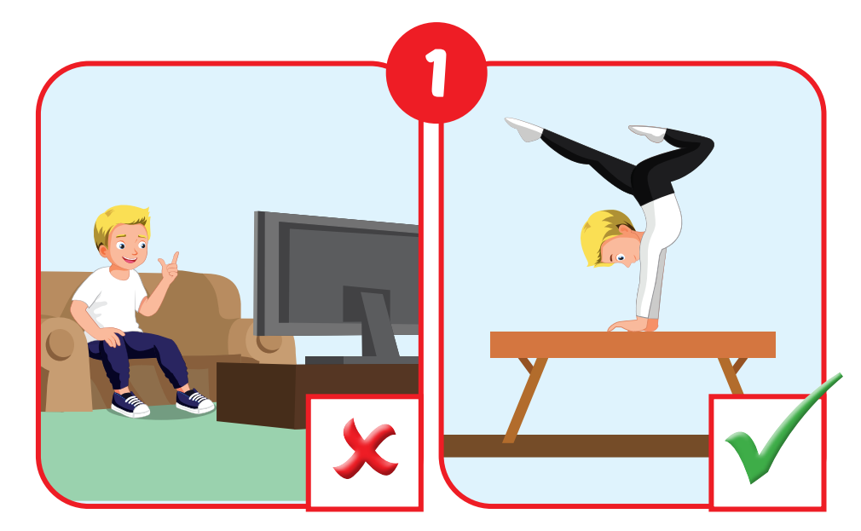
Is he watching TV?
No, he isn’t. He is doing martial arts.

Slide 14
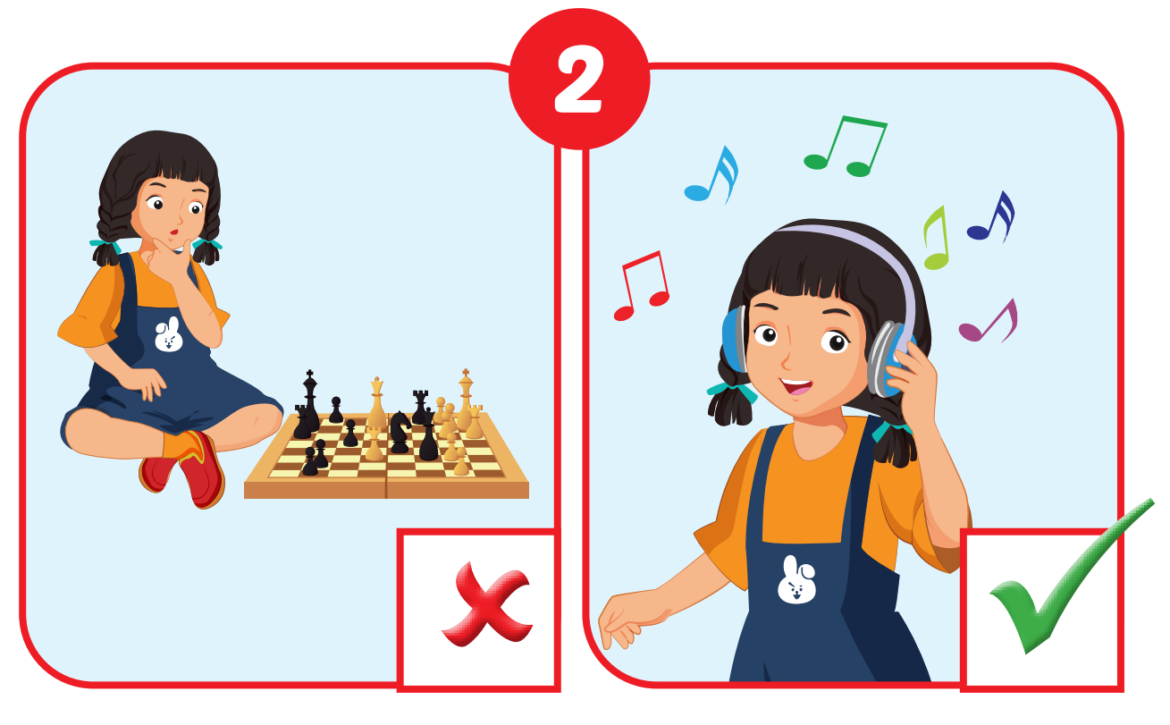
Is she playing chess?
No, she isn’t. She is listening to music.

Slide 15
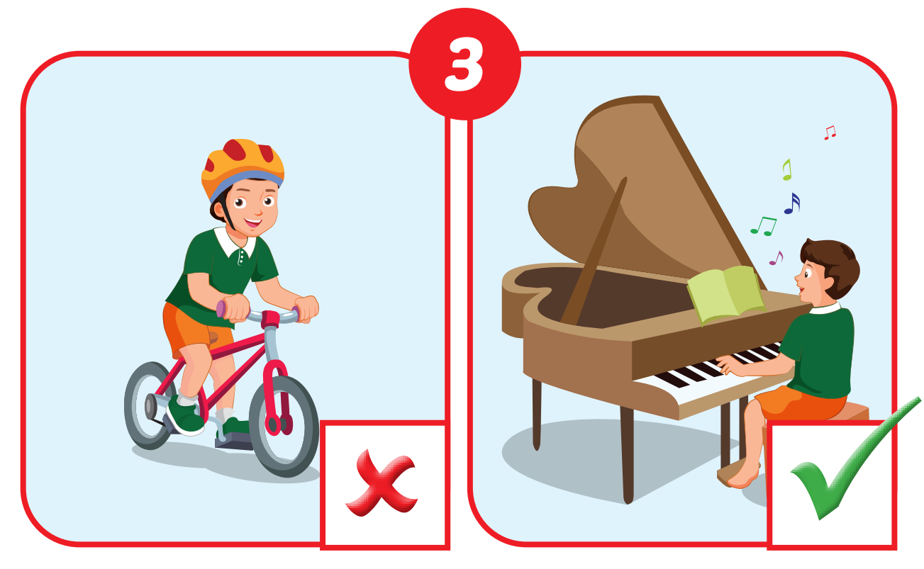
Is he riding a bike?
No, he isn’t. He is playing the piano.

Slide 16
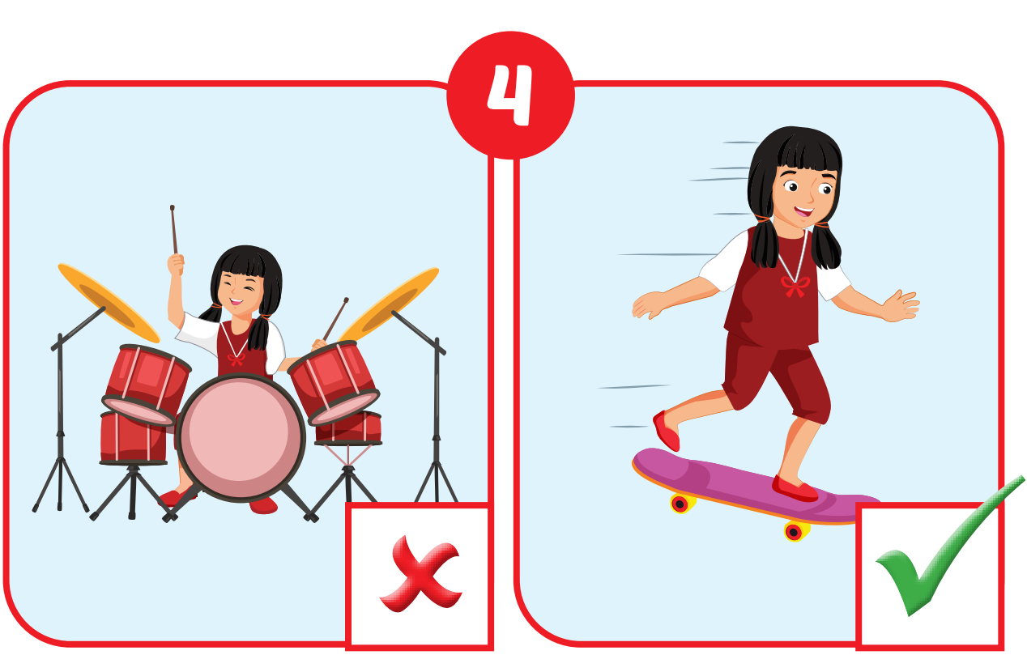
Is she playing drums?
No, she isn’t. She is skating.

Slide 17
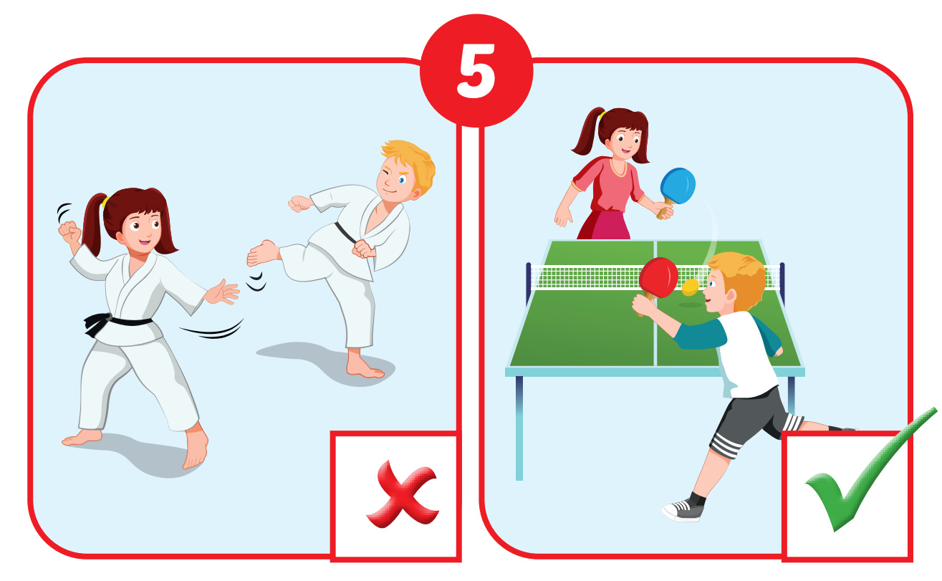
Are they doing martial arts?
No, they aren’t. They are playing table tennis.

Slide 18
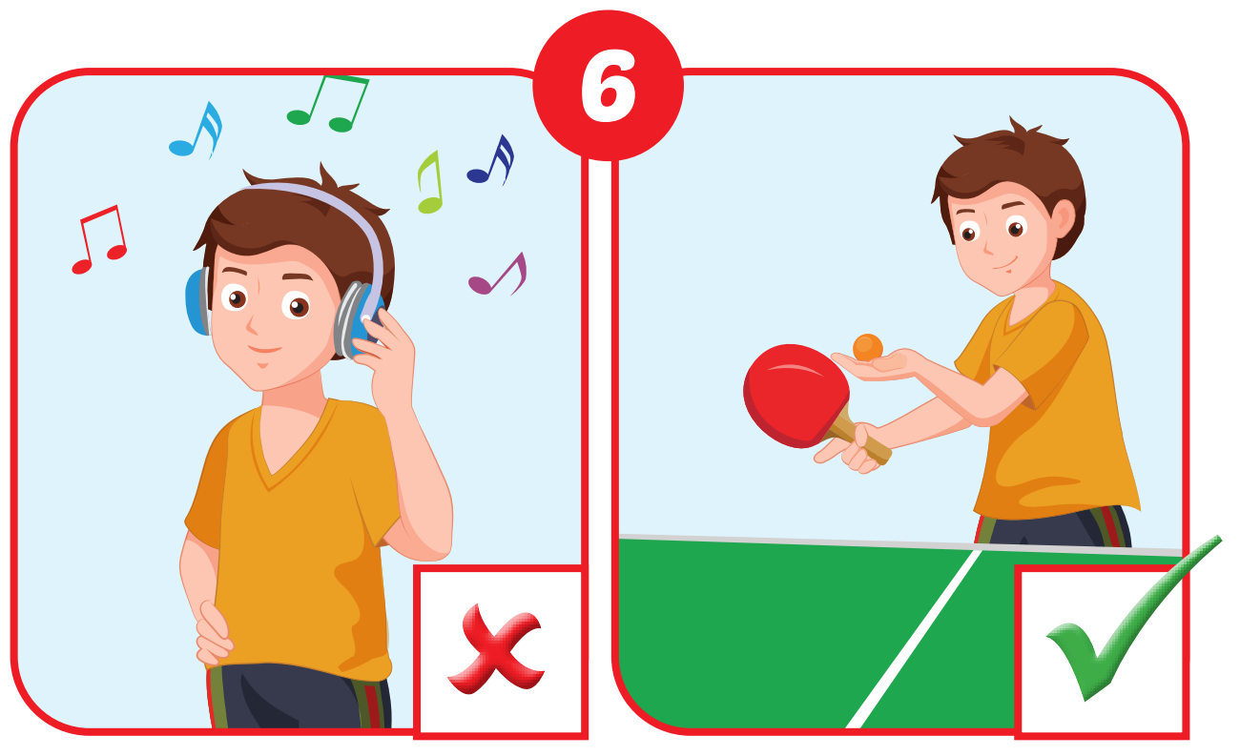
Is he listening to music?
No, he isn’t. He is playing table tennis.

Slide 19

Speaking

Slide 20

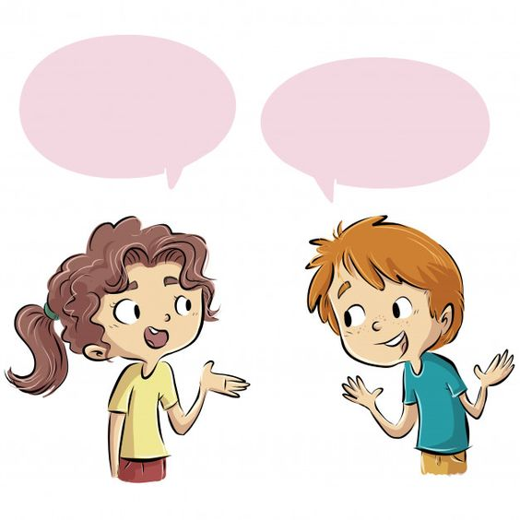

Slide 21
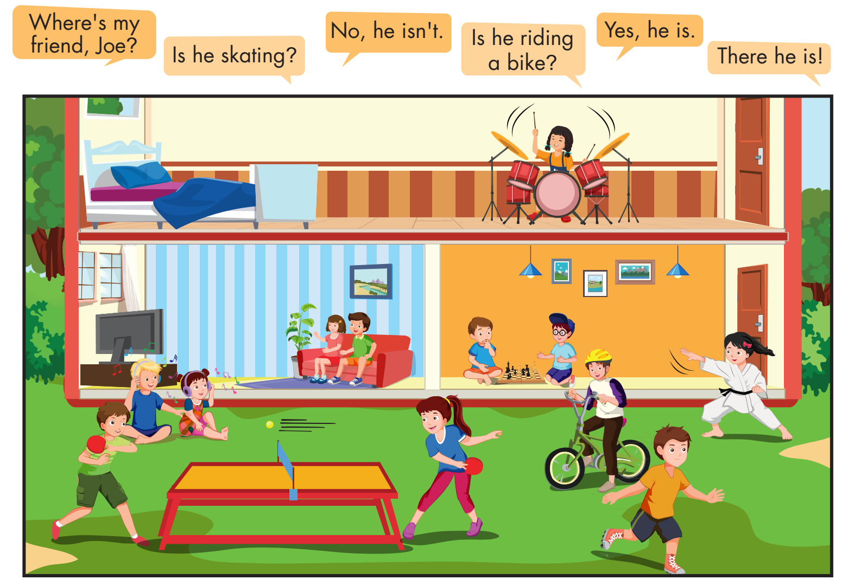

Slide 22

CONSOLIDATION

Slide 23


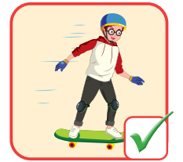
skating/is/he?
he/is/Yes,/.
1
A
He is skating?
Yes, he is.
B
Is he skating?
Yes, he is.
C
Is he skating?
Yes, is he.

Slide 24
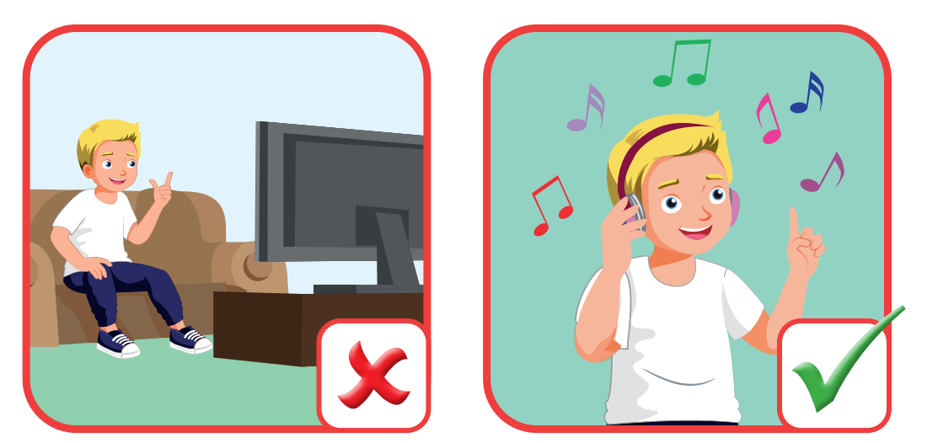
he/watching/is/TV/?
isn’t./he/No,/He/to/listening/ music/.
2
A
Is he watching TV?
No, he isn’t. He is listening to music.
B
Is he TV watching?
No, he isn’t. He is listening music to.
C
Is he watching TV?
No, isn’t he. He is listening to music.

Slide 25
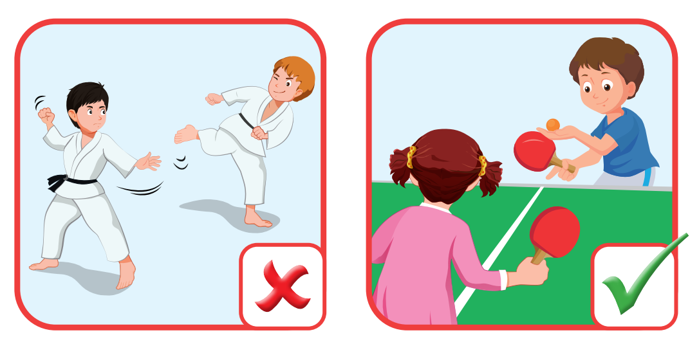
doing/they/arts/are/martial/?
they/No,/aren’t./ table/ They/ playing/are/tennis/.
Are they doing arts martial?
No, they aren’t. They are playing table tennis.
A
Are they doing martial arts?
No, they aren’t. They playing are table tennis.
B
Are they doing martial arts?
No, they aren’t. They are playing table tennis.
C

Slide 26
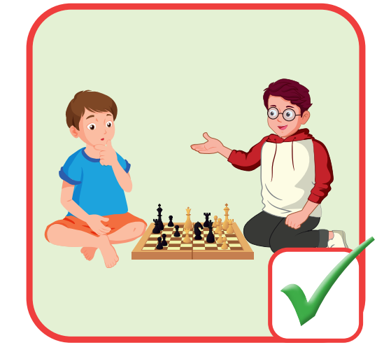
playing/are/they/chess?
Yes/ are./they
A
Are they chess playing?
Yes, they are.
B
Are they playing chess?
Yes, they are.
C
Are playing they chess?
Yes, they are.

Slide 27
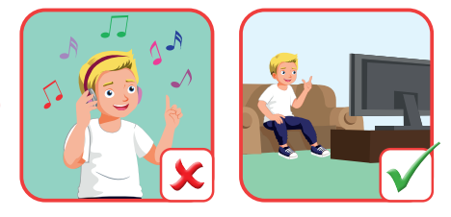
Listening/music/to/is/he?
he/No,/isn’t./TV/he/watching/is/.
Is he listening to music?
No, isn’t he. He is TV watching.
A
Is he listening music to?
No, he isn’t. He is watching TV.
B
Is he listening to music?
No, he isn’t. He is watching TV.
C

Slide 28
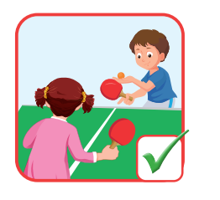
playing/are/they/table/tennis?
Yes/ are./they
A
Are they table tennis playing?
Yes, they are.
B
Are they playing table tennis?
Yes, they are.
C
Are playing they table tennis?
Yes, they are.

Slide 29
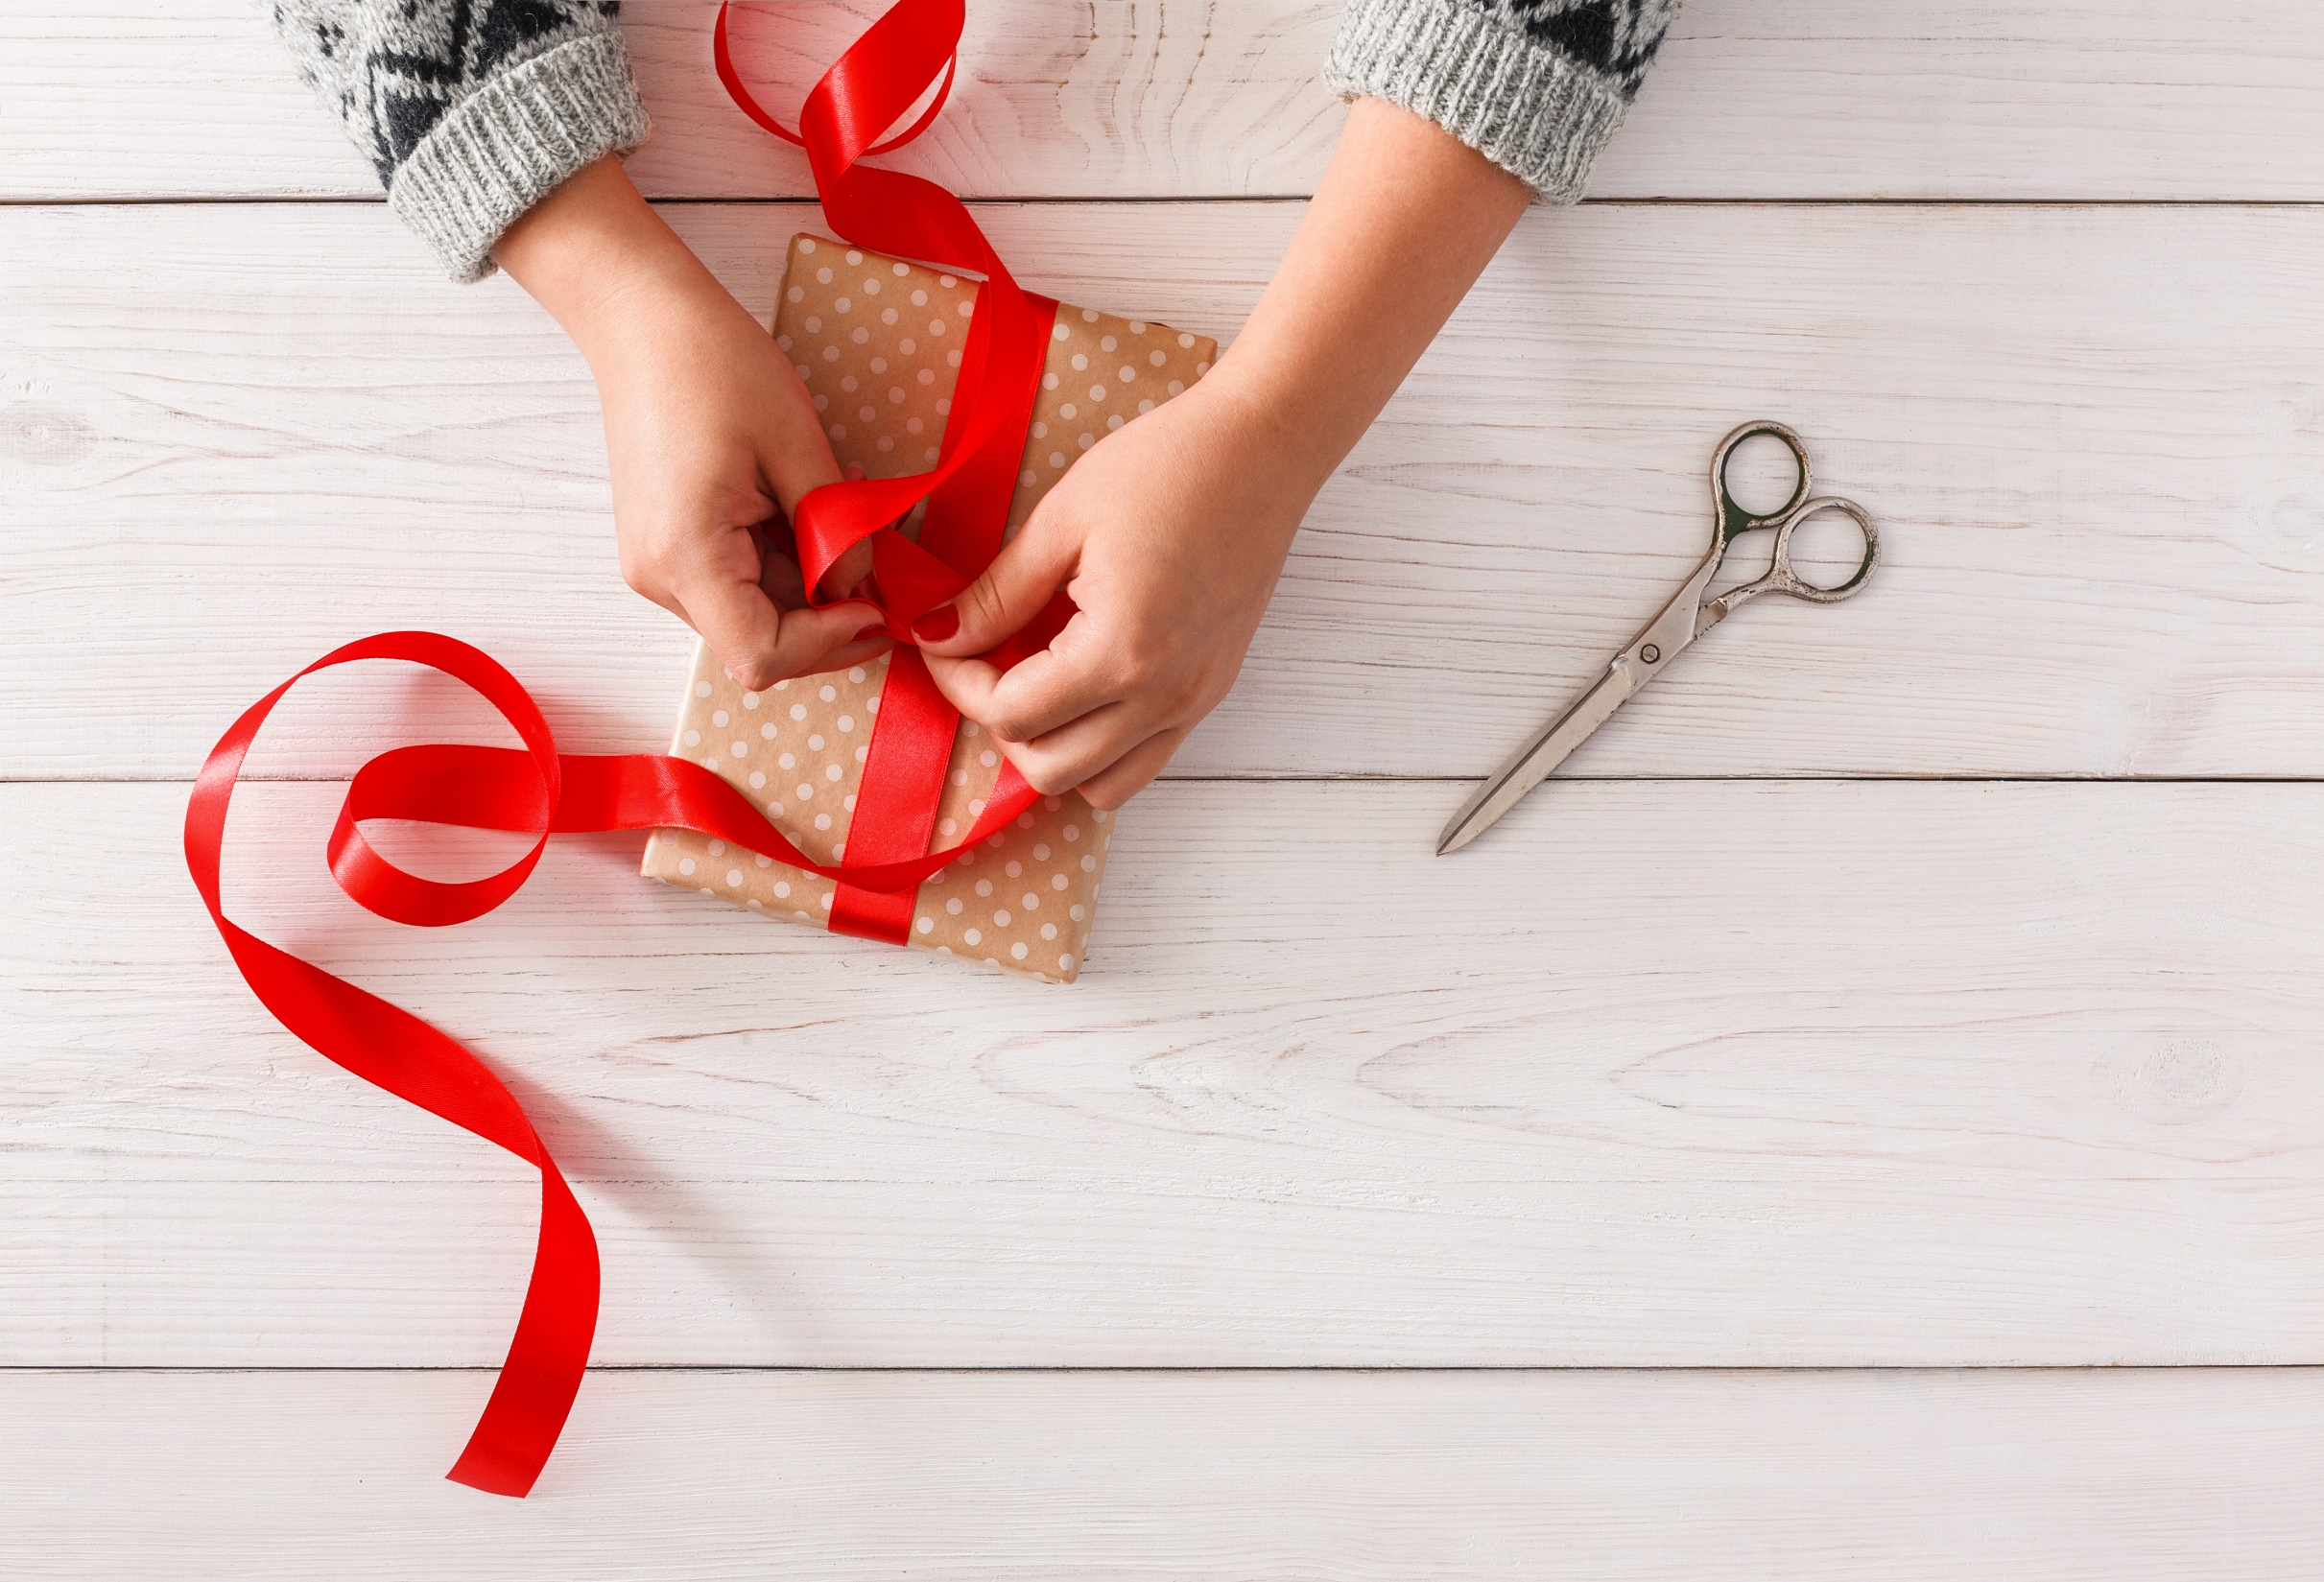
WRAP-UP

Slide 30
Today’s lesson
Vocabularies
listen to music, watch television, play table tennis, do martial arts, skate, play chess.
Structures/ Sentence patterns
Is he playing chess?
– Yes, he is.
Are they doing martial arts?
- No, they aren’t. They’re skating.

Slide 31
Homework
Practice the vocabularies and structure, and make sentences using them.
Do the exercises in Tiếng Anh 4 i-Learn Smart Start WB (page 35)
Do the exercises in Tiếng Anh 4 i-Learn Smart Start Notebook (page 23).
Prepare the next lesson (page 51 SB)
Play the consolidation games in Tiếng Anh 4 i-Learn Smart Start DHA App on www.eduhome.com.vn

Slide 32
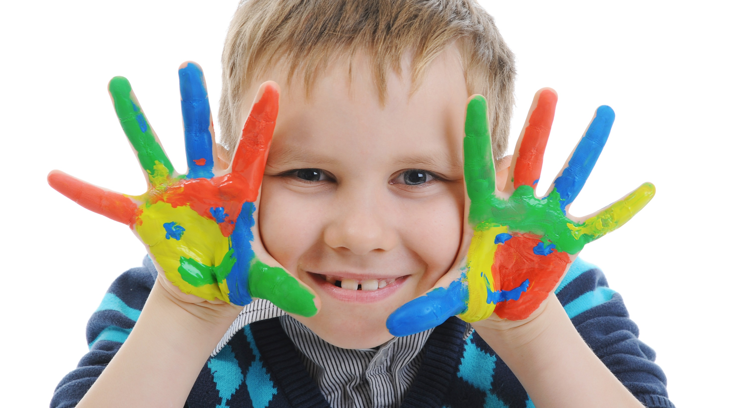
Enjoy your day!

