Slide 1
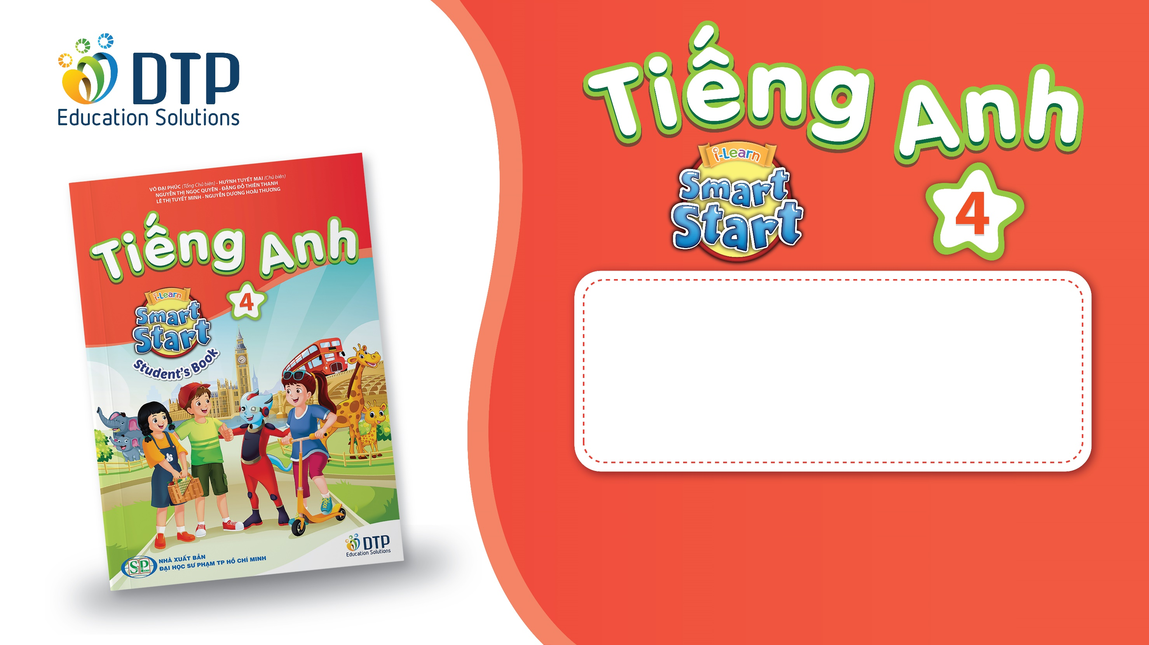
Unit 4: ACTIVITIES
Lesson 2.2
Page 52

Slide 2
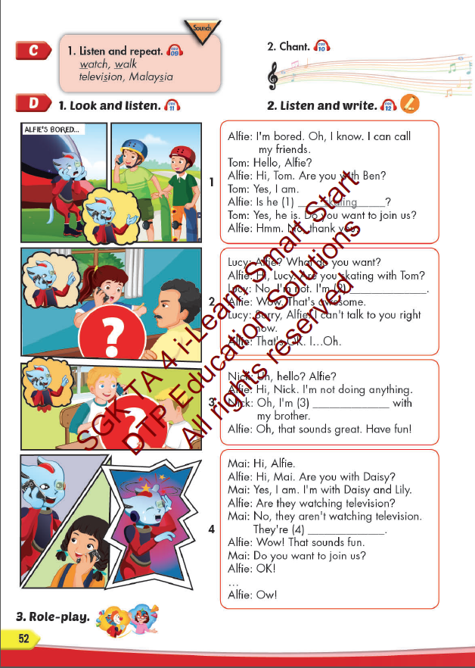
Lesson Outline
Warm-up
Listening
Consolidation
Wrap-up

Slide 3
Objectives
By the end of this lesson, students will be able to pronounce the sounds /w/, and /ʒ/; and practice asking and answering what they are doing.
Vocabulary: listen to music, watch television, play table tennis, do martial arts, skate, play chess.
Structure:
Is he playing chess?
– Yes, he is.
Are they doing martial arts?
- No, they aren’t. They’re skating.
Phonics: /w/, watch, walk; /ʒ/, television, Malaysia

Slide 4

It’s time to learn …

Slide 5

Phonics
/w/
/ʒ/

Slide 6

Presentation

Slide 7
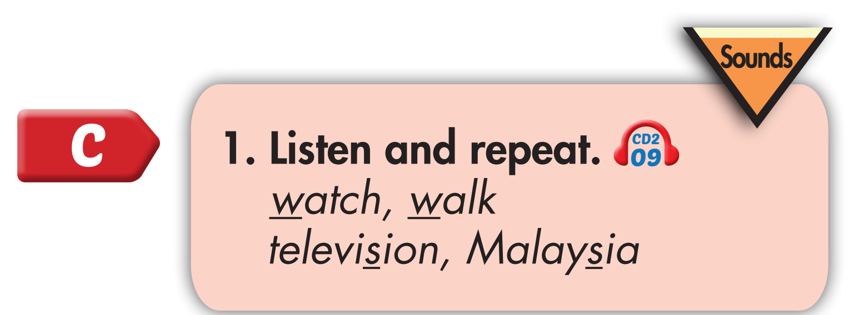
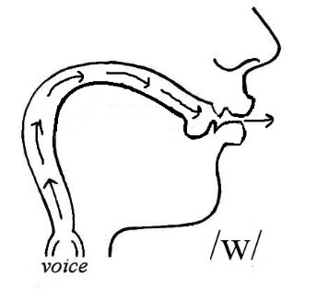
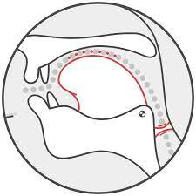

Click on the words to hear the sound
w, w, watch, walk
ʒ, ʒ, television, Malaysia
/ʒ/

Slide 8
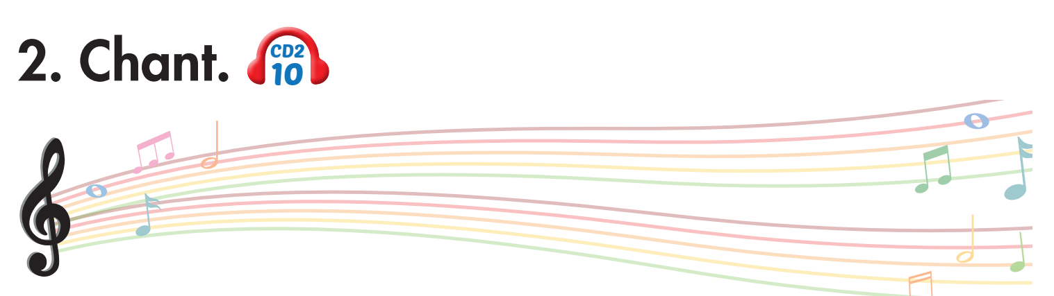
Click on the headphone icon to hear the sound
Is Alfie watching television?
Yes, he is.
Is Lucy watching television?
No, she isn't. She's walking to the store.
Notes:
1. Listen.
2. Listen and chant.

Slide 9
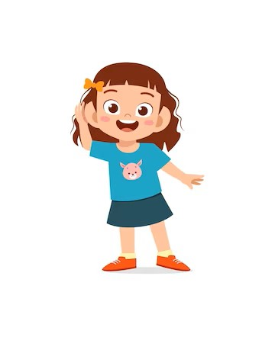
Listen. Hop and repeat when you hear /W/ sound.
Notes:
T say
Violin
Watch
Why
Volleyball
Living room
Wheel
Video games
Who
Water

Slide 10
Listen. Hop and repeat when you hear /ʒ/ sound.
Notes:
T say
Violin
television
Volleyball
Malaysia
Kitchen
usual
leisure
wash

Slide 11

Listening

Slide 12

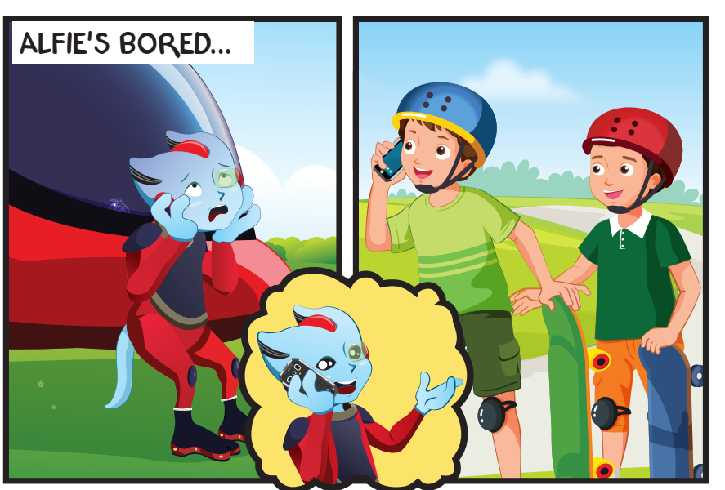
Click on the headphone icon to hear the sound

Slide 13
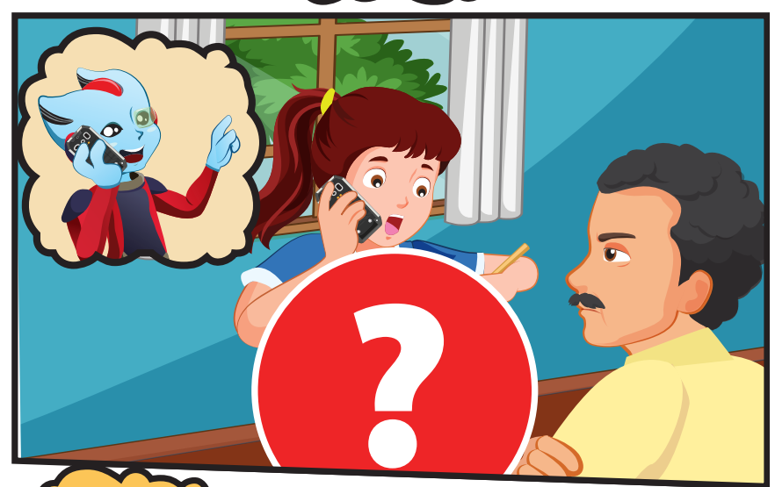
Click on the headphone icon to hear the sound

Slide 14
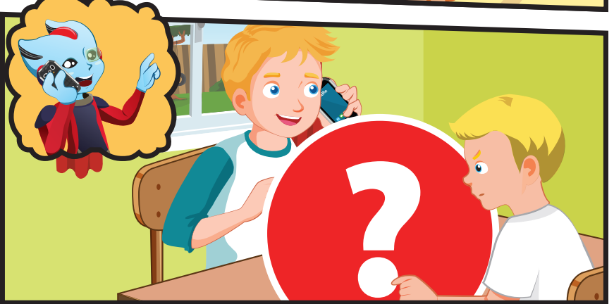
What’s Nick doing?

Slide 15
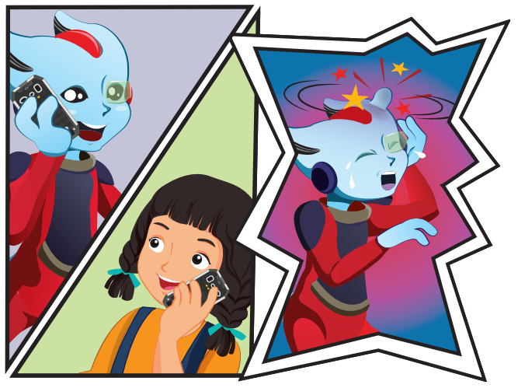
Where is Mai?
What is Mai doing?

Slide 16

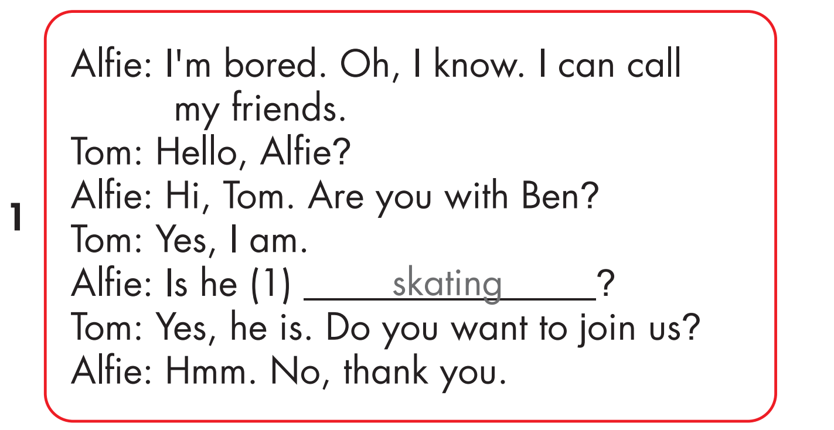
Click on the headphone icon to hear the sound.
Click on number 1
to show the answer.

Slide 17
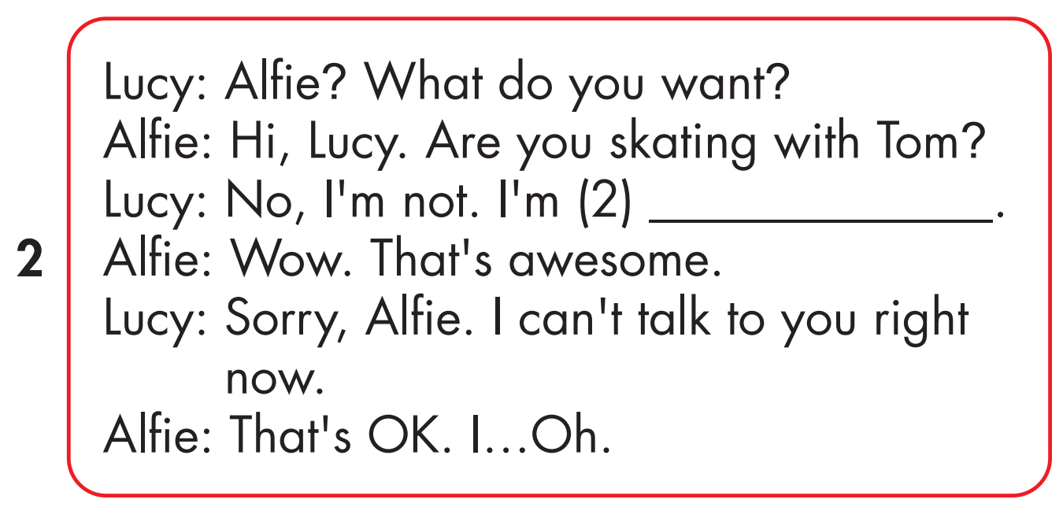
Click on the headphone icon to hear the sound.
playing drums
Click on number 2
to show the answer.

Slide 18
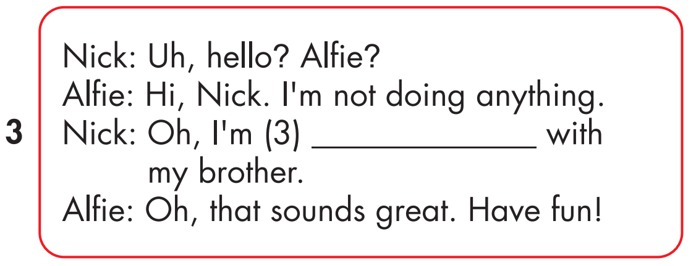
Click on the headphone icon to hear the sound.
playing chess
Click on number 3
to show the answer.

Slide 19
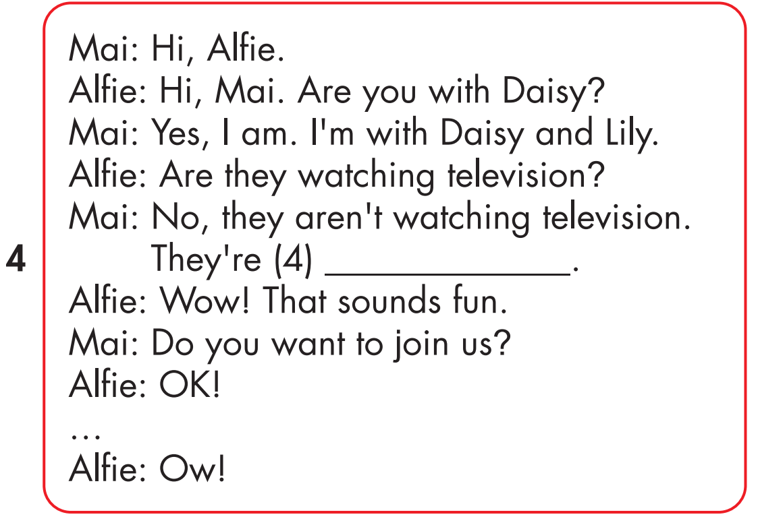
Click on the headphone icon to hear the sound.
doing martial arts
Click on number 4
to show the answer.

Slide 20

Practice

Slide 22
playing drums

Slide 23
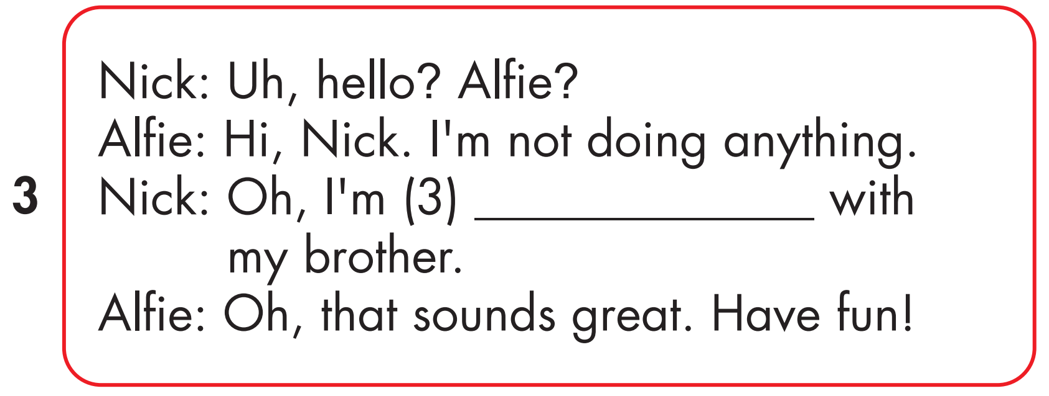
playing chess

Slide 24
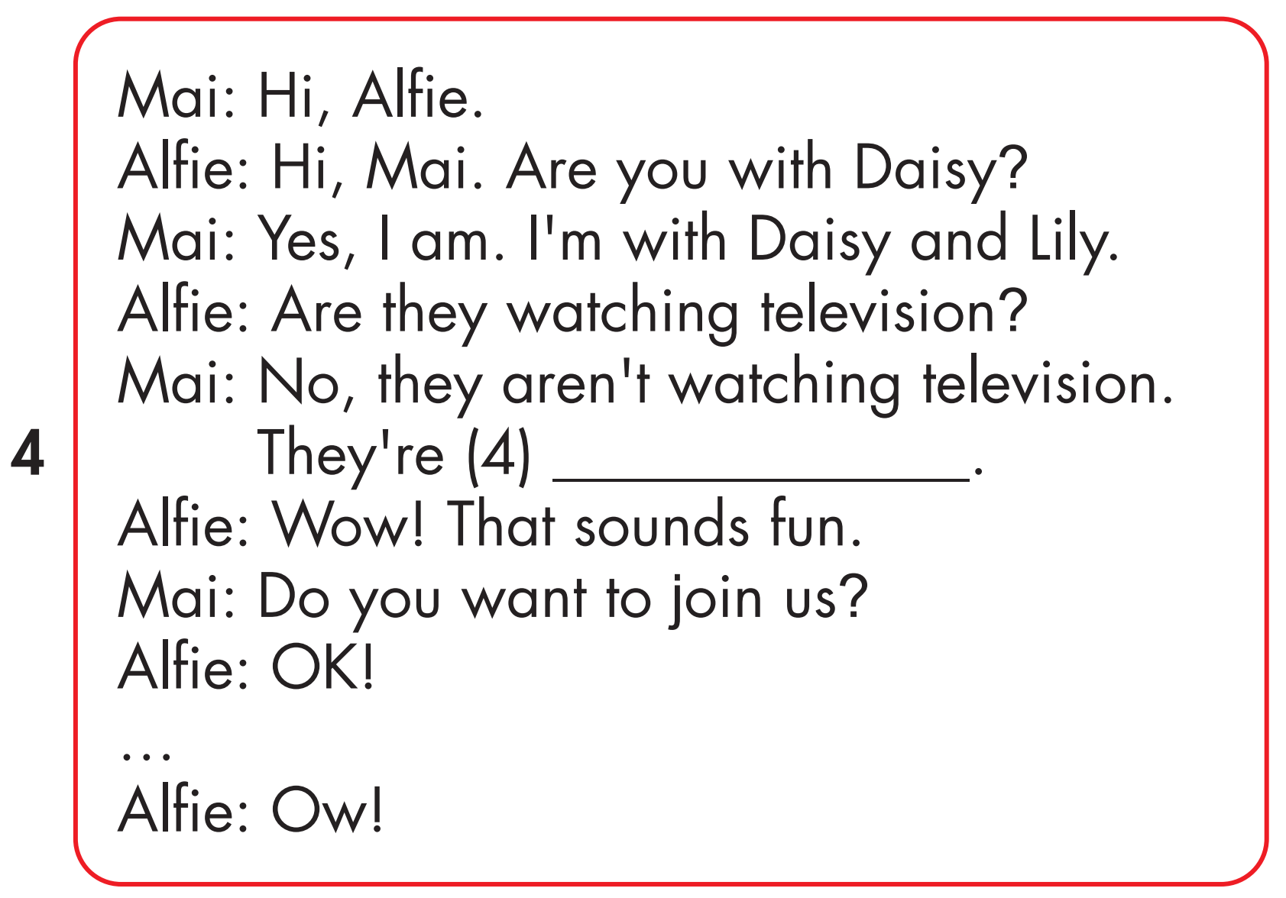
doing martial art

Slide 25

Production

Slide 26
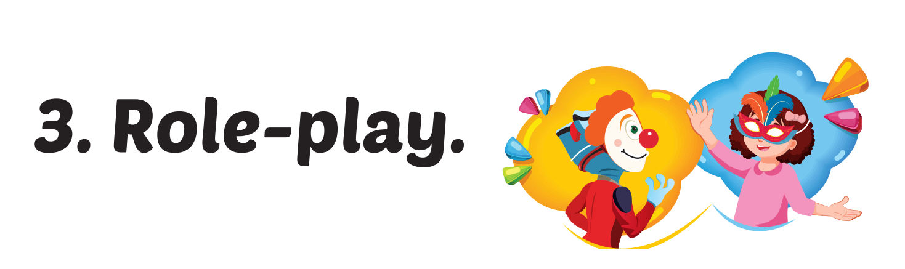

Slide 27

CONSOLIDATION

Slide 28

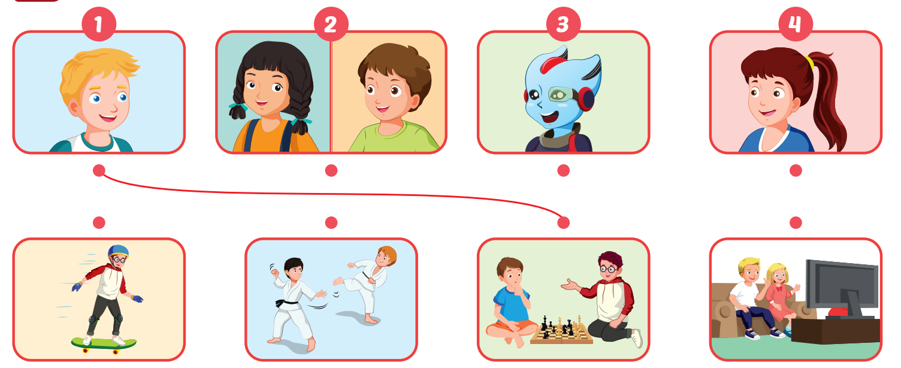
Click on the headphone icon to hear the sound.

Slide 29

WRAP-UP

Slide 30
Today’s lesson
Vocabularies
play a board game, do a puzzle, read a comic book, eat snacks, play video games.
Structures/ Sentence patterns
Are you reading a comic book?
– Yes, I am.
Are you read a comic book?
- No, we aren’t. We’re playing a board game.

Slide 31
Homework
Practice the vocabularies and structure, and make sentences using them.
Do the exercises in Tiếng Anh 4 i-Learn Smart Start WB (page 35)
Do the exercises in Tiếng Anh 4 i-Learn Smart Start Notebook (page 23).
Prepare the next lesson (page 53 SB).
Play the consolidation games in Tiếng Anh 4 i-Learn Smart Start DHA App on www.eduhome.com.vn

Slide 32

Lesson 3
Stay positive and have a nice day!

