Slide 1

Unit 4: ACTIVITIES
LESSON 2
Page 51

Slide 2
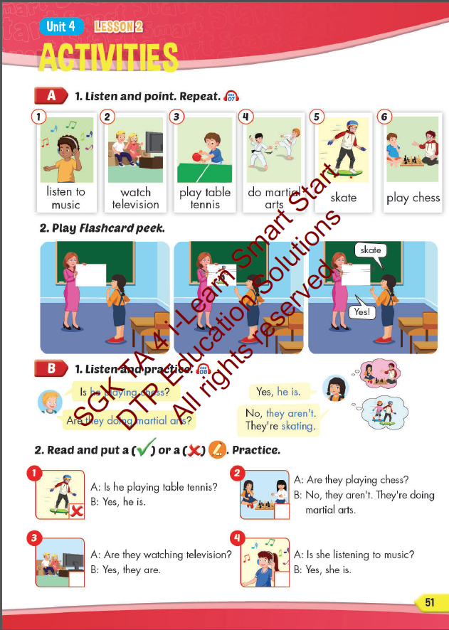
Lesson Outline
Warm-up
Vocabulary
Structure
Consolidation
Wrap-up

Slide 3
Objectives
By the end of this lesson, students will be able to get to know how to ask and answer about what people are doing.
Vocabulary: listen to music, watch television, play table tennis, do martial arts, skate, play chess.
Structure:
Is he playing chess?
– Yes, he is.
Are they doing martial arts?
- No, they aren’t. They’re skating.

Slide 4

WARM UP

Slide 5

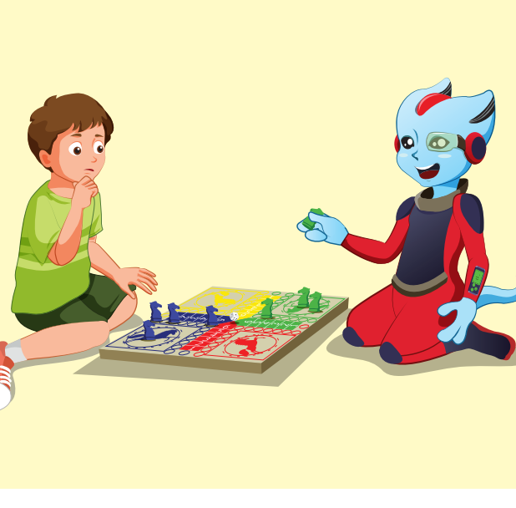
REVIEW 1
Look and say.
START
CHECK
Play a board game

Slide 6
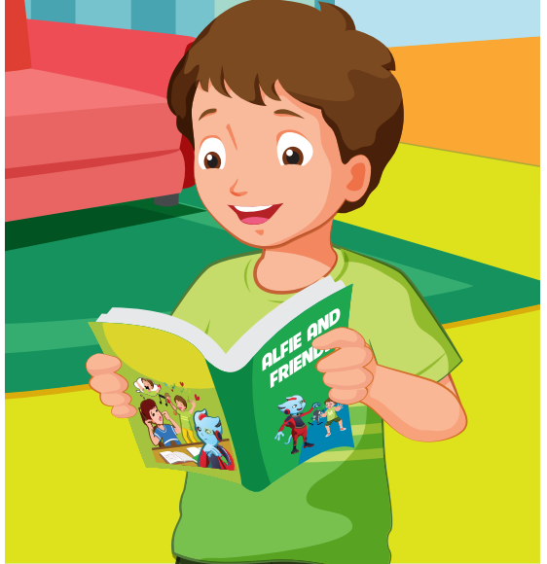
REVIEW 1
Look and say.
START
CHECK
read a comic book

Slide 7
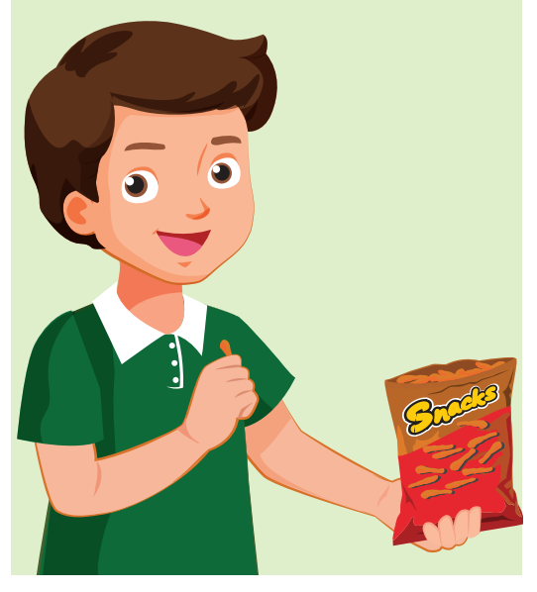
REVIEW 1
Look and say.
START
CHECK
read a comic book

Slide 8
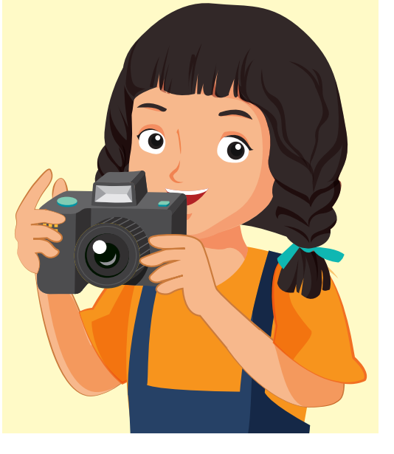
REVIEW 1
Look and say.
START
CHECK
take photos

Slide 9
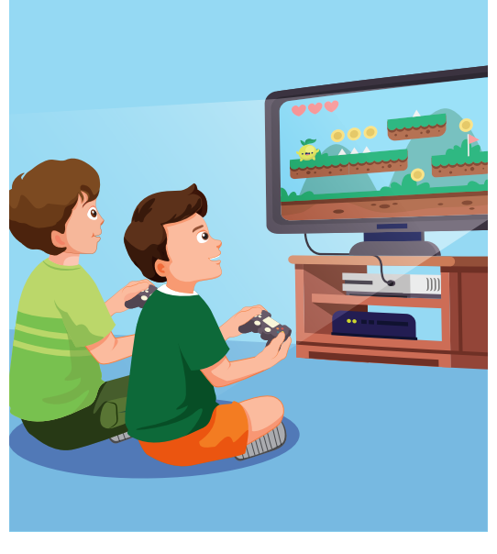
REVIEW 1
Look and say.
START
CHECK
play video games

Slide 10

It’s time to learn …

Slide 11

New words
listen to music, watch television, play table tennis, do martial arts, skate, play chess

Slide 12

Presentation

Slide 13

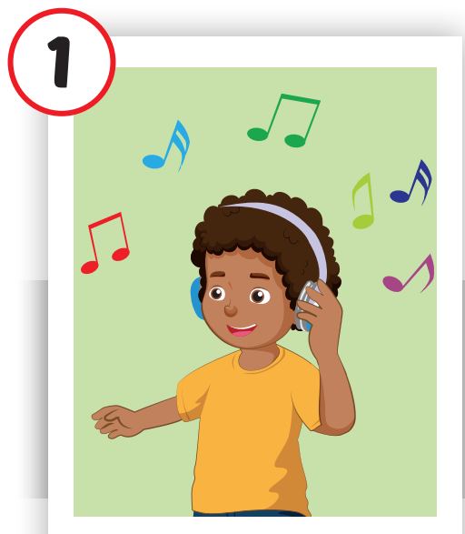
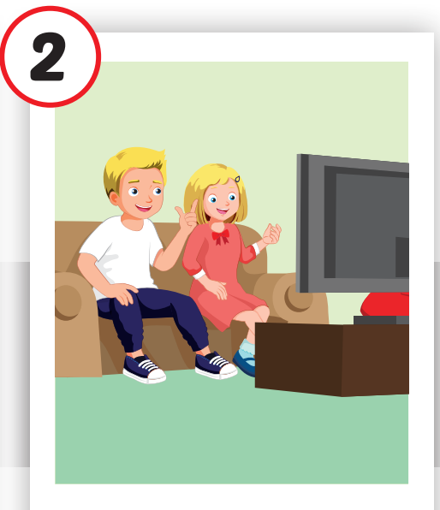
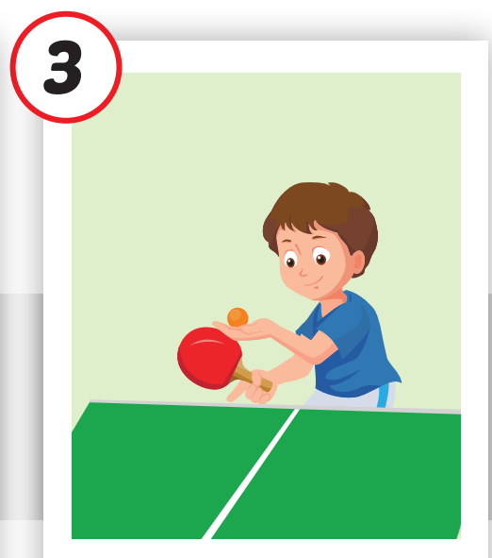

Click each English word to hear the sound.
listen to music
watch television
play table tennis
/ ˈlɪsn tə ˈmjuːzɪk /
nghe nhạc
/ wɑːtʃ ˈteləvɪʒən /
xem tivi
/pleɪˈteɪbl tenɪs/
chơi bóng bàn

Slide 14
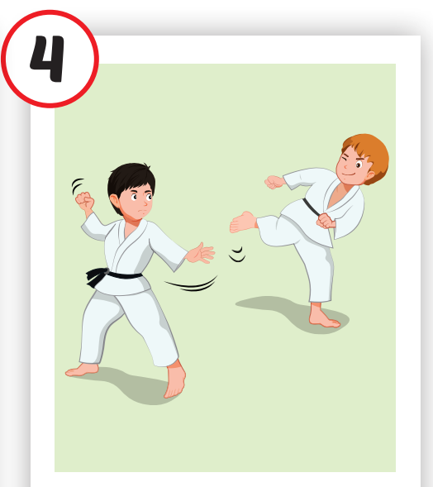
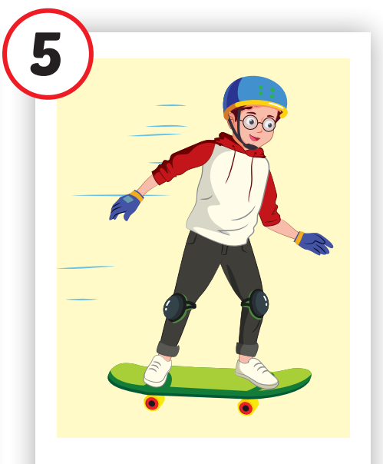
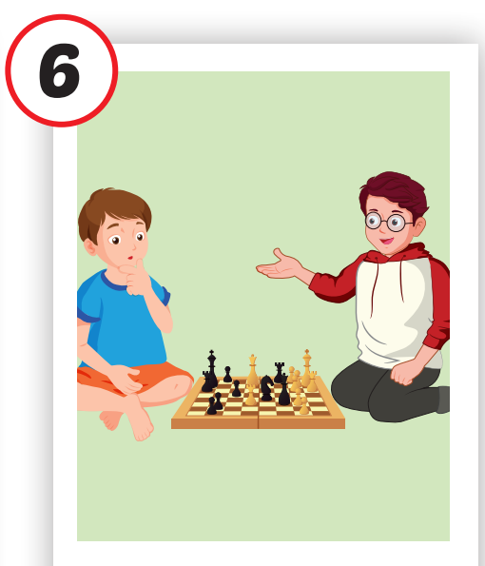
do martial arts
skate
play chess
/duː ˌmɑːrʃl ˈɑːrts/
tập võ
/skeɪt /
trượt ván
/ˈplei ˈtʃes/
chơi cờ vua

Slide 15

Practice

Slide 16
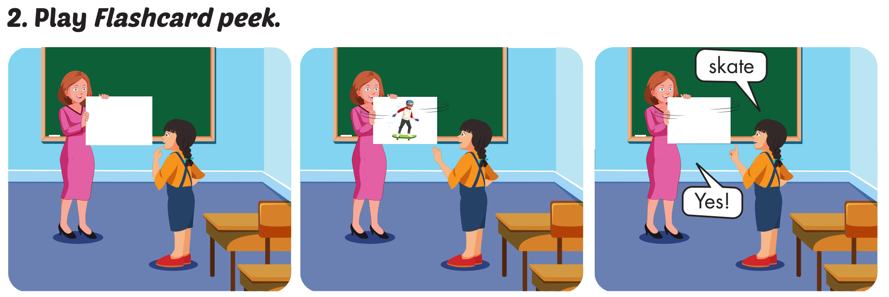

Slide 17
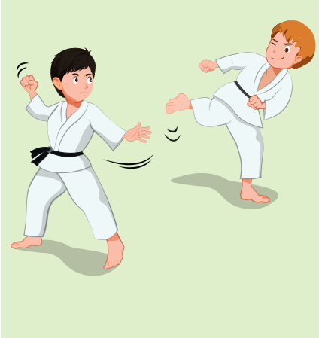
do martial arts
SHOW

Slide 18
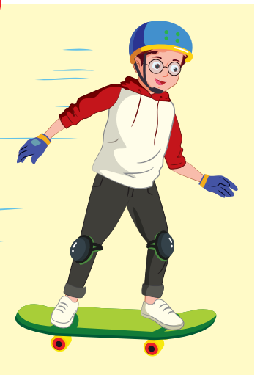
skate
SHOW

Slide 19
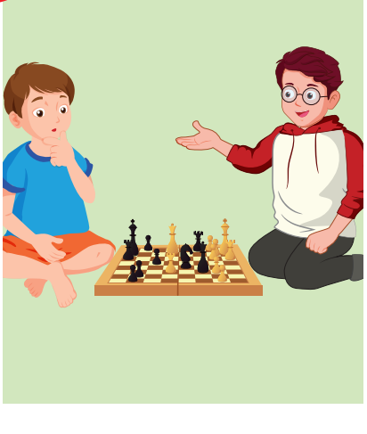
play chess
SHOW

Slide 20
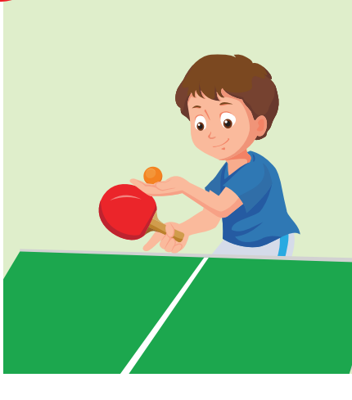
play table tennis
SHOW

Slide 21
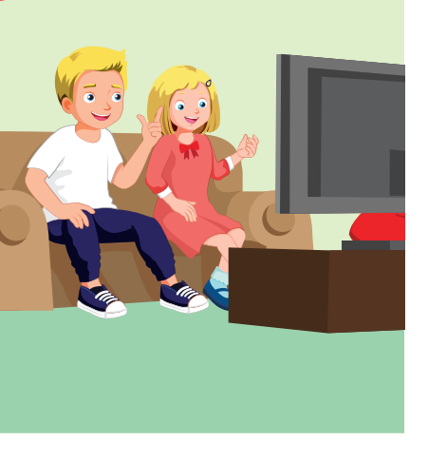
watch television
SHOW

Slide 22
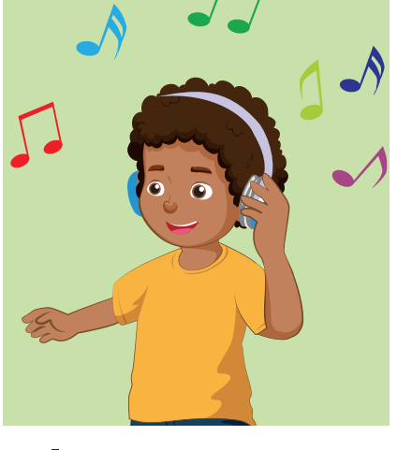
listen to music
SHOW

Slide 23
WHAT’S MISSING?
do martial arts
listen to music
read a comic book
skate
listen to music
skate
do martial arts
watch television
skate
skate
listen to music
play table tennis
listen to music
do martial arts
play table tennis
do martial arts
watch television
watch television
listen to music
skate
skate
play table tennis
watch television
play tabl tennis

Slide 24
Structures
Is he playing chess?
– Yes, he is.
Are they doing martial arts?
- No, they aren’t. They’re skating.

Slide 25
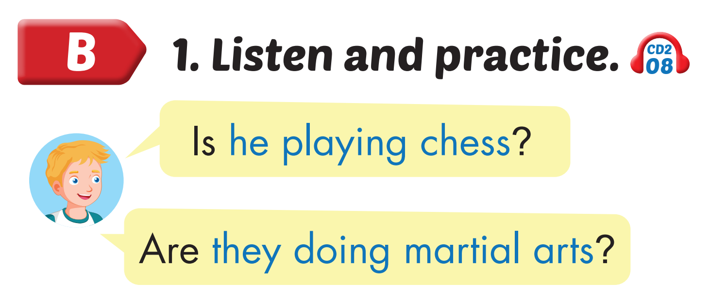
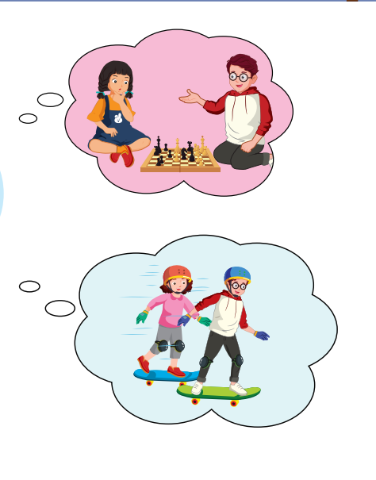
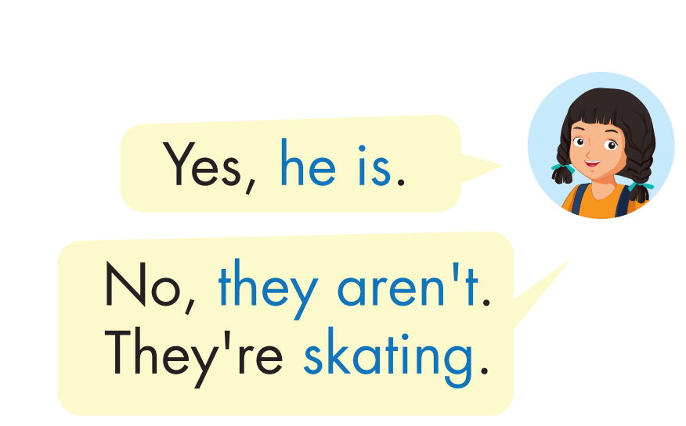
Click on the headphone icon to hear the sound.

Slide 26

Practice

Slide 27
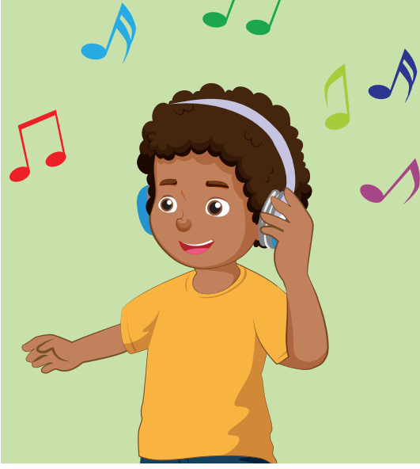
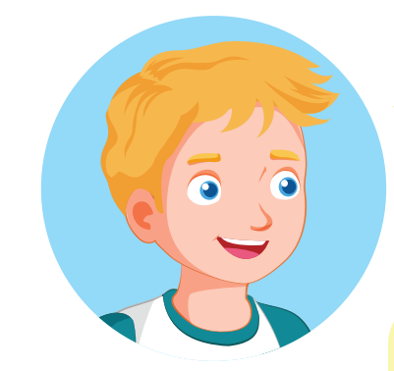


Is he listening to music?
Yes, he is.

Slide 28
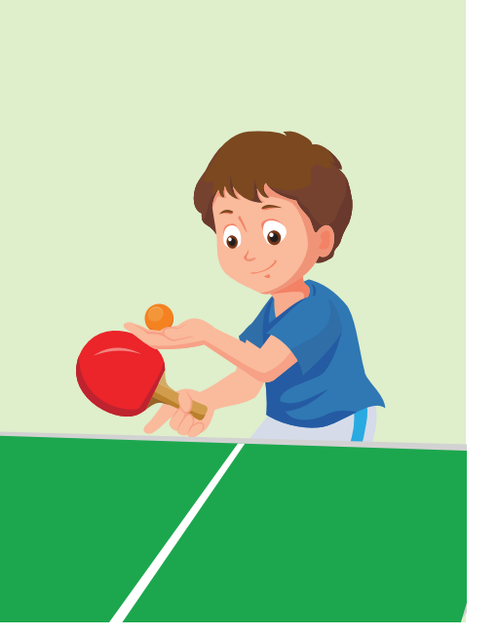
Is he ……..?
Yes,…...

Slide 29
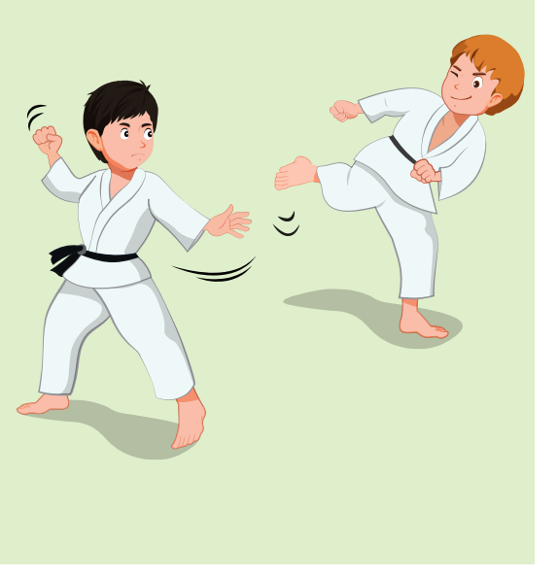
Are they ……..?
Yes,…...

Slide 30
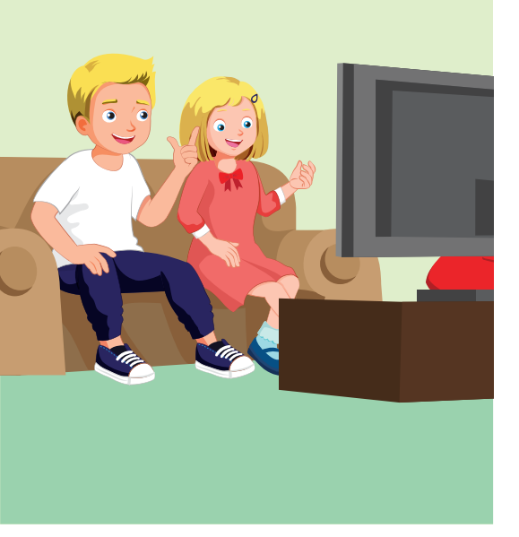

Are they ……..?
No,….... They are….

Slide 31
Are they ……..?
No,….... They are….

Slide 32
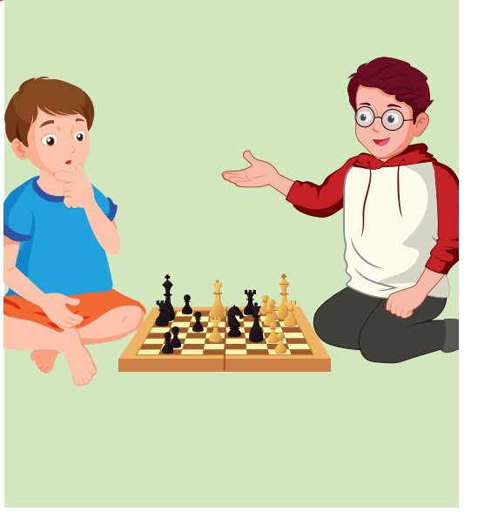
Are they ……..?
No,….... They are….

Slide 33
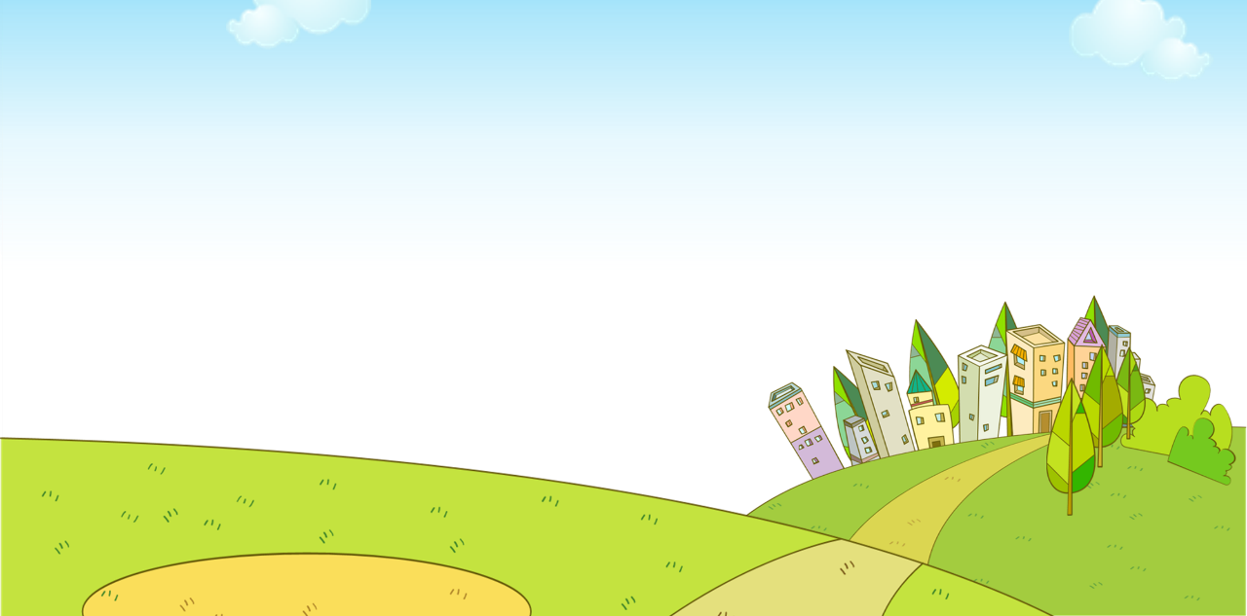


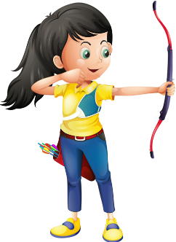
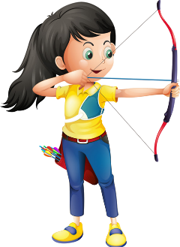


Ms Huyền Phạm
0936.082.789

Slide 34
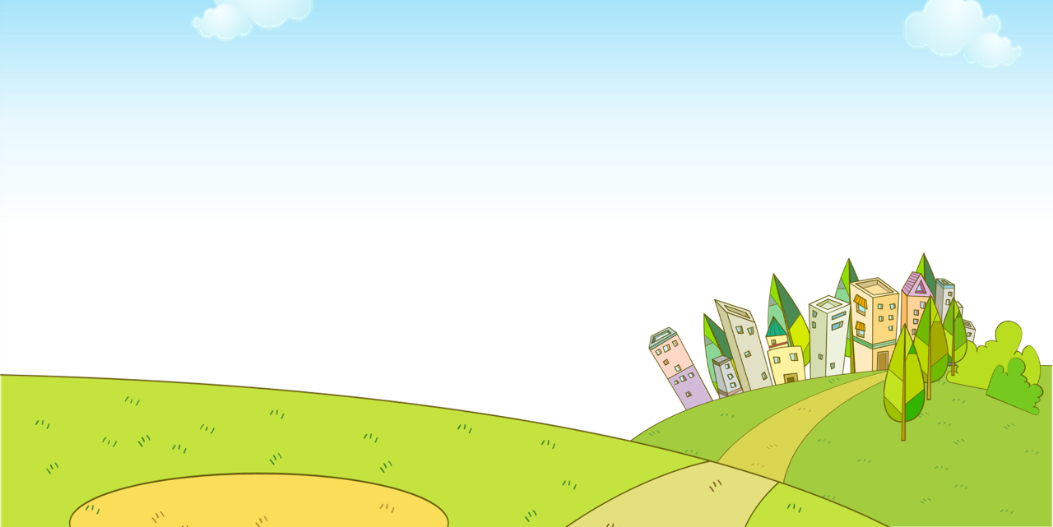

Is he listening
to music?
Yes, he is.
No, he isn’t.
Ms Huyền Phạm
0936.082.789
Notes:
Ms Huyền Phạm - 0936.082.789 – YOUTUBE: MsPham. Facebook: Dạy và học cùng công nghệ.

Slide 35
Is he playing table tennis?
Yes, he is.
No, he isn’t.
Ms Huyền Phạm
0936.082.789

Slide 36
Are they
playing a board
game?
Yes, they are.
No, they aren’t. They are playing chess.
Ms Huyền Phạm
0936.082.789

Slide 37
Are they
playing watching
television?
Yes, they are.
No, they aren’t. They are doing martial arts.
Ms Huyền Phạm
0936.082.789

Slide 38
Are they watching television?
Yes, they are.
No, they aren’t.
Ms Huyền Phạm
0936.082.789

Slide 39

CONSOLIDATION

Slide 40

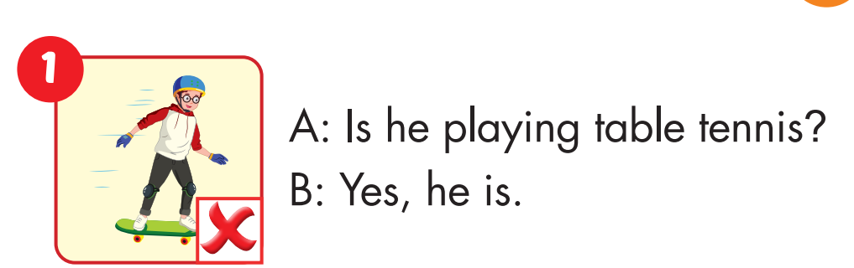

Slide 41
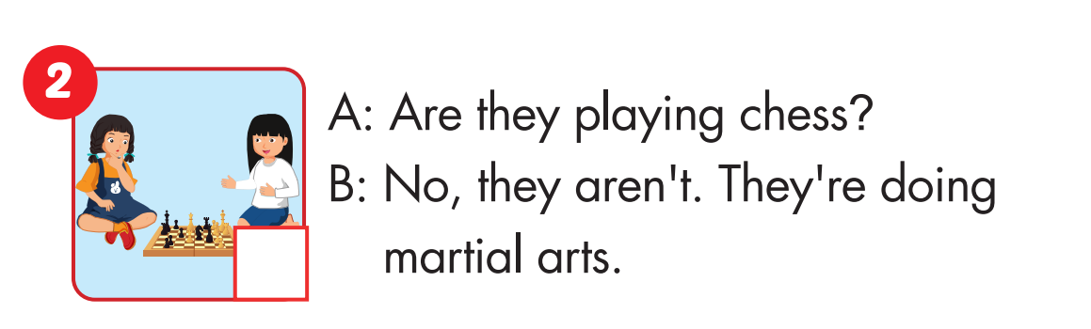

Slide 42
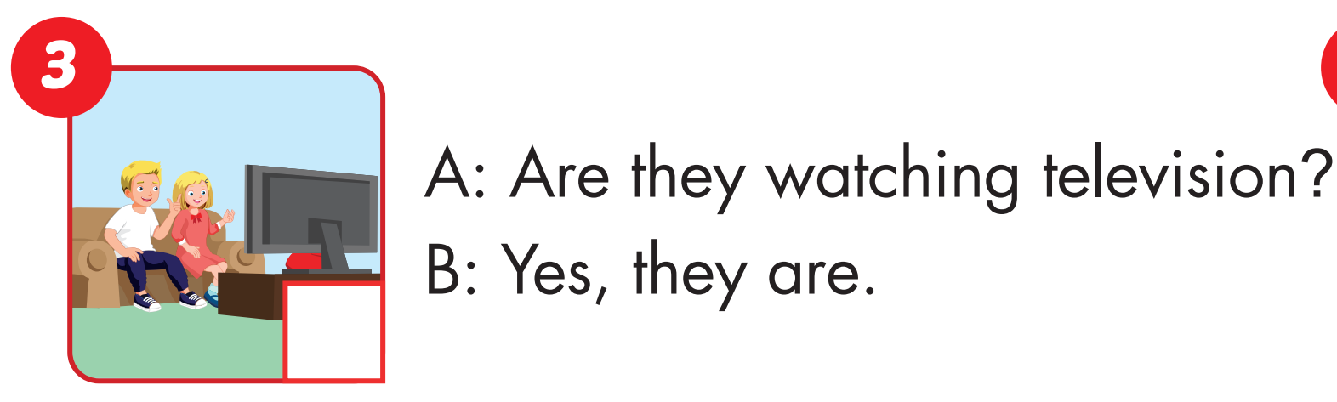

Slide 43
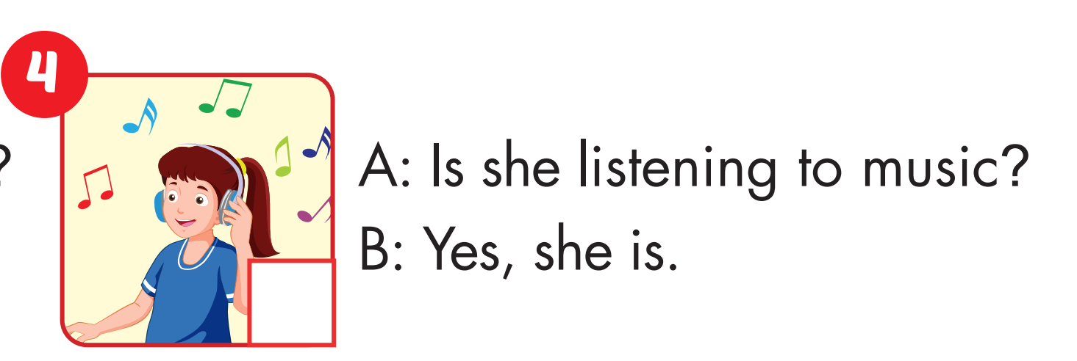

Slide 44

WRAP-UP

Slide 45
Today’s lesson
Vocabularies
listen to music, watch television, play table tennis, do martial arts, skate, play chess.
Structures/ Sentence patterns
Is he playing chess?
– Yes, he is.
Are they doing martial arts?
- No, they aren’t. They’re skating.

Slide 46
Homework
Practice the vocabularies and structure, and make sentences using them.
Do the exercises in Tiếng Anh 4 i-Learn Smart Start WB (page 34)
Do the exercises in Tiếng Anh 4 i-Learn Smart Start Notebook (page 23).
Prepare the next lesson (page 52 SB)
Play the consolidation games in Tiếng Anh 4 i-Learn Smart Start DHA App on www.eduhome.com.vn

Slide 47

Enjoy your day!

