Slide 1

Unit 2
WHAT I CAN DO
CULTURE LESSON 2
PAGE 30

Slide 2
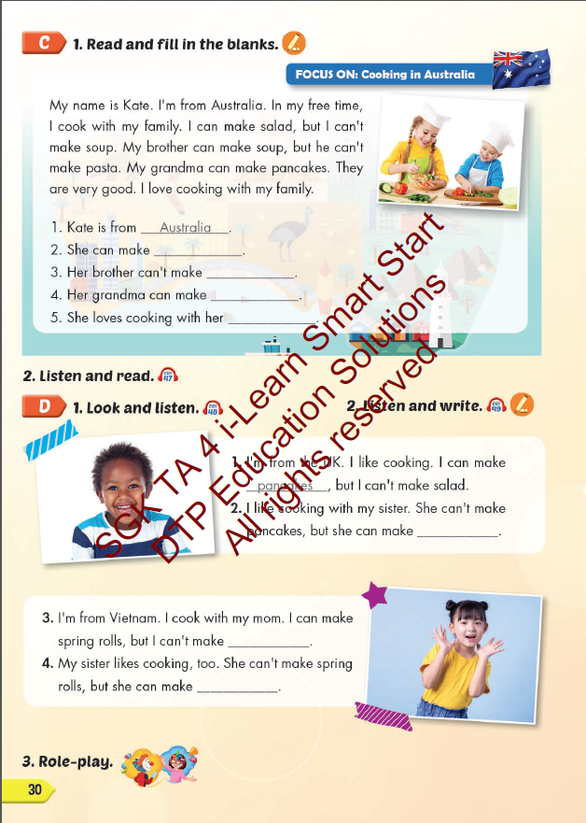
Lesson Outline
Warm-up
Reading
Listening
Consolidation
Wrap-up

Slide 3
Objectives
By the end of this lesson, students will be able to read, listen and talk about cooking in Australia, the UK and Vietnam.
Vocabulary: salad, pasta, pancakes, spring rolls, soup
Structure: I can make pasta, but I can't make soup.

Slide 4

WARM UP

Slide 5


Look and say

Slide 6
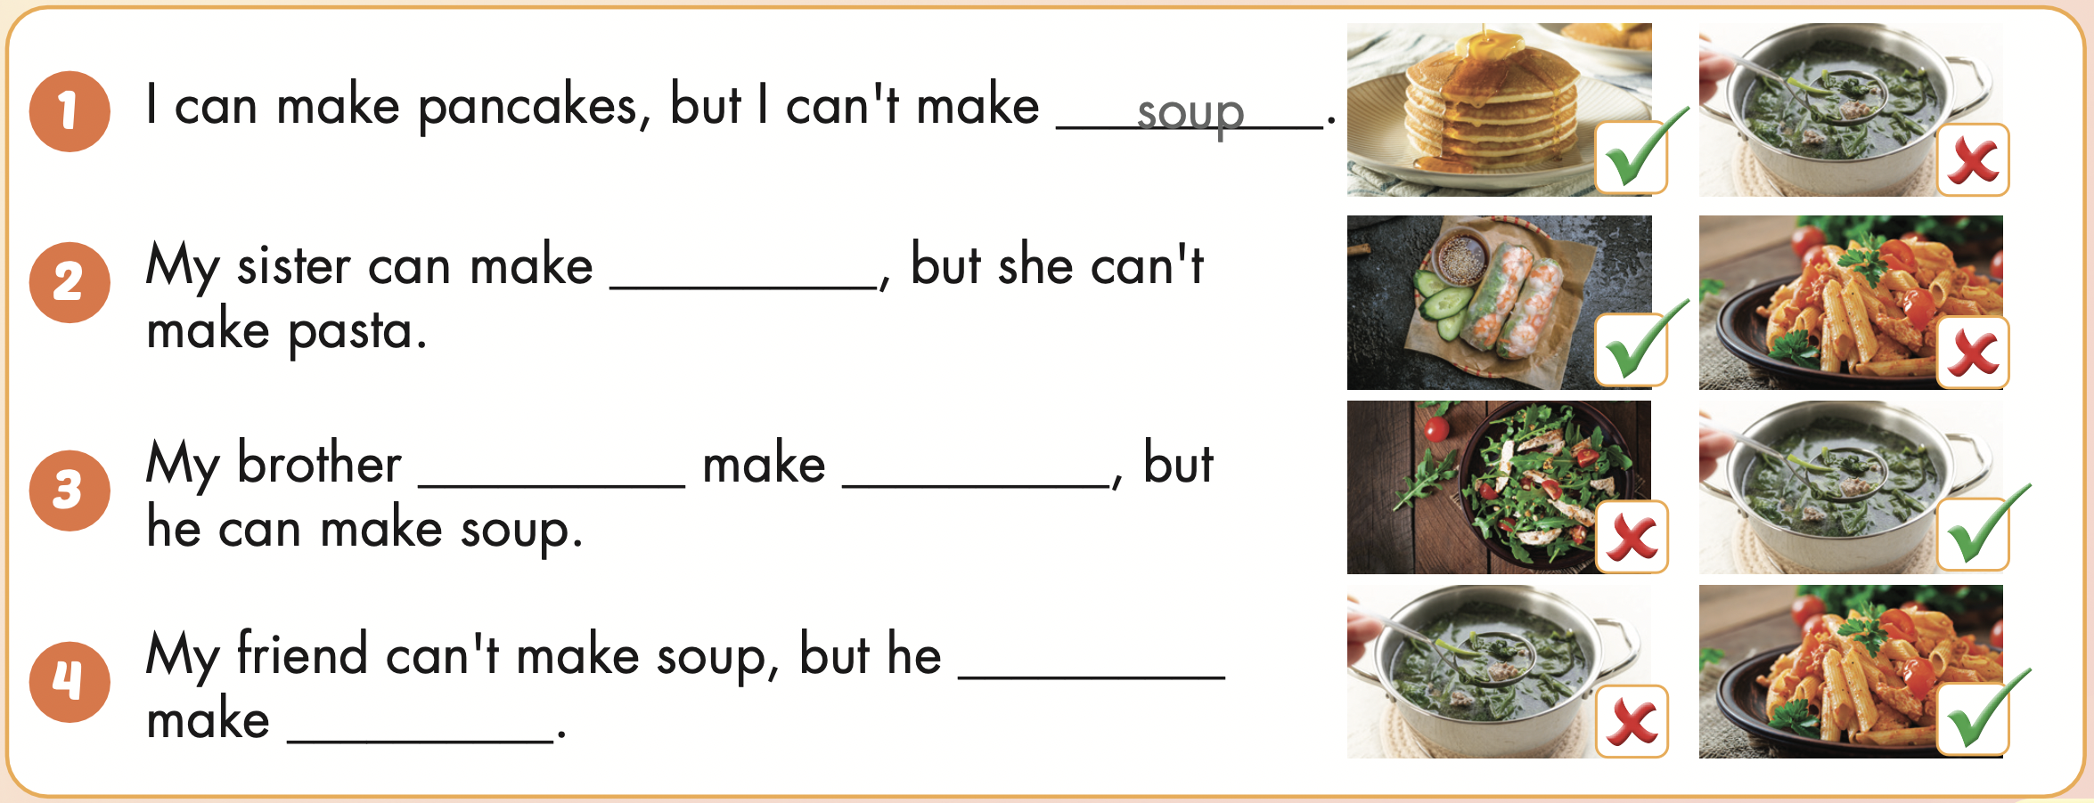
I
I can make pancakes, but I can’t make soup.

Slide 7
My sister
My sister can make spring rolls, but she can’t make pasta.

Slide 8
My brother
My brother can’t make salad, but he can make soup.

Slide 9
My friend
My friend can’t make soup, but he can makepasta.

Slide 10

It’s time to learn …

Slide 11

Reading

Slide 12
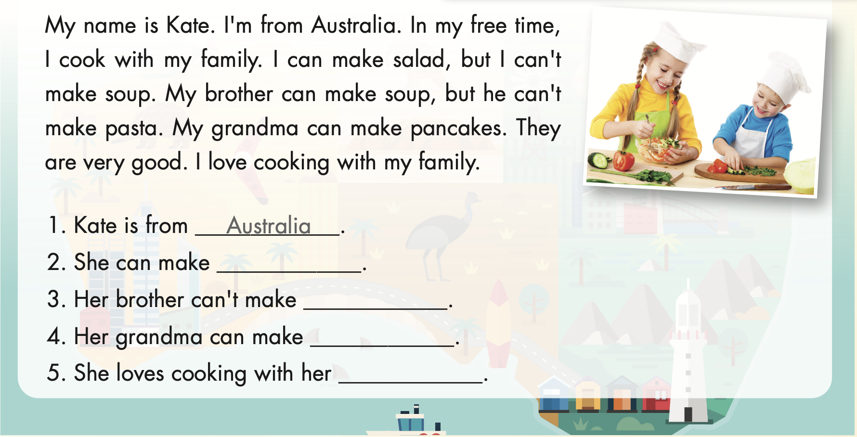
LOOK AT THE PICTURE AND ANSWER THESE QUESTIONS
What can she do?
Where are they from?

Slide 13


Slide 14


READ AND CHOOSE

Slide 15
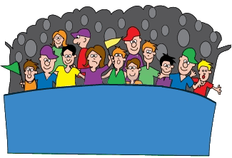





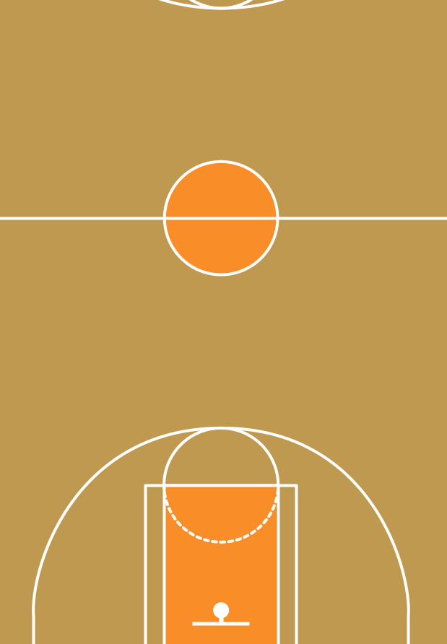


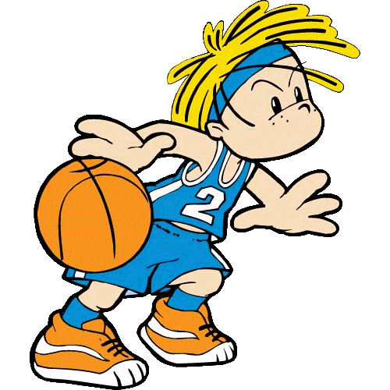
Kate is from.....
Vietnam
Australia
England
Japan

Slide 16
She can make......
pasta
soup
salad
pancakes

Slide 17
Her brother can’t make....
pasta
soup
salad
pancakes

Slide 18
Her grandma can make....
soup
pasta
pancakes
salad

Slide 19
She loves cooking with her....
brother
grandma
mother
family

Slide 20



Slide 21

Listening

Slide 22

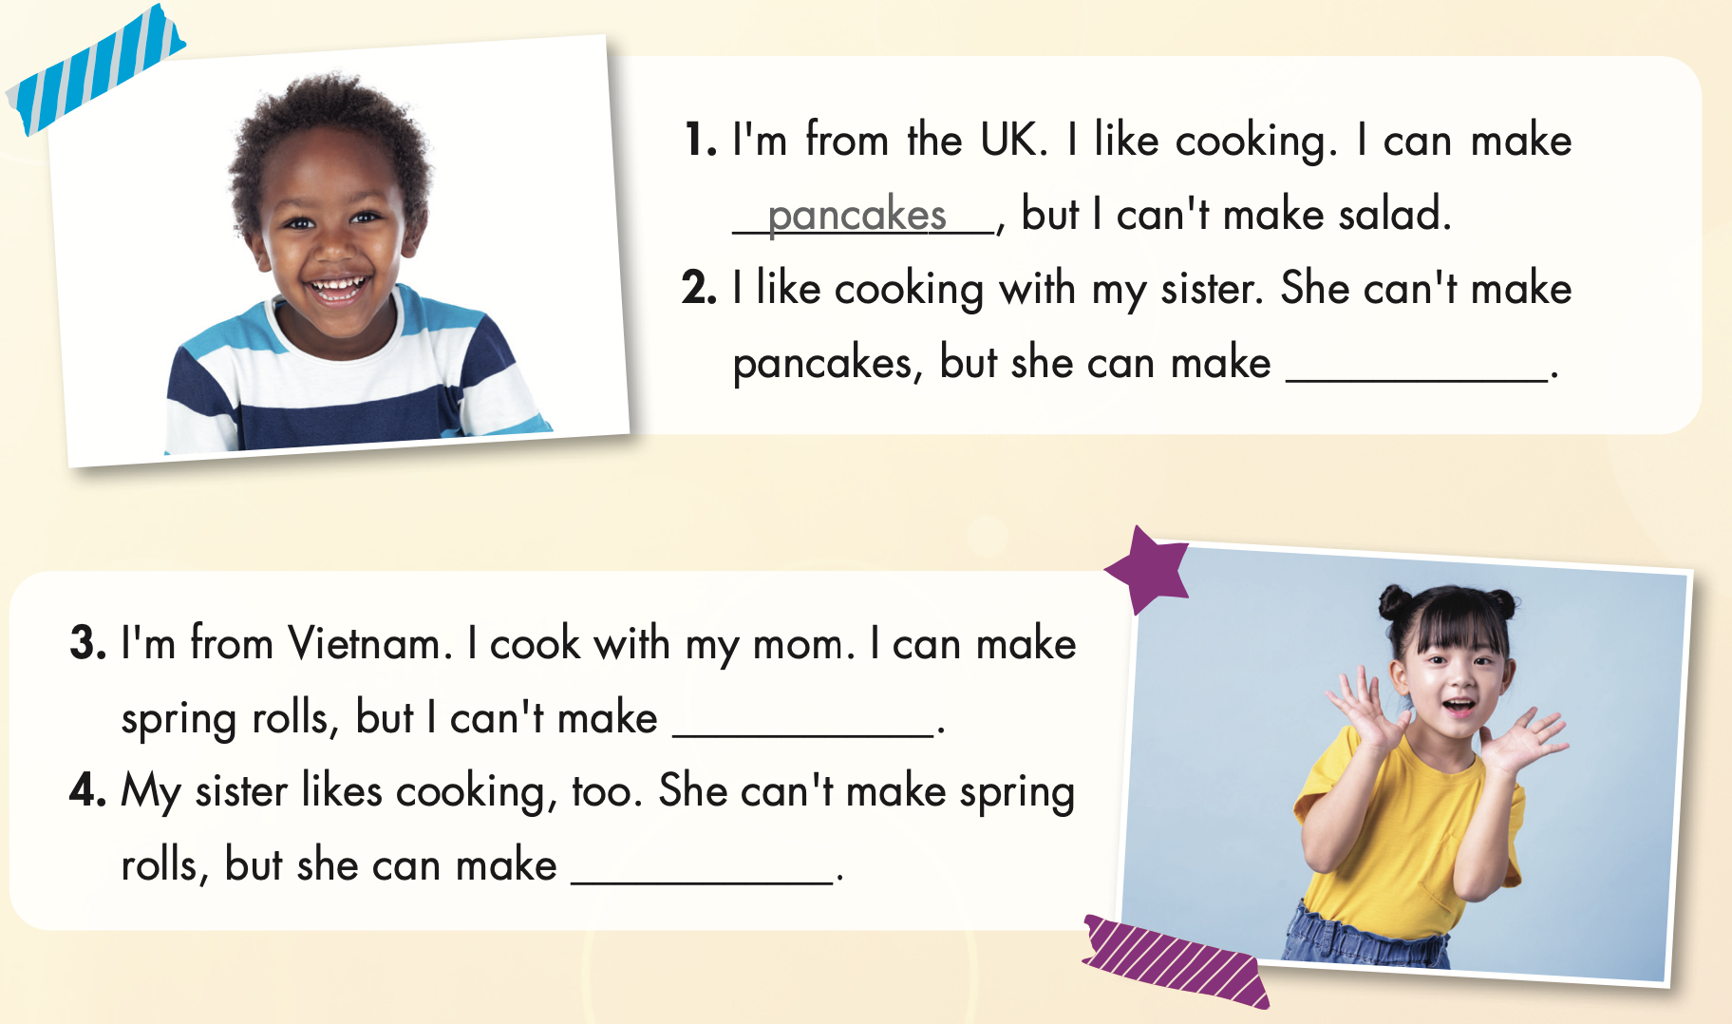

Slide 23

soup
salad
pasta

Slide 24

Speaking

Slide 25



Slide 26

CONSOLIDATION

Slide 27

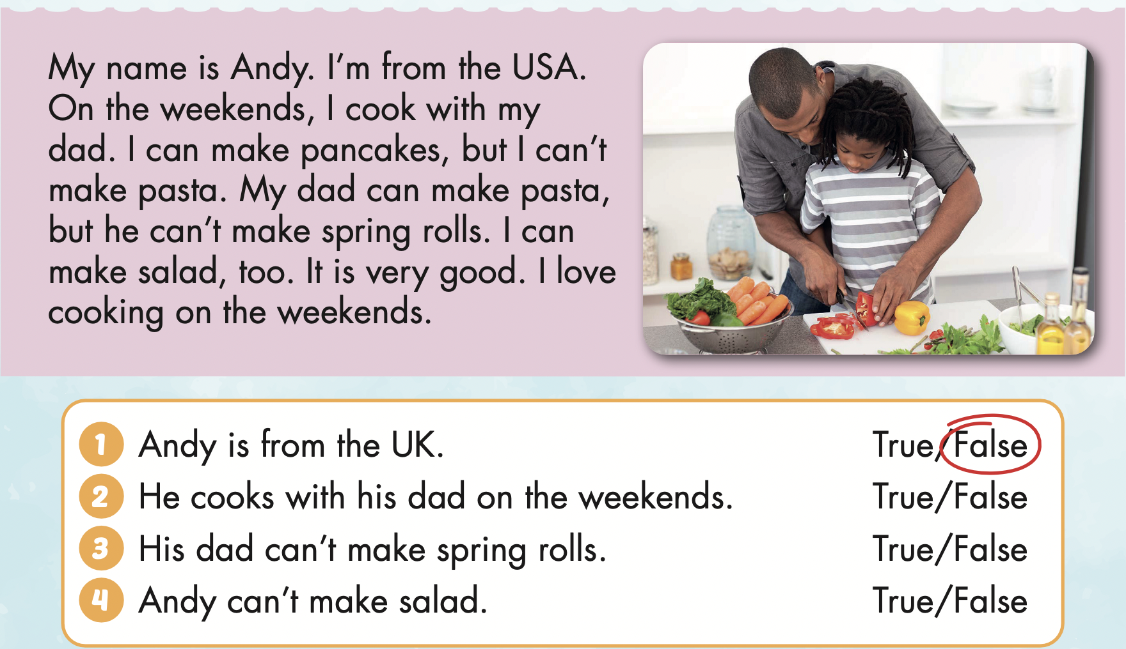
Extra Practice
WB, page 19

Slide 28

WRAP-UP

Slide 29
Today’s lesson
Vocabularies
salad,
pasta,
pancakes,
spring rolls,
soup
Structures/ Sentence patterns
I can make pasta, but I can't make soup.

Slide 30
Homework
Practice the vocabularies and structure; and make sentences using them.
Do the exercises in Tiếng Anh 4 i-Learn Smart Start WB (page 19)
Do the exercises in Tiếng Anh 4 i-Learn Smart Start Notebook (page 13)
Prepare the next lesson (page 31 SB)
Play the consolidation games in Tiếng Anh 4 i-Learn Smart Start DHA App on www.eduhome.com.vn

Slide 31

Enjoy your day!

