Slide 1

Unit 2
WHAT I CAN DO
REVIEW 1- PAGE 32

Slide 2
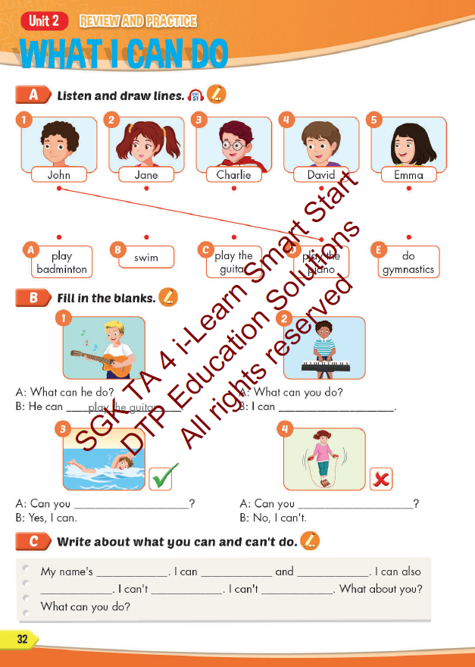
Lesson Outline
Warm-up
Reading
Listening
Consolidation
Wrap-up

Slide 3
Objectives
By the end of this lesson, students will be able to review unit 2.
Vocabulary: play badminton, play the guitar, swim, play the piano, do gymnastics
Structure:
What can you do?
I can swim.
Can you play the piano?
Yes, I can. / No, I can’t.

Slide 4

WARM UP

Slide 5

WORD
Click on the right word

Slide 6

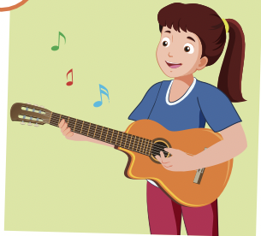


Click on the right word
play the piano
drive a car
play the guitar

Slide 7
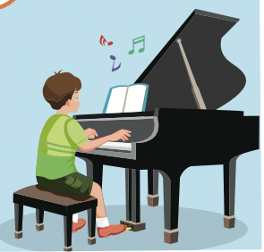
Click on the right word
play the piano
drive a car
ride a bike

Slide 8
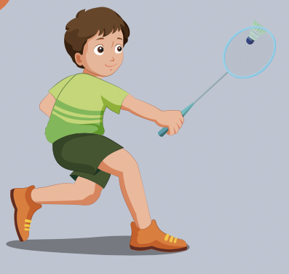
Click on the right word
do gymnastics
play badminton
swim

Slide 9
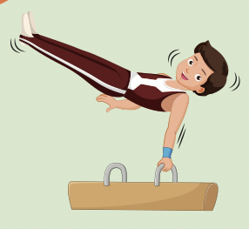
Click on the right word
do gymnastics
play the drums
ride a bike

Slide 10
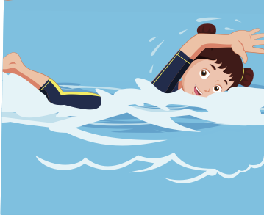
Click on the right word
play badminton
play the drums
swim

Slide 11

It’s time to learn …

Slide 12

Listening

Slide 13


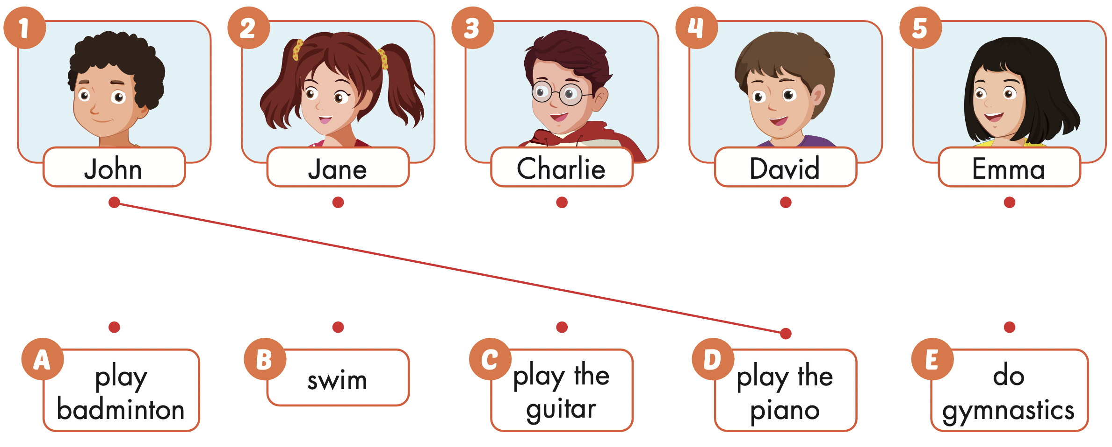

Slide 14

Writing

Slide 15

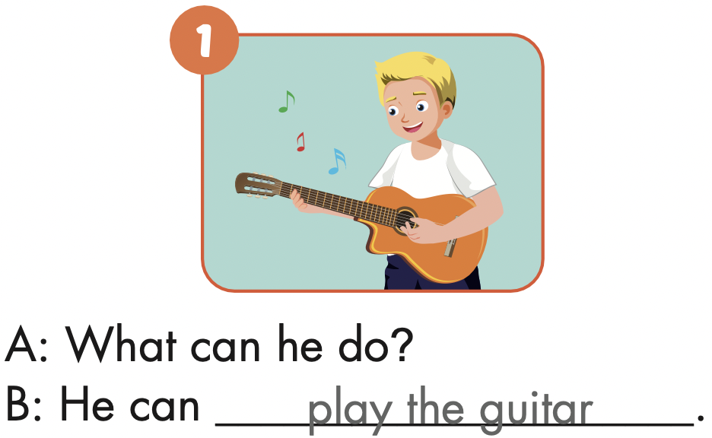

Slide 16
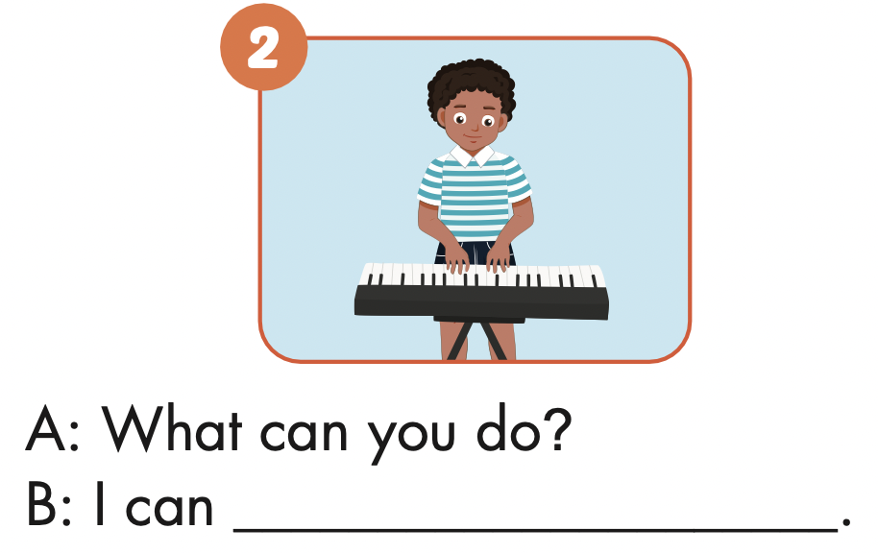
play the keyboard

Slide 17
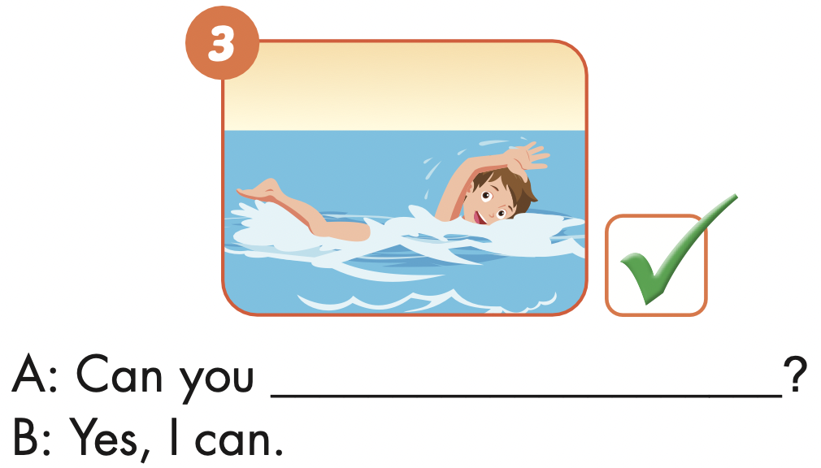
swim

Slide 18
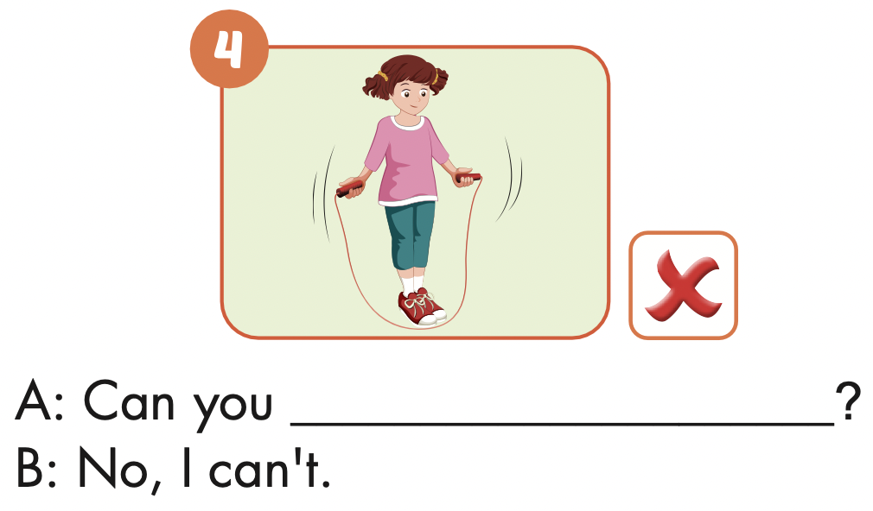
hop

Slide 19
Writing

Slide 20
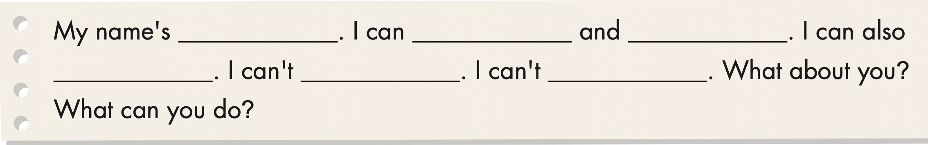

Slide 21

Speaking

Slide 22

Work in pairs to share your writing

Slide 23

READ AND CHOOSE

Slide 24
What can you do?
I can swim.
Yes, I can.
She can swim.

Slide 25
What can she do?
He can swim.
Yes, I can.
She can swim.

Slide 26
Can you dance?
Yes, she can.
Yes, he can.
Yes, we can.

Slide 27
Can he play the guitar?
Yes, I can.
No, he can’t.
He can swim.

Slide 28

CONSOLIDATION

Slide 29

WRAP-UP

Slide 30
Today’s lesson
Vocabularies
play badminton,
play the guitar,
swim,
play the piano,
do gymnastics
Structures/ Sentence patterns
What can you do?
I can swim.
Can you play the piano?
Yes, I can. / No, I can’t.

Slide 31
Homework
Practice the vocabularies and structure; and make sentences using them.
Do the exercises in Tiếng Anh 4 i-Learn Smart Start WB (page 20)
Do the exercises in Tiếng Anh 4 i-Learn Smart Start Notebook (page 15)
Prepare the next lesson (page 33 SB)
Play the consolidation games in Tiếng Anh 4 i-Learn Smart Start DHA App on www.eduhome.com.vn

Slide 32

Enjoy your day!

