Slide 1

Warm up

Slide 2
Thursday, October 2nd 2025
Unit 1: My friends
Lesson 4.1 (P19)

Slide 3







Slide 4

hi

Slide 5

good

Slide 6

great

Slide 8

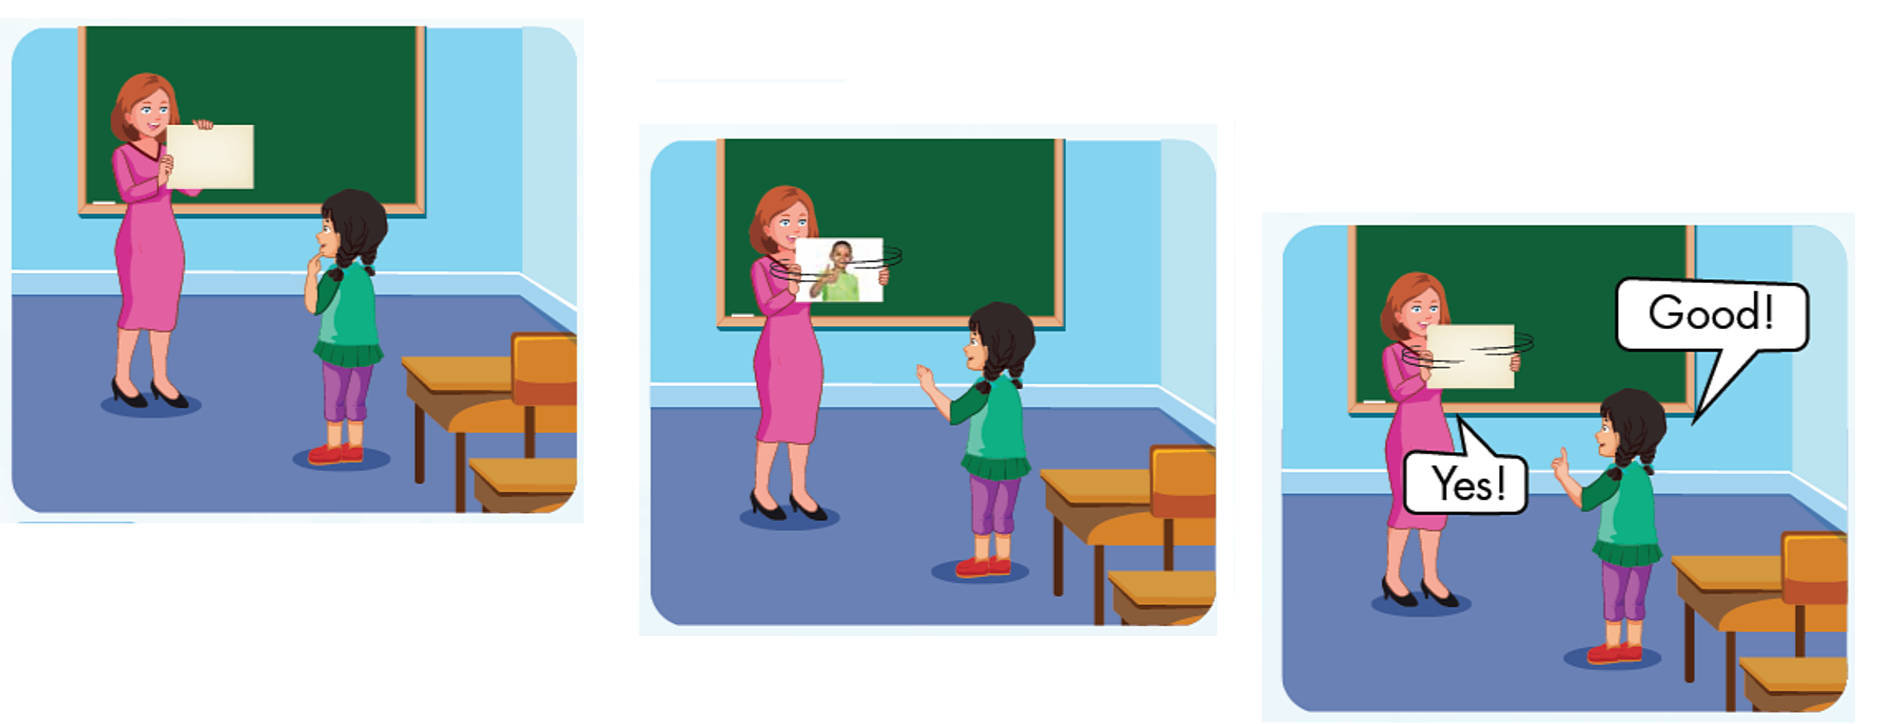

Slide 9








Slide 10
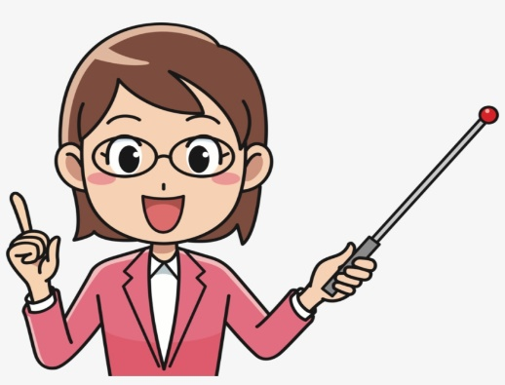
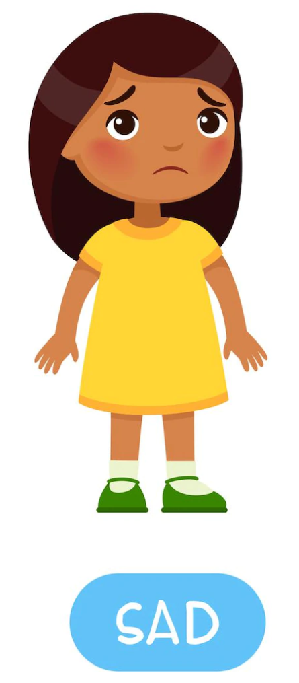


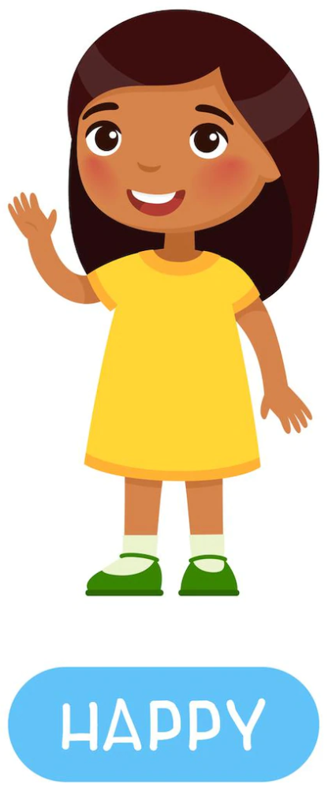
* Asking and answering about health
How are you ?
I’m ____. And you ?

Slide 11




How are
you
welcome

Slide 12
Wrap up
Learn by heart vocabulary
Do homework in workbook
Prepare new lesson

Slide 13


