Slide 1
Monday, September 29th 2025
Unit 1: My friends
Lesson 3.1 (P16)

Slide 2


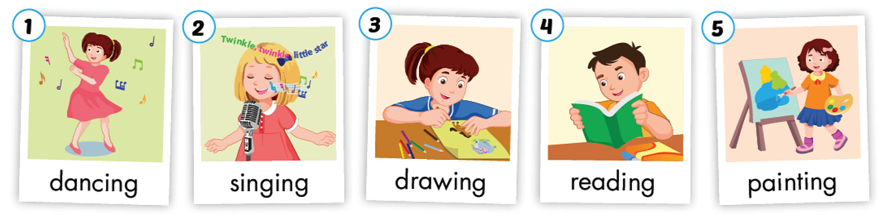

Slide 3
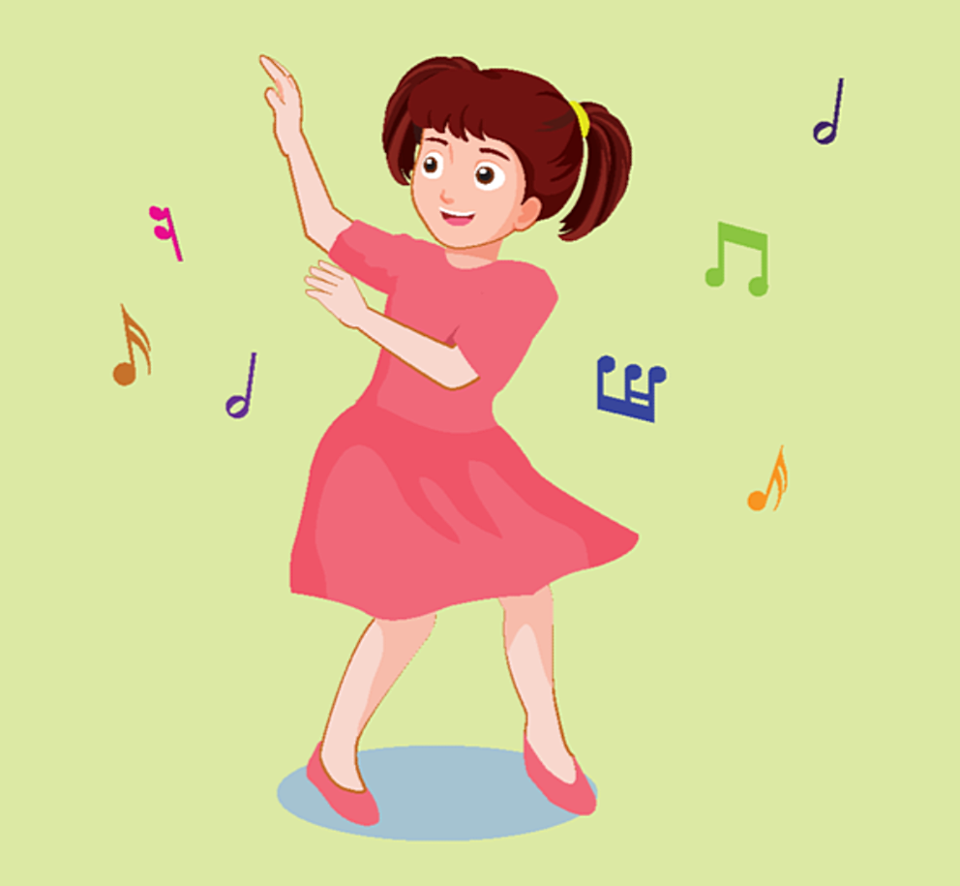
d
a
n
c
i
n
g

Slide 4

s
i
n
g
i
n
g

Slide 5
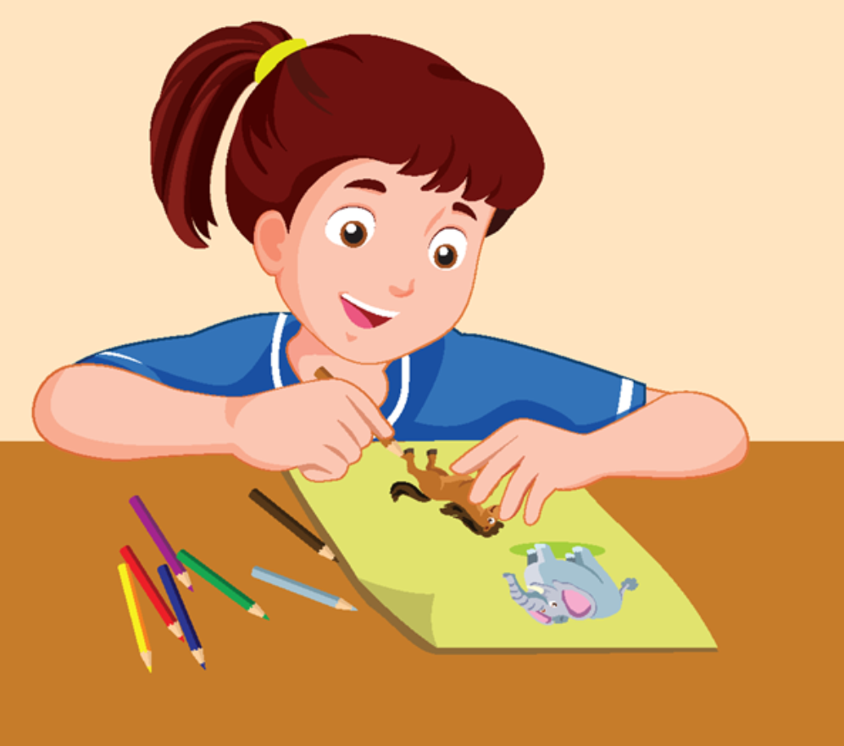
d
r
a
w
i
n
g

Slide 6

r
e
a
d
i
n
g

Slide 7
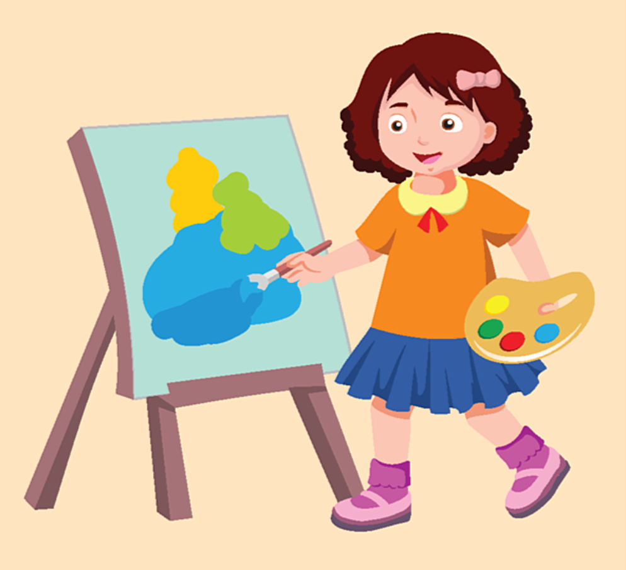
p
a
i
n
t
i
n
g

Slide 9

Play Slow
motion

Slide 10
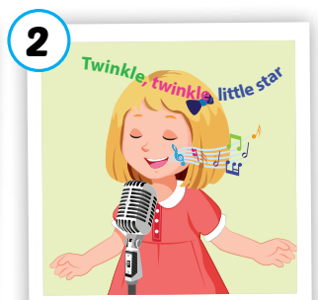
Activity 1
2. Play Slow Motion

singing
Notes:
Click to open the picture under the cover slowly.
Click the star to show answer.

Slide 11
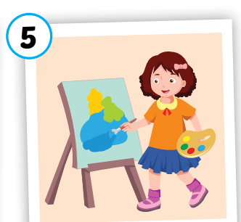
Activity 1
Slow Motion

painting
Notes:
Click to open the picture under the cover slowly.

Slide 12
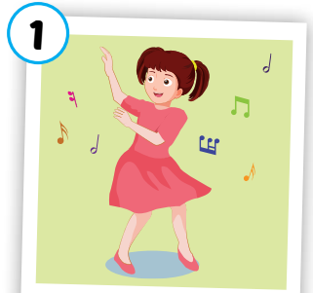
Activity 1
Slow Motion

dancing
Notes:
Click to open the picture under the cover slowly.

Slide 13
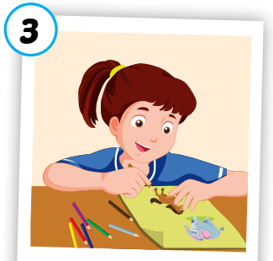
Activity 1
Slow Motion

drawing
Notes:
Click to open the picture under the cover slowly.

Slide 14

Activity 1
Slow Motion

reading
Notes:
Click to open the picture under the cover slowly.

Slide 15


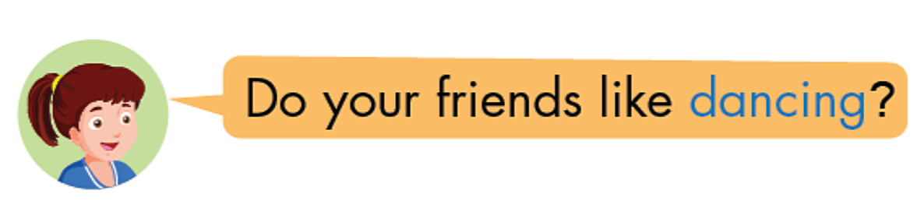
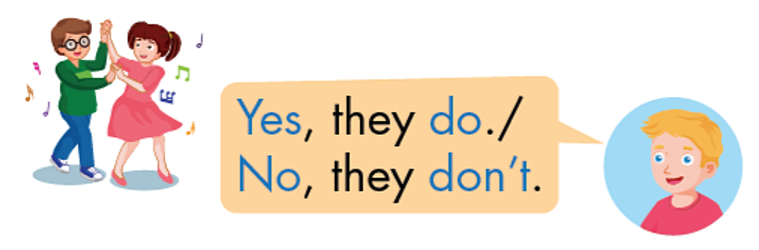

Slide 16



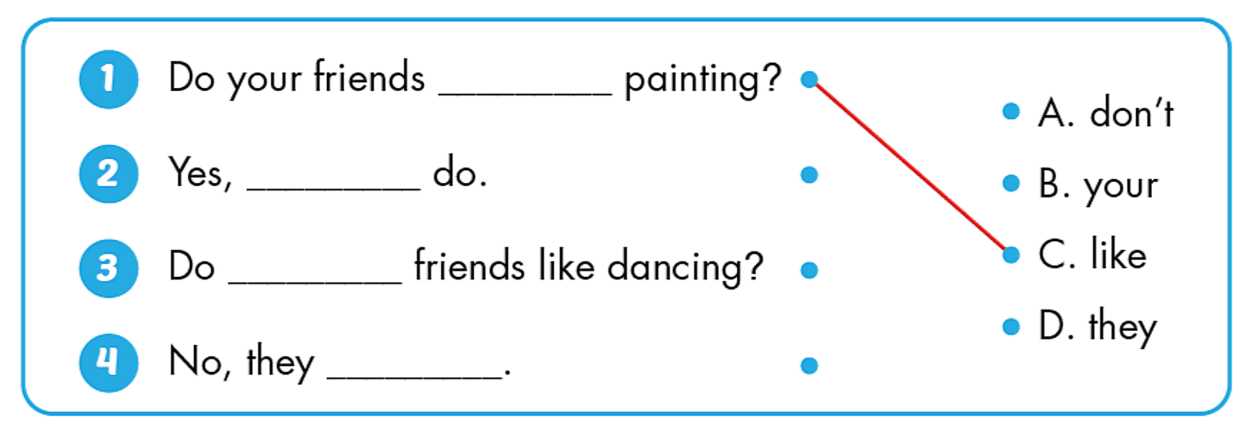
like
they
your
don’t

Slide 17
Wrap up
Learn by heart vocabularies and structure
Do homework in workbook
Prepare new lesson 3.2 (P17)

Slide 18


