Slide 1

Warm up

Slide 2
Review

Slide 3
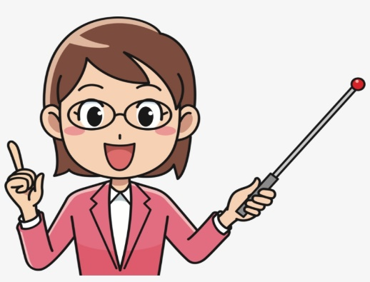

Review Sentence
How do you spell “ ….”?
………..

Slide 4
Tuesday, September 23rd 2025
Unit 1: My friends
Lesson 2.1 (P13)

Slide 5


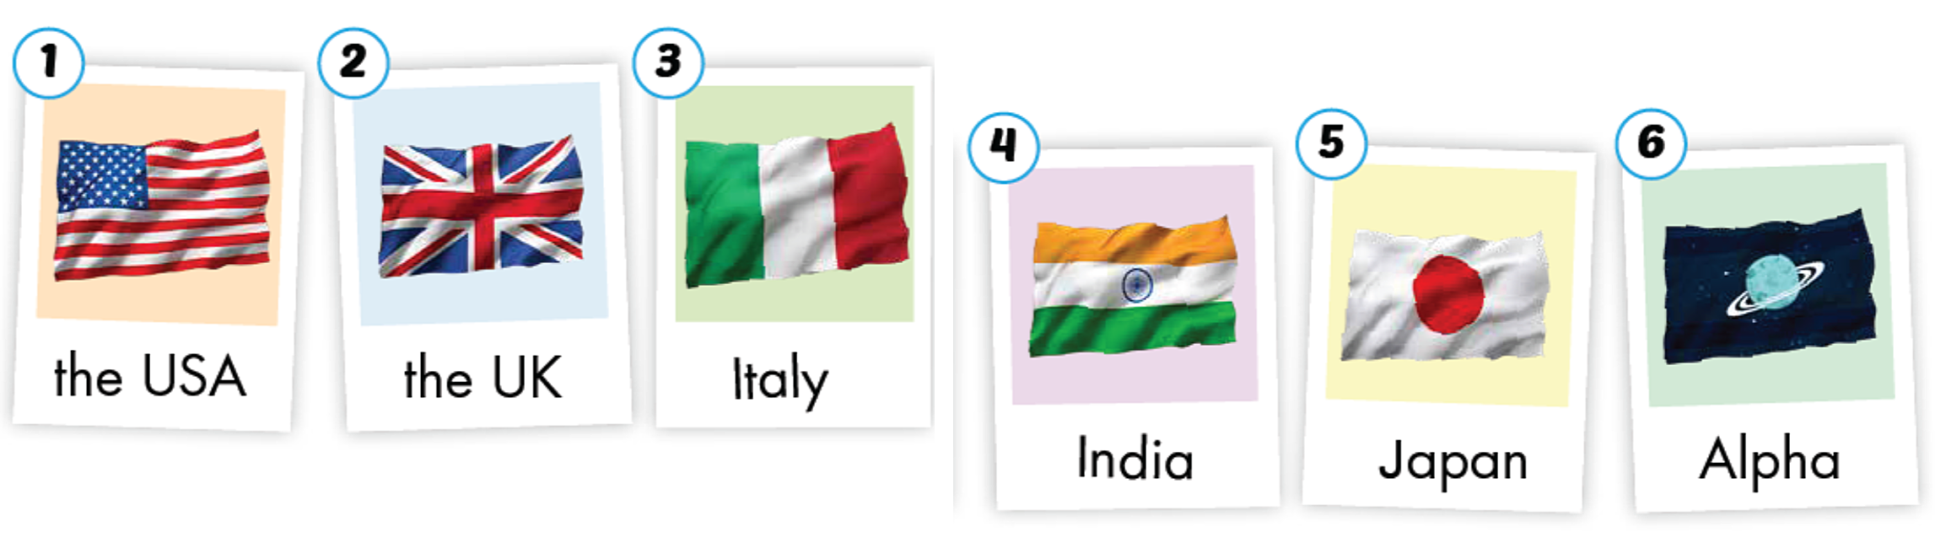

Slide 6



Slide 7



Slide 8



Slide 9



Slide 10



Slide 11
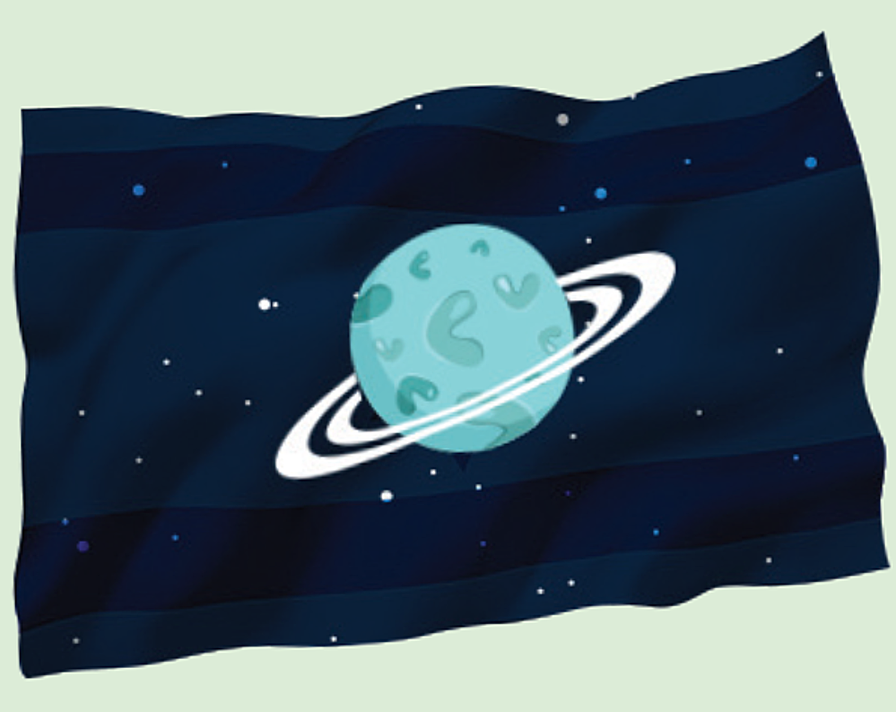


Slide 13

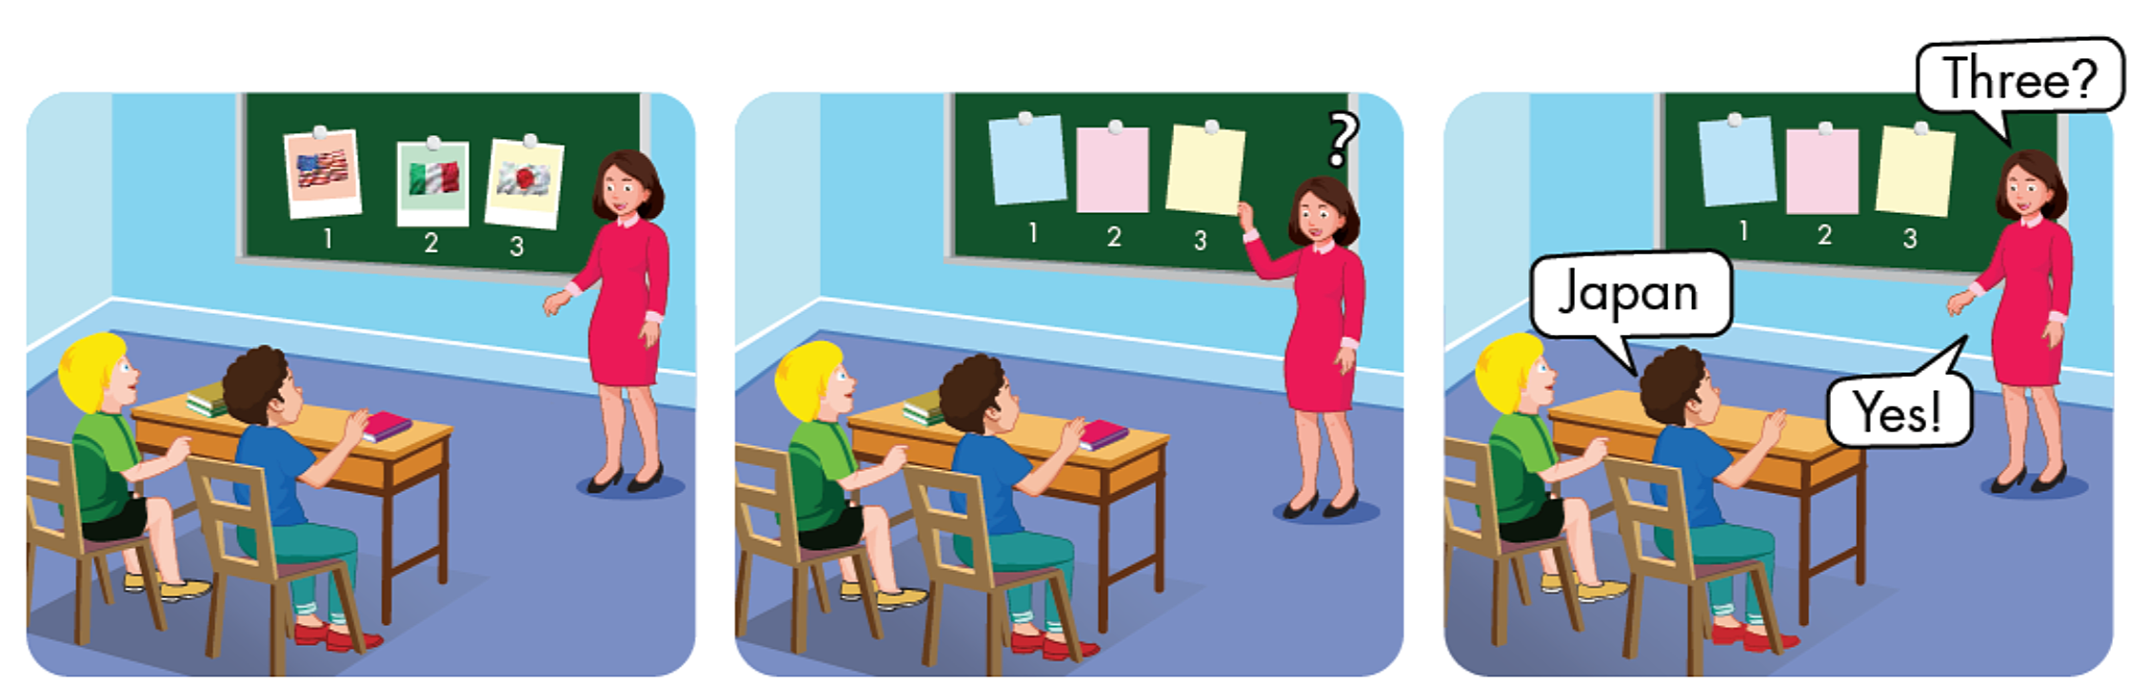

Slide 14

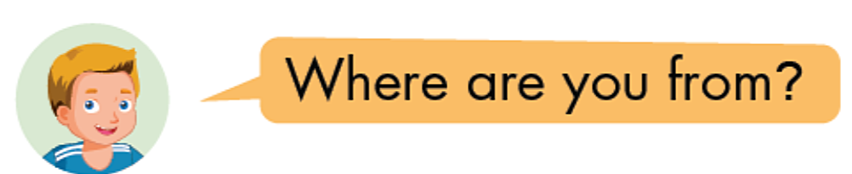
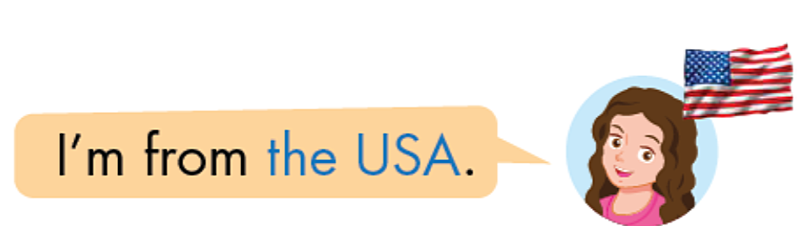
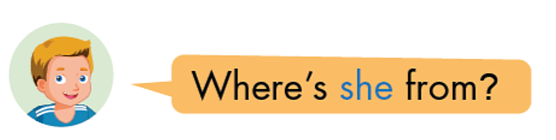
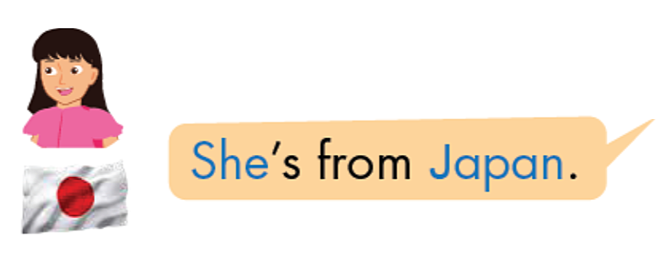


Slide 15
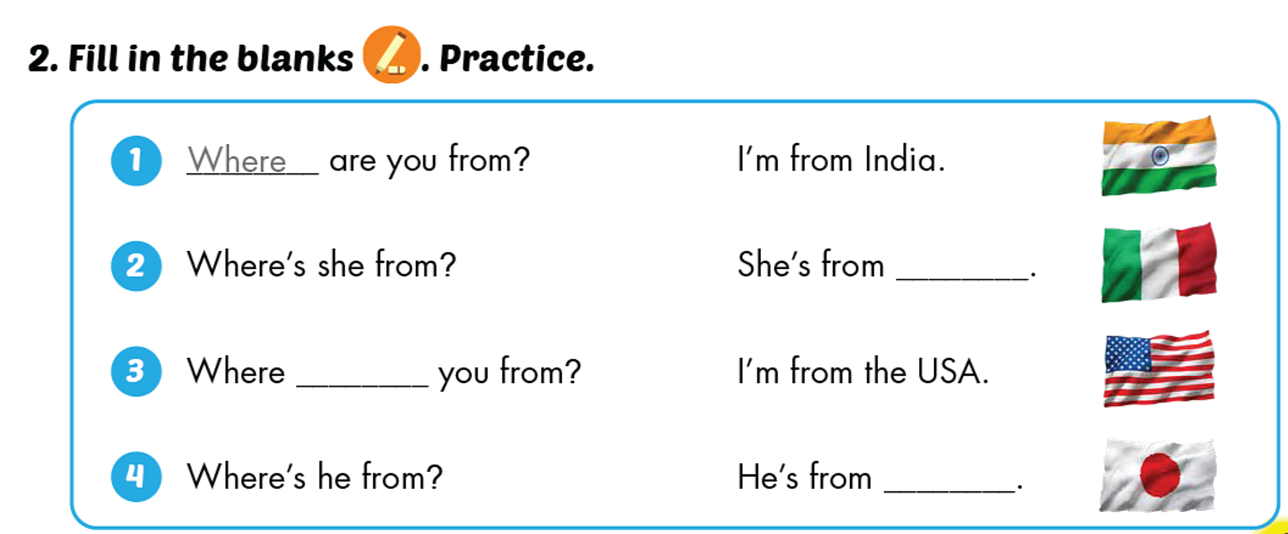
Italy
are
Japan

Slide 16
Wrap up
Learn by heart vocabulary about countries
Do homework in workbook page 10 + 11
Prepare new lesson page 14

Slide 17


