Slide 1











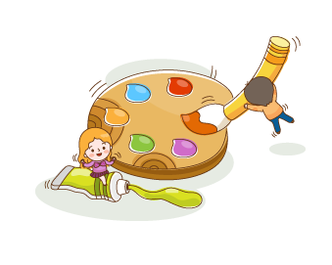
WELCOME TO MY ENGLISH CLASS
Teacher: Nguyen Thi Phuong
Notes:
Thanh Yến Trần 0967 255 149 zalo/ FB https://www.facebook.com/thanhyentrananhngutaymy/

Slide 2

Wednesday, September 17th 2025
Unit 1: My friends
Lesson 1.1 (P10)

Slide 3
A.1. Listen and point.
Repeat

Slide 4




Slide 5
2. Play Head up.
What’s missing?

Slide 6
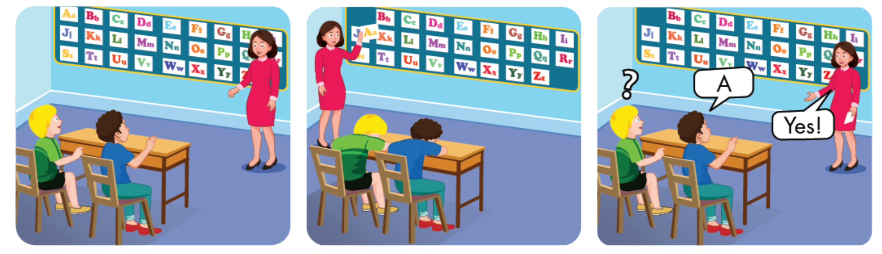

Slide 7
B.1.Listen and
practice

Slide 8

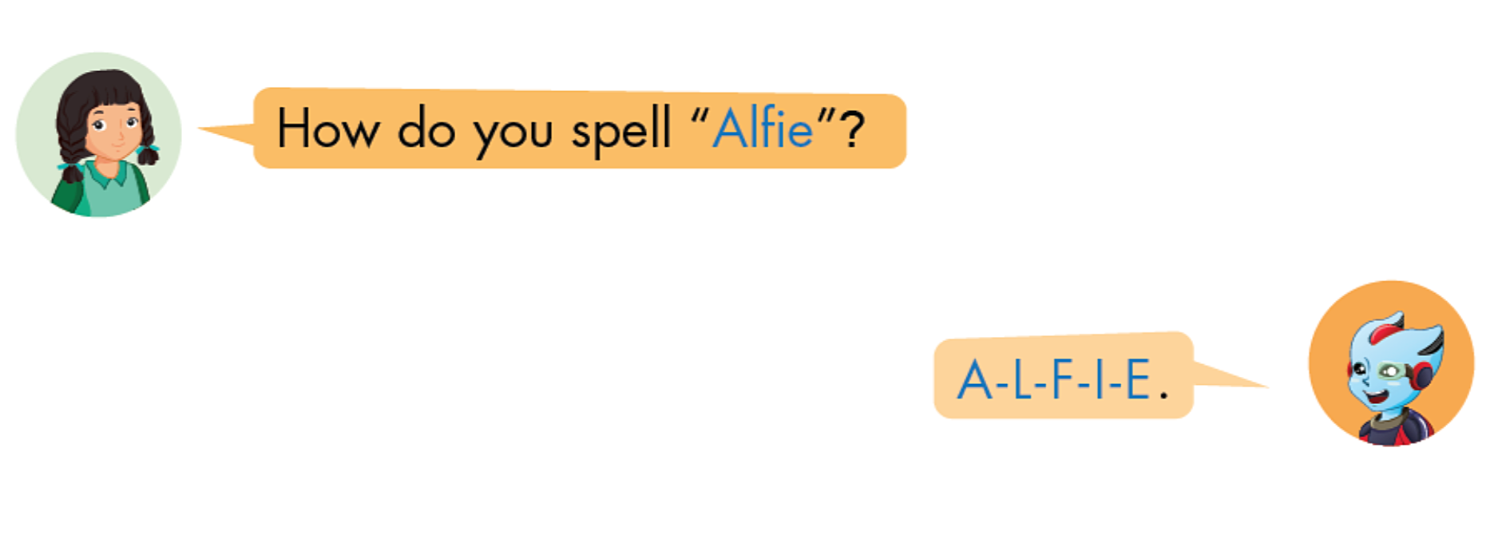

Slide 9


Structure
How do you spell “ Peter”?
P-E-T-E-R

Slide 10
2. Look and match.
Practice

Slide 11
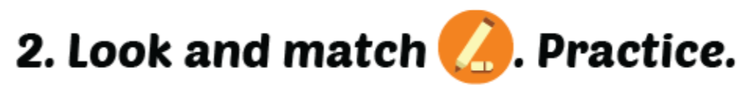

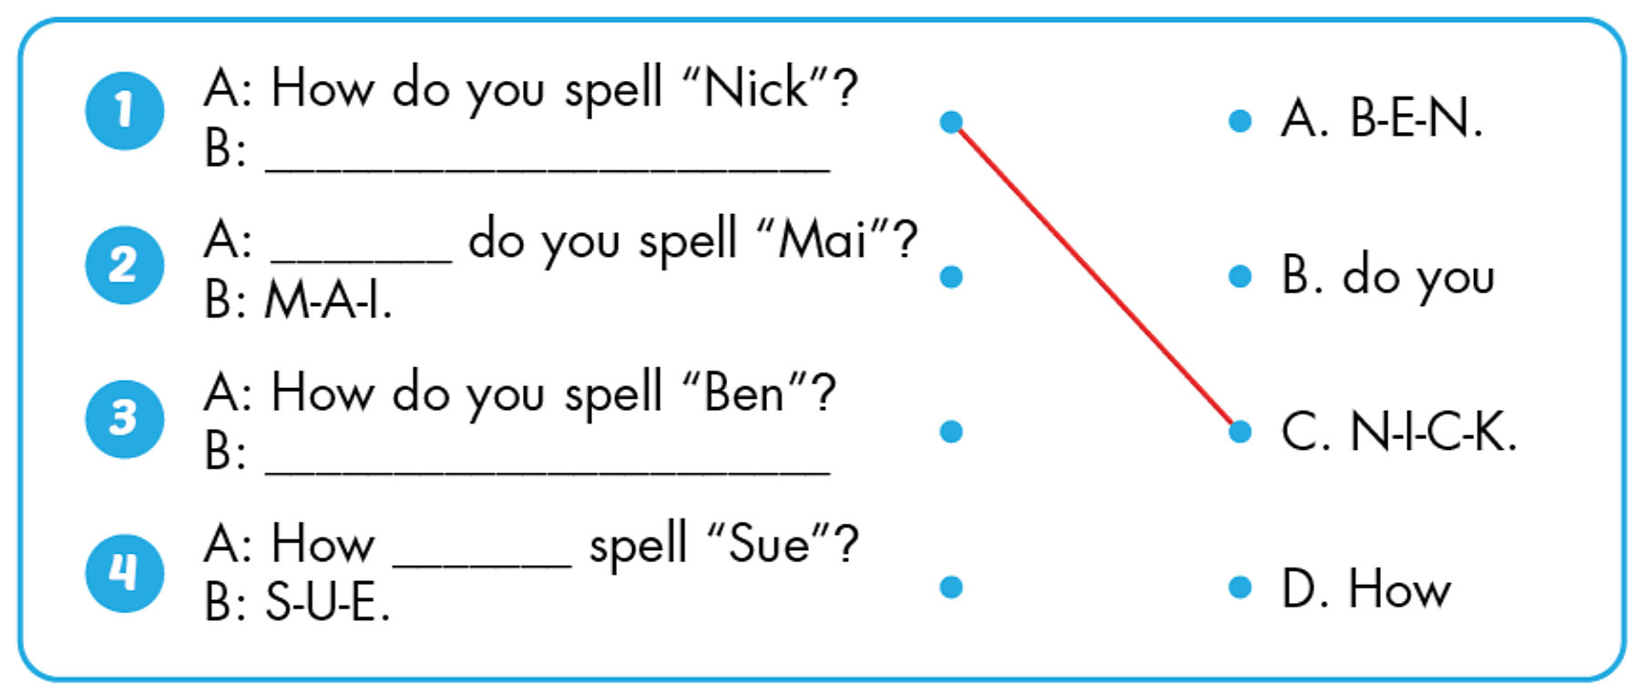

Slide 12
Wrap up
Learn by heart the alphabet
Do homework
Prepare new lesson page 11

Slide 13
GOOD BYE !

