Slide 1

Unit 4: HOME
Lesson 2.3
Page 57

Slide 2
Lesson Outline
Warm-up
Practice
Speaking
Consolidation
Wrap-up

Slide 3
Objectives
By the end of this lesson, students will be able to ask where people are.
Vocabulary: Revision (cleaning, playing, eating, sleeping, cooking).
Structure: Revision
Where’s Dan? He’s in the yard.
What’s he doing? He’s sleeping.

Slide 4

WARM UP

Slide 5
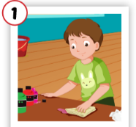
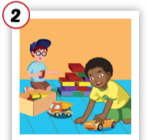
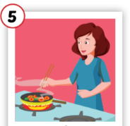
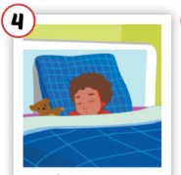
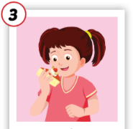
1
2
3
4
5
eating
cleaning
6
8
9
7
10
playing
sleeping
cooking

Slide 6

It’s time to learn …

Slide 7

Practice

Slide 8

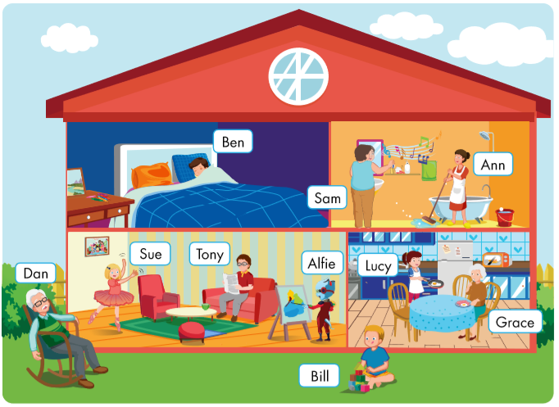
Where’s Dan?
What’s he doing?
He’s in the yard.
He’s sleeping.

Slide 9
Where’s Bill?
What’s he doing?
He’s in the yard.
He’s playing.

Slide 10
Where’s Ben?
What’s he doing?
He’s in the bedroom.
He’s sleeping.

Slide 11
Where’s Sue?
What’s she doing?
She’s in the living room.
She’s dancing.

Slide 12
Where’s Tony?
What’s he doing?
He’s in the living room.
He’s reading.

Slide 13
Where’s Alfie?
What’s he doing?
He’s in the living room.
He’s drawing.

Slide 14
Where’s Sam?
What’s she doing?
She’s in the bathroom.
She’s singing.

Slide 15
Where’s Ann?
She’s in the bathroom.
What’s she doing?
She’s cleaning.

Slide 16
Where’s Lucy?
She’s in the kitchen.
What’s she doing?
She’s cooking.

Slide 17
Where’s Grace?
She’s in the kitchen.
What’s she doing?
She’s eating.

Slide 18

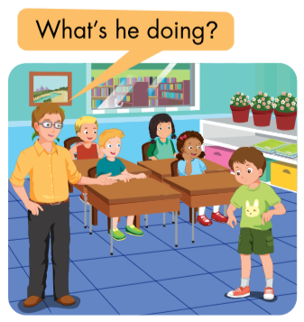
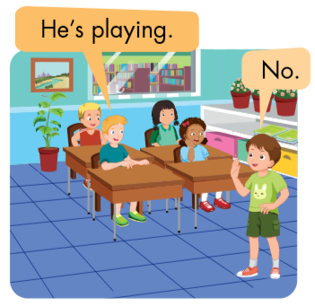
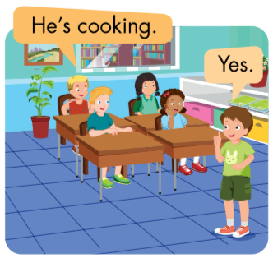

Slide 19

Workbook
p. 41

Slide 20

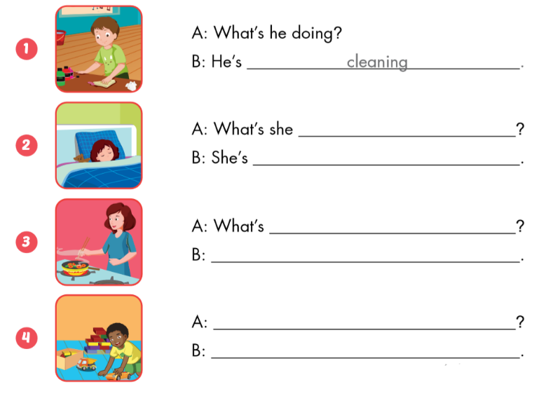
cleaning.
doing?
sleeping.
she doing?
She’s cooking.
What’s he doing?
He’s playing.

Slide 21

CONSOLIDATION

Slide 22

Ask and Answer.
What’s he doing?
He’s playing.

Slide 23
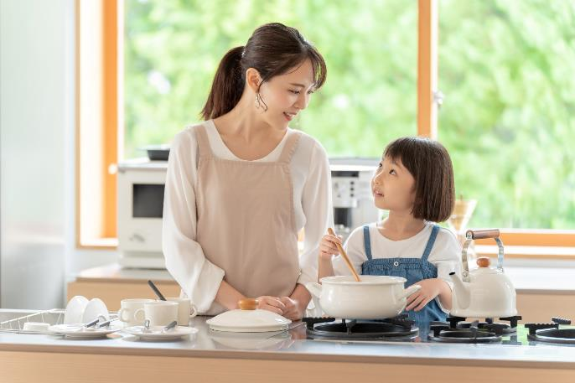
Ask and Answer.
Where’s Mom?
She’s in the kitchen.
What’s she doing?
She’s cooking with Mai.

Slide 24
Lesson 3
Today’s lesson
Vocabularies
bedroom
bathroom
Structures/ Sentence patterns
Where’s Dan?
He’s in the yard.
What’s he doing?
He’s sleeping.

Slide 25
Homework
Review the vocabularies and sentence patterns. Make sentences using them.
Do the exercises on page 41 (WB)
Prepare the next lesson (page 58 SB)
Play the consolidation games in Tiếng Anh 3 i-Learn Smart Start DHA App on www.eduhome.com.vn
Do the exercises in Tiếng Anh 3 i-Learn Smart Start Notebook on page 29.

Slide 26

Enjoy your day!

Slide 27

Have a nice day!

