Slide 1
Welcome to my English class!

Slide 2

WARM UP

Slide 3

LET’S CHANT!

Slide 4

It’s time to learn …

Slide 5

Unit 3: School
Lesson 2.2
Page 42

Slide 6

Presentation

Slide 7

Phonics
/ɪ/

Slide 8


Click on the icon to hear the sound
Click on each word to hear the sound
English
physical
/ɪ/
/ɪ/

Slide 9

Practice

Slide 10
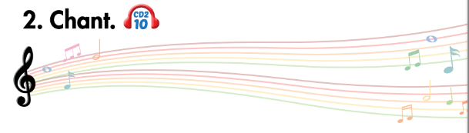
Listen and point
Listen and clap
Listen and chant

Slide 11
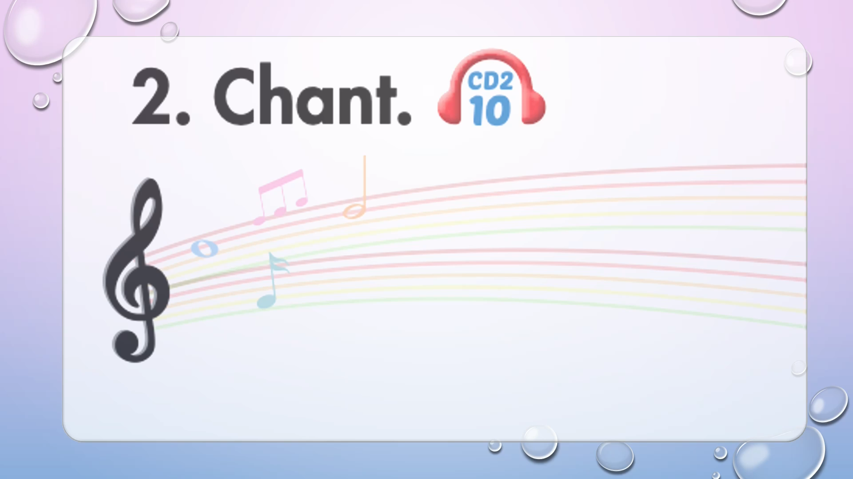

Slide 12

Listening

Slide 13
Pre-Listening
Look at the pictures and answer these questions.

Slide 14
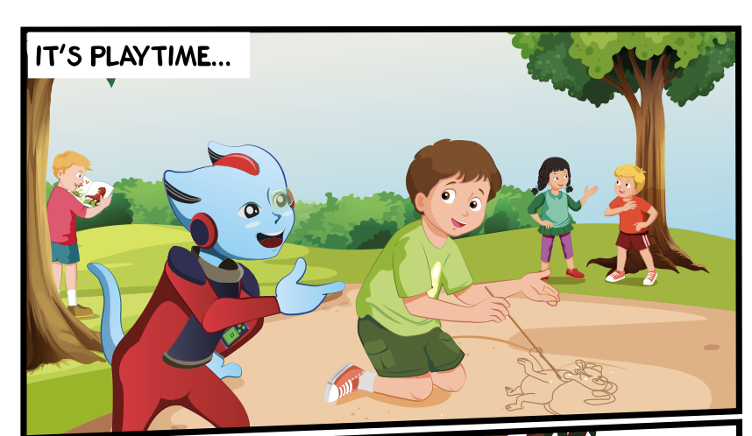
Who can you see?
What are they doing?
Where are they?

Slide 15


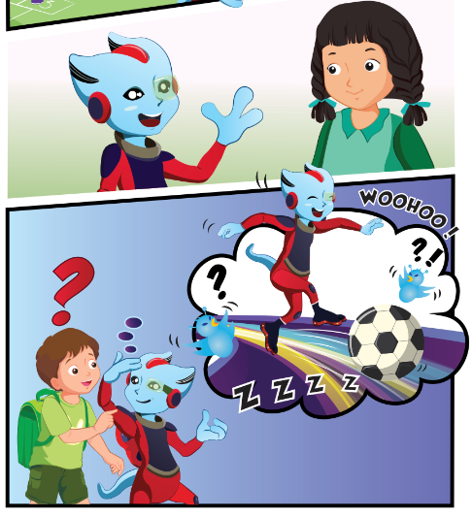

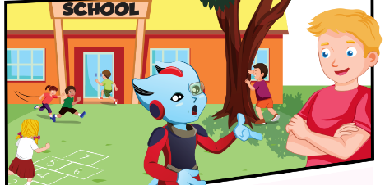
While-Listening
3.
1.
4.
2.

Slide 16

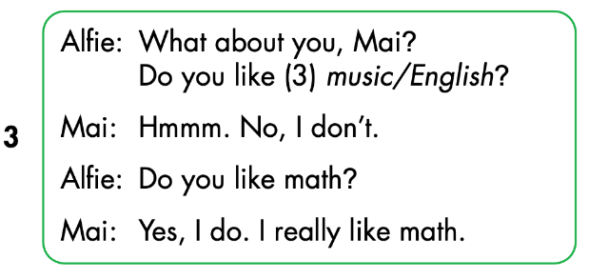
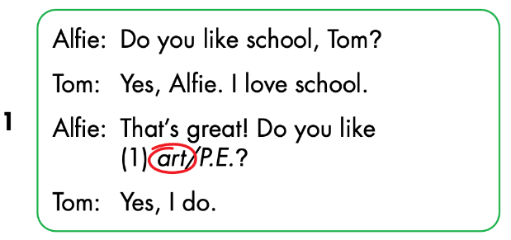
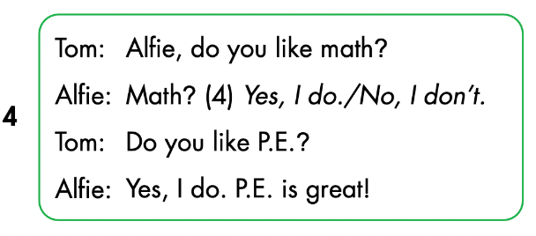
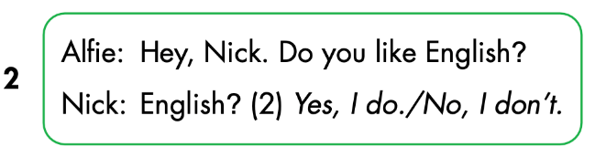

Slide 17
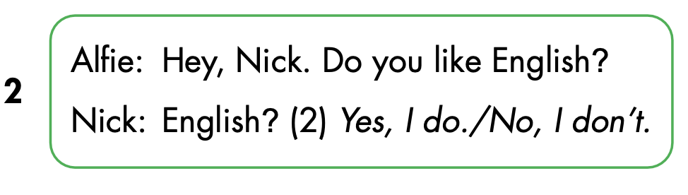
Let’s check!

Slide 18
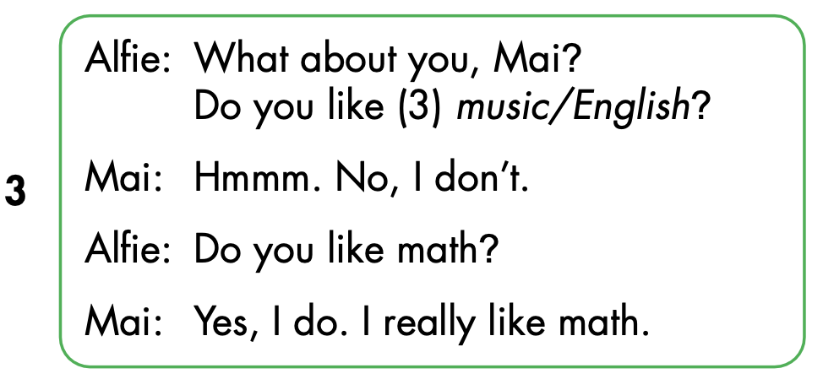

Slide 19
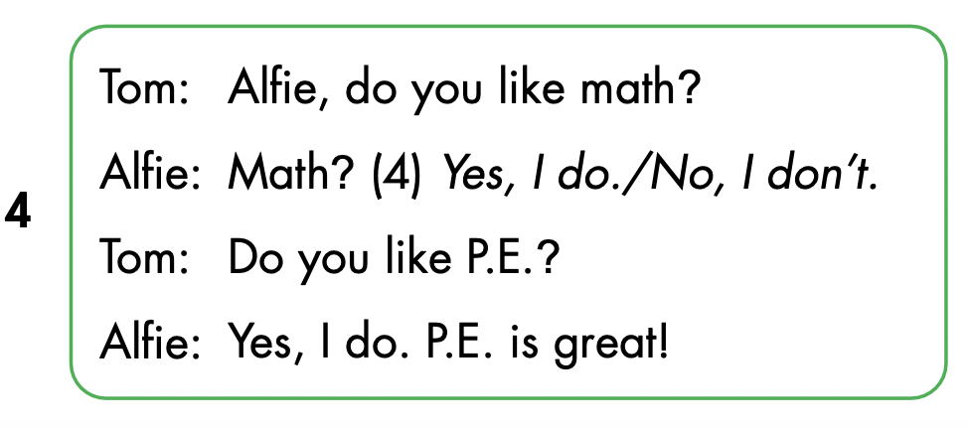

Slide 20

Speaking

Slide 21



Slide 22

CONSOLIDATION

Slide 23

WRAP-UP

Slide 24
Lesson 3
Today’s lesson
Phonics
/ɪ/
Structures/ Sentence patterns
Do you like English?
- Yes, I do./No, I don’t.
.

Slide 25
Lesson 3
Homework
Review the vocabularies, structure and make sentences using them.
Do the exercises on page 31 WB.
Do the exercises in Tiếng Anh 3 i-Learn Smart Start Notebook on page 23.
Prepare the next lesson (page 43 SB).
Play the consolidation games in Tiếng Anh 3 i-Learn Smart Start DHA App on www.eduhome.com.vn

Slide 26

Lesson 3
Stay positive and have a nice day!

Slide 27
CONSOLIDATION

Slide 28
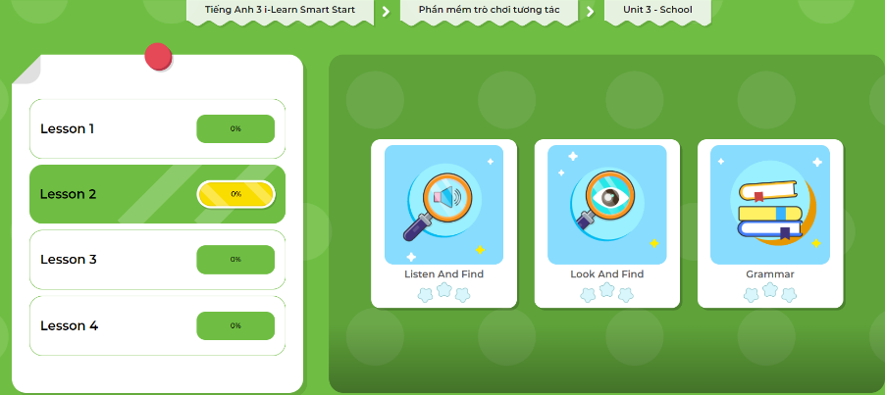
Extra Practice
DHA App
Let’s play!
Click here to play the games.

Slide 29
WRAP-UP

Slide 30
Lesson 3
Today’s lesson
Phonics
/eɪ/ and /ɪə/
Structures/ Sentence patterns
Is this your (eraser)?
- Yes, it is./No, it isn't.
Are these your (notebooks)?
- Yes, they are./No, they aren't.

Slide 31
Lesson 3
Homework
Review the vocabularies, structure and make sentences using them.
Do the exercises on page 31 WB.
Do the exercises in Tiếng Anh 3 i-Learn Smart Start Notebook on page 23.
Prepare the next lesson (page 43 SB).
Play the consolidation games in Tiếng Anh 3 i-Learn Smart Start DHA App on www.eduhome.com.vn

Slide 32
Lesson 3
Stay positive and have a nice day!

