Slide 1
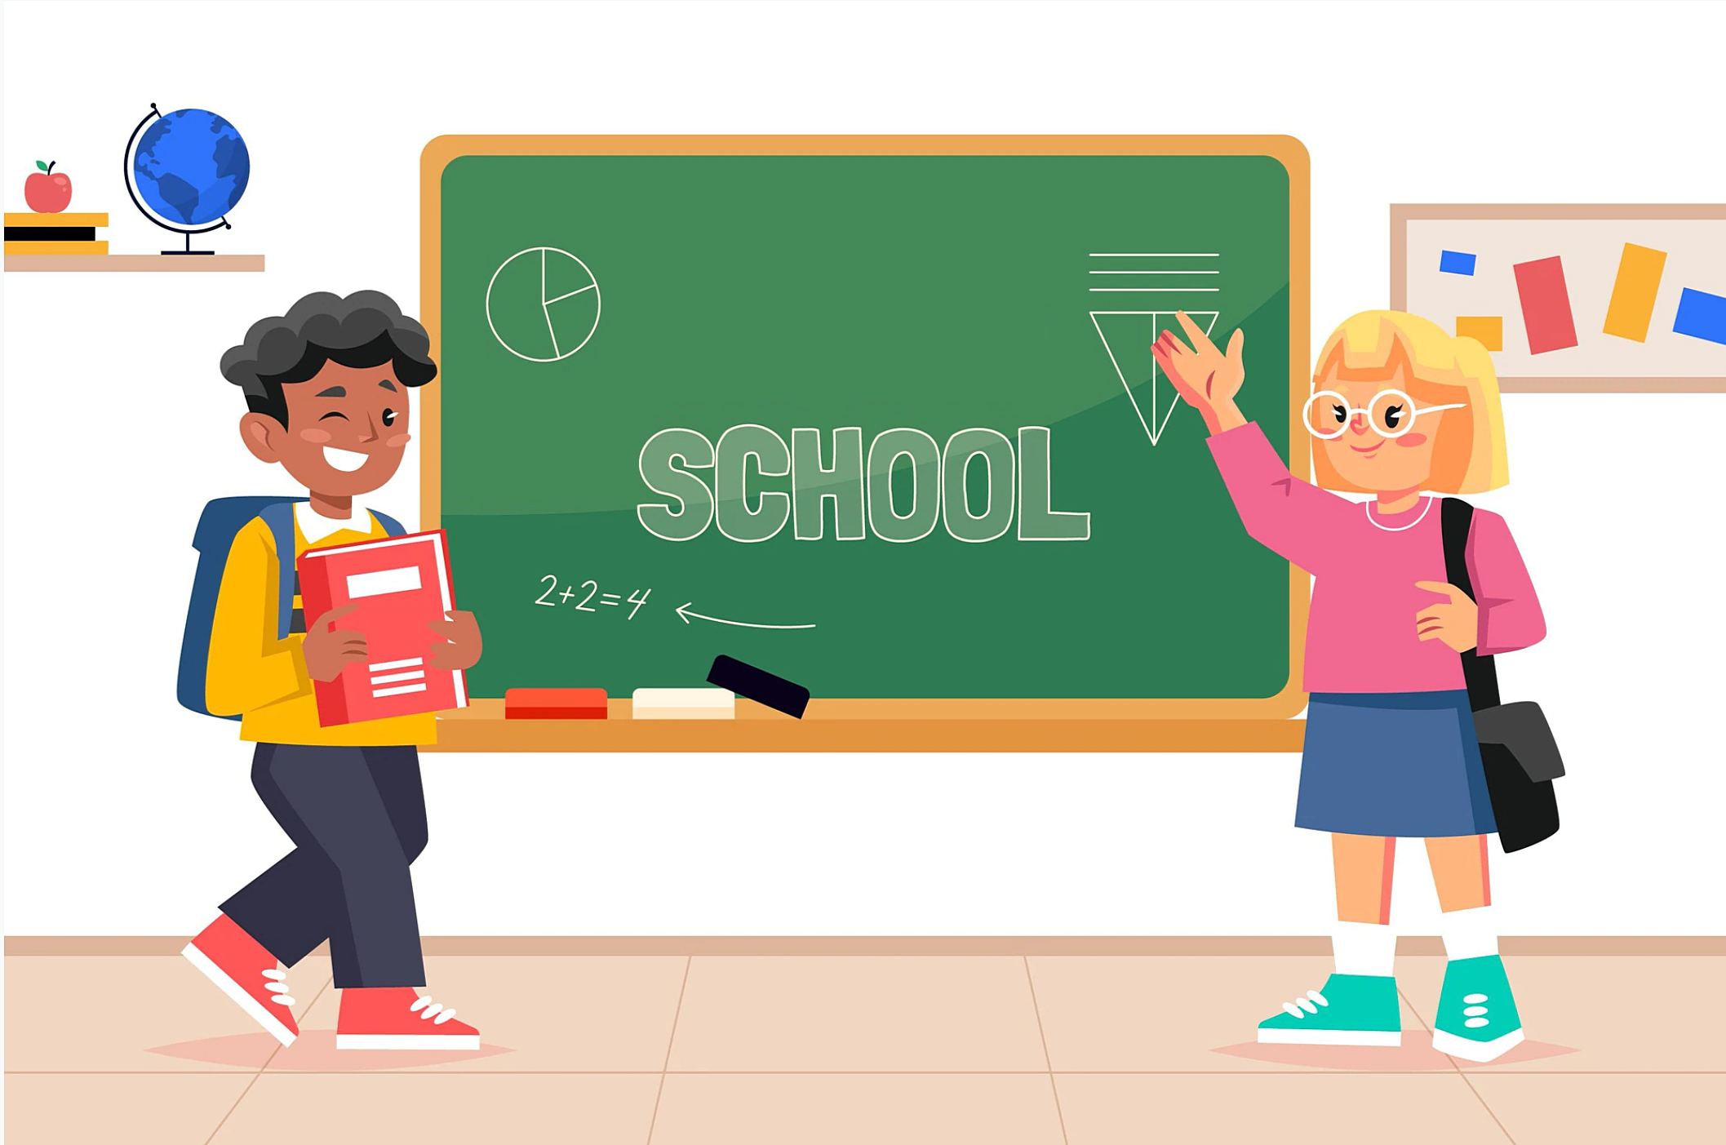
Unit 3: School
Lesson 1.1
Teacher: Nguyen Thi Phuong
Notes:
Thanh Yến Trần 0967 255 149 zalo/ FB https://www.facebook.com/thanhyentrananhngutaymy/

Slide 2

A. 1. Listen and point. Repeat

Slide 3




Notes:
Thanh Yến Trần 0967 255 149 zalo/ FB https://www.facebook.com/thanhyentrananhngutaymy/

Slide 4
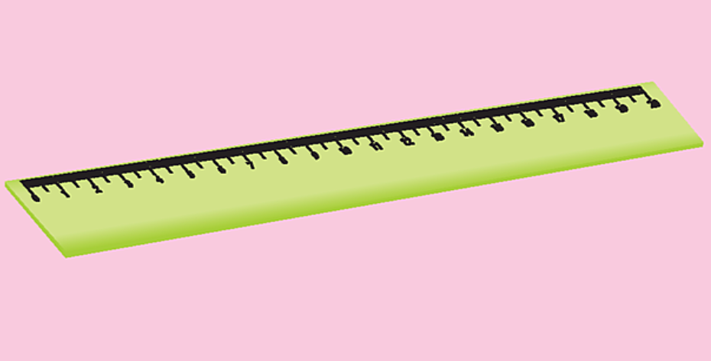


Slide 5



Slide 6



Slide 7
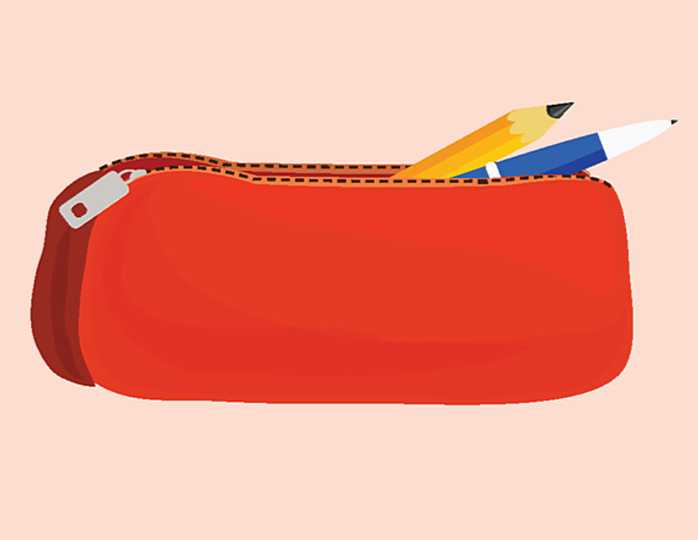


Slide 8

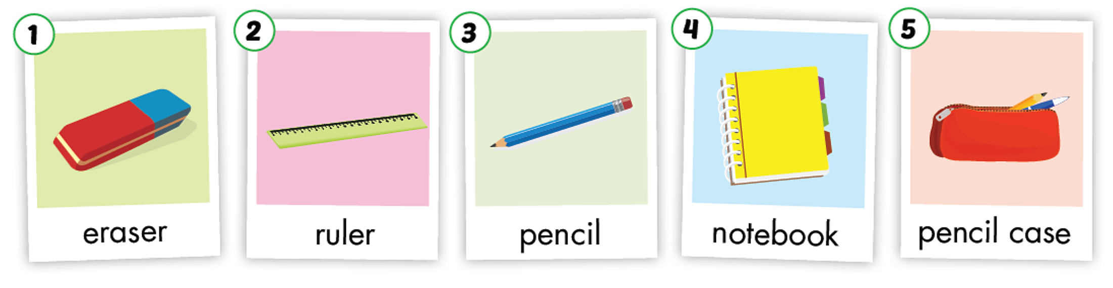

Slide 9
2. Play slow motion.

Slide 10
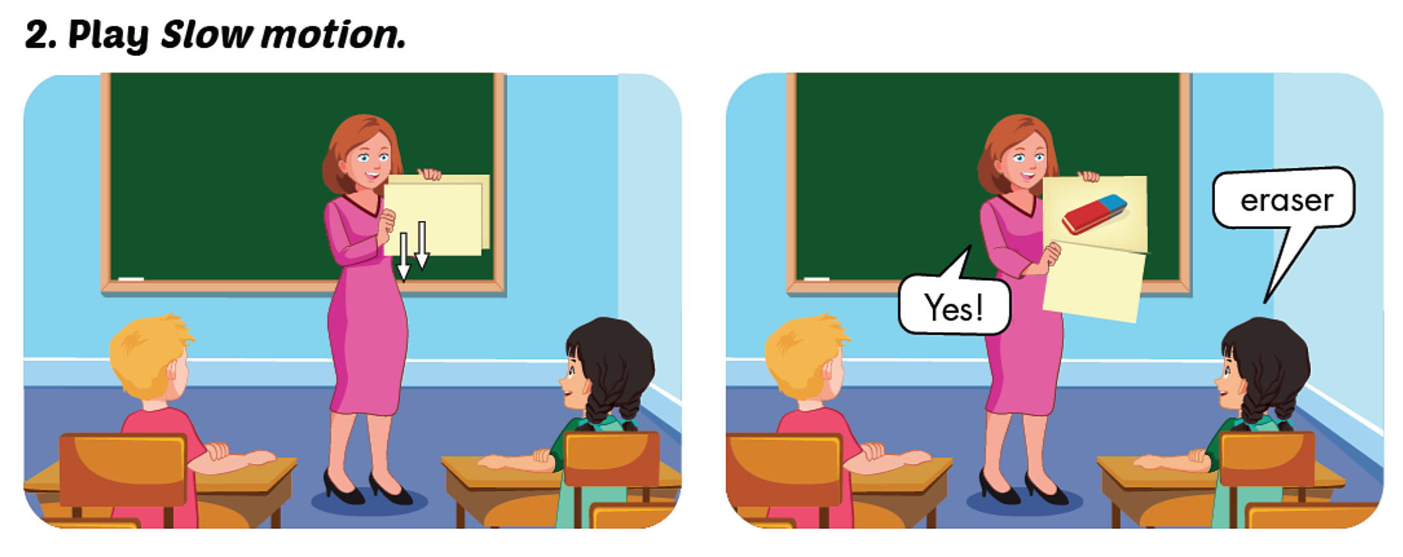

Slide 11
B.1. Listen and practice.

Slide 12




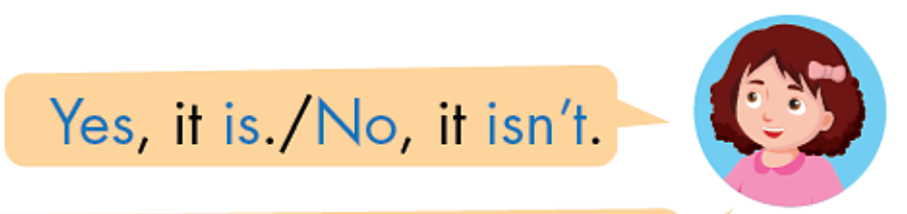

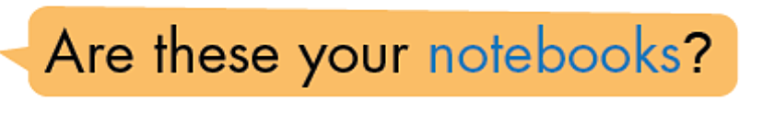

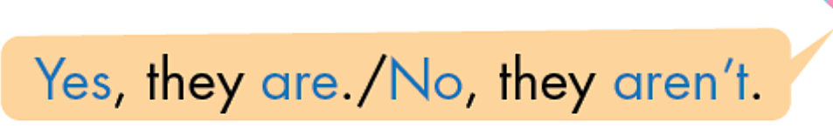

Slide 13

Is this/that your + ……. ?
Yes, it is/ No, it isn’t
Example:
A: Is this your ruler ?
B: Yes, it is.
A: Is that your ruler ?
B: No, it isn’t.

Slide 14
A: Is this/that your + …… ?
B: Yes, it is/ No, it isn’t

Slide 15
Are these/those your + N (plural) ?
Yes, they are/ No, they aren’t.
A: Are these your pencils ?
Example:
B: Yes, they are.
A: Are those your pencil cases ?
B: No, they aren’t.

Slide 16

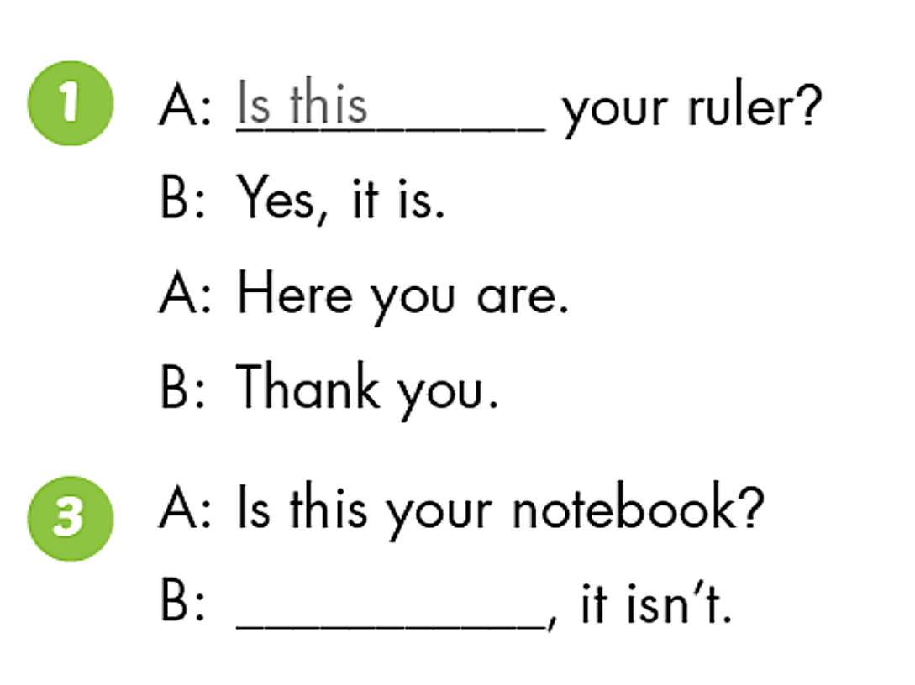
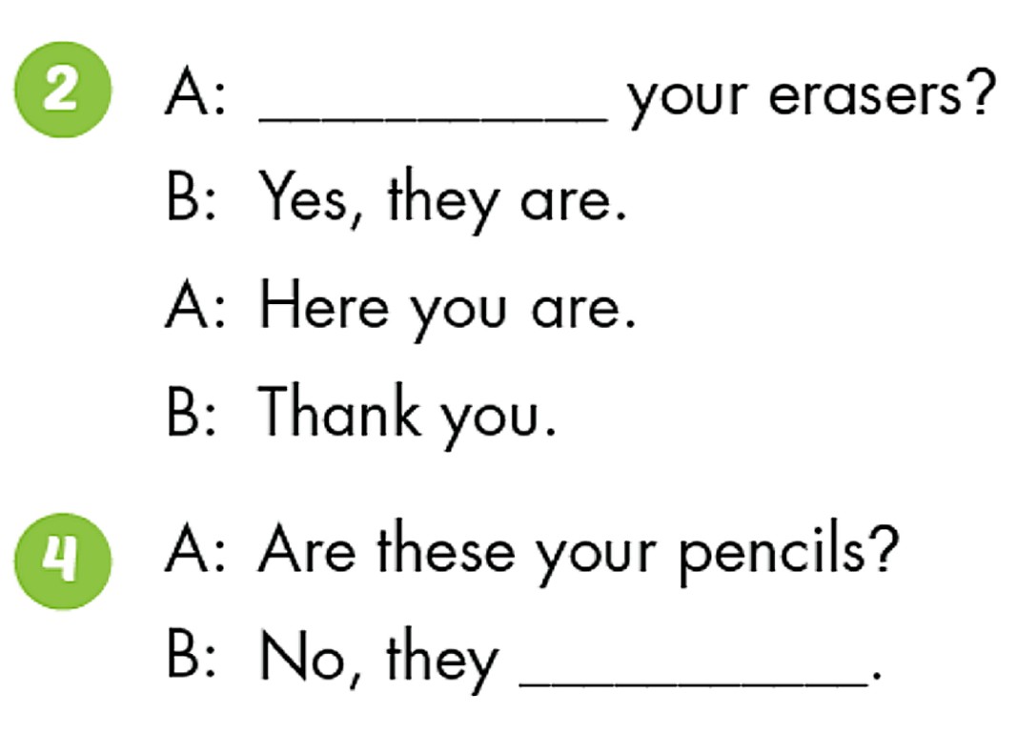
Are these
No
aren’t

Slide 17
WRAP UP
Learn new words and structure.
Do homework in workbook.
Prepare new lesson.

Slide 18
THANK YOU!

Slide 19

Good Bye

