Slide 1
Welcome to my English class
Teacher: Nguyen Thi Phuong
Notes:
Thanh Yến Trần 0967 255 149 zalo/ FB https://www.facebook.com/thanhyentrananhngutaymy/

Slide 2
Warm Up
Sing : I have a pet.

Slide 3
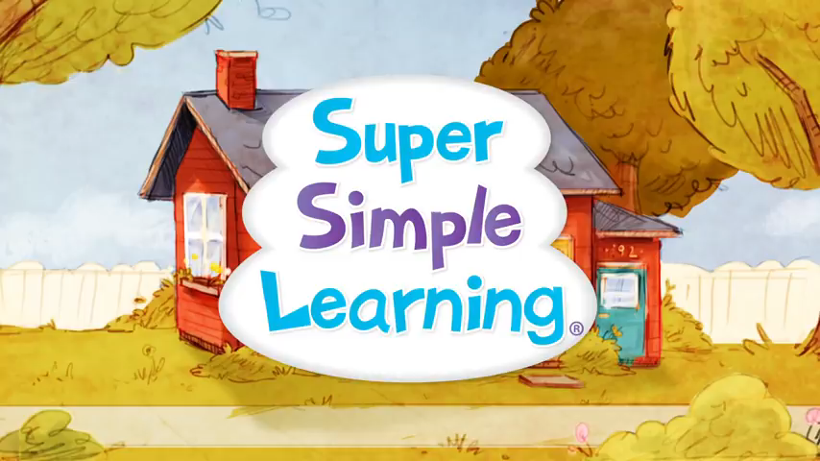

Slide 4
Review

Slide 5



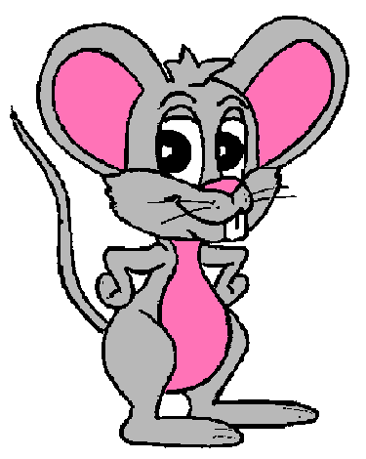



Notes:
Thanh Yến Trần 0967 255 149 zalo/ FB https://www.facebook.com/thanhyentrananhngutaymy

Slide 6
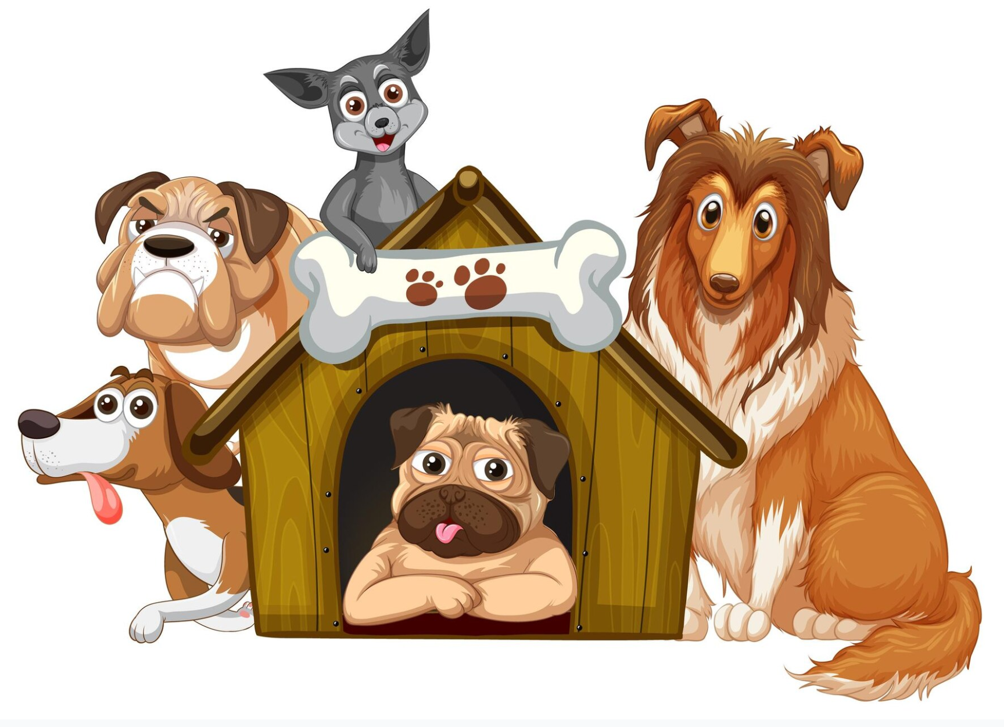
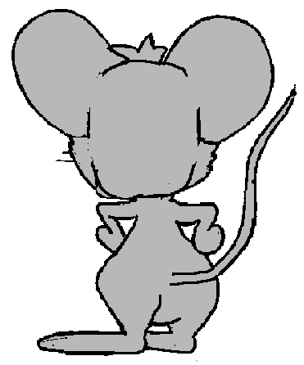

Click on the right answer
A. birds
B. cats
C. dogs
GREAT!
1. I like ……………
NEXT
Notes:
Thanh Yến Trần 0967 255 149 zalo/ FB https://www.facebook.com/thanhyentrananhngutaymy/

Slide 7

Click on the right answer
A. birds
B. fish
C. cats
GREAT!
NEXT
2. I don’t like …………
Notes:
Thanh Yến Trần 0967 255 149 zalo/ FB https://www.facebook.com/thanhyentrananhngutaymy/

Slide 8
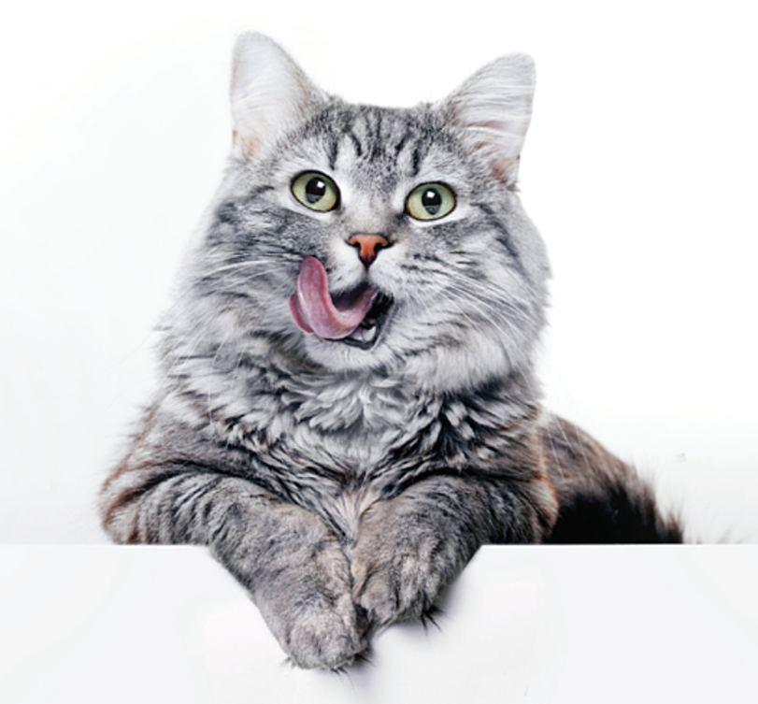
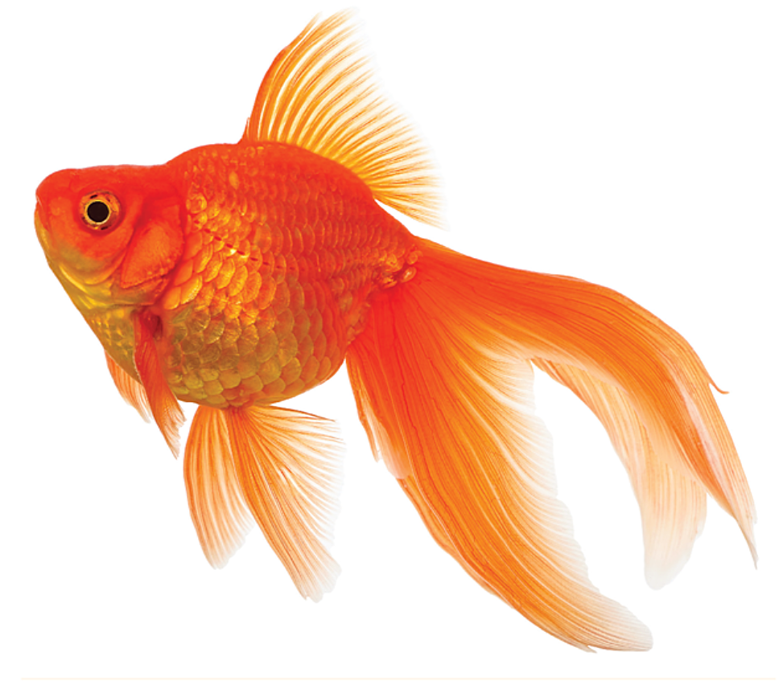
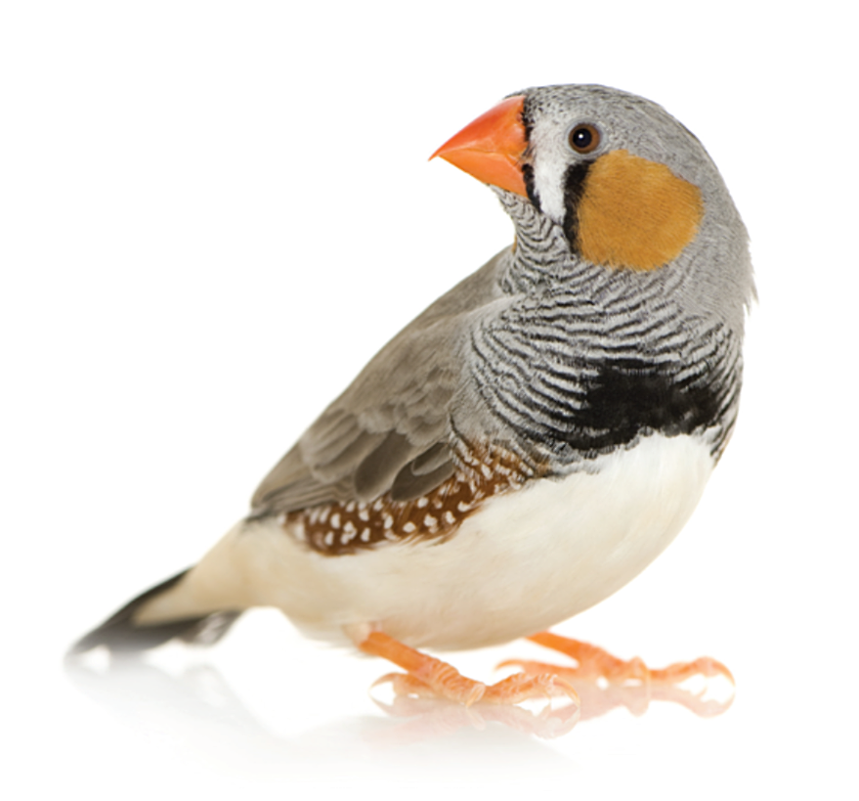
Click on the right answer
A
B
C
GREAT!
3. I love fish.
NEXT
Notes:
Thanh Yến Trần 0967 255 149 zalo/ FB https://www.facebook.com/thanhyentrananhngutaymy

Slide 9

Click on the right answer
A. don’t like
B. like
C. love
GREAT!
4. I ………….dogs.
NEXT
Notes:
Thanh Yến Trần 0967 255 149 zalo/ FB https://www.facebook.com/thanhyentrananhngutaymy/

Slide 10

Click on the right answer
A. love
B. don’t like
C. like
GREAT!
5. I ……. cats.
NEXT

Slide 11

Click on the right answer
A. love
B. like
C. don’t like
GREAT!
NEXT
6. I ………. fish.

Slide 12
THANK YOU!

Slide 13
Unit 2: Family
Lesson Culture 4.2 (P34)

Slide 14
Contents
01
C. Read and circle.
02
D. 1. Look and listen.
2. Listen and write.
3. Practice with your friends.
Notes:
Thanh Yến Trần 0967 255 149 zalo/ FB https://www.facebook.com/thanhyentrananhngutaymy/

Slide 15
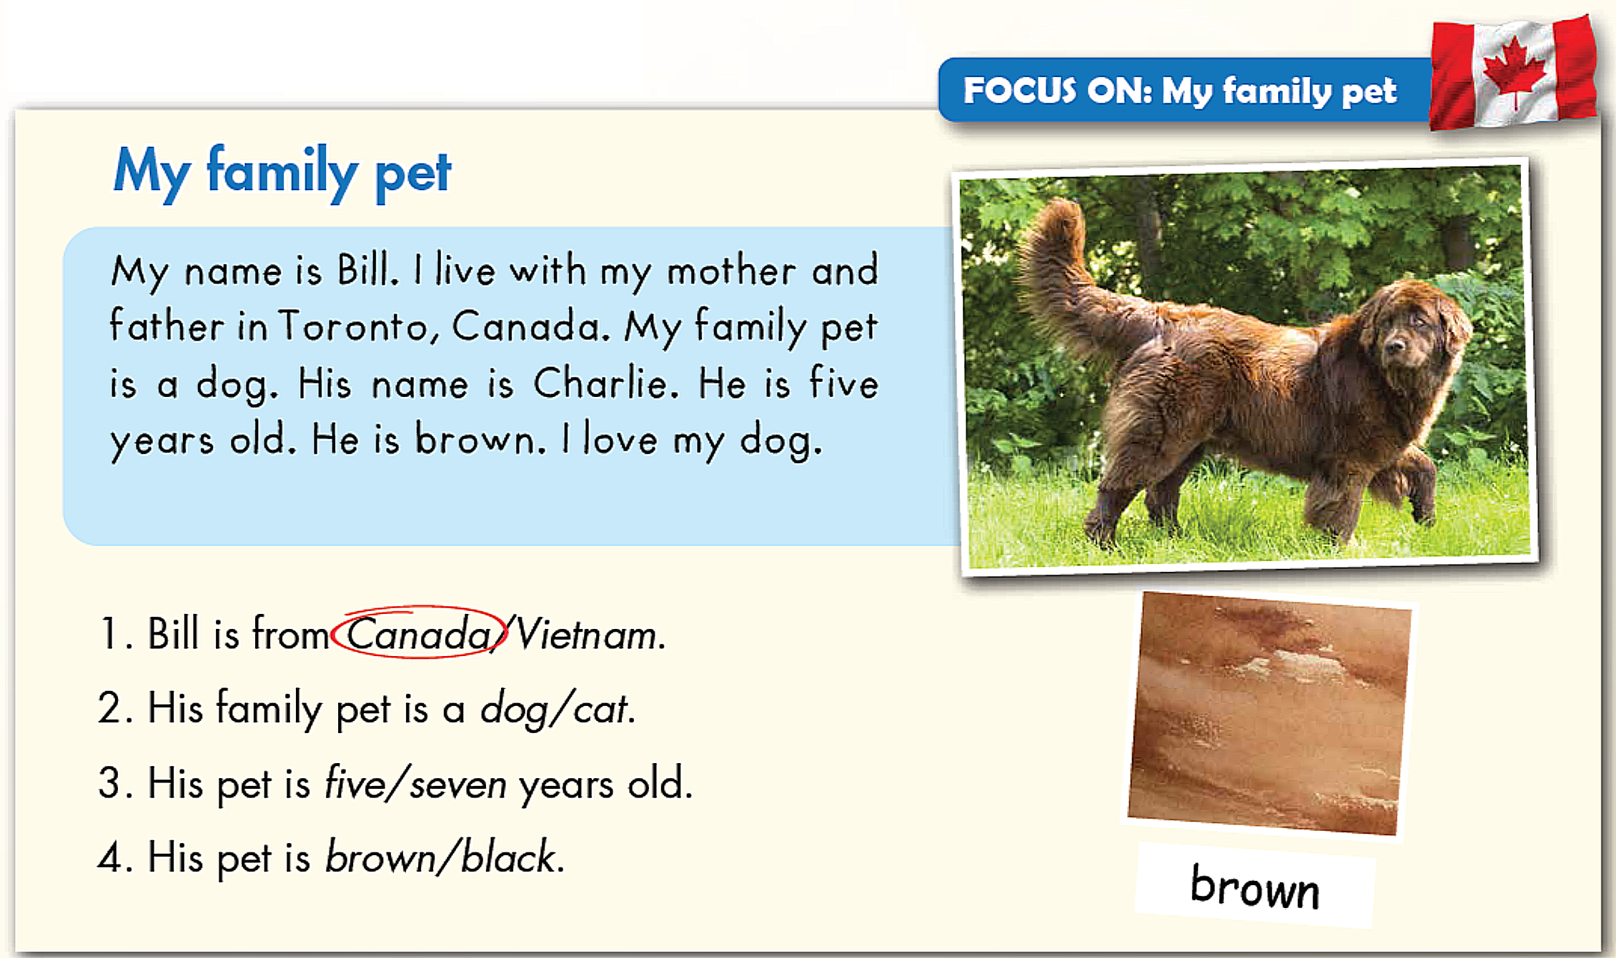
C. Read and circle
Notes:
What animal is it?
What color is it?
Do you have a pet?
What’s its name?

Slide 16


Notes:
Thanh Yến Trần 0967 255 149 zalo/ FB https://www.facebook.com/thanhyentrananhngutaymy/

Slide 17
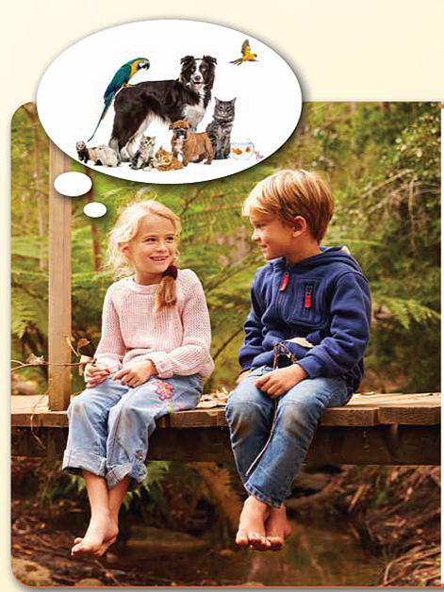
D. 1. Look and listen
Notes:
Who are talking?
What are they talking about?

Slide 18
2. Listen and write

Slide 19
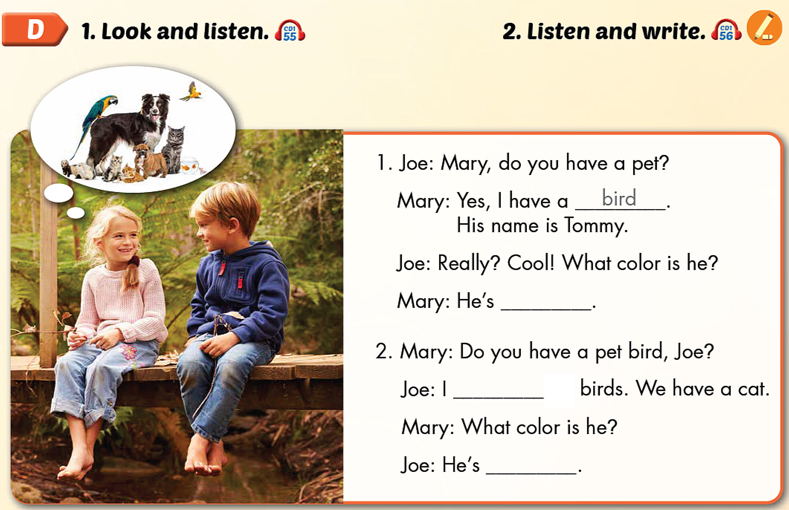
yellow
don’t like
brown

Slide 20
3. Practice with your friends

Slide 21
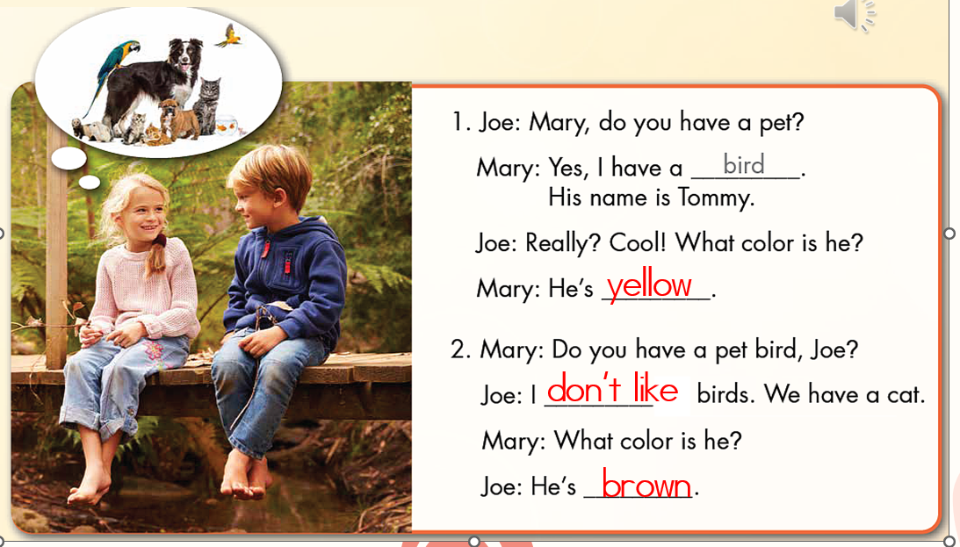

Slide 22
Wrap up
- Do exercise on page 25 in the workbook.
- Prepare Parts E, F, G page 35 in the Student’s book

Slide 23
Thank you!

