Slide 1
Welcome to my English class
Teacher: Nguyen Thi Phuong
Notes:
Thanh Yến Trần 0967 255 149 zalo/ FB https://www.facebook.com/thanhyentrananhngutaymy/

Slide 2
Warm Up

Slide 3









Slide 4
Unit 2: Family Lesson Culture 4.1 (P33)

Slide 5
Contents
01
A. 1. Listen and point. Repeat
02
2. Play Heads up. What’s missing?
B. 1. Listen and practice
2. Look and listen. Practice
Notes:
Thanh Yến Trần 0967 255 149 zalo/ FB https://www.facebook.com/thanhyentrananhngutaymy/

Slide 6
A. 1. Listen and point. Repeat

Slide 7
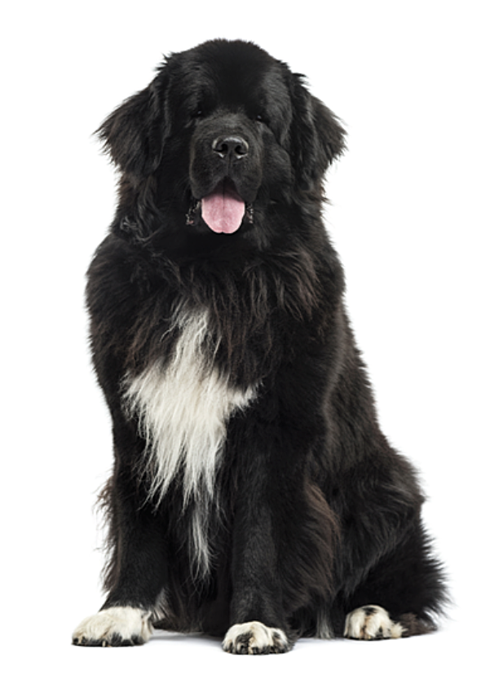



Slide 8
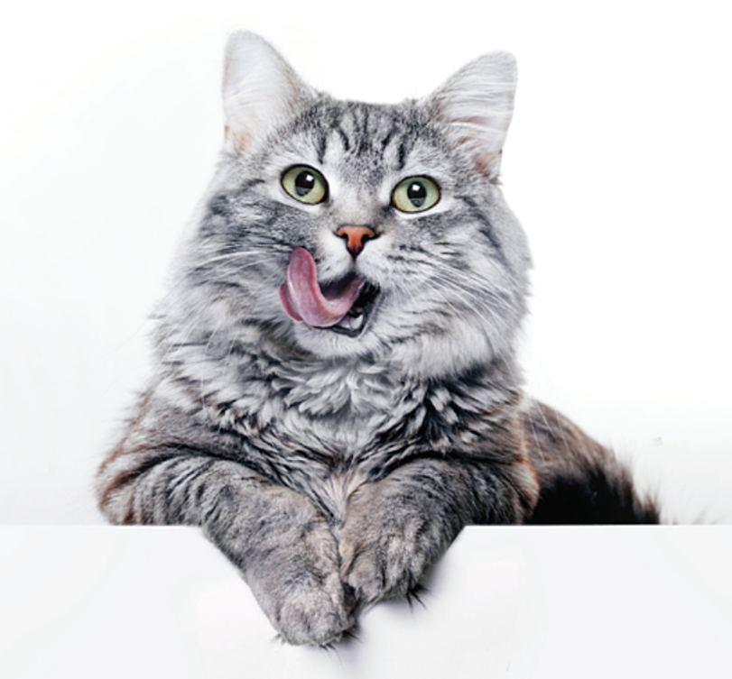


Slide 9
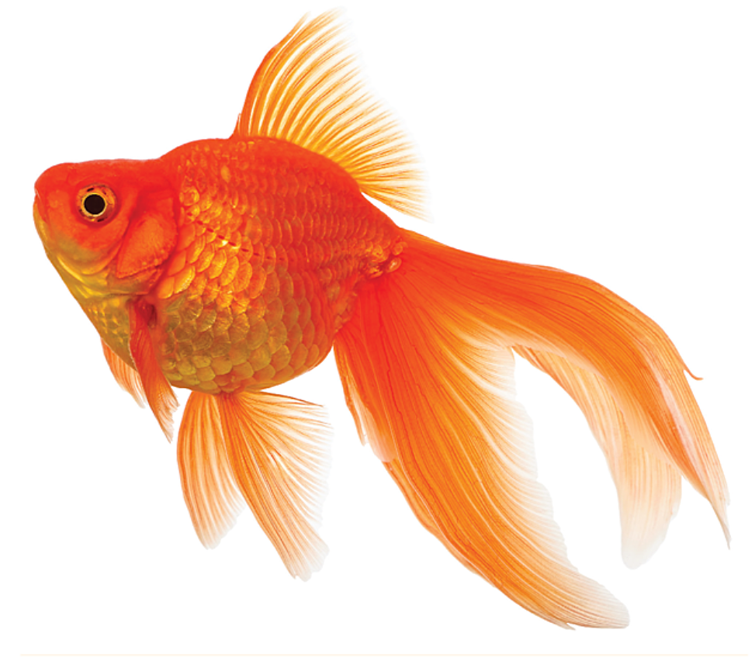


Slide 10
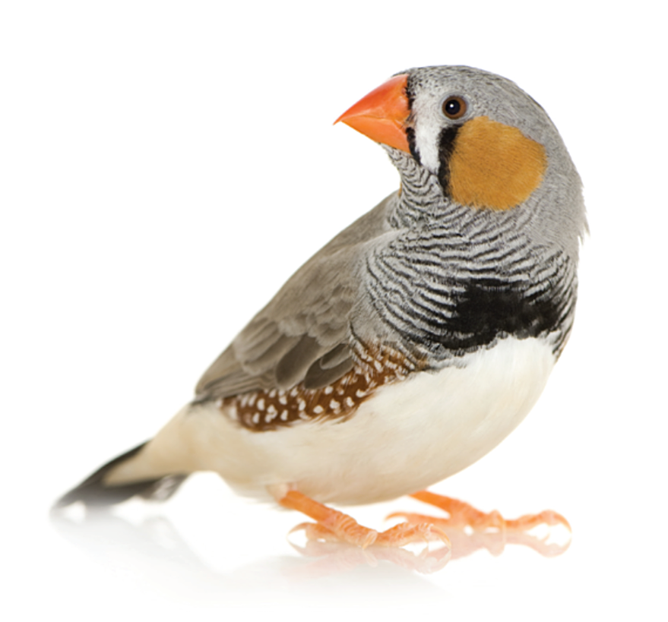


Slide 11

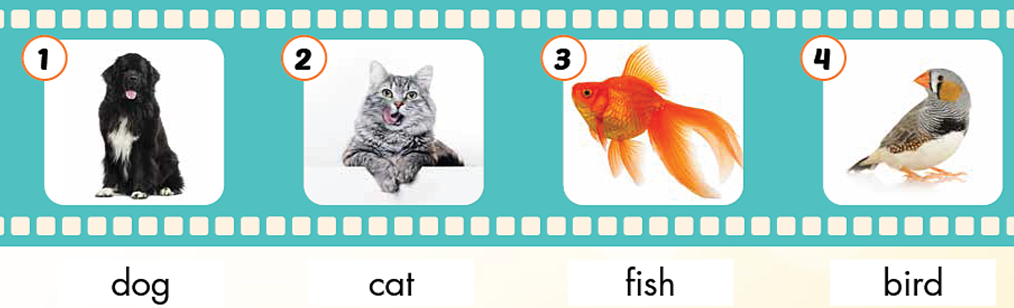

Slide 12
2. Play heads up. What’s missing?

Slide 13
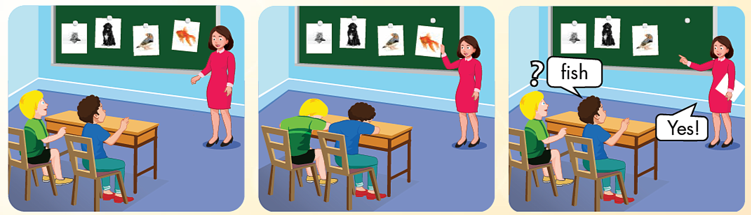

Slide 14
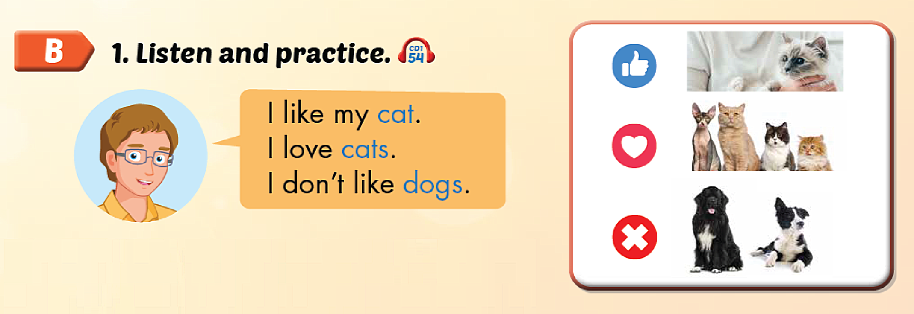

Slide 15

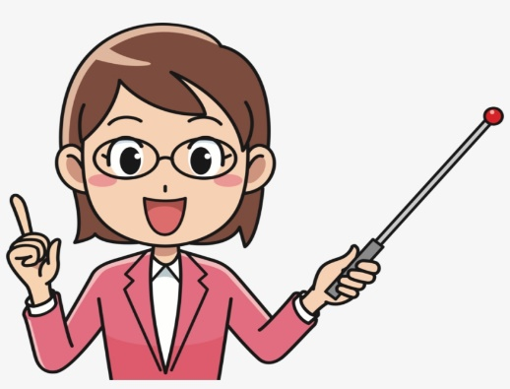


I like my…………
I love…………….
I don’t like……….

Slide 16
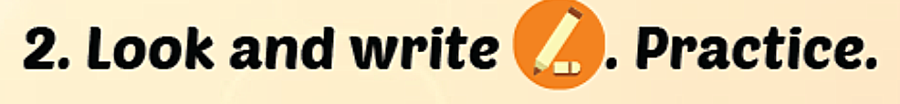

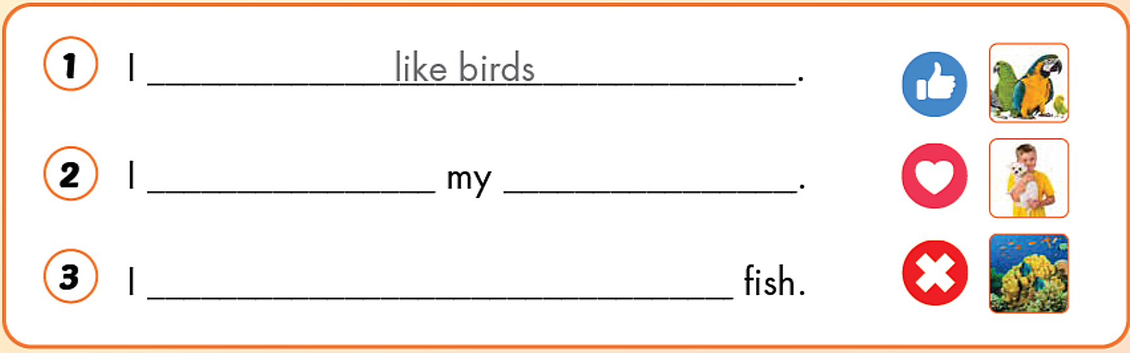
love
dog
don’t like

Slide 17
Guessing Game

Slide 18


Slide 19
Lesson 3
Homework
Review the vocabularies, structures and make sentences using them.
Do the exercises on page 23 WB
Prepare the next lesson (page 34 SB)

Slide 20
Thank you!

