Slide 1
Welcome to my English class.
Teacher: Nguyen Thi Phuong
Notes:
Thanh Yến Trần 0967 255 149 zalo/ FB https://www.facebook.com/thanhyentrananhngutaymy/

Slide 2
WARM UP

Slide 3









This is my...

Slide 4
Friday, October 13th 2023 Unit 2: Family Lesson 2.1 (P27)

Slide 5


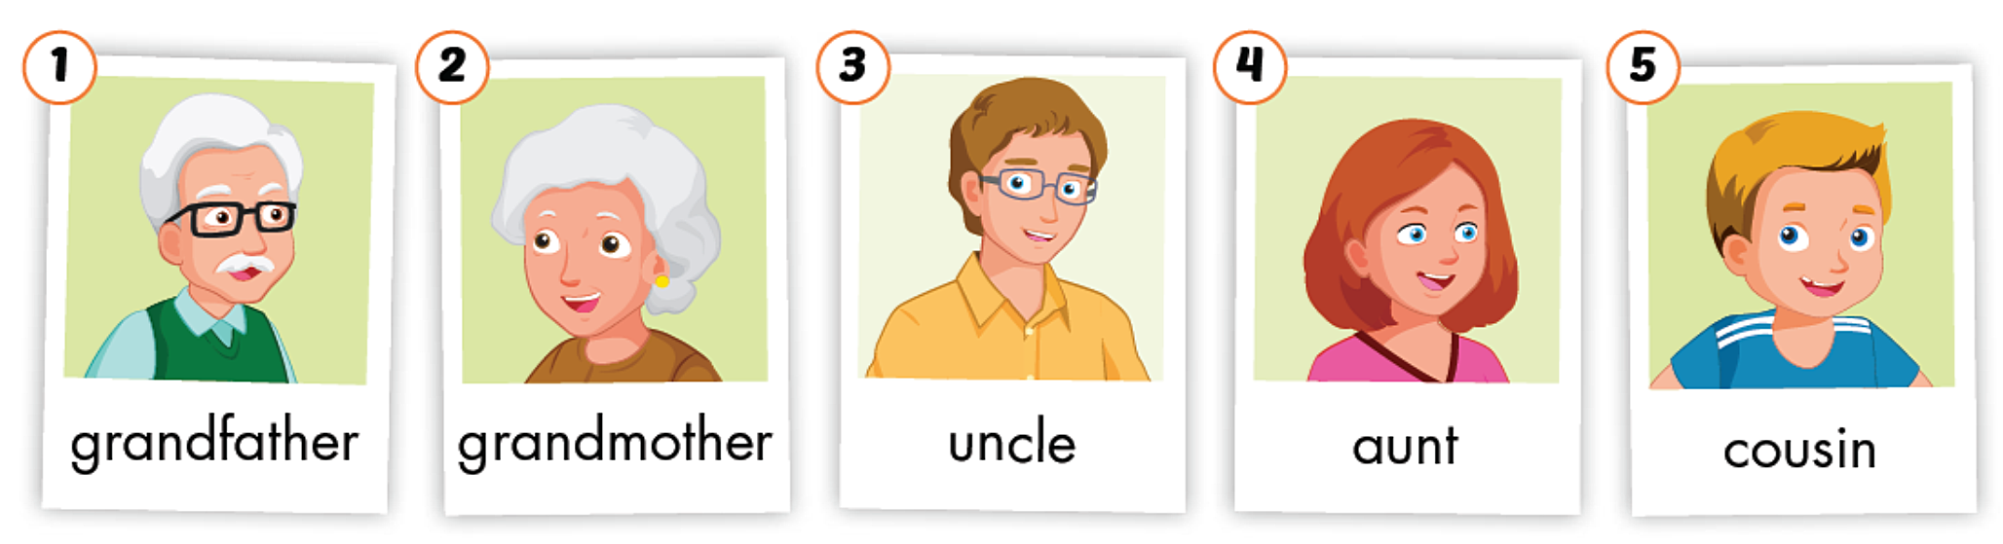

Slide 6
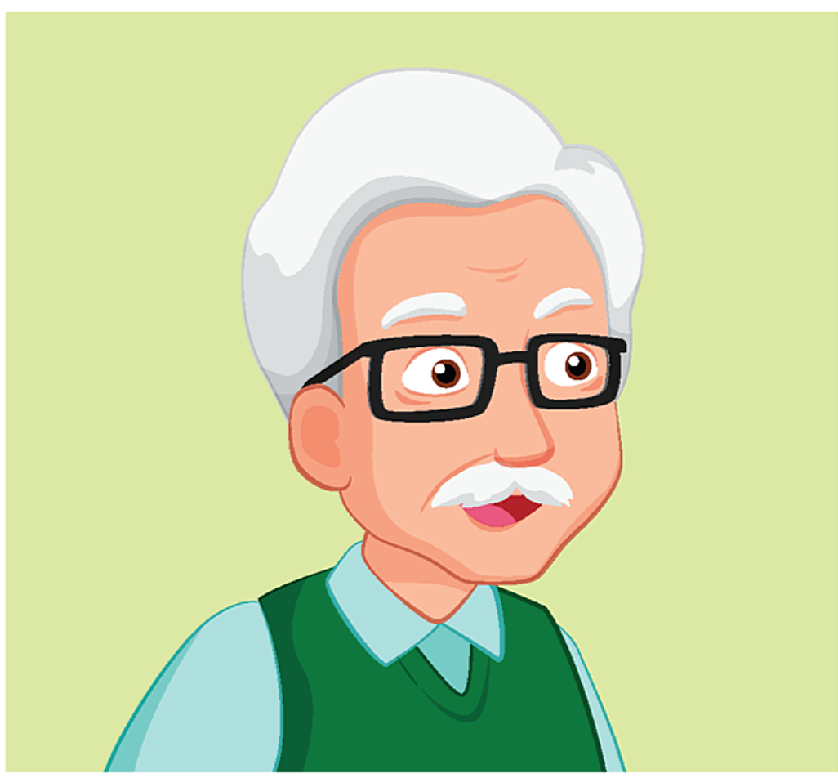


Slide 7



Slide 8
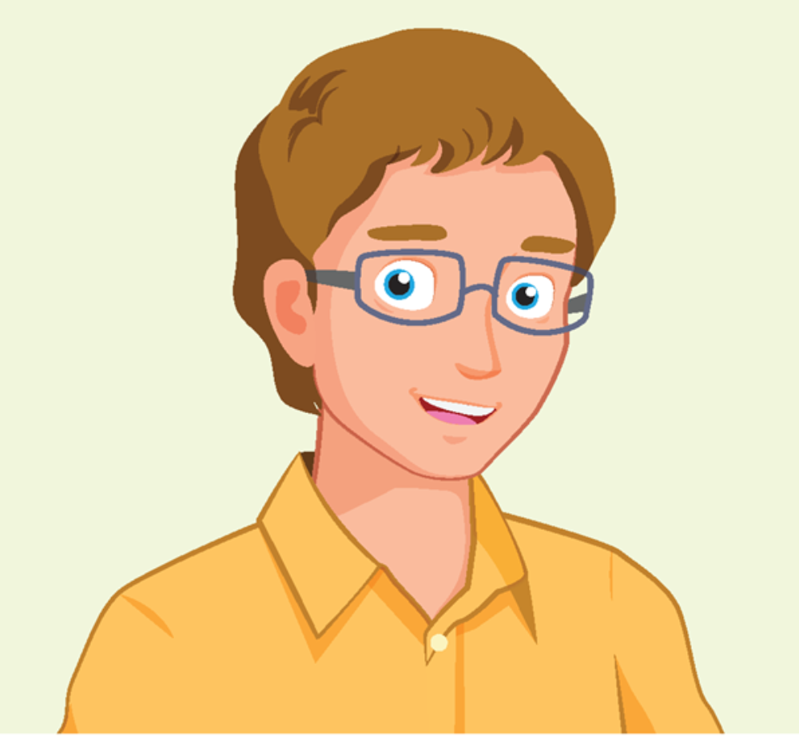


Slide 9

aunt

Slide 10



Slide 12
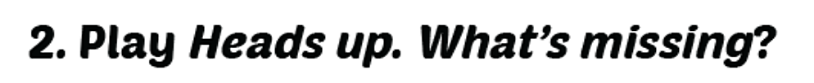
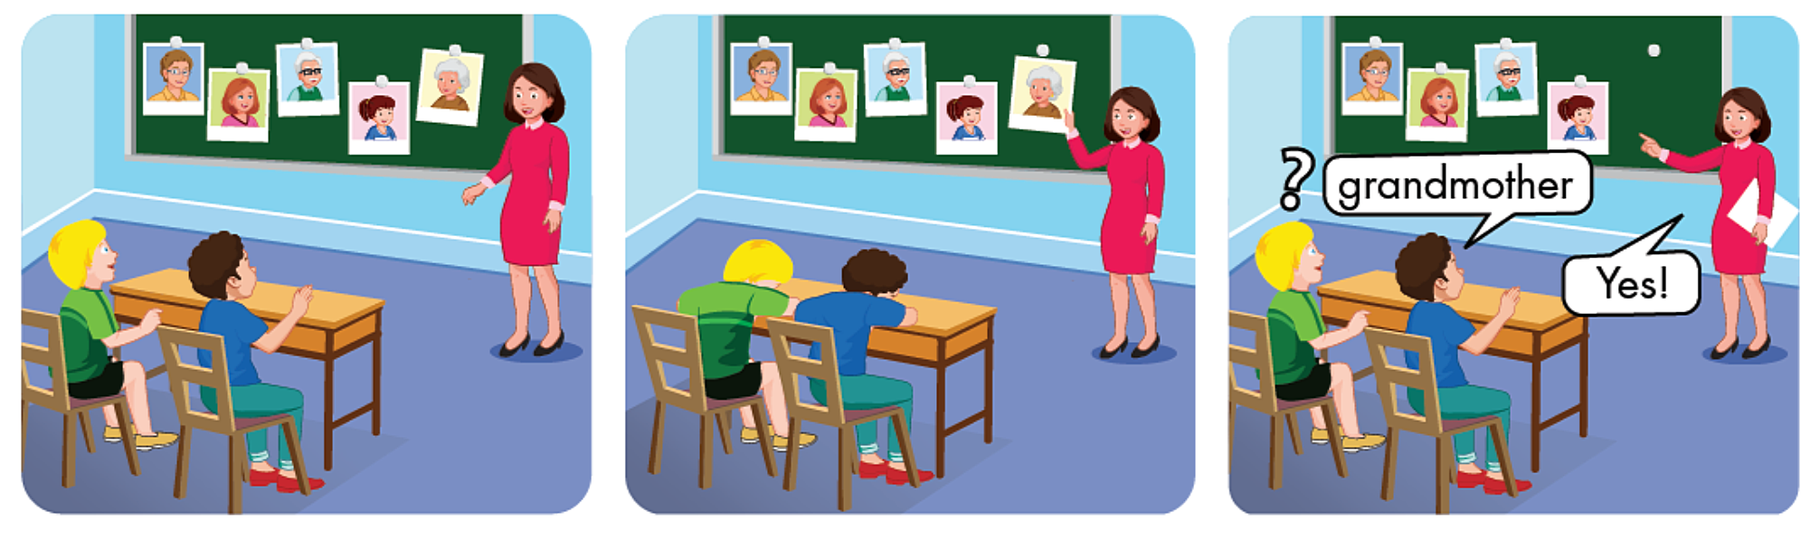

Slide 13

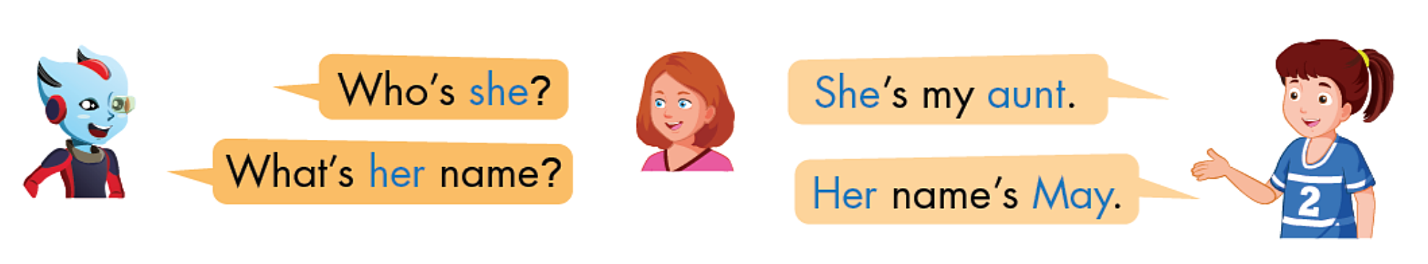

Slide 14

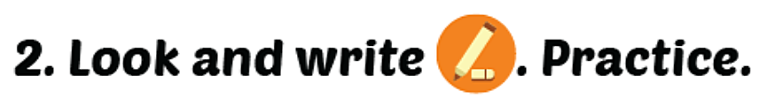
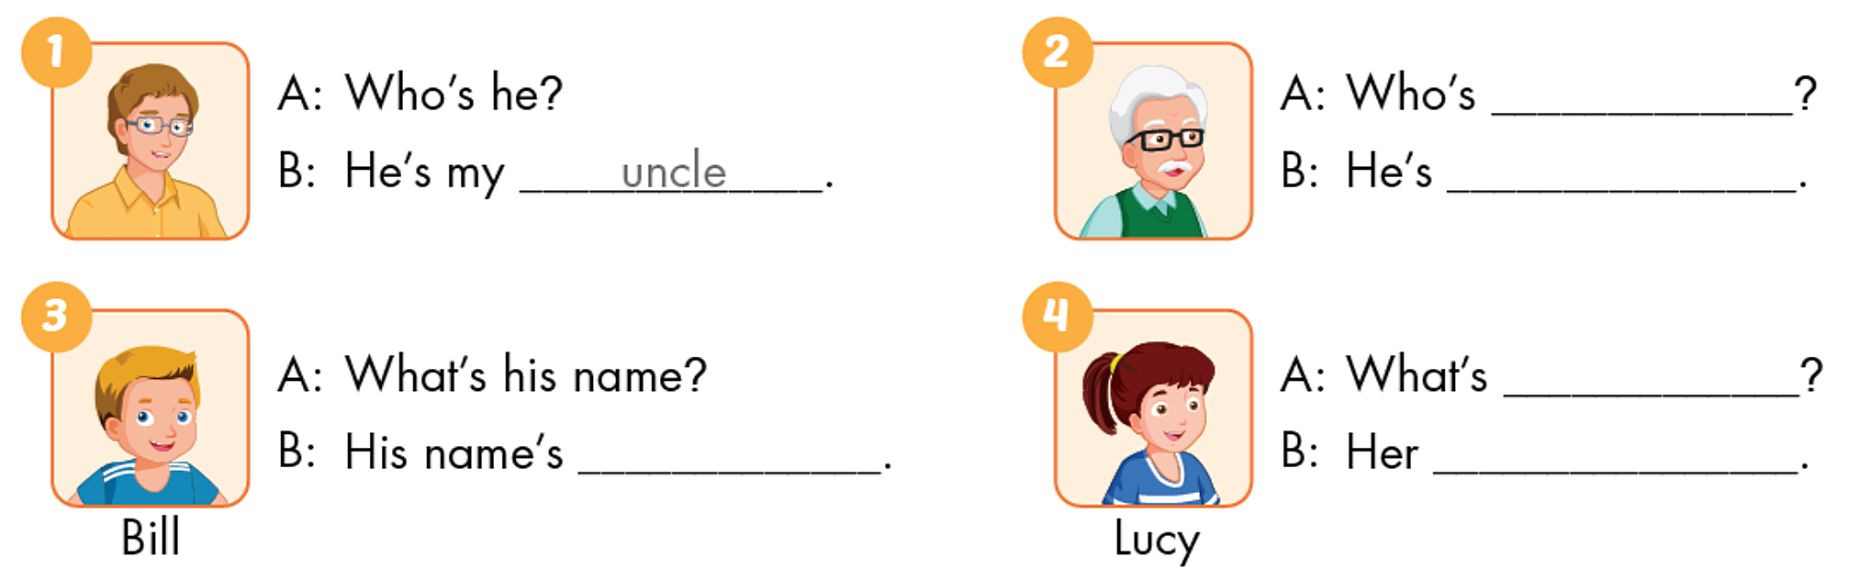
he
my grandfather
her name
Bill
name’s Lucy

Slide 15
Wrap up
Learn new words and structure.
Do homework in workbook.
Prepare new lesson.

Slide 16
Thank you!

