Slide 1

Unit 1: SCHOOL
Lesson 2.2
Page 10

Slide 2
Objectives
By the end of this lesson, students will be able to practice intonation, the target language and the conversations about why they like different subjects.
Pronunciation: word stress for verb-ing
Structure: Why do you like math?
Because I like solving problems.

Slide 3
Read and choose. Then say.

Slide 4



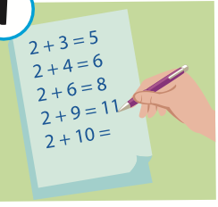
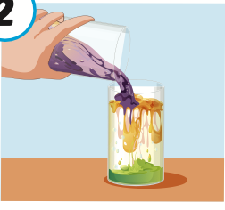
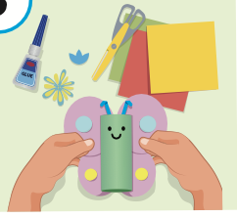

Read and choose
A
B
C
solving problems

Slide 5

Presentation

Slide 6
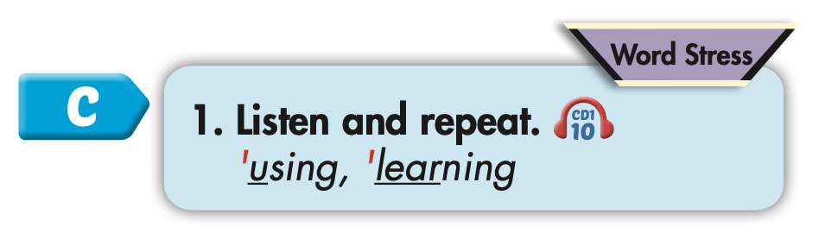
Click on C to hear the sound.

Slide 7
Practice

Slide 8

Chant (p123)

Slide 9

Structure
Why do you like math?
Because I like solving problems.

Slide 10
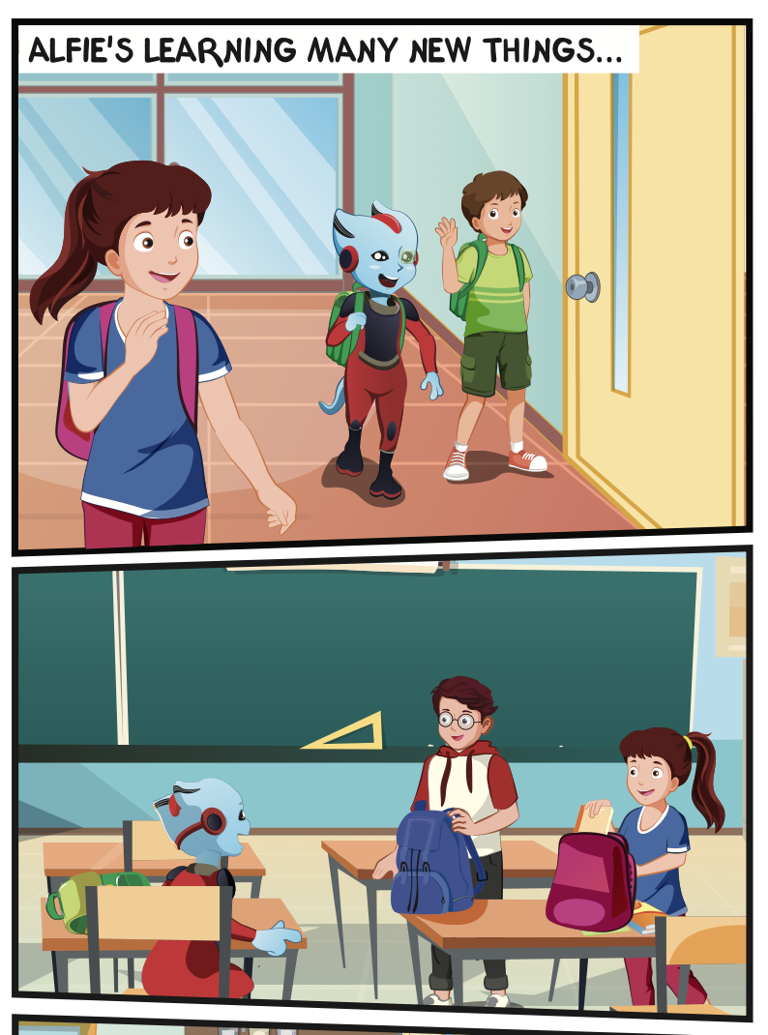

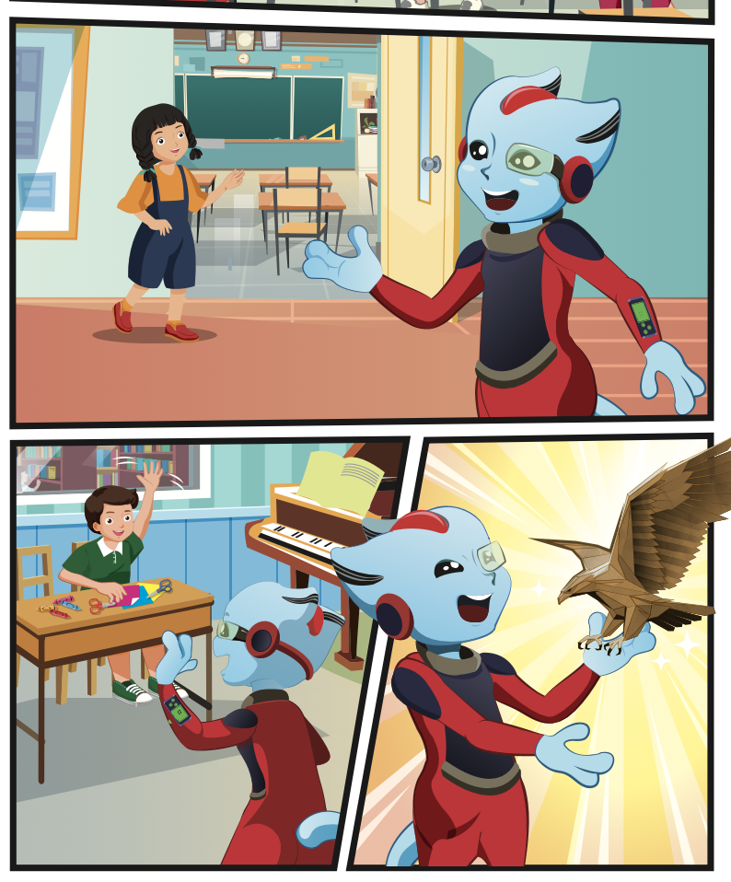
Click on D to hear the sound.

Slide 11

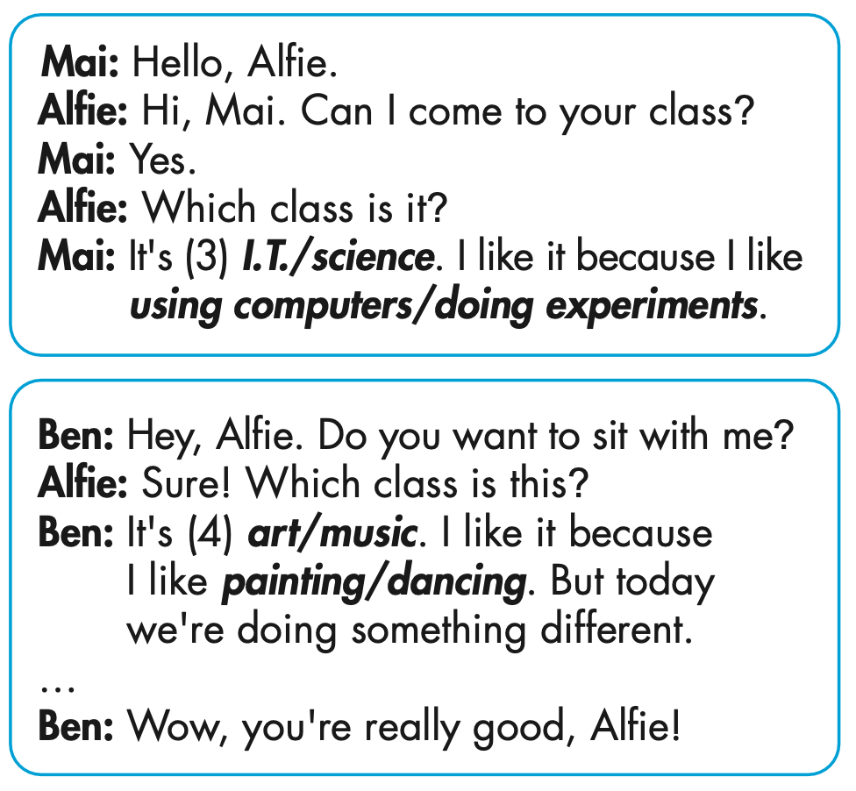
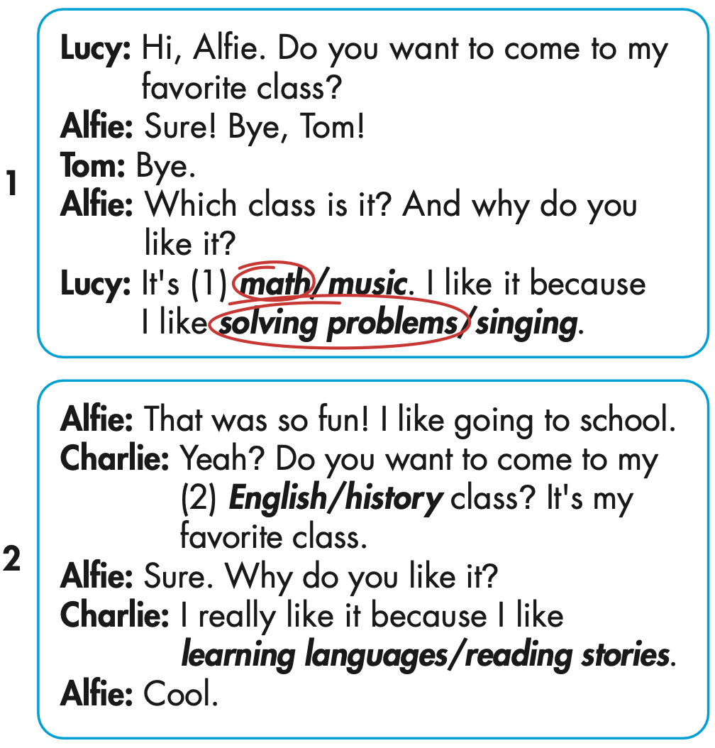
3
4

Slide 12


Slide 13

Production

Slide 14
MAKE YOUR OWN STORY
3
4

Slide 15

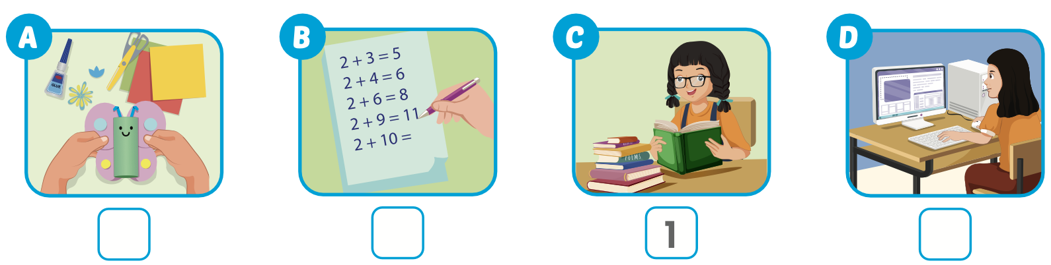
Extra Practice
WB, page 5
Click on the picture to hear the sound.
4
2
3

Slide 16

CONSOLIDATION

Slide 17
Today’s lesson
Pronunciation
word stress for verb-ing
Structures/ Sentence patterns
Why do you like math?
Because I like solving problems.

Slide 18
Homework
Practice the vocabularies and structure, and make sentences using them.
Do the exercises in Tiếng Anh 5 i-Learn Smart Start WB (page 5).
Do the exercises in Tiếng Anh 5 i-Learn Smart Start Notebook.
Prepare the next lesson (page 11 SB).
Play the consolidation games in Tiếng Anh 5 i-Learn Smart Start DHA App on www.eduhome.com.vn

