Slide 1

Unit 1: SCHOOL
Lesson 2.1
Page 9

Slide 2
Objectives
By the end of this lesson, students will be able to recognize the vocabulary and get to know the structure asking and answering about why they like a school subject.
Vocabulary: solving problems, doing experiments, making things, using computers, reading stories, learning languages.
Structure: Why do you like math?
Because I like solving problems.

Slide 3

Guess the SCHOOL SUBJECT

Slide 4

You learn about kings, queens, wars and facts from the past.
H I S T O R Y

Slide 5
You add, subtract, divide and multiply numbers.
M A T H S
3 x 4 = 12
25 : 5 = 5
10 + 7 = 17

Slide 6

You learn about continents, countries, oceans, rivers, lakes and cities.
G E O G R A P H Y

Slide 7
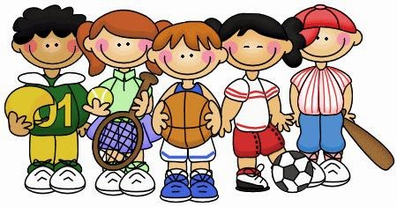
You do gymnastics and play sports there.
P.E.

Slide 8
You learn about plants, animals and human body.
S C I E N C E

Slide 9

You learn about composers, singing and listening to music.
M U S I C

Slide 10

You draw and paint there.
A R T

Slide 11

You learn how to use a computer there.
I.T.
Microsoft
Windows

Slide 12

New words
solving problems,
doing experiments,
making things,
using computers,
reading stories,
learning languages.

Slide 13

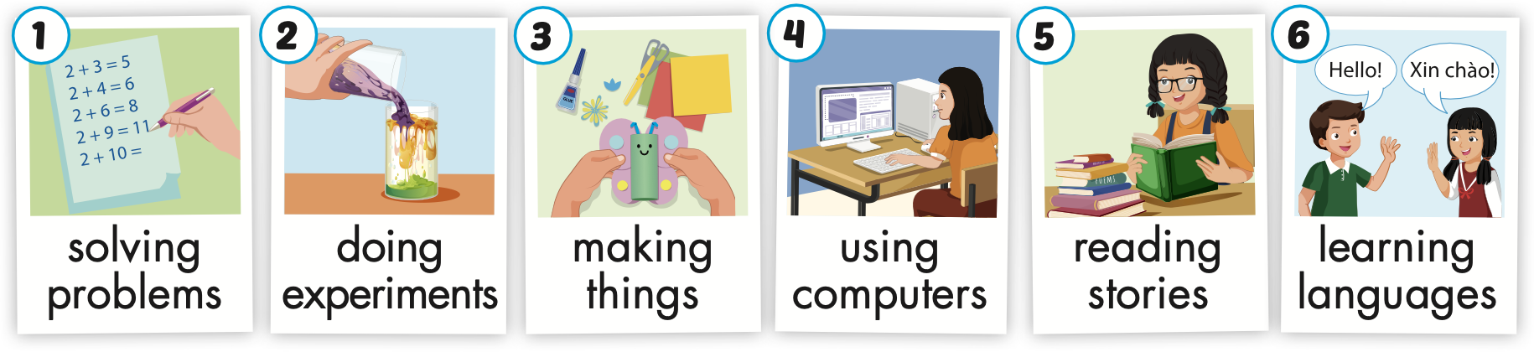
Click on A to hear the sound.
Notes:
Click vào hình A. 1. Listen and point. Repeat để cho cả audio full chạy

Slide 14
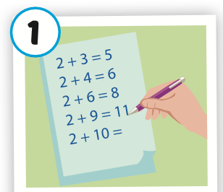
Click on the picture to hear the sound.
solving problems
/ ˈ sɑːlvɪŋ ˈprɑːbləmz/
giải bài toán

Slide 15
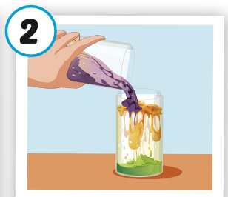
Click on the picture to hear the sound.
doing experiments
/ˈduːɪŋ ɪkˈsperəmənts/
làm thí nghiệm

Slide 16
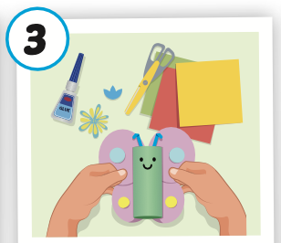
Click on the picture to hear the sound.
making things
/ ˈmeɪkɪŋ θɪŋz/
làm đồ vật

Slide 17
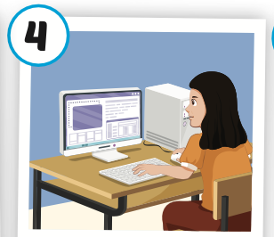
Click on the picture to hear the sound.
using computers
/ˈjuːzɪŋ kəmˈpjuːtərz/
sử dụng máy vi tính

Slide 18
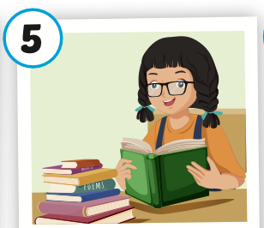
Click on the picture to hear the sound.
reading stories
/ ˈ riːdɪŋ ˈstɔːriz/
đọc truyên

Slide 19
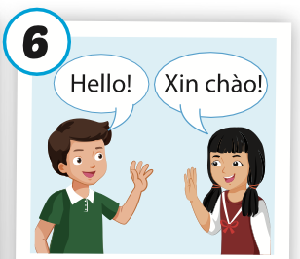
Click on the picture to hear the sound.
learning languages
/ ˈlɜːrnɪŋ ˈlæŋɡwɪdʒiz/
học ngôn ngữ

Slide 20
Read and choose. Then say.

Slide 21




Read and choose
A
B
C
solving problems

Slide 22


Read and choose
A
B
C
making things

Slide 23

Read and choose
A
B
C
using computers

Slide 24

Read and choose
A
C
B
doing experiments

Slide 25

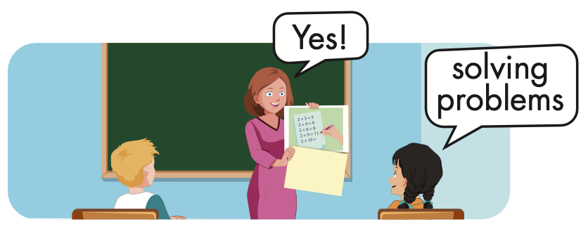


Slide 26
Structure
Why do you like math?
- Because I like solving problems.

Slide 27

Presentation

Slide 28
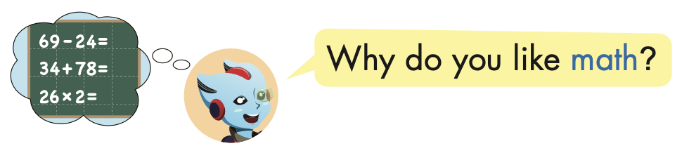
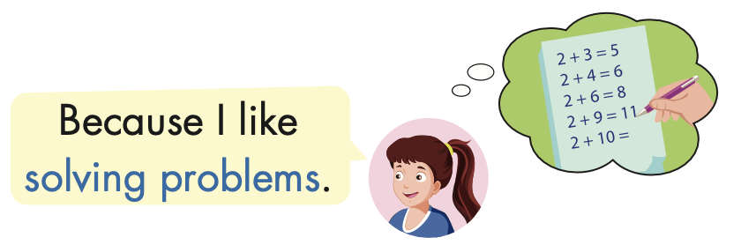
Structure

Slide 29



Slide 30

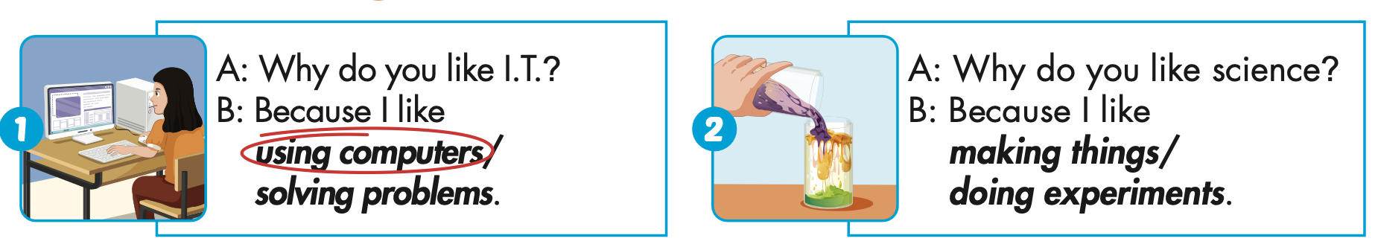

Slide 31
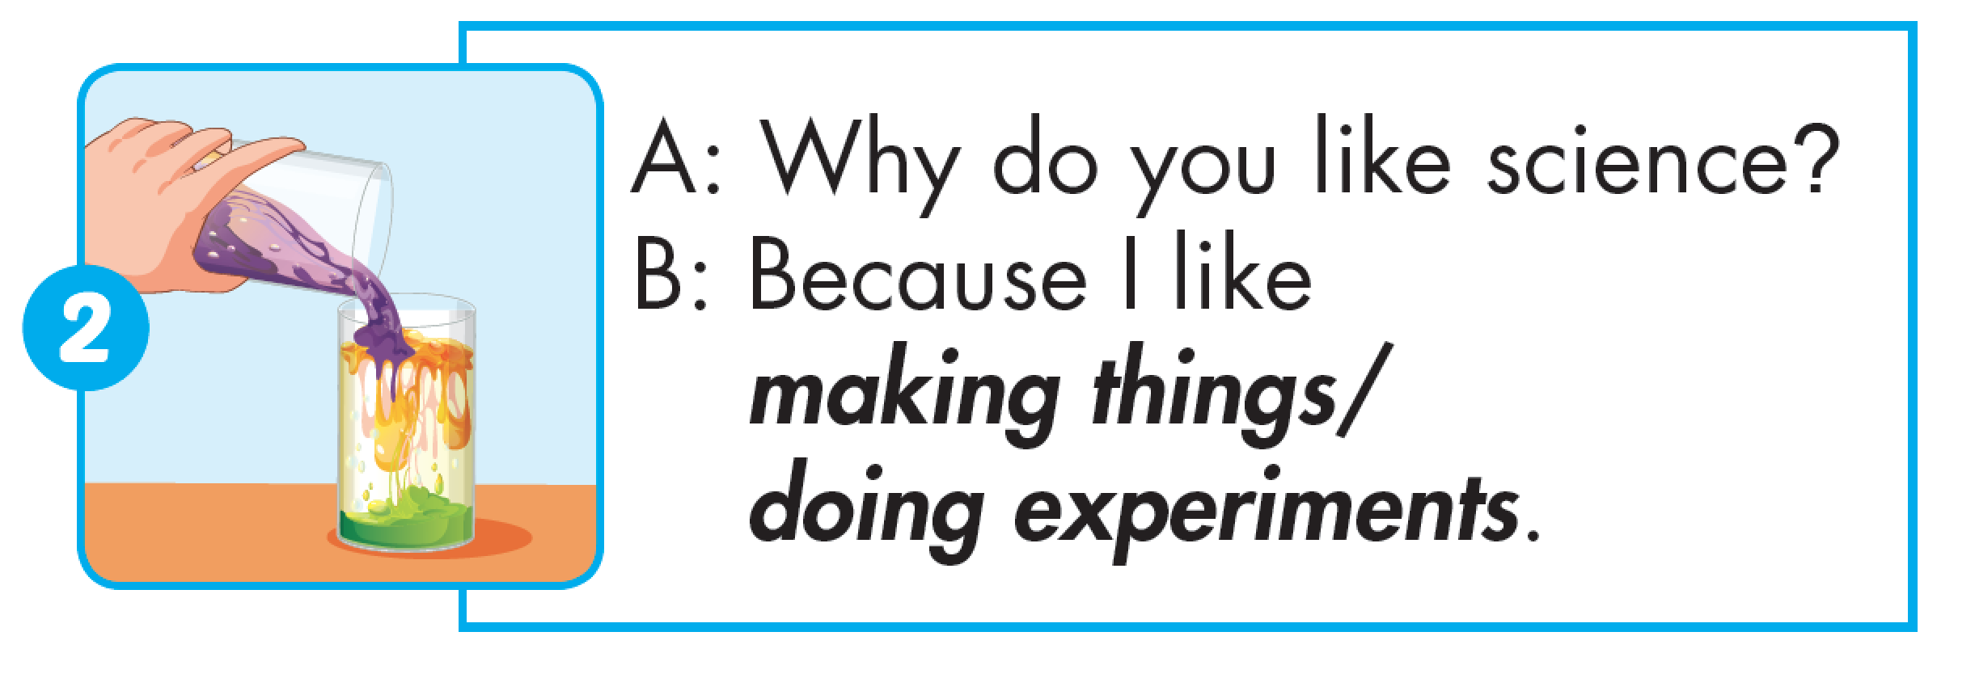

Slide 32
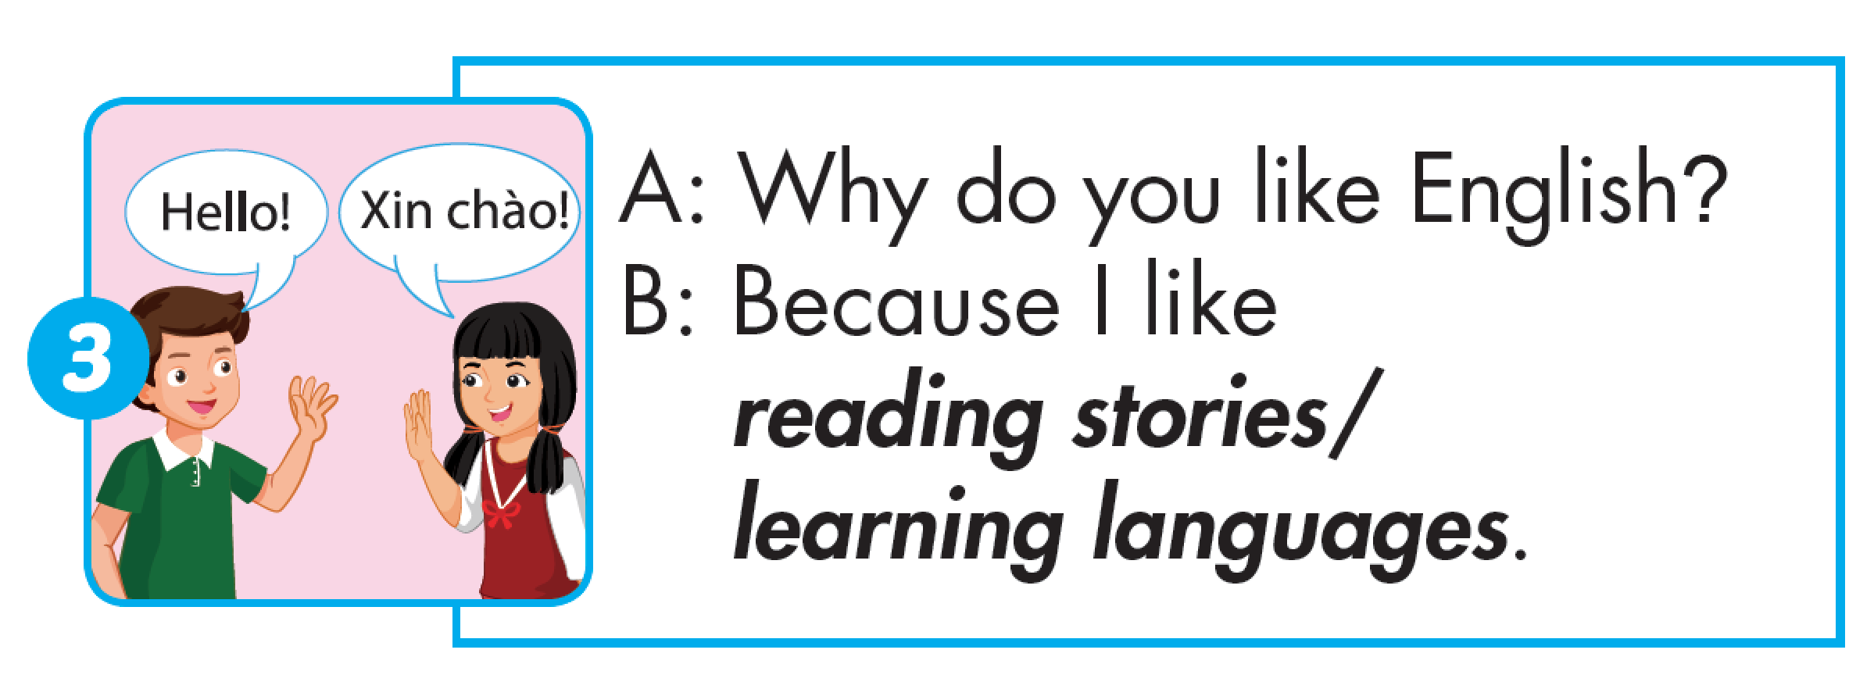

Slide 33
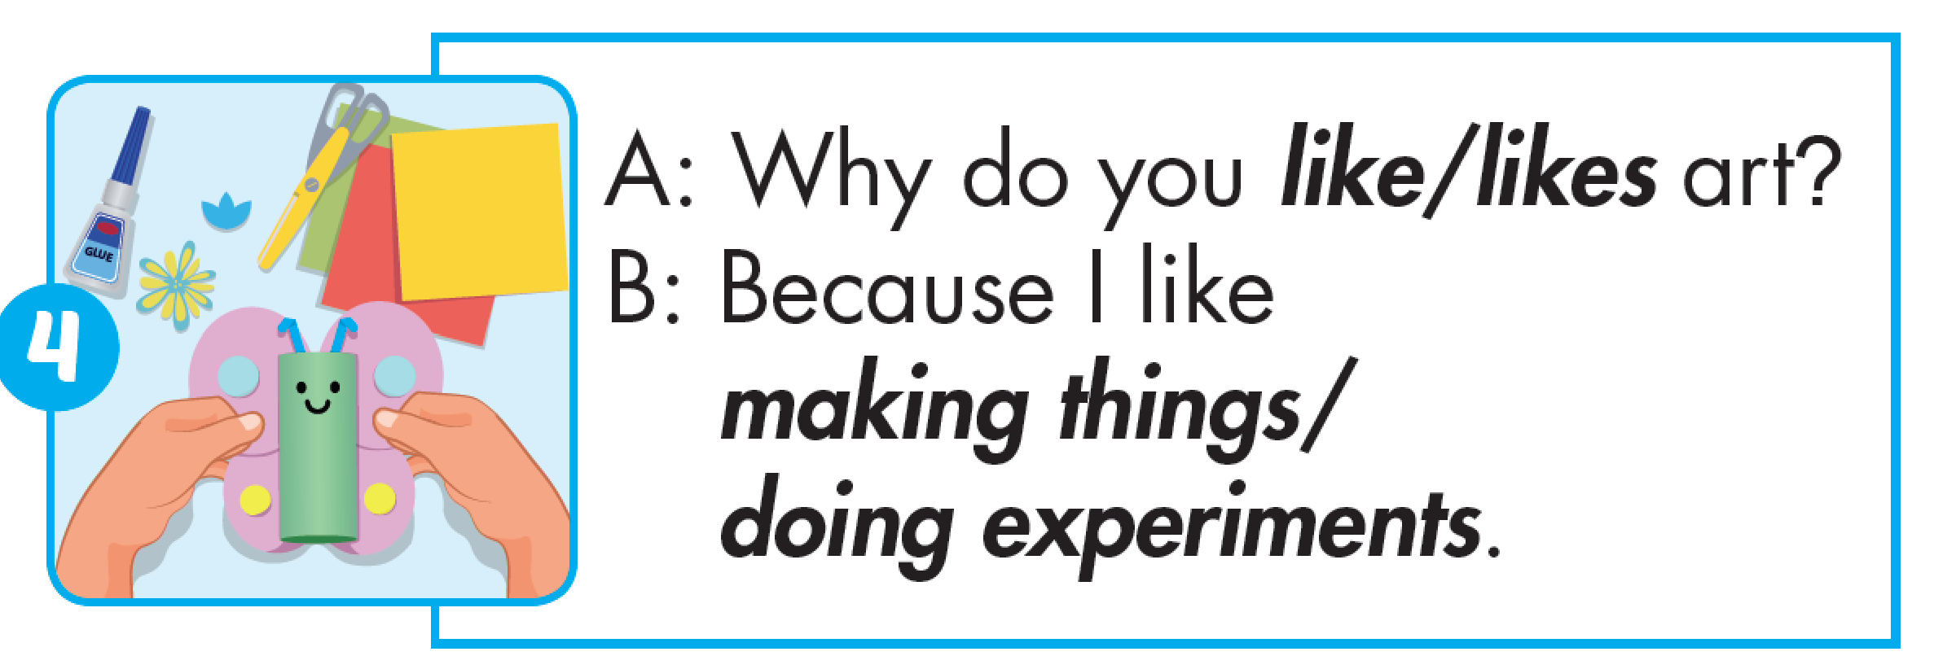

Slide 34
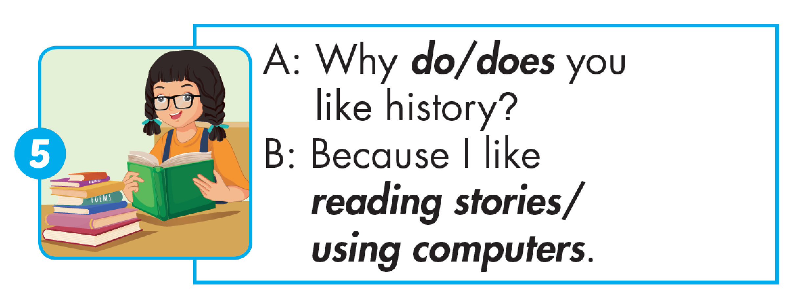

Slide 35
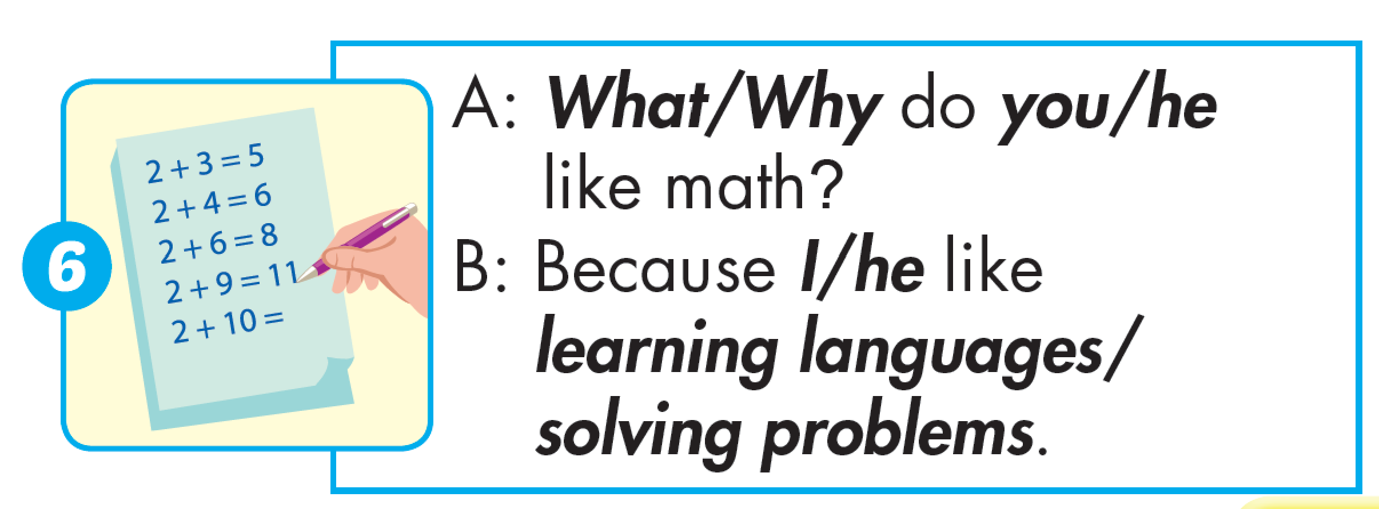

Slide 36

Production

Slide 37

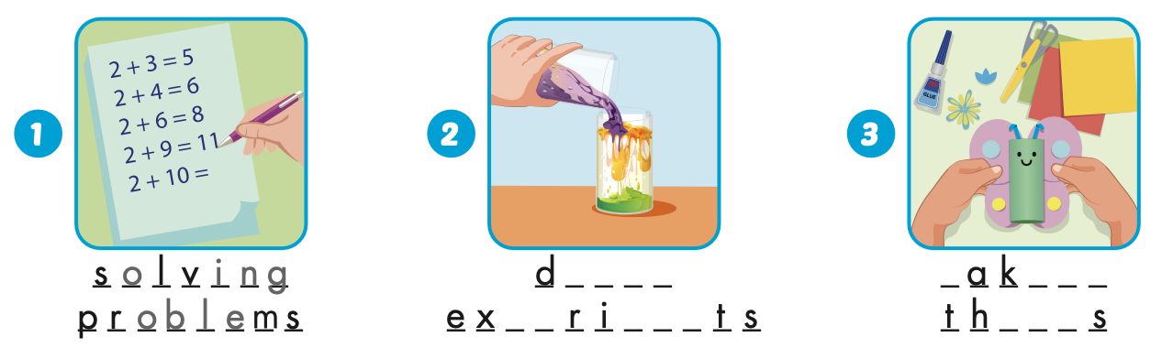
Extra Practice
WB, page 4
o i n g
m
i n g
p e
men
i n g

Slide 38
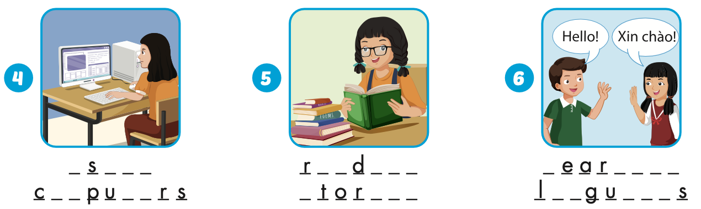
Extra Practice
WB, page 4
u
i n g
e a
i n g
l
n i n g
om
t e
s
i e s
a n
a g e

Slide 39

CONSOLIDATION

Slide 40
Today’s lesson
Vocabularies
solving problems, doing experiments, making things,
using computers, reading stories, learning languages.
Structures/ Sentence patterns
Why do you like math?
- Because I like solving problems.

Slide 41
Homework
Practice the vocabularies and structure, and make sentences using them.
Do the exercises in Tiếng Anh 5 i-Learn Smart Start WB (page 4).
Do the exercises in Tiếng Anh 5 i-Learn Smart Start Notebook.
Prepare the next lesson (page 10 SB).
Play the consolidation games in Tiếng Anh 5 i-Learn Smart Start DHA App on www.eduhome.com.vn

