Slide 1

Unit 1: SCHOOL
Lesson 1.3
Page 8

Slide 2
Objectives
By the end of this lesson, students will be able to ask and answer about the school subjects they like.
Vocabulary: geography, history, science, I.T., Vietnamese, ethics.
Structure: Which subject do you like? - I like science.
Which subject does he like? - He likes English.

Slide 3
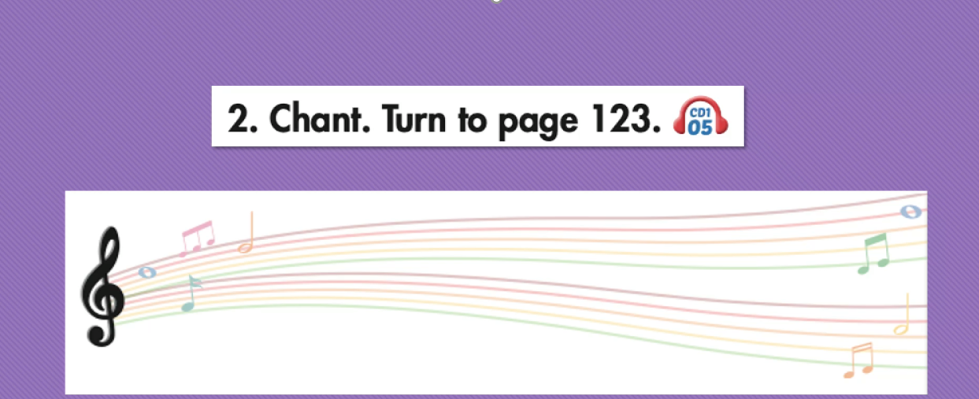

Slide 4

Click on the right word
MATHS
GEOGRAPHY
ENGLISH
GEOGRAPHY
Notes:
4

Slide 5

Presentation

Slide 6





Slide 7

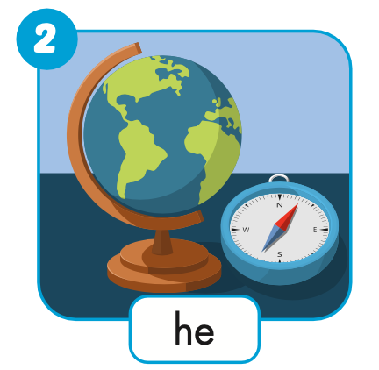


Slide 8

Practice

Slide 9
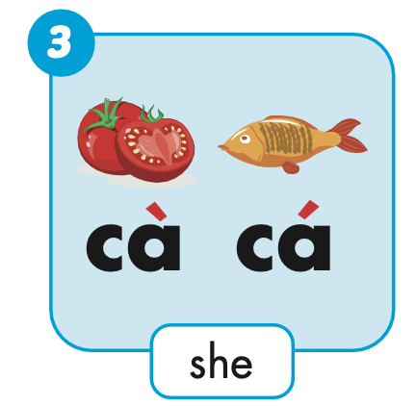
Which subject does she like?
She likes Vietnamese.

Slide 10
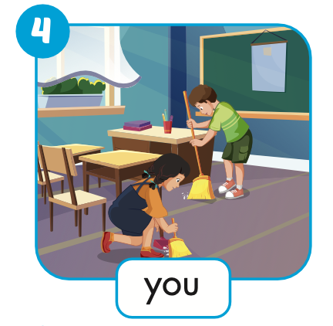
Which subject do you like?
I like ethics.

Slide 11

Production

Slide 12


Slide 13

CONSOLIDATION

Slide 14
Today’s lesson
Vocabulary
geography, history, science, I.T., Vietnamese, ethics.
Structures/ Sentence patterns
Which subject do you like?
- I like science.
Which subject does he like?
- He likes English.

Slide 15
Homework
Practice the vocabularies and structure, and make sentences using them.
Do the exercises in Tiếng Anh 5 i-Learn Smart Start WB (page 3).
Do the exercises in Tiếng Anh 5 i-Learn Smart Start Notebook.
Prepare the next lesson (page 9 SB).
Play the consolidation games in Tiếng Anh 5 i-Learn Smart Start DHA App on www.eduhome.com.vn

