Slide 1

Unit 1: SCHOOL
Lesson 1.2
Page 7

Slide 2
Objectives
By the end of this lesson, students will be able to practice the intonation, the target language and the conversations.
Pronunciation: intonation for WH questions
Structure: Which subject do you like? - I like science.
Which subject does he like? - He likes English.

Slide 3



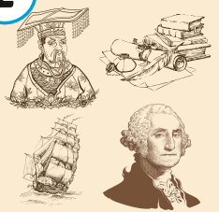
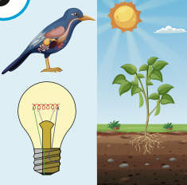


WARM UP:
Listen and choose
A
B
C

Slide 4
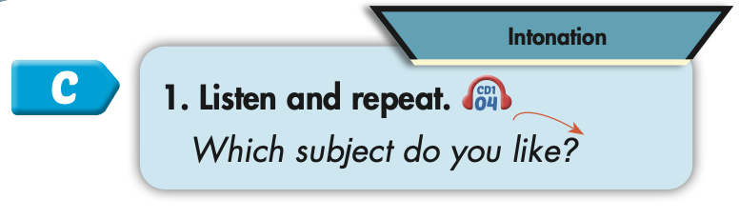
Click on the picture to hear the sound.
Which subject do you like?

Slide 5



Slide 6

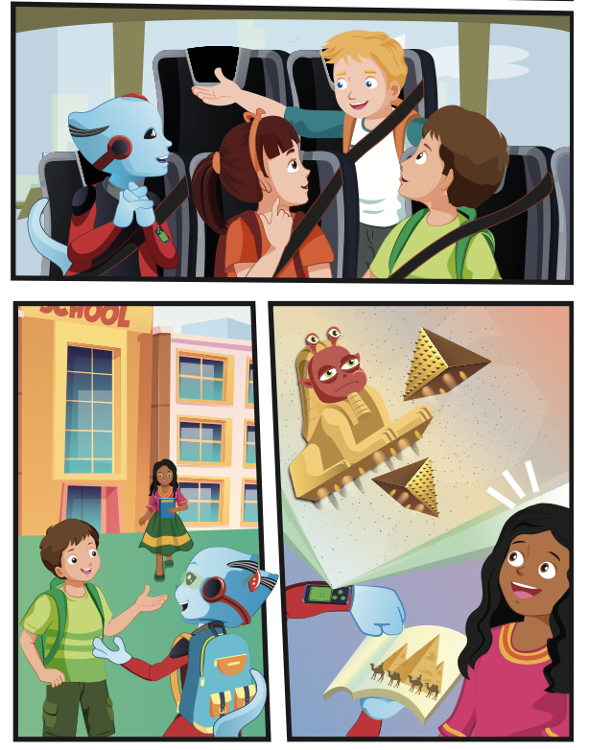
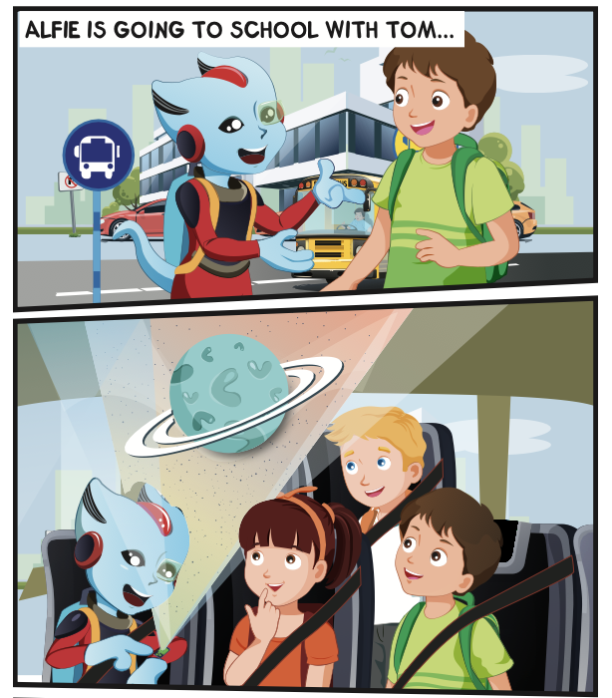
Click on D to hear the sound.

Slide 7

Practice

Slide 8
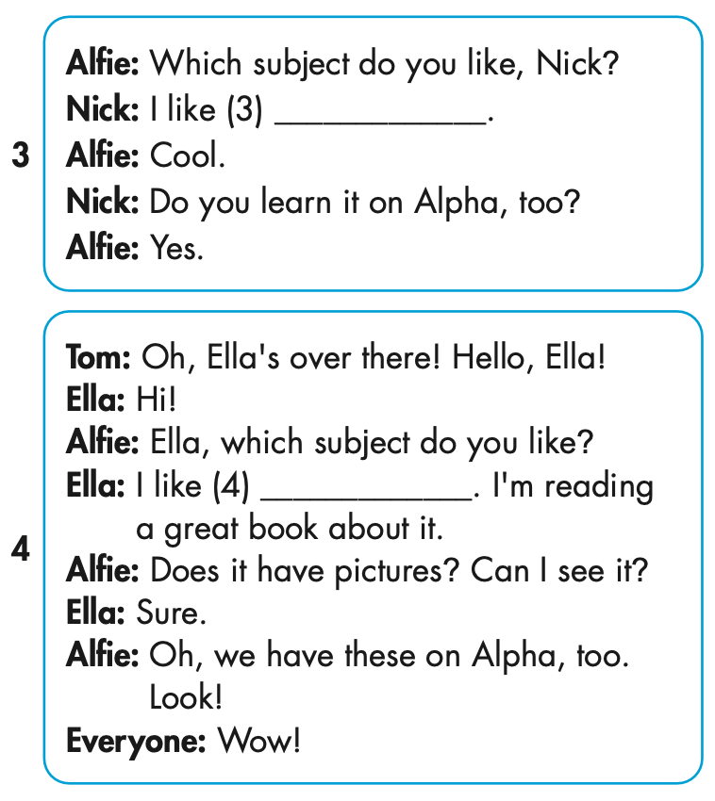

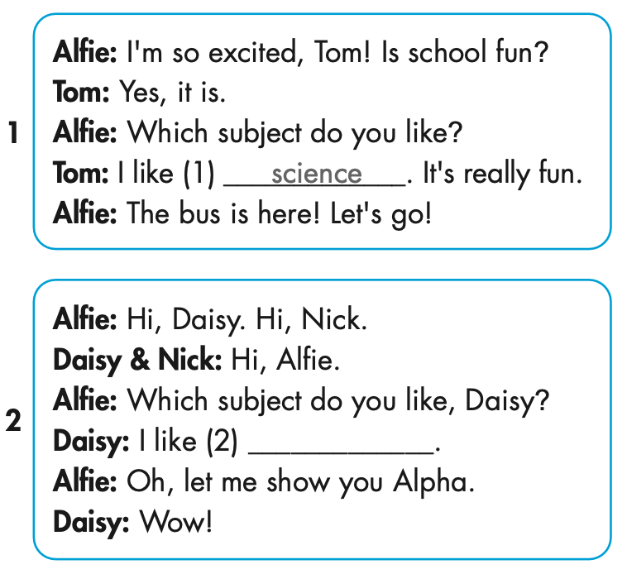

Slide 9


Slide 10
MAKE YOUR OWN STORY

Slide 11

CONSOLIDATION

Slide 12
Today’s lesson
Pronunciation
Intonation for WH-questions
Structures/ Sentence patterns
Which subject do you like?
- I like science.
Which subject does he like?
- He likes English.

Slide 13
Homework
Practice the vocabularies and structure, and make sentences using them.
Do the exercises in Tiếng Anh 5 i-Learn Smart Start WB (page 3).
Do the exercises in Tiếng Anh 5 i-Learn Smart Start Notebook.
Prepare the next lesson (page 8 SB).
Play the consolidation games in Tiếng Anh 5 i-Learn Smart Start DHA App on www.eduhome.com.vn

