Slide 1

Unit 1: SCHOOL
Lesson 1.1
Page 6

Slide 2
Objectives
By the end of this lesson, students will be able to point out and say different school subjects and get to know asking and answering about the subject they like.
Vocabulary: geography, history, science, I.T., Vietnamese, ethics.
Structure: Which subject do you like? - I like science.
Which subject does he like? - He likes English.

Slide 3


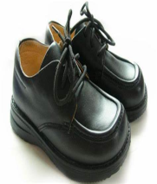














Click on SPIN and STOP.
Answer the questions.

Slide 4



WHAT IS IT?

Slide 5
WHAT IS IT?

Slide 6
WHAT IS IT?

Slide 7
WHAT IS IT?

Slide 8
WHAT IS IT?

Slide 9
WHAT IS IT?

Slide 10

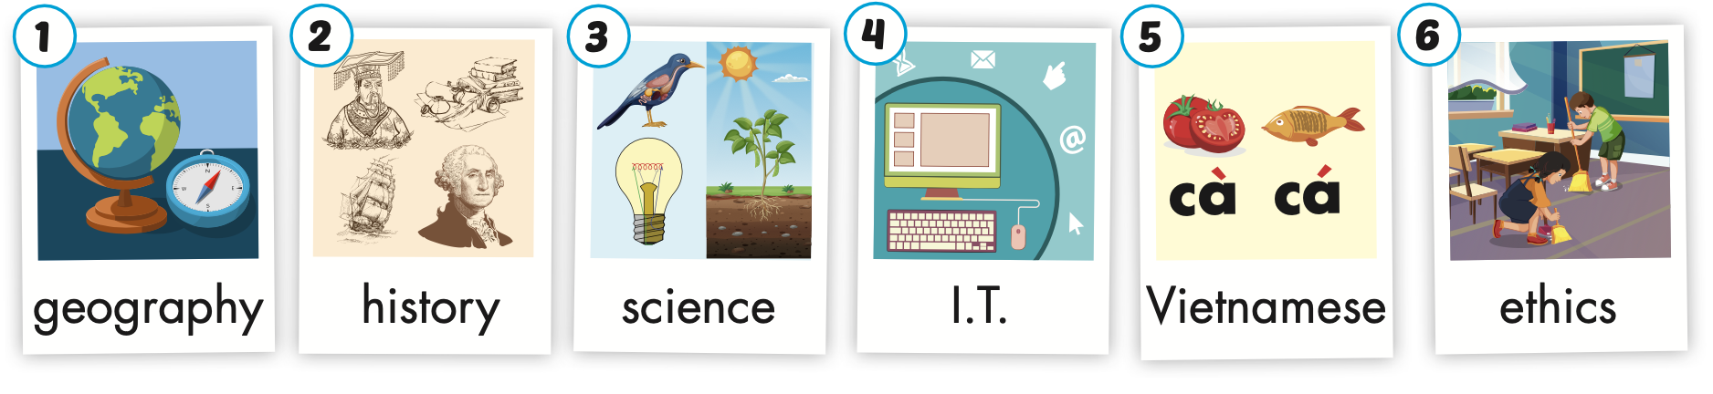
Click on the picture to hear the sound.
/ˈhɪstri/
môn Lịch sử
/ˌaɪ ˈtiː/
môn Tin học
/ˈeθɪks/
môn Đạo đức
/dʒiˈɑːɡrəfi/
môn Địa lí
/ˈsaɪəns/
môn Khoa học
/ˌviːetnəˈmiːz/
môn Tiếng Việt
Notes:
Click vào hình A. 1. Listen and point. Repeat để cho cả audio full chạy

Slide 11


Click on the picture to hear the sound.
geography
/dʒiˈɑːɡrəfi/
môn Địa lí

Slide 12
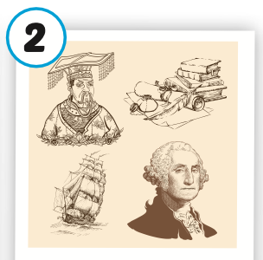
Click on the picture to hear the sound.
history
/ˈhɪstri/
môn Lịch sử

Slide 13
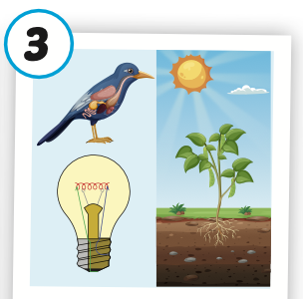
Click on the picture to hear the sound.
science
/ˈsaɪəns/
môn khoa học

Slide 14

Click on the picture to hear the sound.
I.T.
/ˌaɪ ˈtiː/
môn Tin học

Slide 15
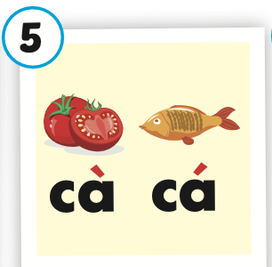
Click on the picture to hear the sound.
Vietnamese
/ˌviːetnəˈmiːz/
môn Tiếng Việt

Slide 16

Click on the picture to hear the sound.
ethics
/ˈeθɪks/
môn Đạo đức

Slide 17

Practice

Slide 18
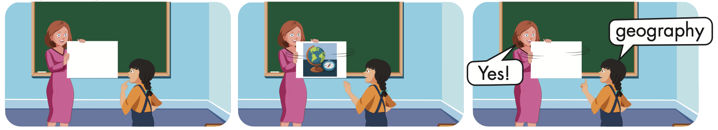

Slide 19
Look and say.

Slide 20

Structure
Which subject do you like?
- I like science.
Which subject does he like?
- He likes English.

Slide 21
Presentation

Slide 22

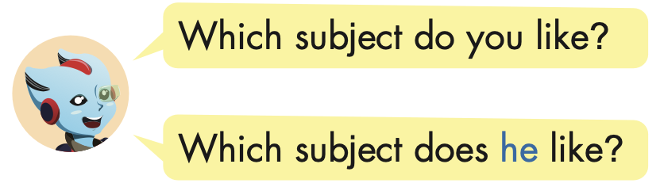
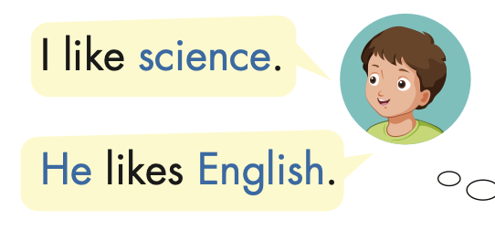
Structure

Slide 23

Practice

Slide 24


Slide 25


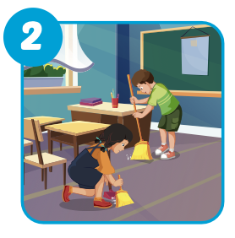
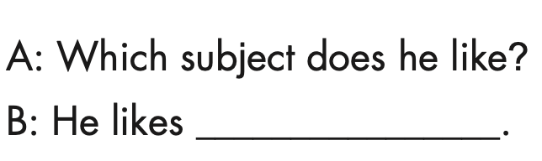
ethics

Slide 26
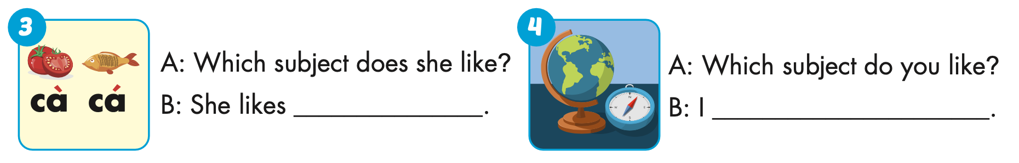
Vietnamese
like geography

Slide 27
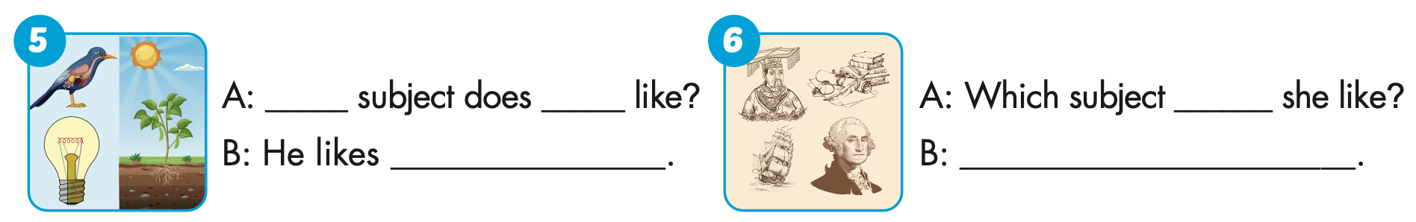
Which
he
science
does
She likes history

Slide 28

Production

Slide 29
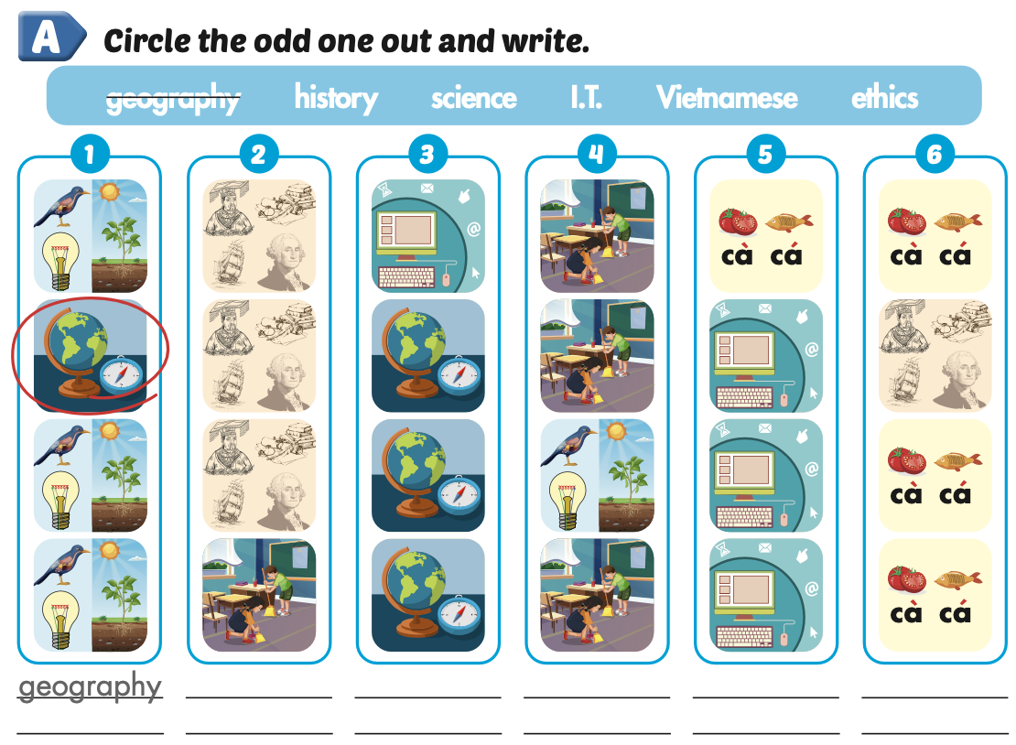
Extra Practice
WB, page 2
ethics
I.T.
science
history
Vietnamese

Slide 30

CONSOLIDATION

Slide 31
Today’s lesson
Vocabularies
geography, history, science, I.T., Vietnamese, ethics.
Structures/ Sentence patterns
Which subject do you like?
- I like science.
Which subject does he like?
- He likes English.

Slide 32
Homework
Practice the vocabularies and structure, and make sentences using them.
Do the exercises in Tiếng Anh 5 i-Learn Smart Start WB (page 2).
Do the exercises in Tiếng Anh 5 i-Learn Smart Start Notebook.
Prepare the next lesson (page 7 SB).
Play the consolidation games in Tiếng Anh 5 i-Learn Smart Start DHA App on www.eduhome.com.vn

