Slide 1

Unit 8: THE WEATHER
Lesson 3.1
Page 112

Slide 2
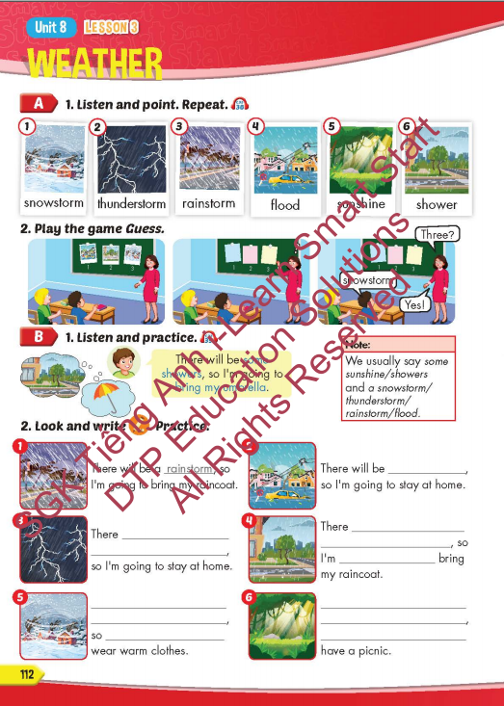
Lesson Outline
Warm-up
Vocabulary
Structure
Consolidation
Wrap-up

Slide 3
Objectives
By the end of this lesson, students will be able to to talk about future weather and the things they're going to do.
Vocabulary: snowstorm, thunderstorm, rainstorm, flood, sunshine, shower.
Structure: There will be some showers, so I'm
going to bring my umbrella.

Slide 4

WARM-UP

Slide 5
MATCHING GAME

Slide 6












Find the umbrella

Slide 7
Find the raincoat

Slide 8
Find the cap

Slide 9
Find the hat

Slide 10
Find the sunglasses

Slide 11
Find the jacket

Slide 12

It’s time to learn …

Slide 13

New words
snowstorm, thunderstorm, rainstorm, flood, sunshine, shower.

Slide 14

Presentation

Slide 15


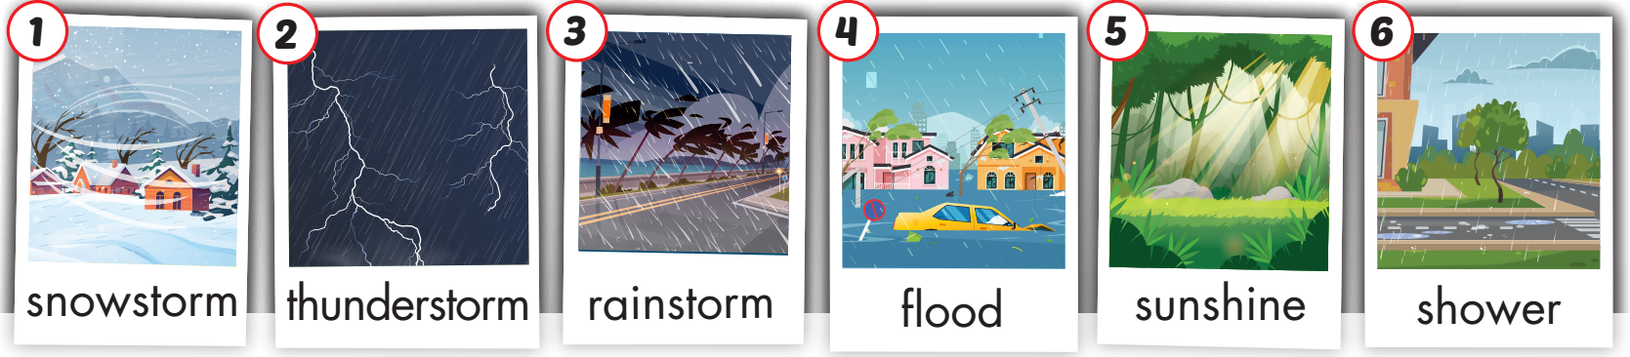
Click on A to hear the sound.
/ˈsnoʊstɔːrm/
bão tuyết
/ˈθʌndərstɔːrm/
giông bão
/ˈreɪnstɔːrm/ mưa bão
/flʌd/
ngập lụt, lũ lụt
/ˈsʌnʃaɪn/
ánh nắng mặt trời
/ˈʃaʊər/ cơn mưa rào

Slide 16

Click on the picture to hear the sound.
Snowstorm (n)
/ˈsnoʊstɔːrm/
bão tuyết

Slide 17
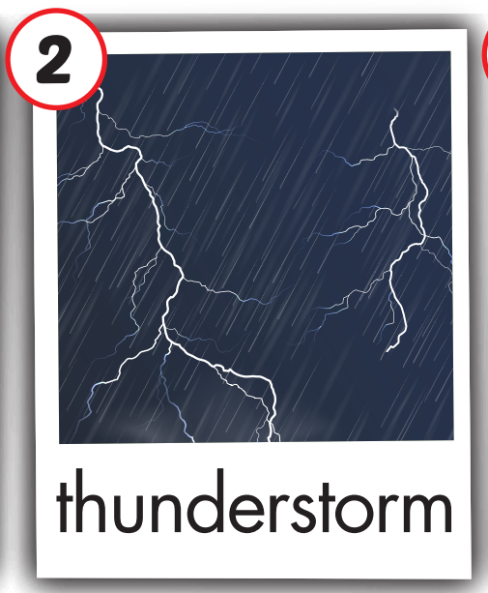
Click on the picture to hear the sound.
thunderstorm (n)
/ˈθʌndərstɔːrm/
giông bão

Slide 18
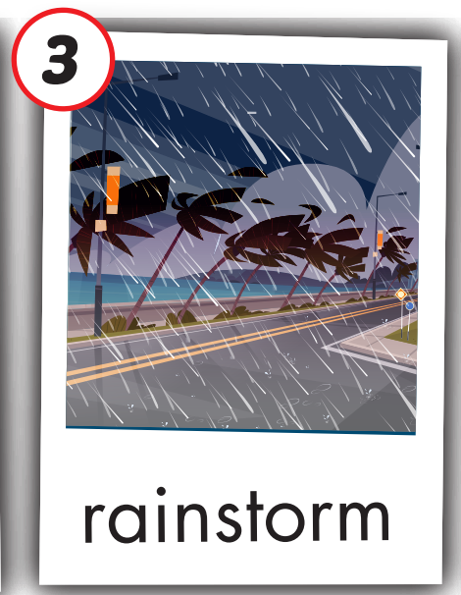
Click on the picture to hear the sound.
rainstorm (n)
/ˈreɪnstɔːrm/ mưa bão

Slide 19
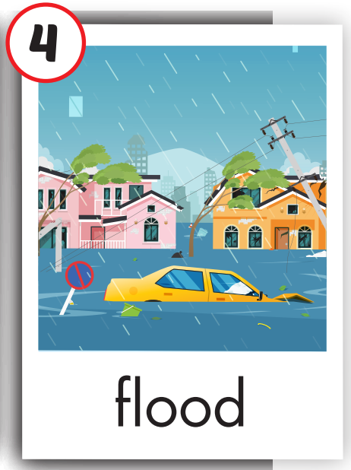
Click on the picture to hear the sound.
flood (n)
/flʌd/
ngập lụt, lũ lụt

Slide 20

Click on the picture to hear the sound.
sunshine (n)
/ˈsʌnʃaɪn/
ánh nắng mặt trời

Slide 21
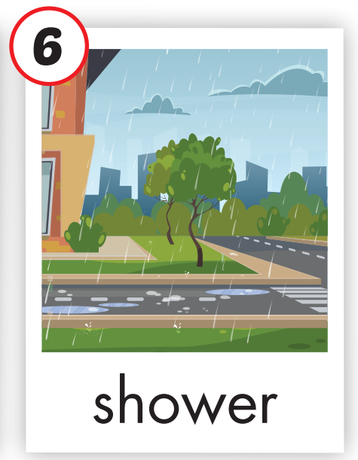
Click on the picture to hear the sound.
shower (n)
/ˈʃaʊər/ cơn mưa rào

Slide 22
Practice

Slide 23
Look, read and choose

Slide 24

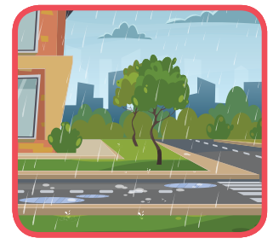
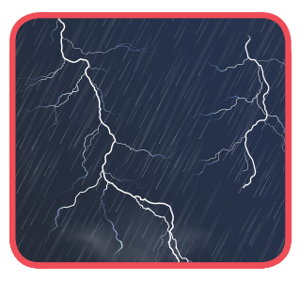

Read and choose
shower
A
B
C

Slide 25
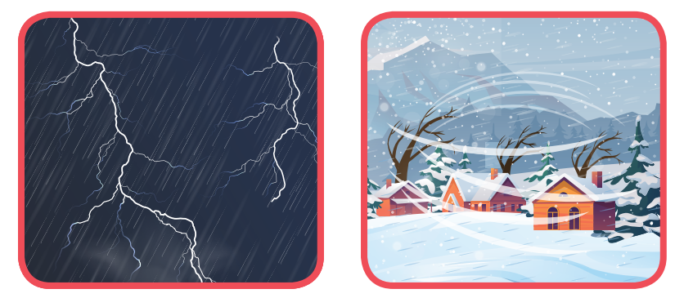
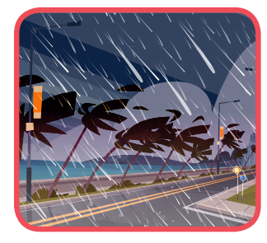
Listen and choose
rainstorm
A
B
C

Slide 26


Read and choose
sunshine
A
B
C

Slide 27
Read and choose
flood
A
B
C

Slide 28
Read and choose
thunderstorm
A
B
C

Slide 29

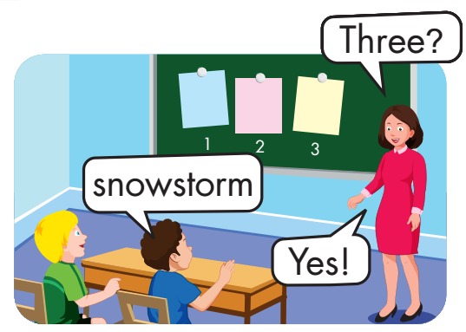
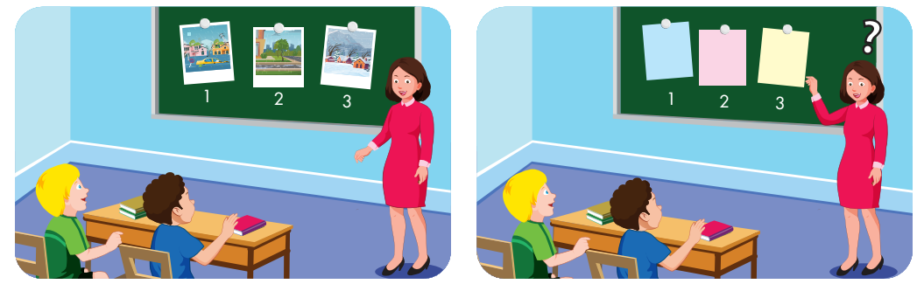

Slide 30
Structure
There will be some showers, so I’m going to bring my umbrella.

Slide 31
Presentation

Slide 32
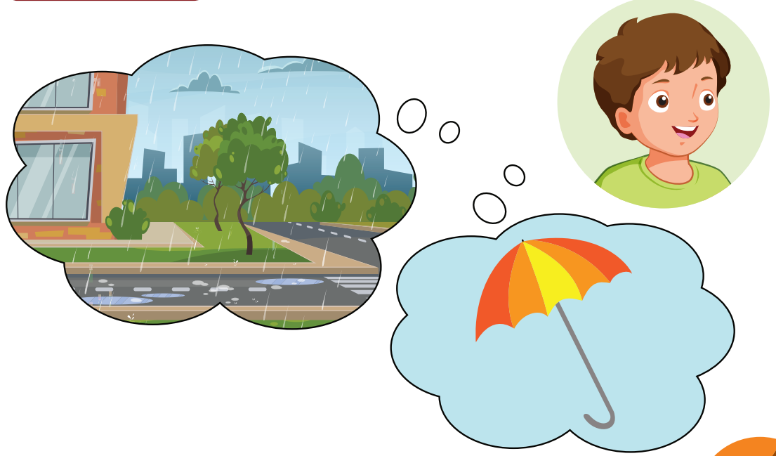
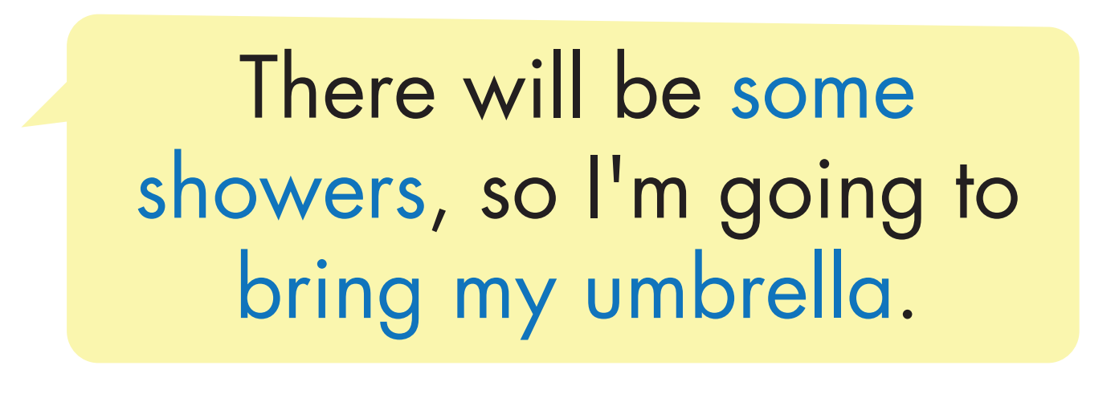
Structure

Slide 33



Slide 34

Practice

Slide 35
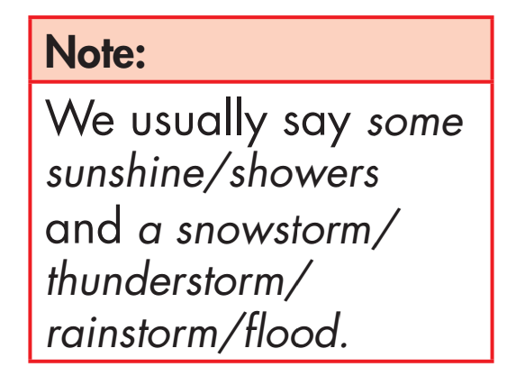
Structure
some
a

Slide 36
Extra practice
_______________
sunshine/ showers
snowstorm/
_____________
thunderstorm/ /rainstorm/ flood.
________________________________

Slide 37
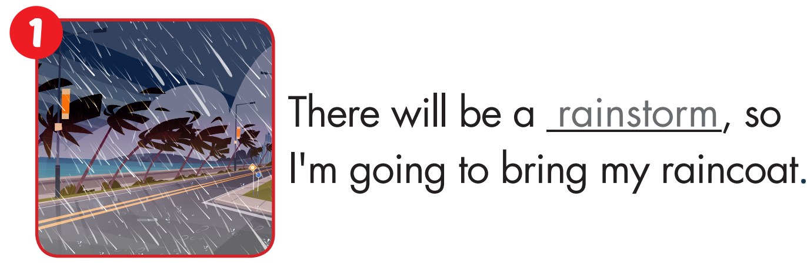

Slide 38
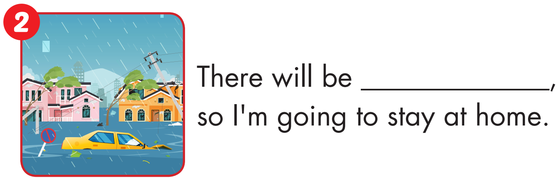
a flood

Slide 39
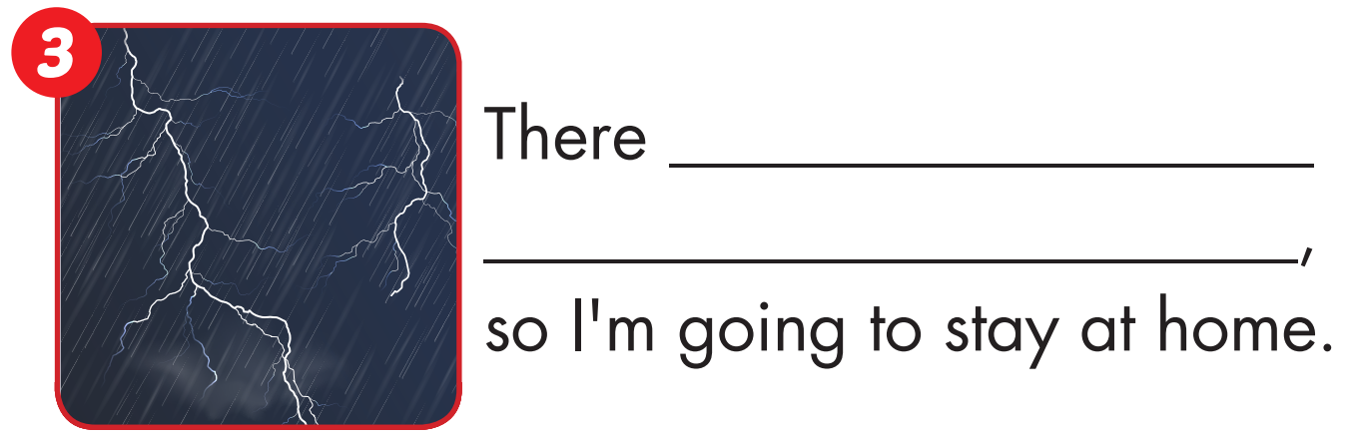
will be a thunderstorm

Slide 40
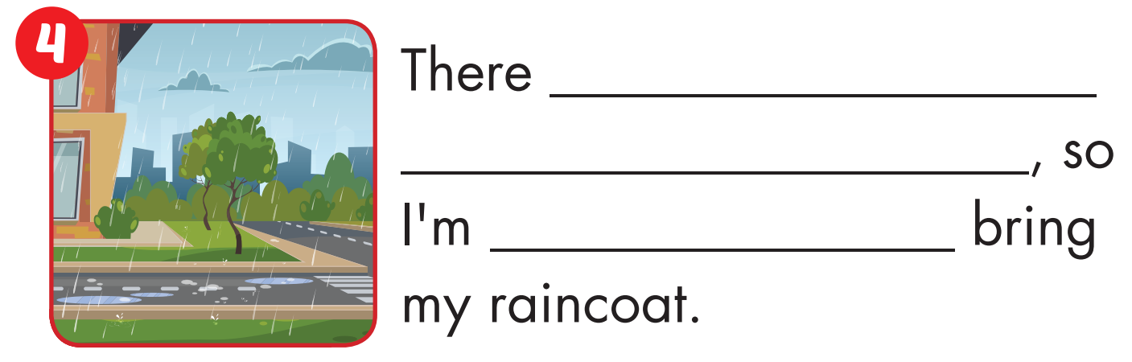
will be some showers
going to

Slide 41
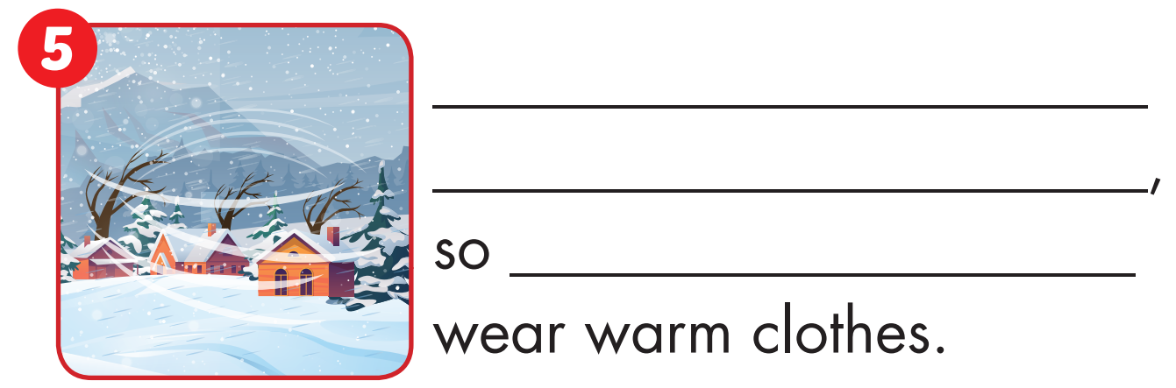
There will be a snowstorm
I’m going to

Slide 42

There will be some sunshine
I’m going to

Slide 43

Production

Slide 44




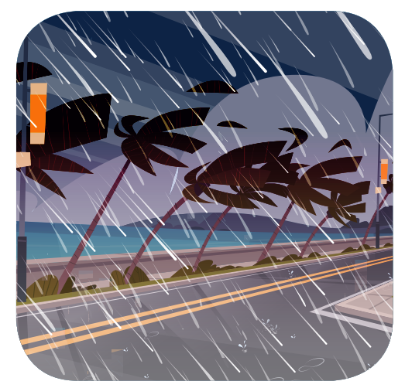
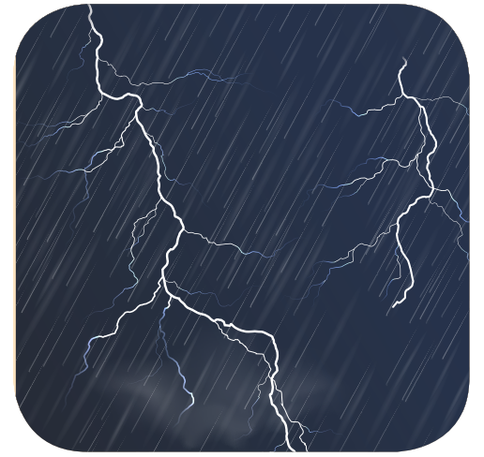
WHAT’S MISSING?
1
2
3
?
?
?
4
5
6
?
?
?

Slide 45

CONSOLIDATION

Slide 46
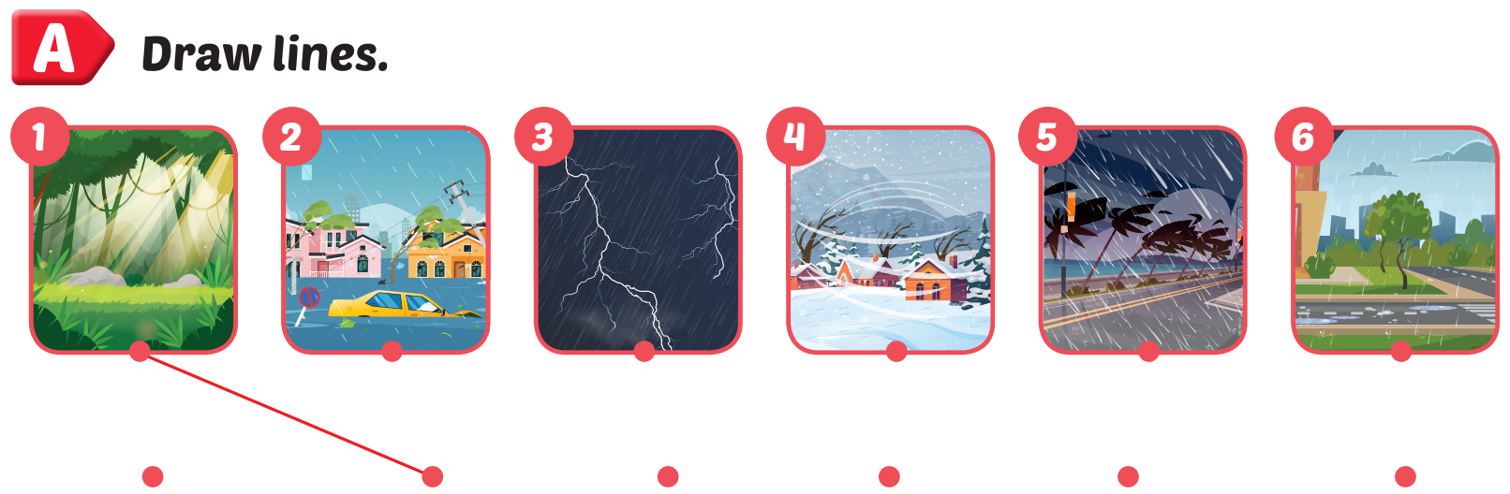
Extra Practice
WB, page 57

Slide 47

WRAP-UP

Slide 48
Today’s lesson
Vocabularies
snowstorm, thunderstorm, rainstorm, flood, sunshine, shower.
Structures/ Sentence patterns
There will be some showers, so I'm
going to bring my umbrella.

Slide 49
Homework
Practice the vocabularies and structure, and make sentences using them.
Do the exercises in Tiếng Anh 5 i-Learn Smart Start WB (page 113).
Do the exercises in Tiếng Anh 5 i-Learn Smart Start Notebook.
Prepare the next lesson (page 85 SB).
Play the consolidation games in Tiếng Anh 5 i-Learn Smart Start DHA App on www.eduhome.com.vn

Slide 50

Enjoy your day!

Slide 51

Lesson 3
Stay positive and have a nice day!

