Slide 1

Unit 8: WEATHER
Lesson 2.1
Page 109

Slide 2
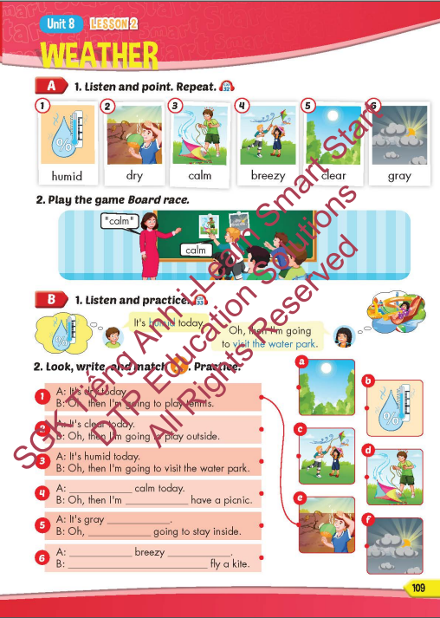
Lesson Outline
Warm-up
Vocabulary
Structure
Consolidation
Wrap-up

Slide 3
Objectives
By the end of this lesson, students will be able to recognize the vocabulary to say what the weather is like today and what they're going to do.
Vocabulary: humid, dry, calm, breezy, clear, gray.
Structure:
It's humid today.
Oh, then I'm going to visit the water park.

Slide 4

WARM-UP

Slide 5

Guess the WEATHER

Slide 6


drops of water that fall from clouds.
RAIN

Slide 7

We've had a very ______winter this year.
SNOWY

Slide 8

with a lot of wind.
WINDY

Slide 9

a weather condition in which very small drops of water come together to form a thick cloud, making it difficult to see.
FOGGY

Slide 10

bright because of light from the sun.
SUNNY

Slide 11

It’s time to learn …

Slide 12

New words
humid, dry, calm, breezy, clear, gray.

Slide 13

Presentation

Slide 14
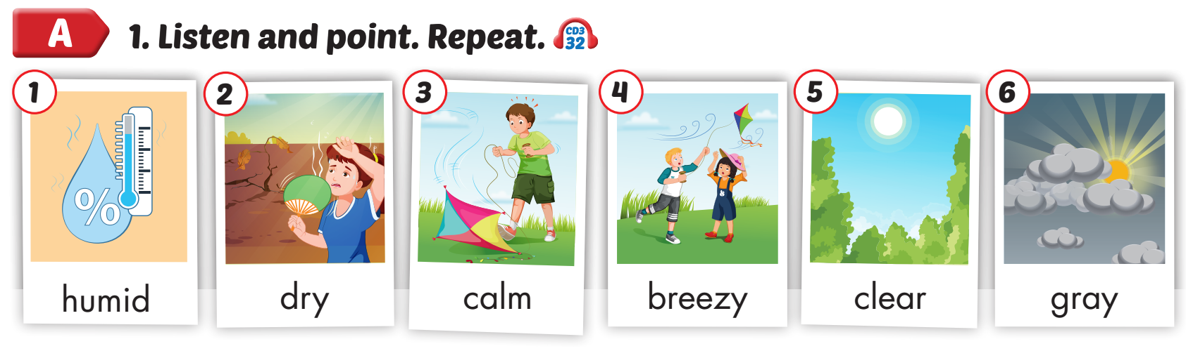

Click on A to hear the sound.
/ˈhjuːmɪd/
ẩm ướt
/draɪ/
khô
/kɑːm/
êm đềm, lặng gió
/ˈbriːzi/ có gió hiu hiu
/klɪr/
trời (trong), không mây
/ɡreɪ/ (trời) xám xịt
Notes:
Click vào hình A. 1. Listen and point. Repeat để cho cả audio full chạy

Slide 15
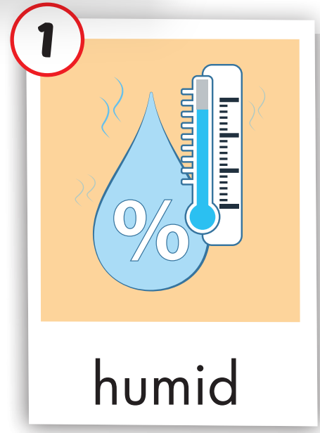
Click on the picture to hear the sound.
humid (adj)
/ˈhjuːmɪd/
ẩm ướt

Slide 16
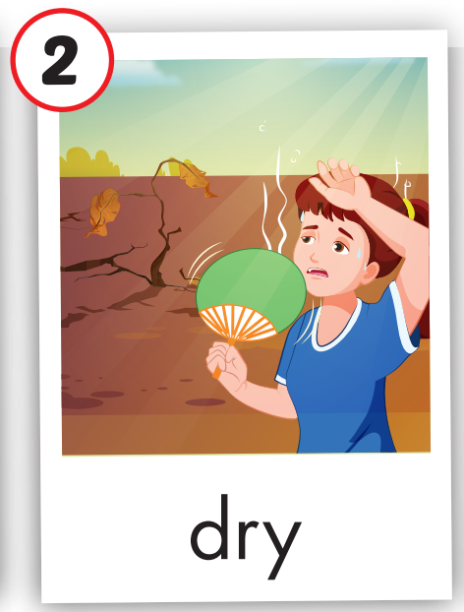
Click on the picture to hear the sound.
dry (adj)
/draɪ/
khô

Slide 17

Click on the picture to hear the sound.
calm (adj)
/kɑːm/
êm đềm, lặng gió

Slide 18
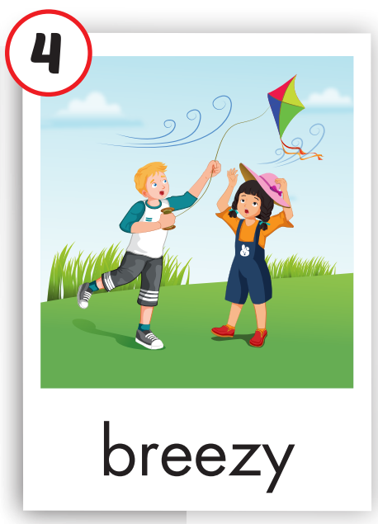
Click on the picture to hear the sound.
breezy (adj)
/ˈbriːzi/ có gió hiu hiu

Slide 19

Click on the picture to hear the sound.
clear (adj)
/klɪr/
trời (trong), không mây

Slide 20
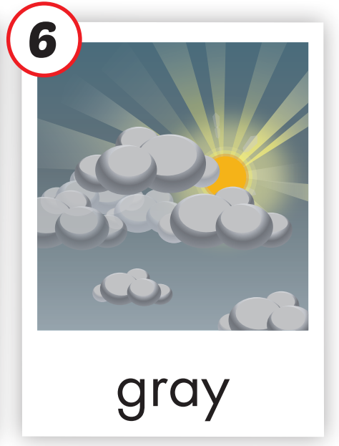
Click on the picture to hear the sound.
gray (adj)
/ɡreɪ/ (trời) xám xịt

Slide 21
Practice

Slide 22
Listen and choose. Then say.

Slide 23


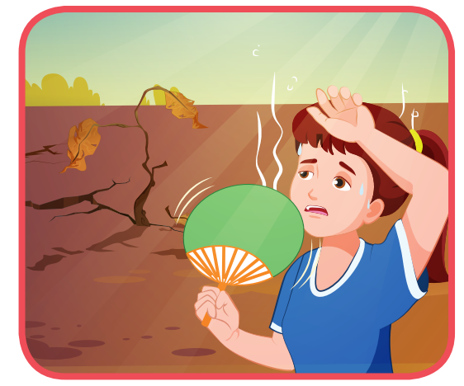

Listen and choose
A
B
C
breezy

Slide 24

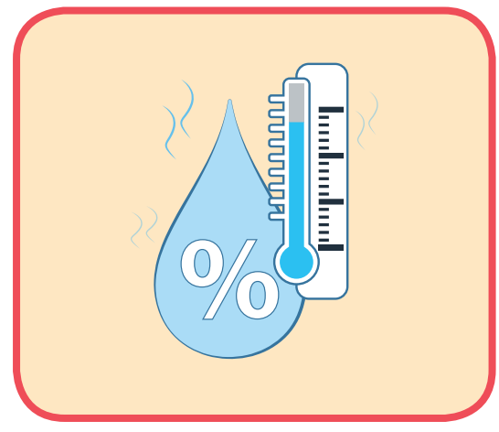

Listen and choose
A
B
C
calm

Slide 25
Listen and choose
A
B
C
humid

Slide 26
Listen and choose
A
B
C
gray

Slide 27
Listen and choose
A
B
C
clear

Slide 28
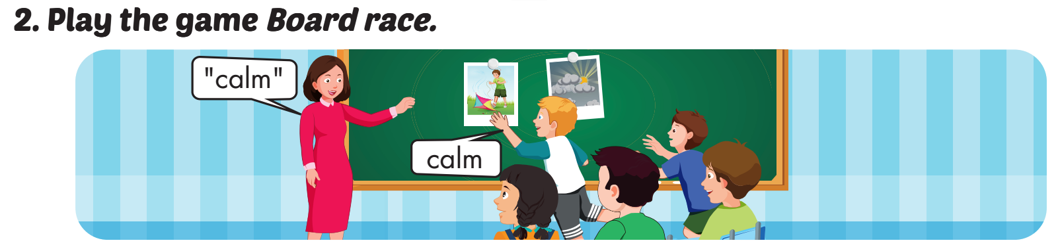

Slide 29
Structure
It's humid today.
Oh, then I'm going to visit the water park.

Slide 30
Presentation

Slide 31
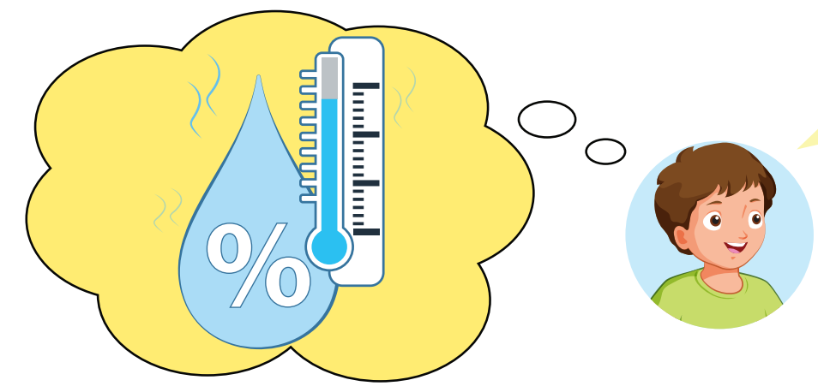



Structure

Slide 32

Practice

Slide 33

Structure

Slide 34

Oh, then I’m going to
____________________.
It’s ________ today.
humid
visit the water park

Slide 35



Slide 36
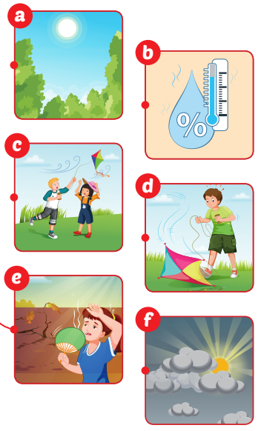
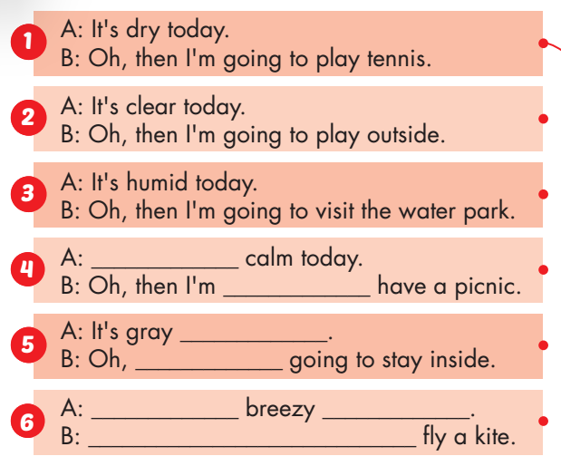
It’s
going
today
I’m
It’s
today
Oh, I’m going to

Slide 37


Production

Slide 38
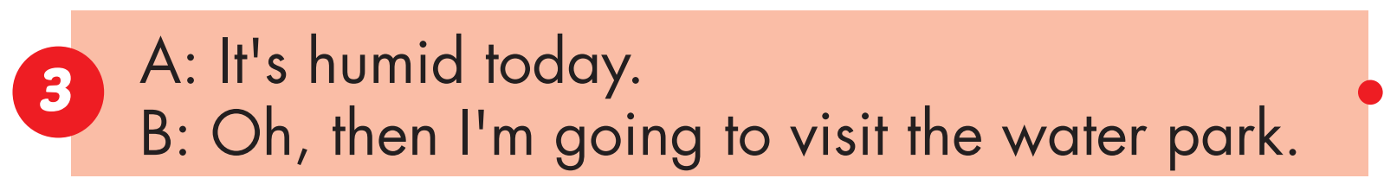
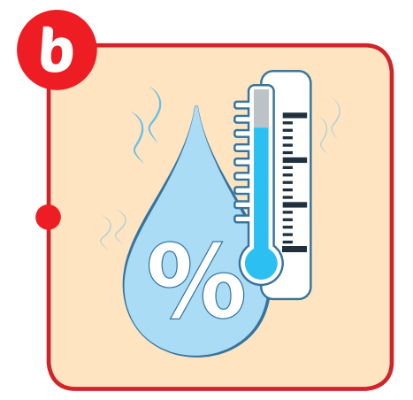
Production

Slide 39


It’s
going
Production

Slide 40
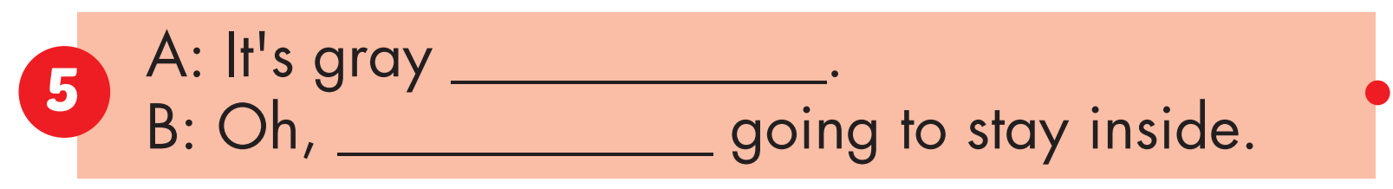

today
I’m
Production

Slide 41
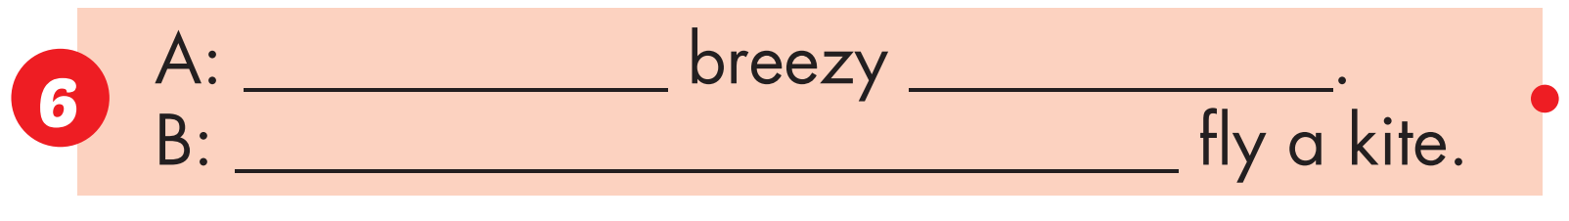

It’s
today
I’m going to
Production

Slide 42

Production

Slide 43
calm |  | dry
 | breezy
humid |  | gray
 | clear
1
2
3
4
5
6
7
8
9
10
11
12

Slide 44

CONSOLIDATION

Slide 45
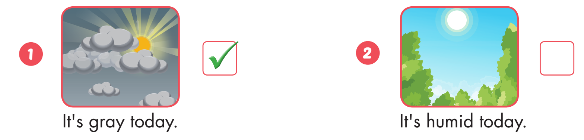

Extra Practice
WB, page 74

Slide 46
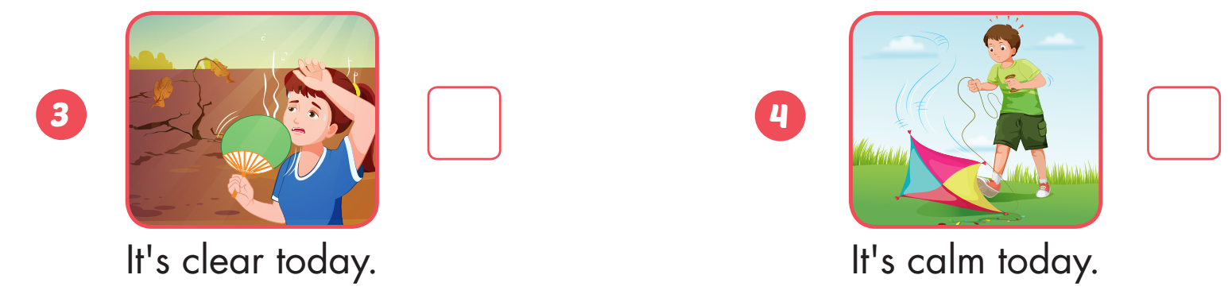

Extra Practice
WB, page 74

Slide 47
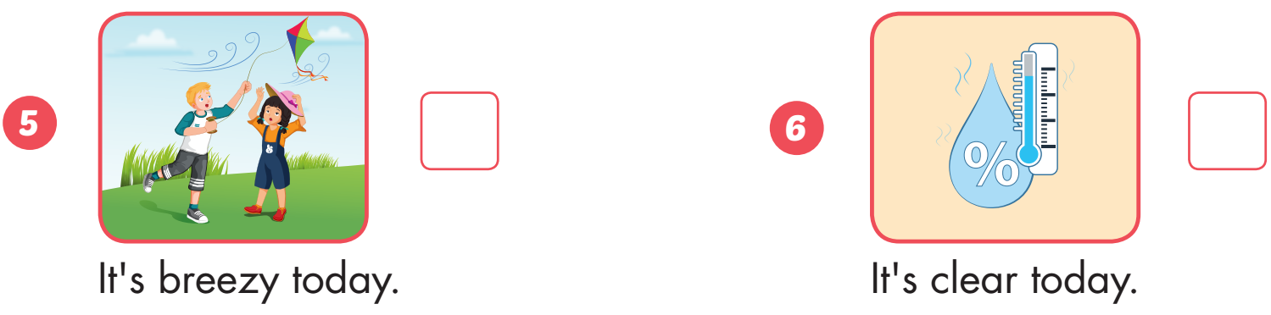
Extra Practice
WB, page 74

Slide 48

WRAP-UP

Slide 49
Today’s lesson
Vocabularies
humid, dry, calm, breezy, clear, gray.
Structures/ Sentence patterns
It's humid today.
Oh, then I'm going to visit the water park.

Slide 50
Homework
Practice the vocabularies and structure, and make sentences using them.
Do the exercises in Tiếng Anh 5 i-Learn Smart Start WB (page 74).
Do the exercises in Tiếng Anh 5 i-Learn Smart Start Notebook.
Prepare the next lesson (page 110 SB).
Play the consolidation games in Tiếng Anh 5 i-Learn Smart Start DHA App on www.eduhome.com.vn

Slide 51

Enjoy your day!

Slide 52

Lesson 3
Stay positive and have a nice day!

