Slide 1

Unit 8: WEATHER
Lesson 1.1
Page 106

Slide 2
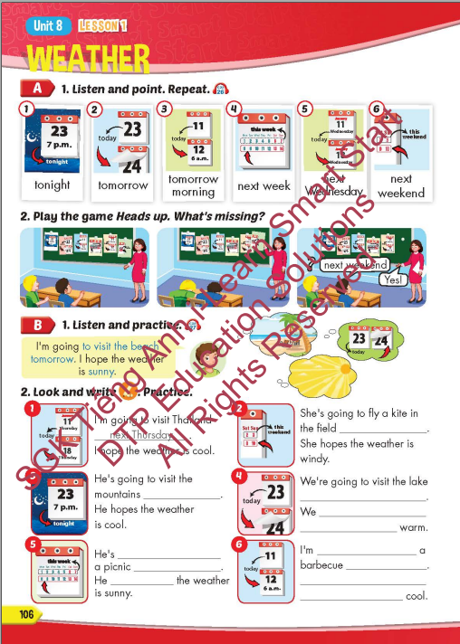
Lesson Outline
Warm-up
Vocabulary
Structure
Consolidation
Wrap-up

Slide 3
Objectives
By the end of this lesson, students will be able to talk about their plans and what they hope the weather is like.
Vocabulary: tonight, tomorrow, tomorrow morning,
next week, next Wednesday, next weekend.
Sentence pattern:
I'm going to visit the beach tomorrow.
I hope the weather is sunny.

Slide 4

WARM-UP

Slide 5



Catch the word
rain
a raincoat
a coat

Slide 6


Catch the word
rain
boots
rain boots

Slide 7



Catch the word
a sun
glasses
sunglasses

Slide 8


Catch the word
a sun
a sunflower
a flower

Slide 9


Catch the word
rain
boots
rain boots

Slide 10
Catch the word
a sun
glasses
sunglasses

Slide 11
Catch the word
a sun
a sunflower
a flower

Slide 12
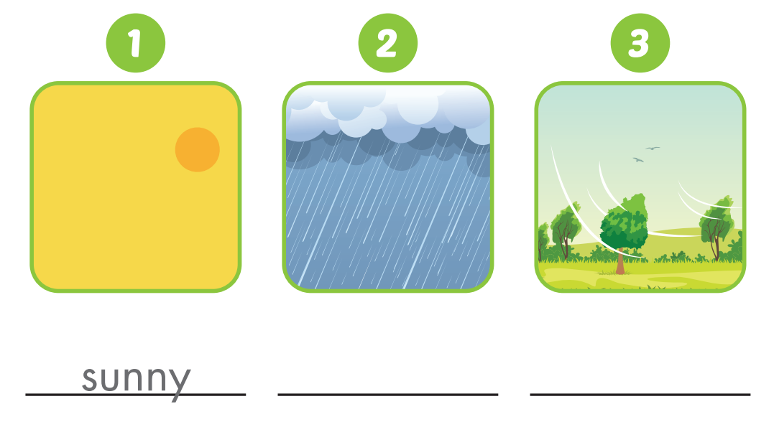
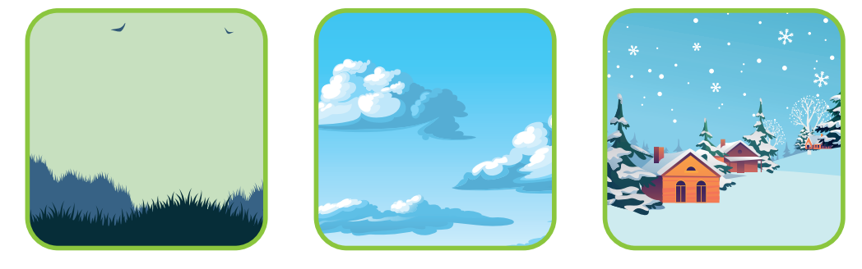
WEATHER

Slide 13

It’s time to learn …

Slide 14

New words
tonight, tomorrow, tomorrow morning,
next week, next Wednesday, next weekend.

Slide 15

Presentation

Slide 16


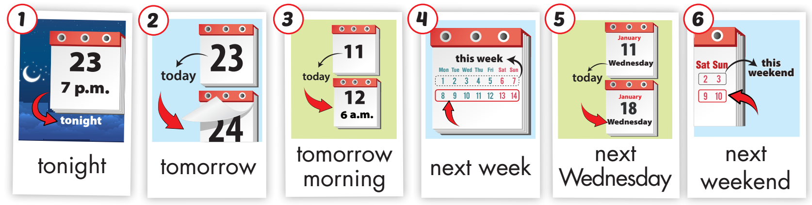
Click on A to hear the sound.
/təˈnaɪt/
tối nay
/təˈmɔːroʊ ˈmɔːrnɪŋ/
sáng mai
/nekst wiːk/
tuần kế tiếp
/nekst ˈwenzdeɪ/ thứ tư kế tiếp
/nekst ˈwiːkend/ cuối tuần
/təˈmɔːroʊ/
ngày mai
Notes:
Click vào hình A. 1. Listen and point. Repeat để cho cả audio full chạy

Slide 17
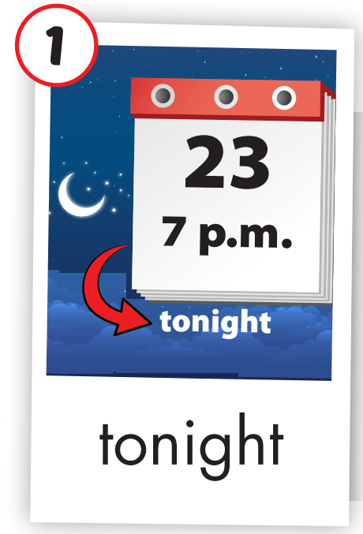
Click on the picture to hear the sound.
tonight (adv)
/təˈnaɪt/
tối nay

Slide 18
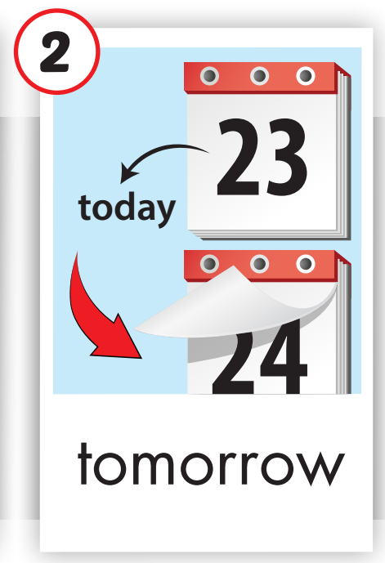
Click on the picture to hear the sound.
tomorrow (adv)
/təˈmɔːroʊ/
ngày mai

Slide 19
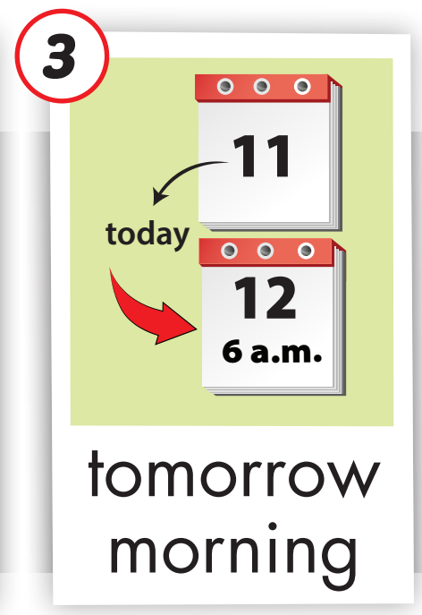
Click on the picture to hear the sound.
tomorrow morning (adv)
/təˈmɔːroʊ ˈmɔːrnɪŋ/
sáng mai

Slide 20
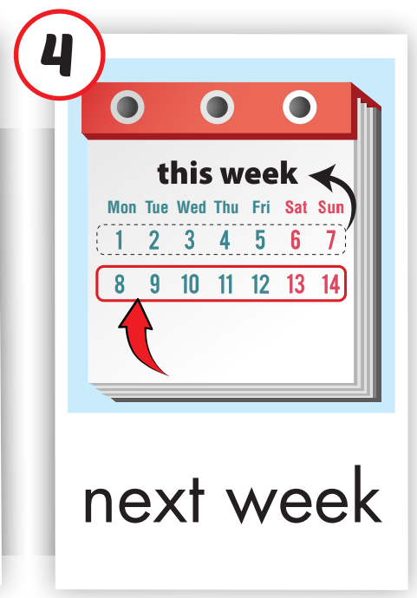
Click on the picture to hear the sound.
next week (adv)
/nekst wiːk/
tuần kế tiếp

Slide 21
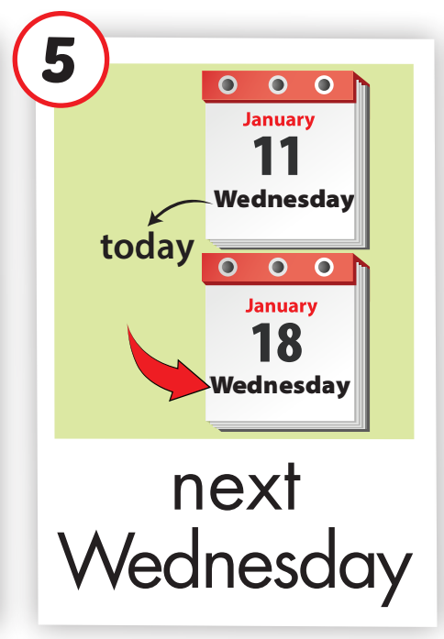
Click on the picture to hear the sound.
next Wednesday (adv)
/nekst ˈwenzdeɪ/ thứ tư kế tiếp

Slide 22
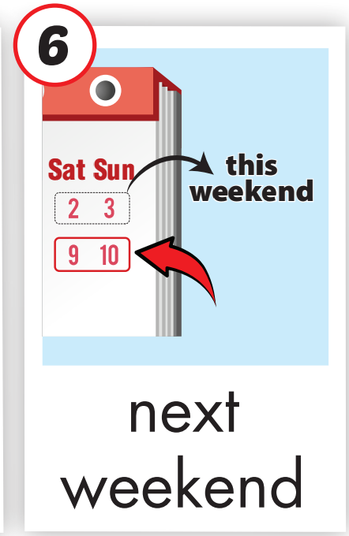
Click on the picture to hear the sound.
next weekend (adv)
/nekst ˈwiːkend/ cuối tuần

Slide 23
Practice

Slide 24
Listen and choose. Then say.

Slide 25
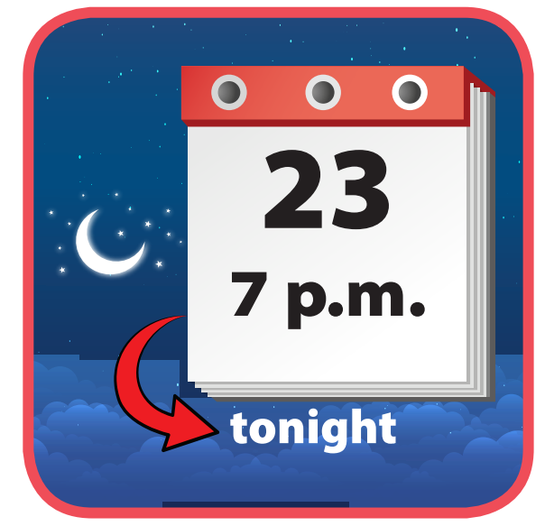
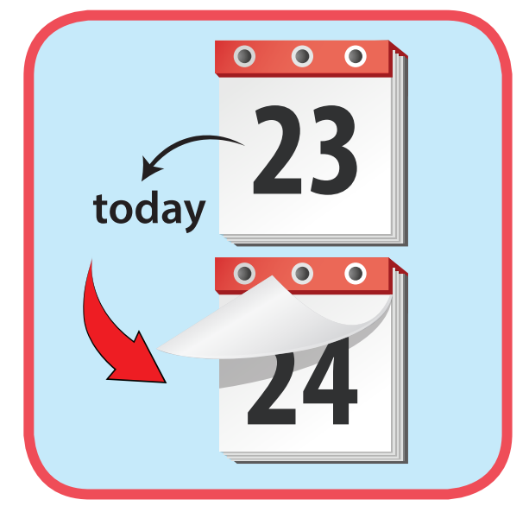
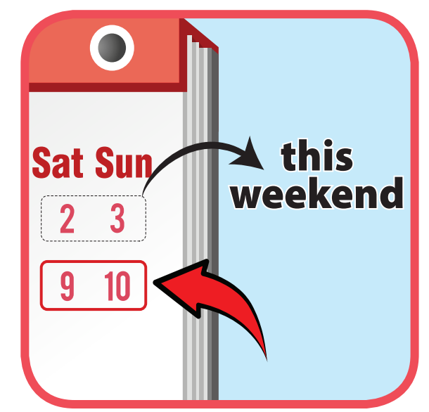

Listen and choose
A
B
C

Slide 26

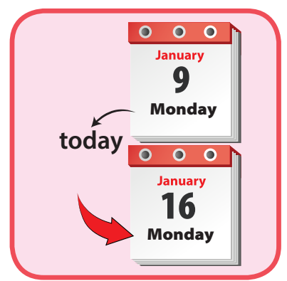
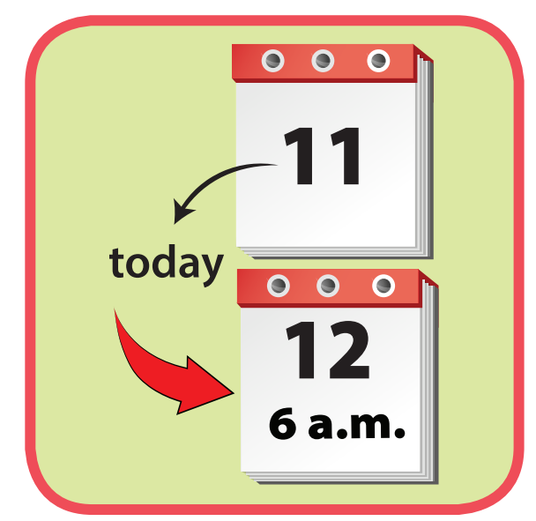
Listen and choose
A
B
C

Slide 27
Listen and choose
A
B
C

Slide 28
Listen and choose
A
B
C

Slide 29
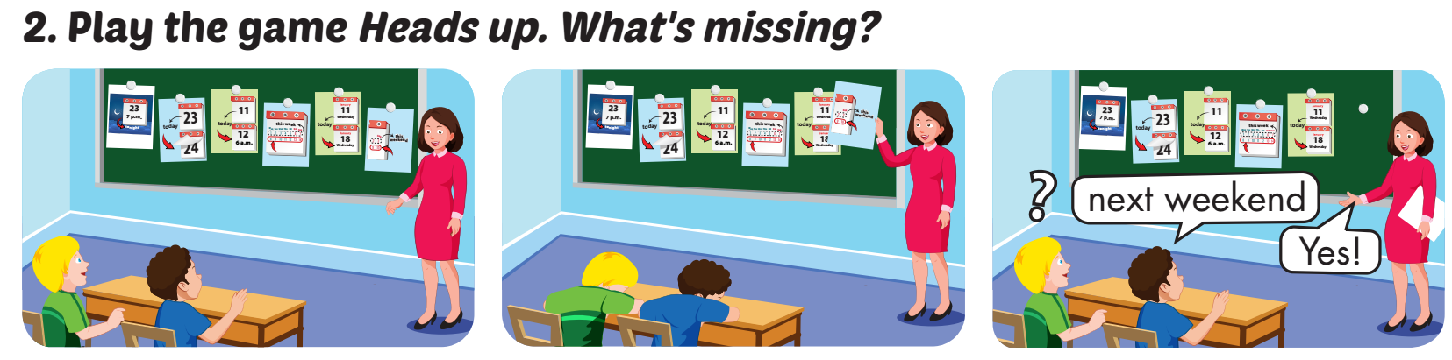

Slide 30
Structure
I'm going to visit the beach tomorrow.
I hope the weather is sunny.

Slide 31
Presentation

Slide 32

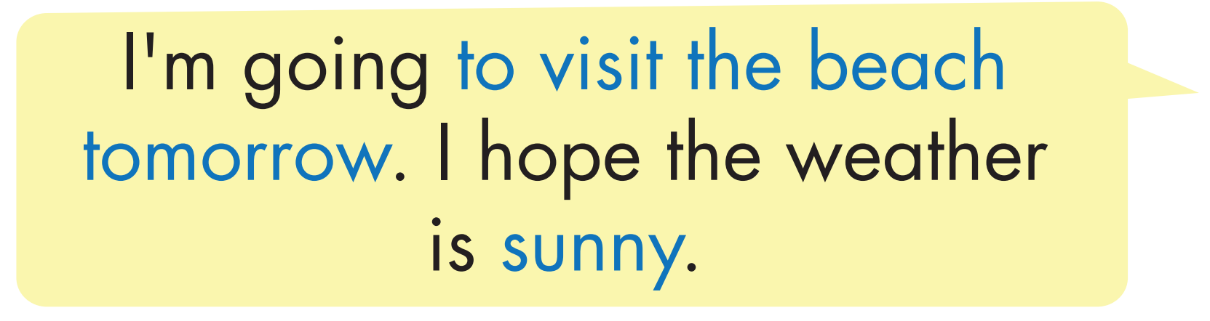
Structure

Slide 33


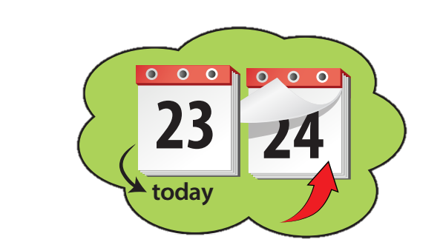

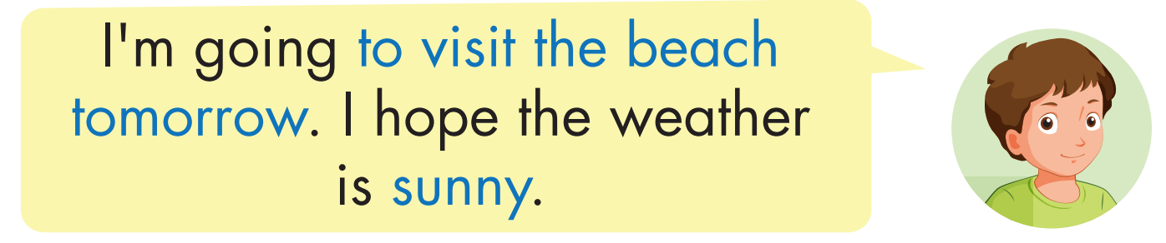
Click on B to hear the sound.

Slide 34

Practice

Slide 35

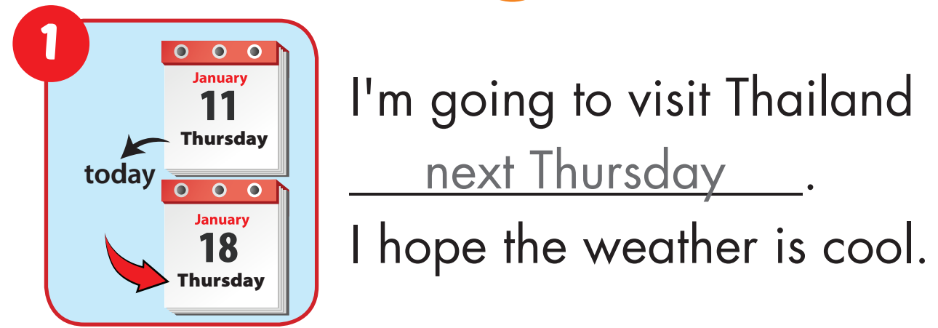

Slide 36
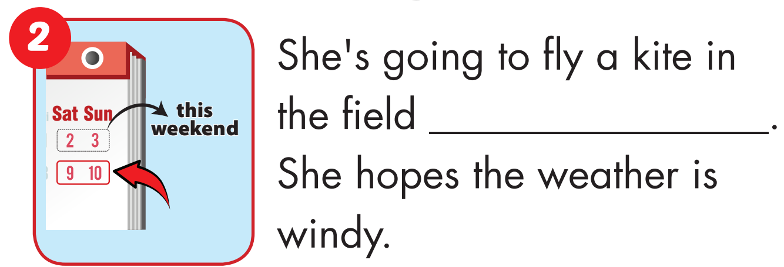
next weekend

Slide 37
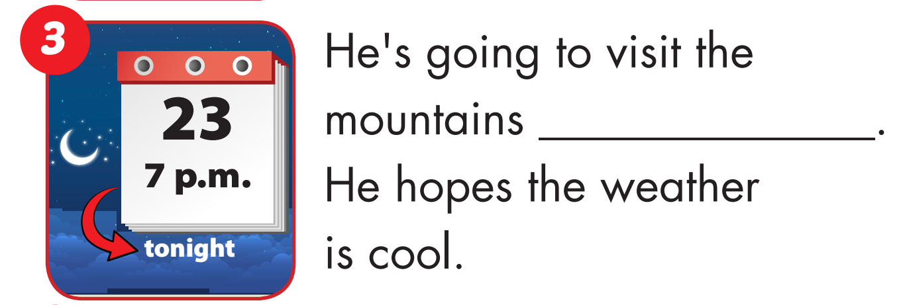
tonight

Slide 38
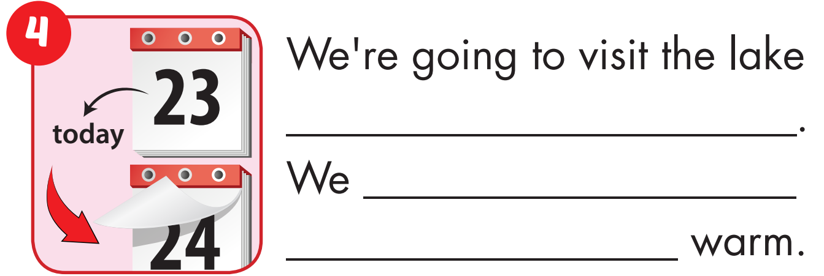
tomorrow
hope the weather is

Slide 39
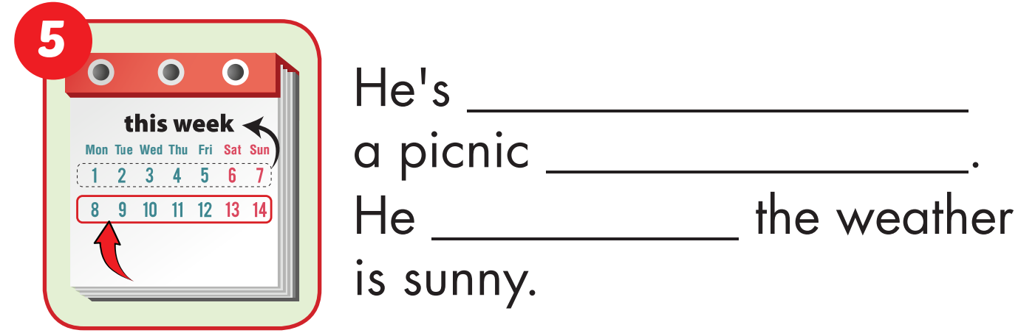
going to
next week
hopes

Slide 40
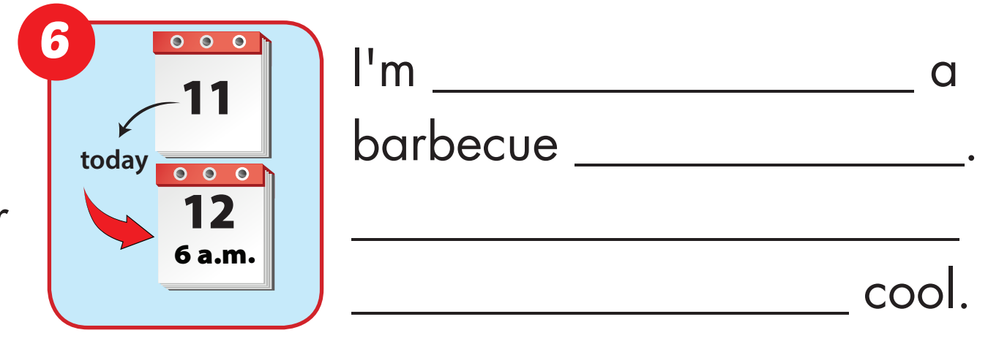
going to
tomorrow
morning. I hope the weather is

Slide 41

Production

Slide 42
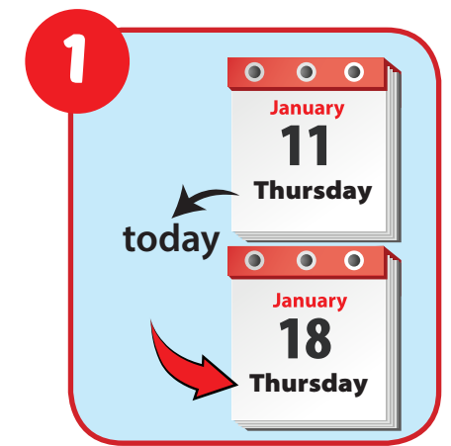
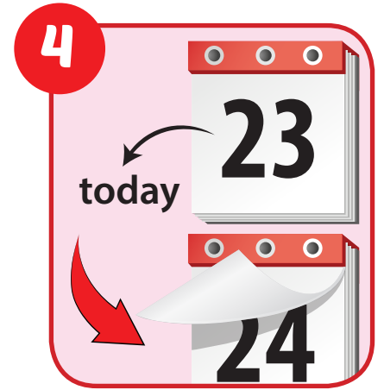
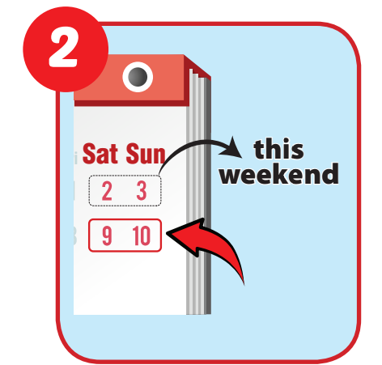
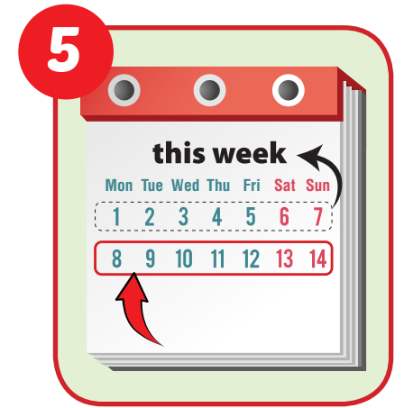
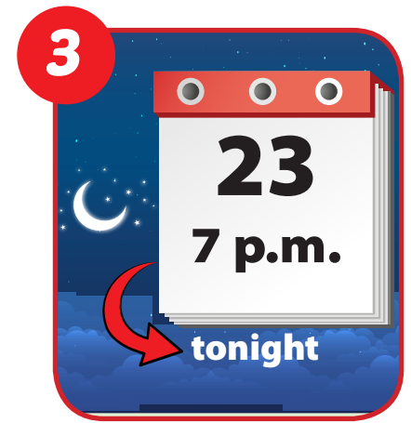
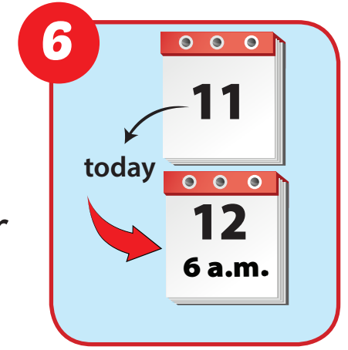
6
1
SPIN
5
2
4
3

Slide 43

CONSOLIDATION

Slide 44

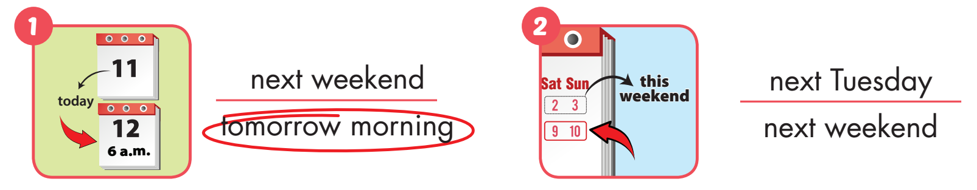
Extra Practice
WB, page 72

Slide 45
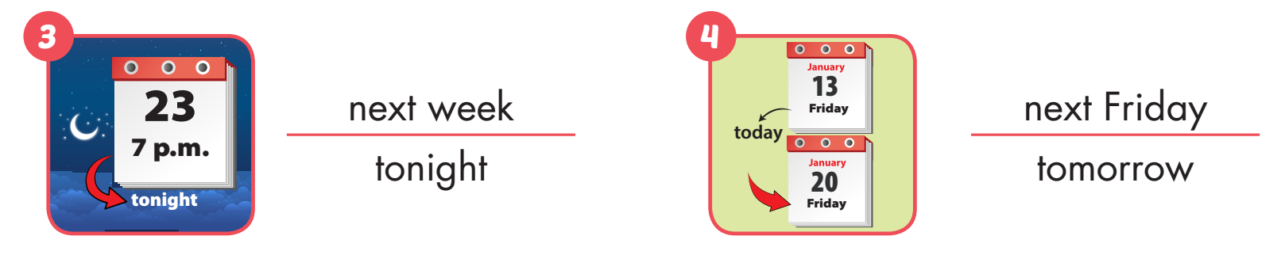
Extra Practice
WB, page 72

Slide 46
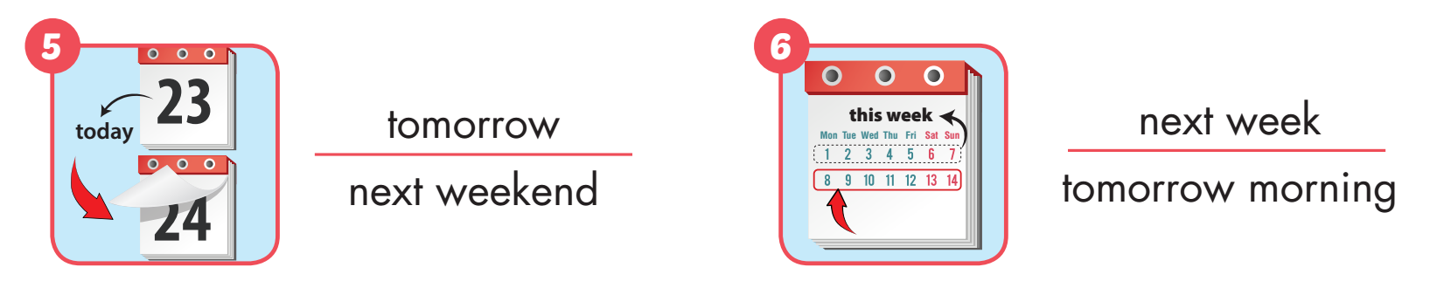
Extra Practice
WB, page 72

Slide 47

WRAP-UP

Slide 48
Today’s lesson
Vocabularies
tonight, tomorrow, tomorrow morning,
next week, next Wednesday, next weekend.
Structures/ Sentence patterns
I'm going to visit the beach tomorrow.
I hope the weather is sunny.

Slide 49
Homework
Practice the vocabularies and structure, and make sentences using them.
Do the exercises in Tiếng Anh 5 i-Learn Smart Start WB (page 72).
Do the exercises in Tiếng Anh 5 i-Learn Smart Start Notebook.
Prepare the next lesson (page 107 SB).
Play the consolidation games in Tiếng Anh 5 i-Learn Smart Start DHA App on www.eduhome.com.vn

Slide 50

Enjoy your day!

Slide 51

Lesson 3
Stay positive and have a nice day!

