Slide 1

Unit 7: JOBS
Lesson 1.2
Page 93

Slide 2
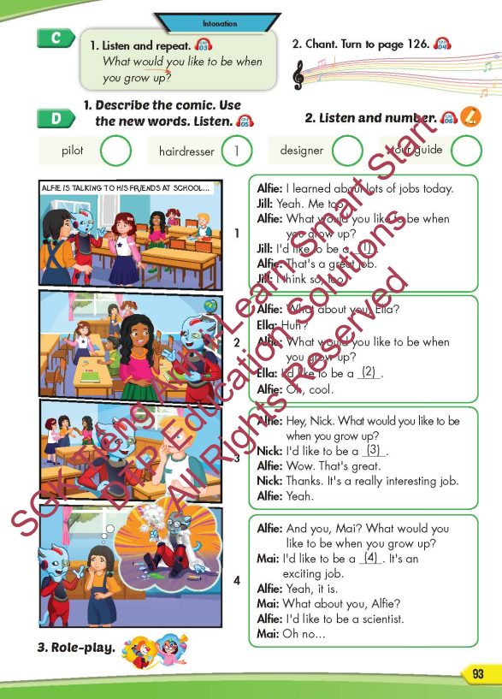
Lesson Outline
Warm-up
Pronunciation
Pre-listening
While-listening
Post-listening
Consolidation
Wrap-up

Slide 3
Objectives
By the end of this lesson, students will be able to practice the intonation, the target language and the conversations.
Pronunciation: intonation for WH-question.
Structure: What would you like to be when you grow up?
- I’d like to be a scientist.

Slide 4

WARM-UP

Slide 5
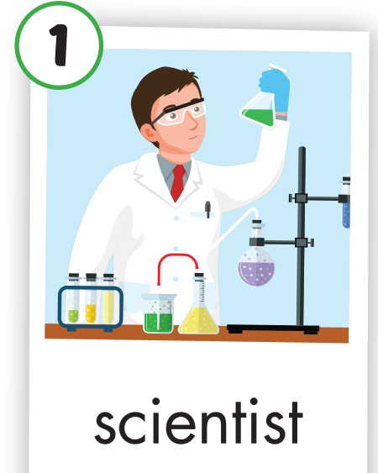

Look and say

Slide 6
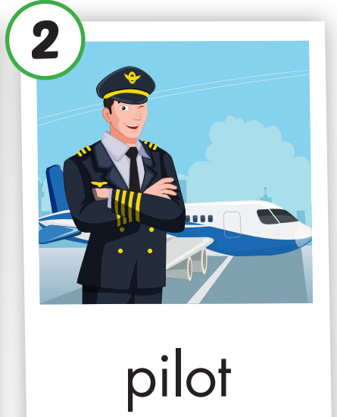
Look and say

Slide 7
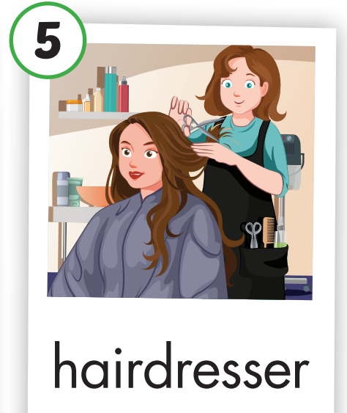
Look and say

Slide 8
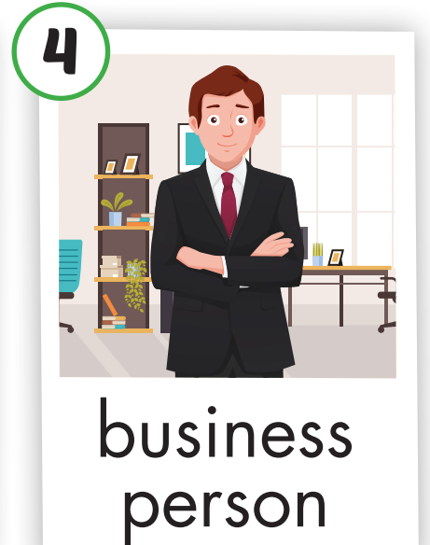
Look and say

Slide 9
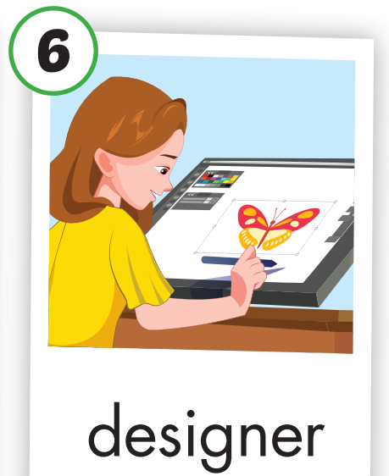
Look and say

Slide 10
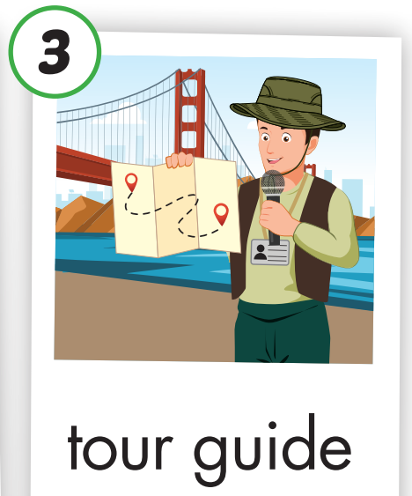
Look and say

Slide 11

It’s time to learn …

Slide 12

Pronunciation
intonation for Wh-question

Slide 13

Presentation

Slide 14
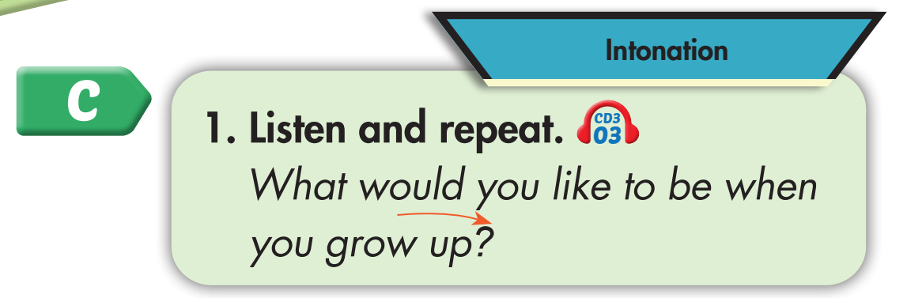

Click on the picture to hear the sound.
What would you like to be when you grow up?

Slide 15
Practice

Slide 16
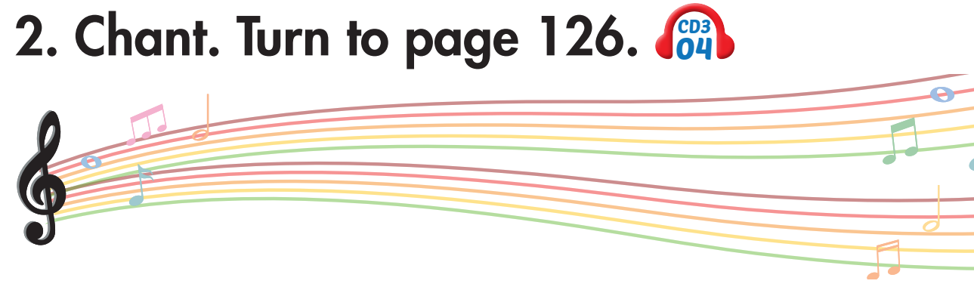
Click on the picture to hear the sound.

Slide 17
Click on the picture to hear the sound.
What would you like to be when you grow up?
I’d like to be a tour guide.
I’d like to be a hairdresser.
I’d like to be a designer.
I’d like to be a pilot.

Slide 18
Pre-listening

Slide 19
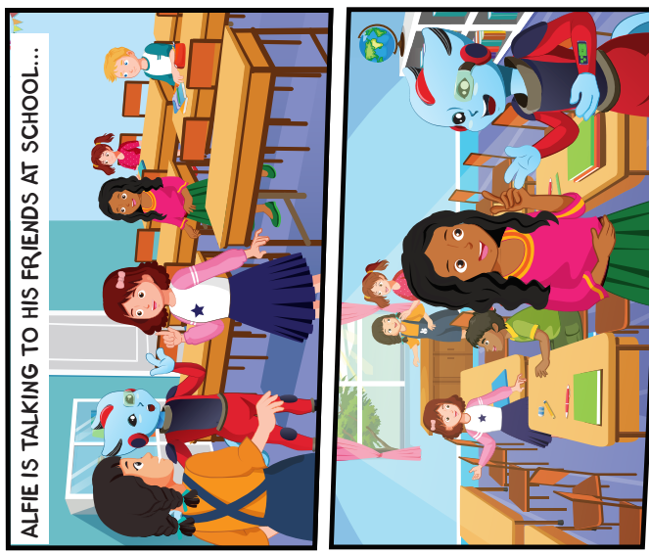
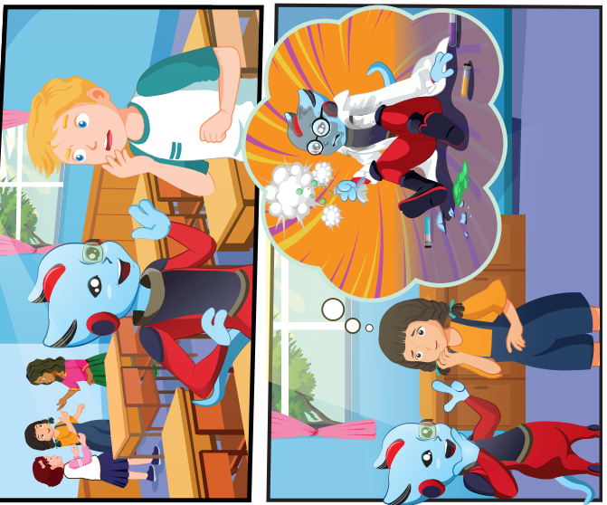
Look and answer the questions.
“ What happens?”
“ Where are they?”
“ Who is talking?”

Slide 20

← Click on the title to hear the sound.

Slide 21

While-listening

Slide 22

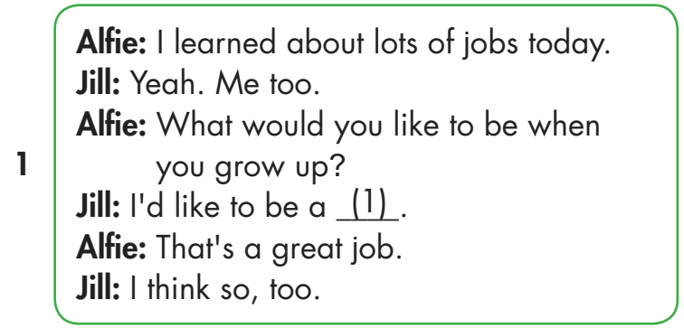
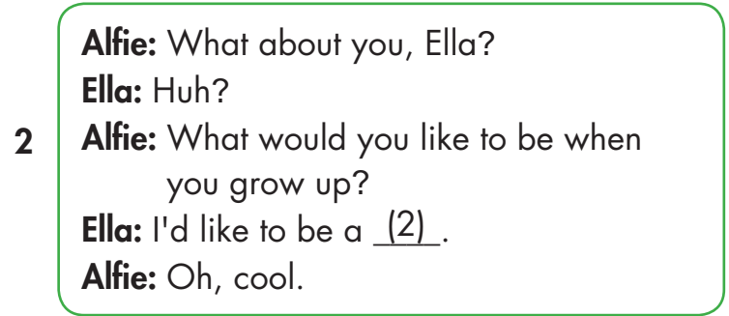
← Click on the title to hear the sound.
2

Slide 23
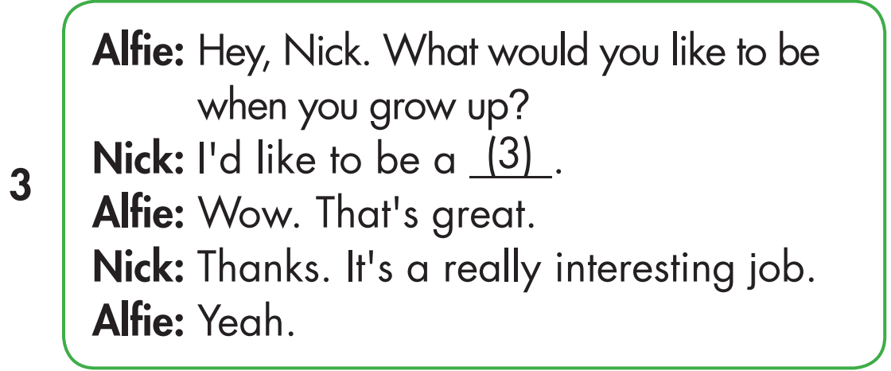
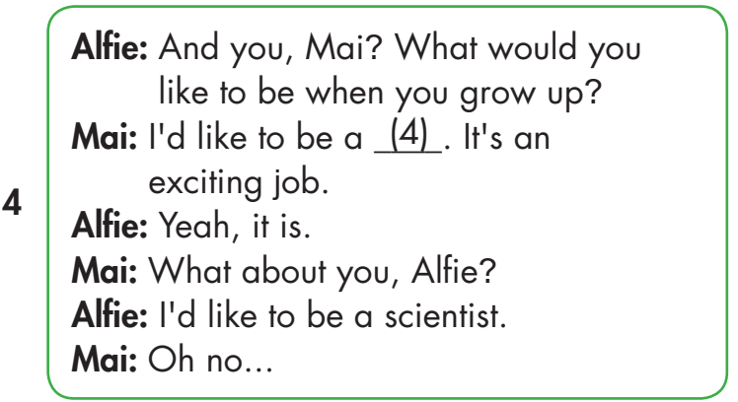
← Click on the title to hear the sound.
4
2
3

Slide 24

Post-listening

Slide 25

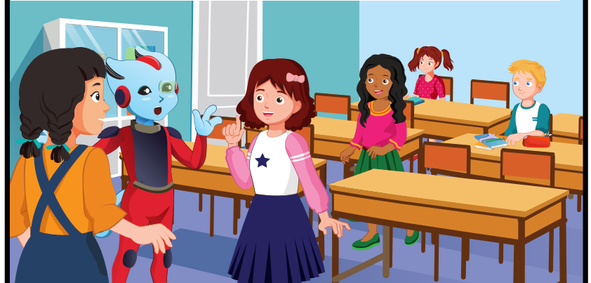
hairdresser

Slide 26
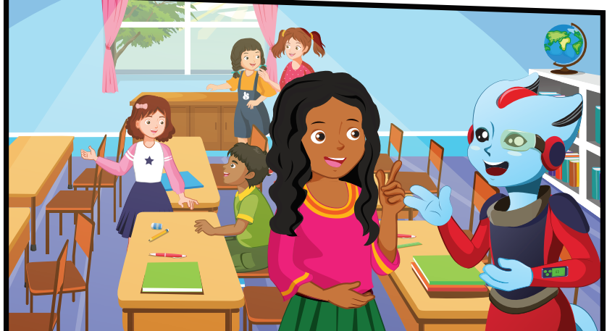
designer

Slide 27
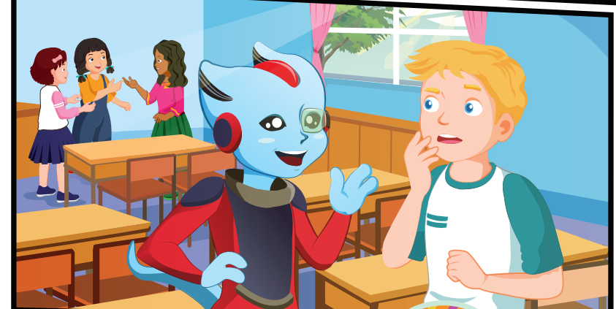
tour guide

Slide 28
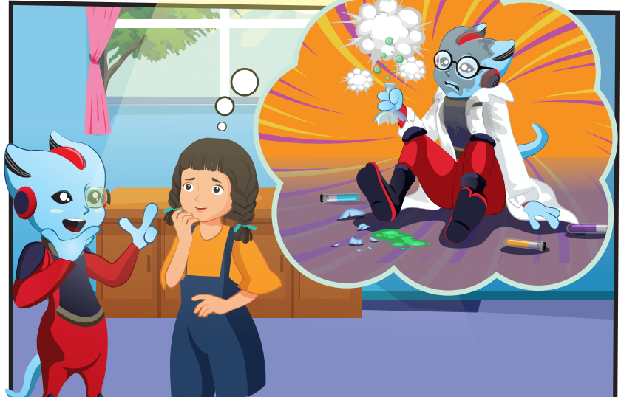
pilot

Slide 29


Slide 30
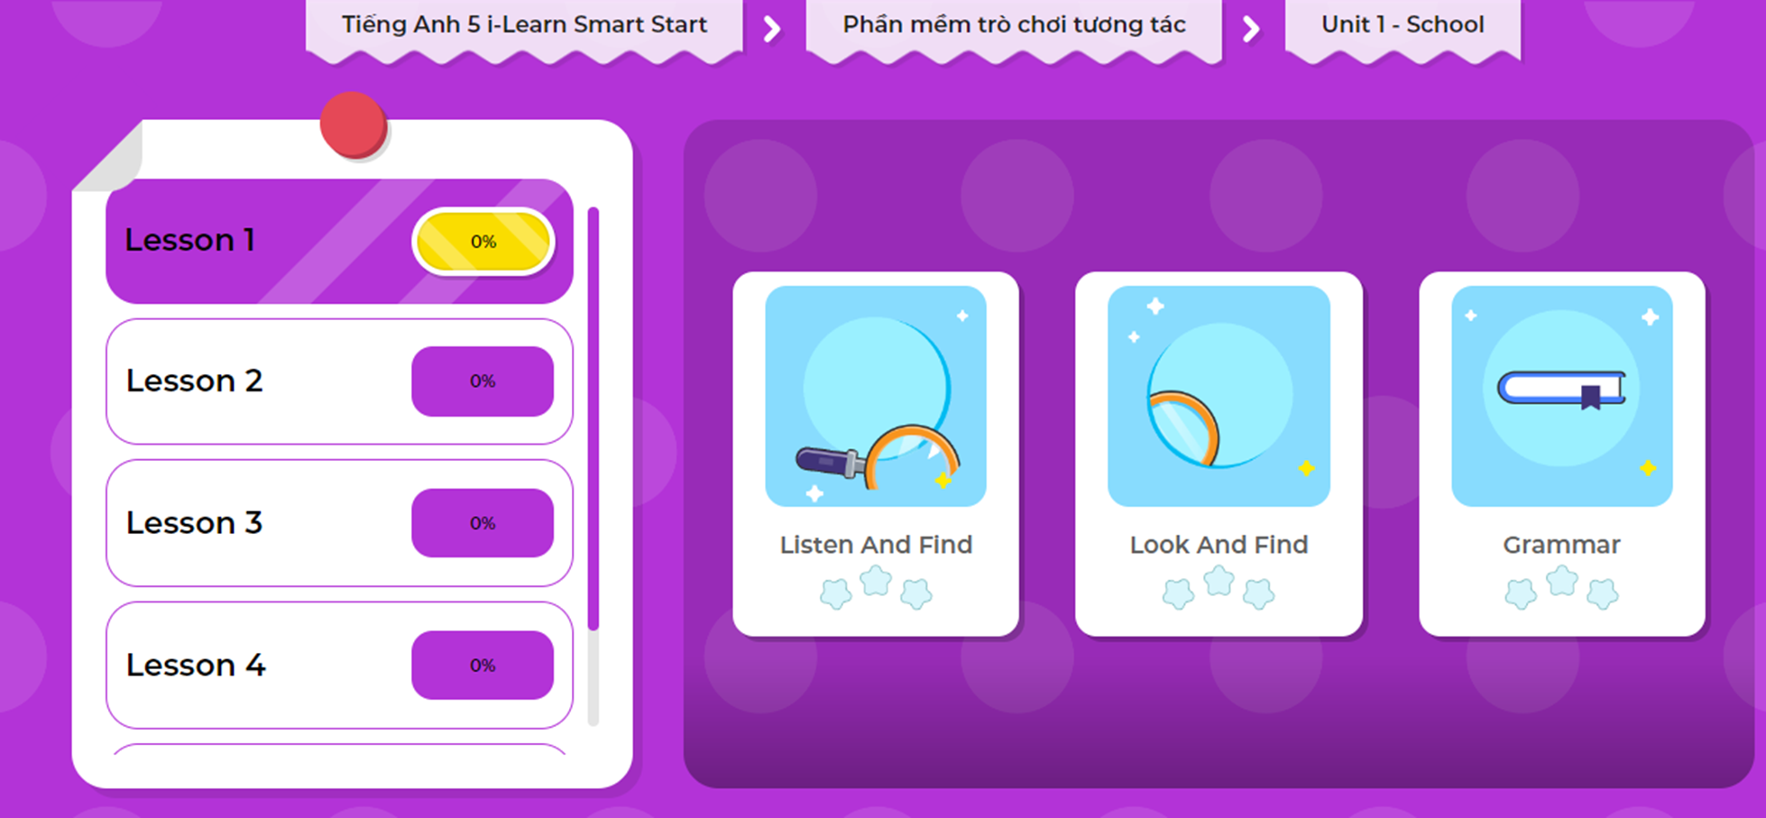

Slide 31

CONSOLIDATION

Slide 32
Listen and choose the correct answer.
Click on the question to hear the sound.
What would you like to be when you grow up?
- I’d like to be ______________.
A. a pilot
B. a scientist
C. a designer
answer

Slide 33
Listen and choose the correct answer.
Click on the question to hear the sound.
What would you like to be when you grow up?
- I’d like to be ______________.
A. a hairdresser
B. a pilot
C. a designer
answer

Slide 34
Listen and choose the correct answer.
Click on the question to hear the sound.
What would you like to be when you grow up?
- I’d like to be ______________.
A. a business person
B. a tour guide
C. a designer
answer

Slide 35
Listen and choose the correct answer.
Click on the question to hear the sound.
What would you like to be when you grow up?
- I’d like to be ______________.
A. a pilot
B. a tour guide
C. a scientist
answer

Slide 36
Listen and choose the correct answer.
Click on the question to hear the sound.
What would you like to be when you grow up?
- I’d like to be ______________.
A. a pilot
B. a hairdresser
C. a designer
answer

Slide 37

WRAP-UP

Slide 38
Today’s lesson
Pronunciation
intonation for Wh-questions.
Structures/ Sentence patterns
What would you like to do when you grow up?
- I’d like to be a scientist.

Slide 39
Homework
Practice the vocabulary and structure, and make sentences using them.
Do the exercises in Tiếng Anh 5 i-Learn Smart Start WB (page 63).
Do the exercises in Tiếng Anh 5 i-Learn Smart Start Notebook.
Prepare for the next lesson (page 94 SB).
Play the consolidation games in Tiếng Anh 5 i-Learn Smart Start DHA App on www.eduhome.com.vn

Slide 40

Enjoy your day!

Slide 41

Lesson 3
Stay positive and have a nice day!

