Slide 1

Unit 7: JOBS
Lesson 1.1
Page 92

Slide 2
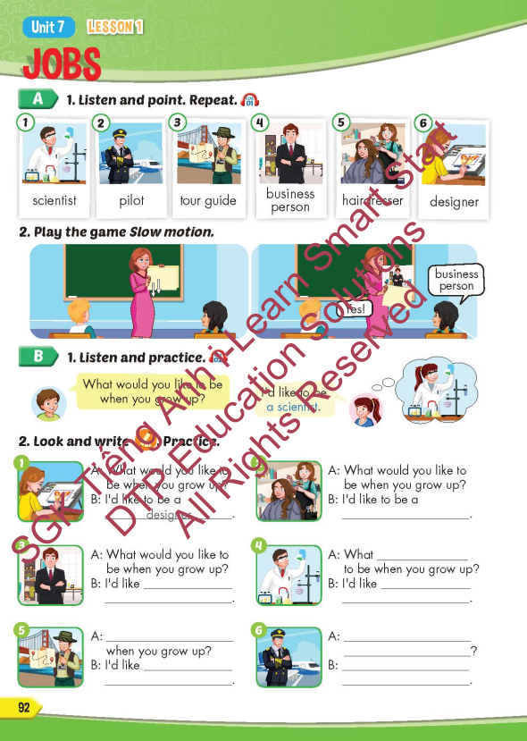
Lesson Outline
Warm-up
Vocabulary
Structure
Consolidation
Wrap-up

Slide 3
Objectives
By the end of this lesson, students will be able to point out and name different jobs.
Vocabulary: scientist, pilot, tour guide, business person, hairdresser, designer.
Structure: What would you like to be when you grow up?
- I’d like to be a scientist.

Slide 4

WARM-UP

Slide 5
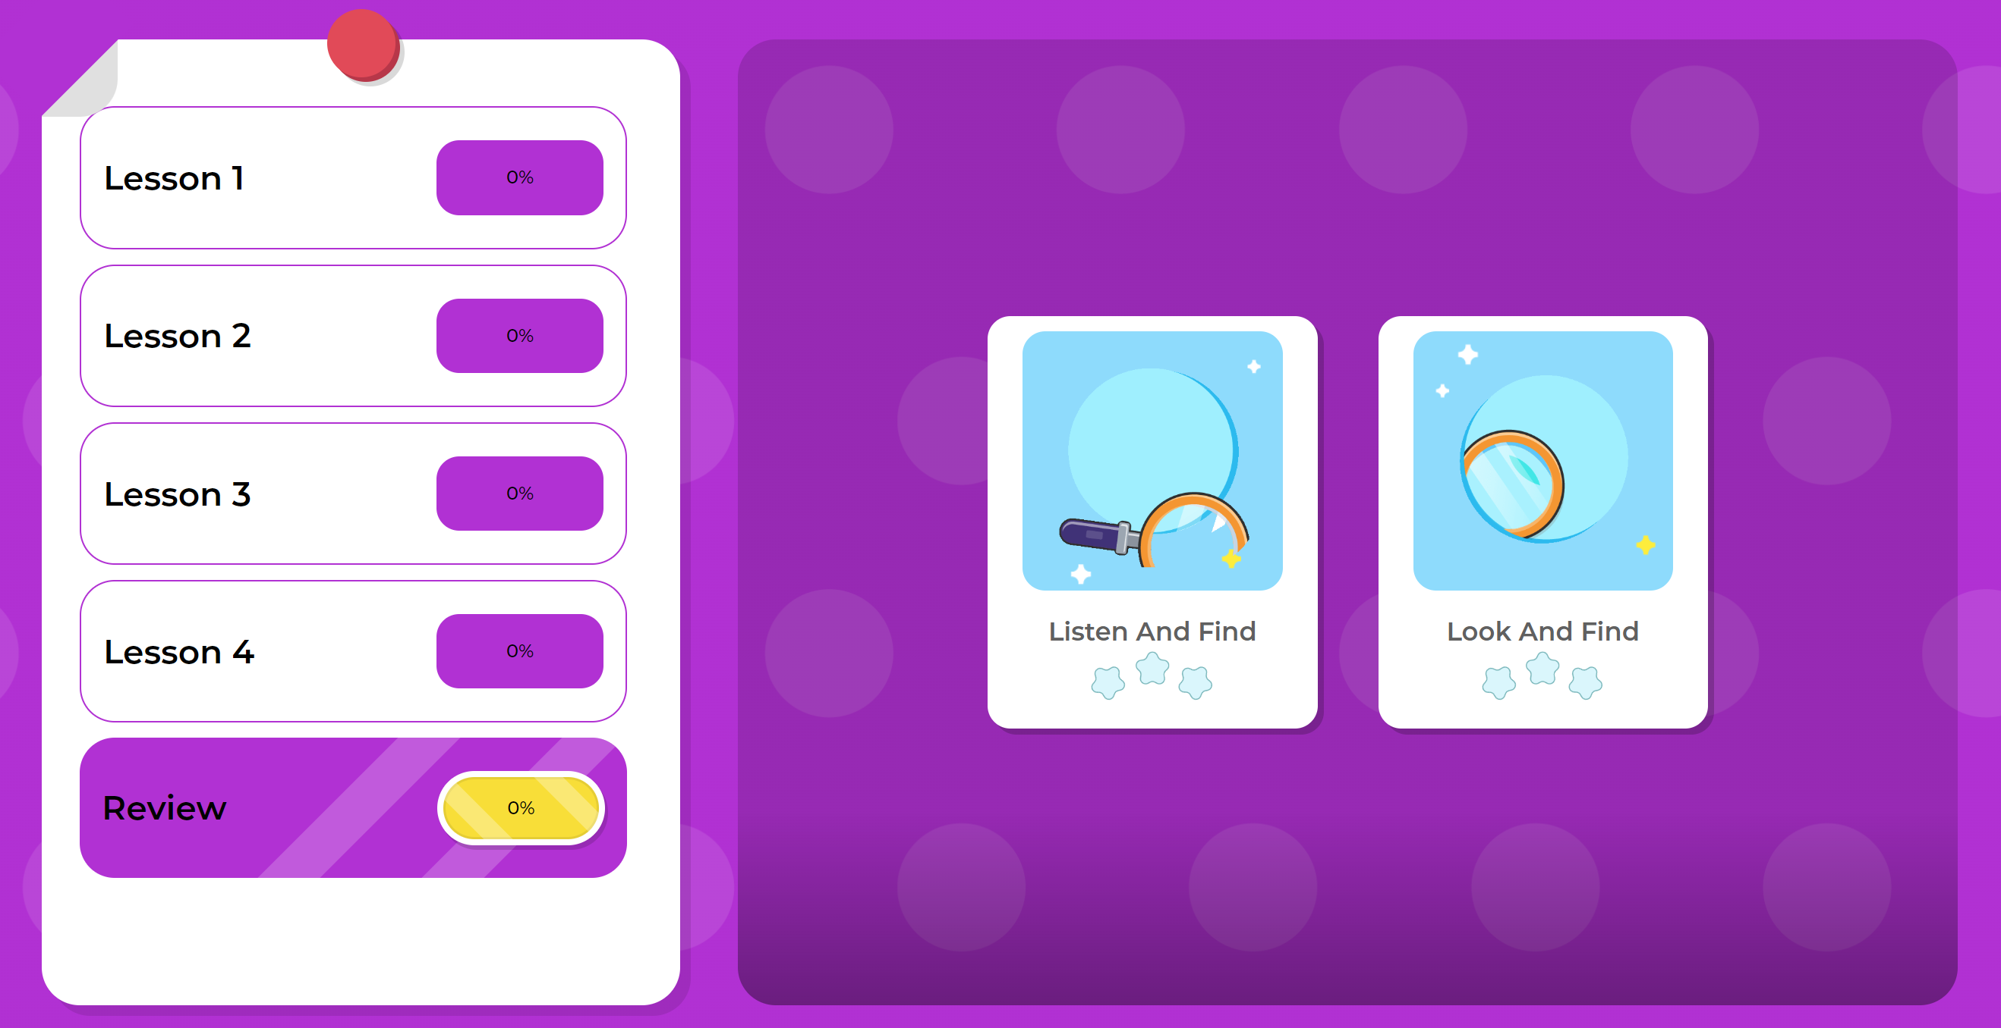
Play the game on DHA on Eduhome – Unit 6 – Review

Slide 6

It’s time to learn …

Slide 7

New words
scientist,
pilot,
tour guide,
business person,
hairdresser
designer

Slide 8

Presentation

Slide 9


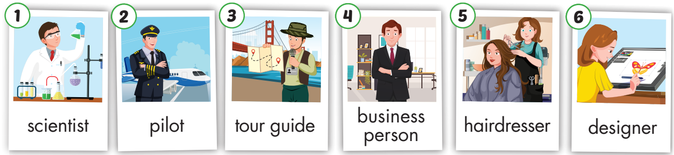
Click on the picture below to hear the sound.
/ˈpaɪlət/
phi công
/ ˈbɪznəs pɜːrsən /
doanh nhân
/dɪˈzaɪ.nɚ/
nhà thiết kế
/ˈsaɪəntɪst/
nhà khoa học
/tʊr ɡaɪd/
hướng dẫn viên du lich
/ˈherˌdres.ɚ/
thợ cắt tóc
Notes:
Click vào hình A. 1. Listen and point. Repeat để cho cả audio full chạy

Slide 10

Click on the picture to hear the sound.
scientist
/ˈsaɪəntɪst/
nhà khoa học

Slide 11
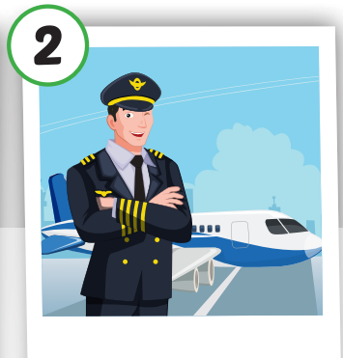
Click on the picture to hear the sound.
pilot
/ˈpaɪlət/
phi công

Slide 12
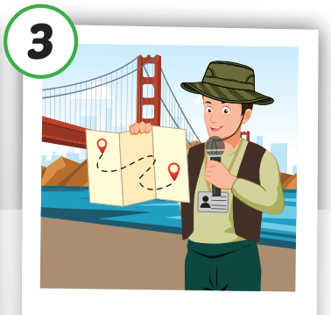
Click on the picture to hear the sound.
tour guide
/ˈtʊr ɡaɪd/
hướng dẫn viên du lich

Slide 13
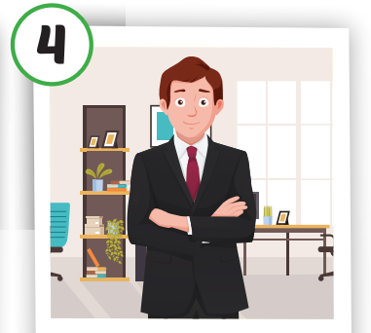
Click on the picture to hear the sound.
business person
/ ˈbɪznəs pɜːrsən/
doanh nhân

Slide 14
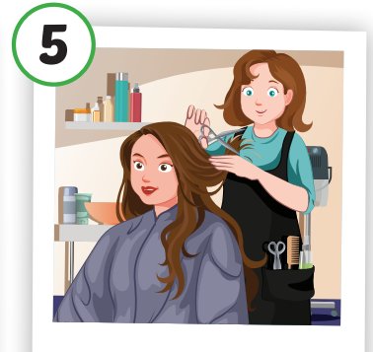
Click on the picture to hear the sound.
hairdresser
/ˈherˌdres.ɚ/
thợ cắt tóc

Slide 15
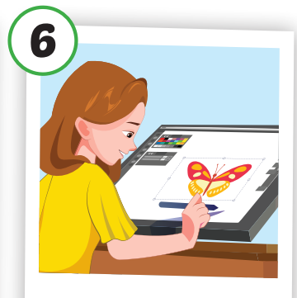
Click on the picture to hear the sound.
designer
/dɪˈzaɪ.nɚ/
nhà thiết kế

Slide 16
Practice

Slide 17
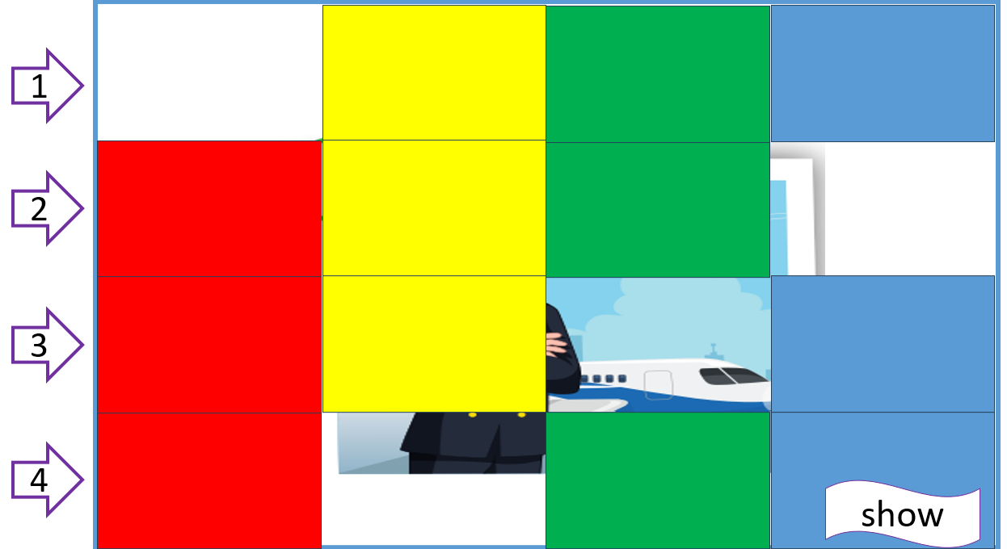
Let’s play!
What’s hidden?

Slide 18

pilot
1
2
3
4
show
1

Slide 19
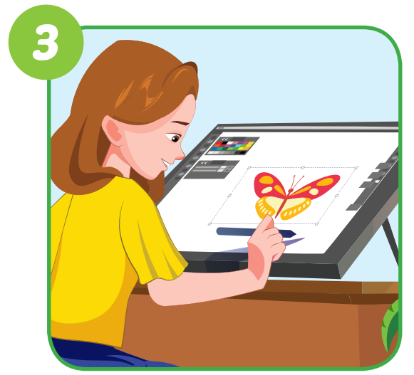
designer
1
2
3
4
show
2

Slide 20
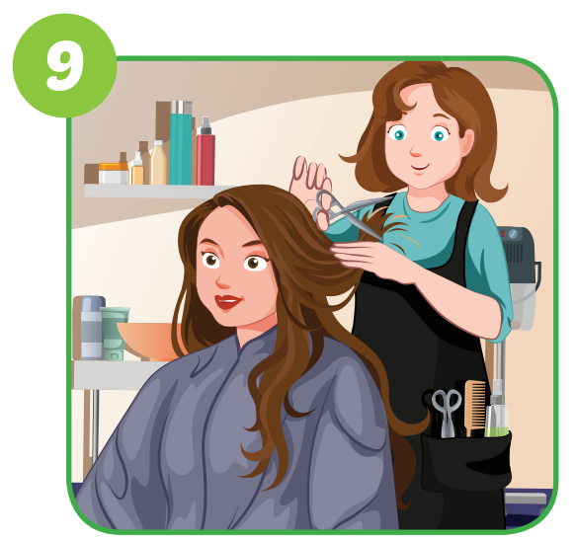
hairdresser
1
2
3
4
show
3

Slide 21

scientist
1
2
3
4
show
4

Slide 22

business person
1
2
3
4
show
5

Slide 23
pilot
1
2
3
4
show
6

Slide 24
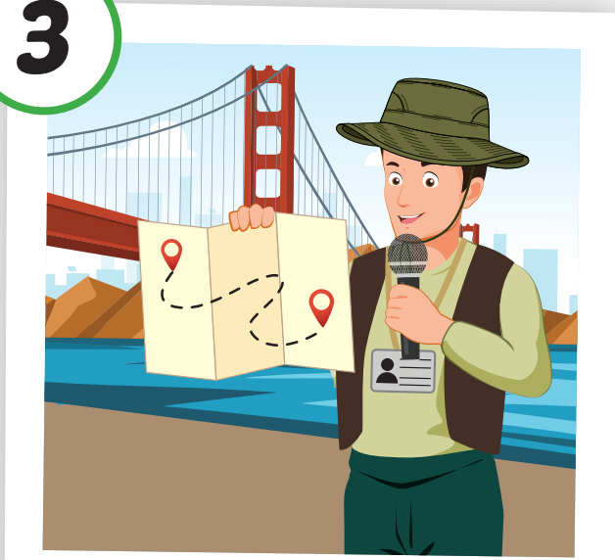



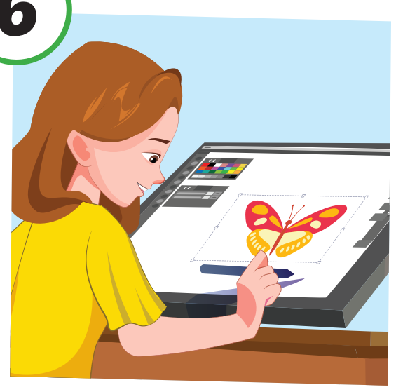
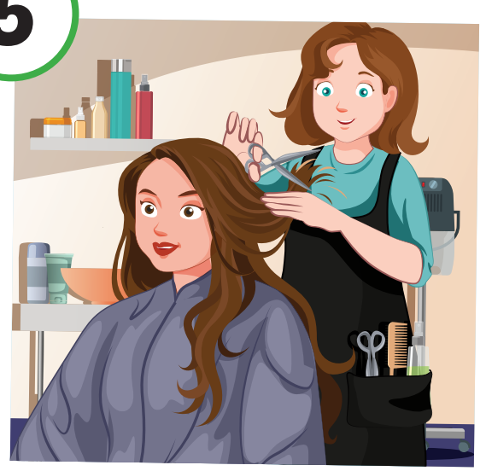
Let’s play – “Slow motion” game.

Slide 25
Structure
What would you like to be
when you grow up?
- I’d like to be a scientist.

Slide 26
Presentation

Slide 27
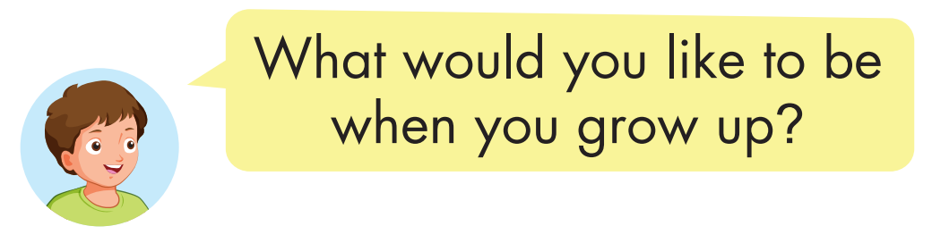

Structure
Click on the picture to hear the sound.

Slide 28

Practice

Slide 29

Click on the picture to hear the sound.

Slide 30

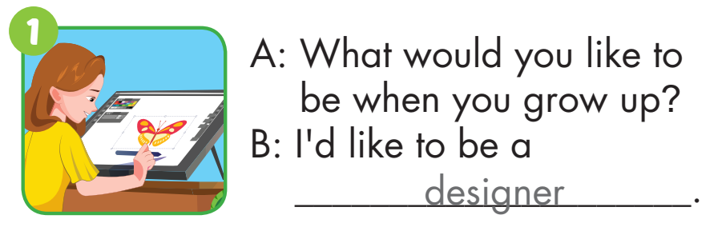
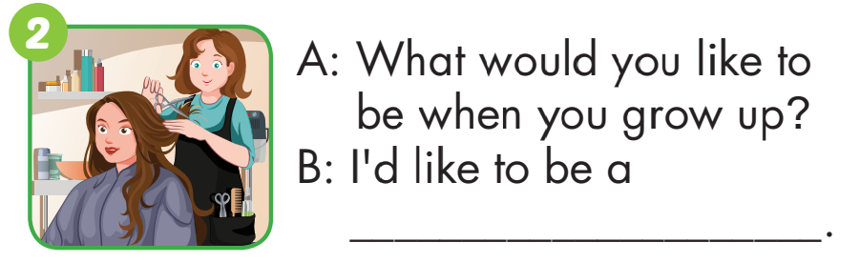
hairdresser

Slide 31

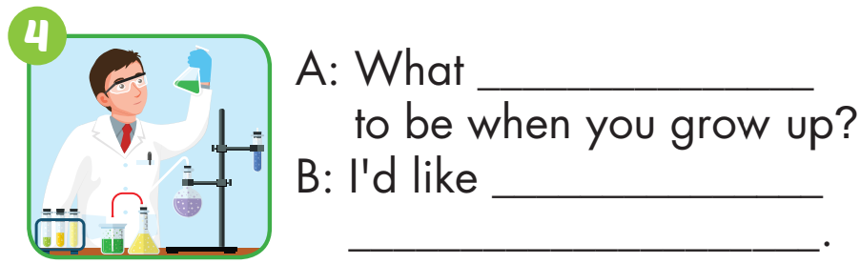
to be
a business person
would you like
to be
a scientist

Slide 32
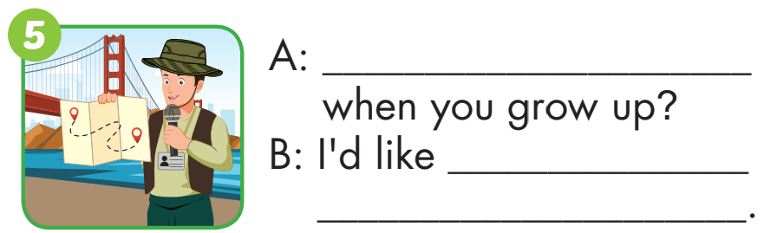

What would you like to be
to be
a tour guide
What would you like to be
when you grow up
I’d like to be a pilot.

Slide 33

Production

Slide 34
Make a survey
Name | What would you like to be when you grow up?
1,
2,
3,

Slide 35

CONSOLIDATION

Slide 36

Ask and answer.
What would you like to be when you grow up?
I’d like to be a ……………

Slide 37

WRAP-UP

Slide 38
Today’s lesson
Vocabularies
scientist, pilot,
tour guide, business person, hairdresser, designer.
Structures/ Sentence patterns
What would you like to do when you grow up?
- I’d like to be a scientist.

Slide 39
Homework
Practice the vocabulary and structure, and make sentences using them.
Do the exercises in Tiếng Anh 5 i-Learn Smart Start WB (page 62).
Do the exercises in Tiếng Anh 5 i-Learn Smart Start Notebook.
Prepare for the next lesson (page 93 SB).
Play the consolidation games in Tiếng Anh 5 i-Learn Smart Start DHA App on www.eduhome.com.vn

Slide 40

Enjoy your day!

Slide 41

Lesson 3
Stay positive and have a nice day!

