Slide 1

Unit 6: FOOD AND DRINKS
Lesson 1.2
Page 79

Slide 2
Objectives
By the end of this lesson, students will be able to practice the sound changes, the target language and the conversations.
Pronunciation: Sound Changes.
Structure: I need a lot of sugar.

Slide 3

WARM-UP

Slide 4
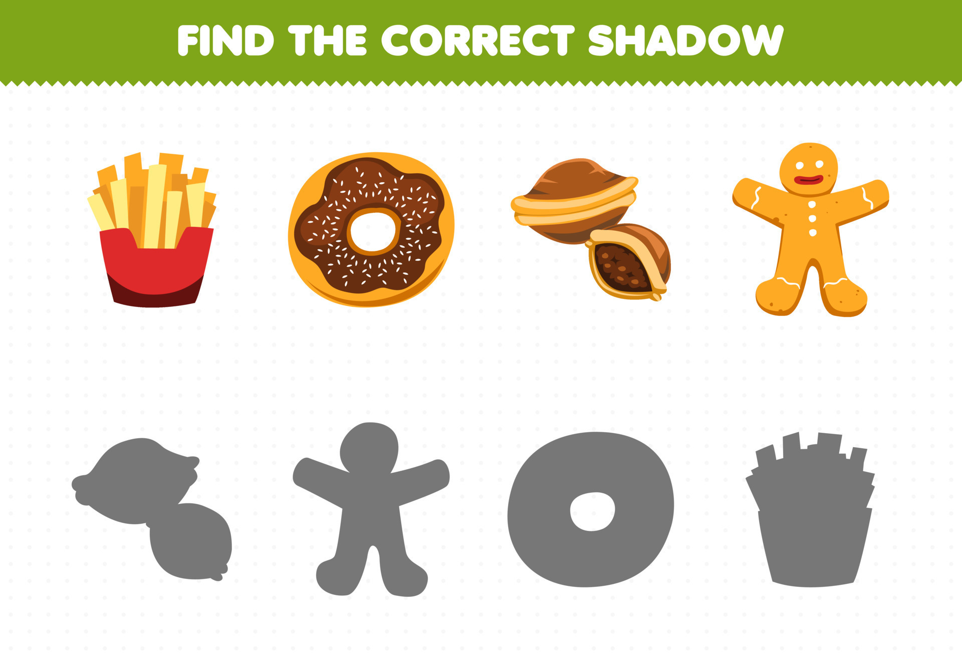

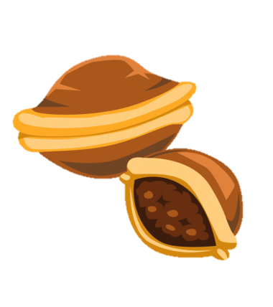



Slide 5
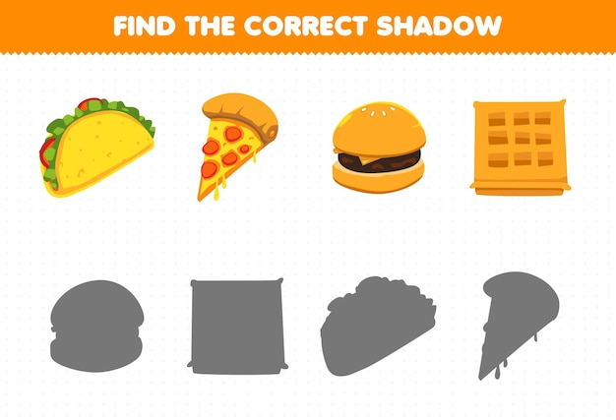





Slide 6
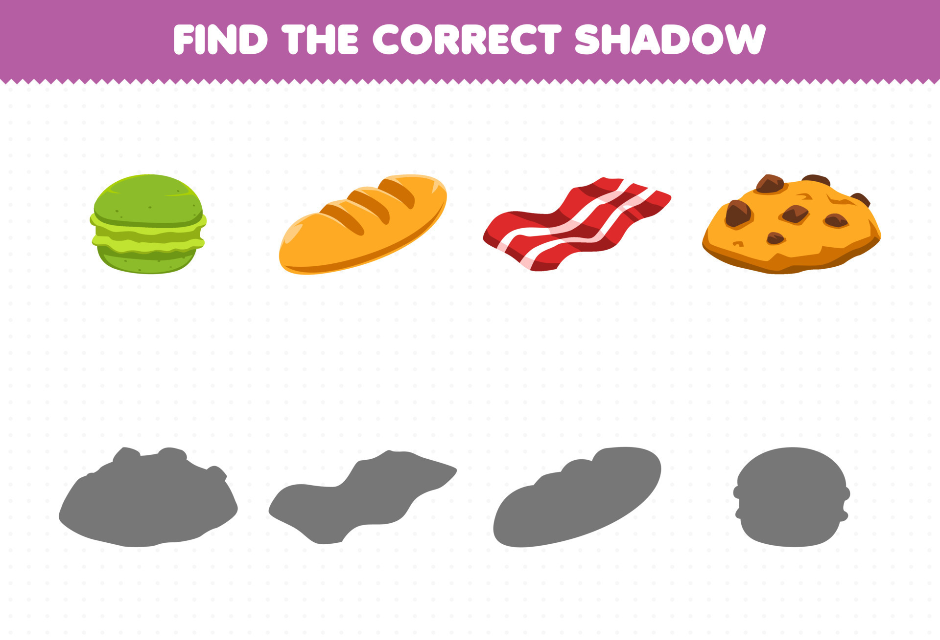





Slide 7
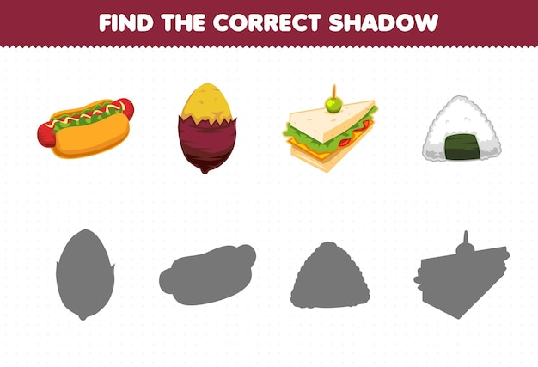


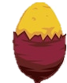


Slide 8

It’s time to learn …

Slide 9

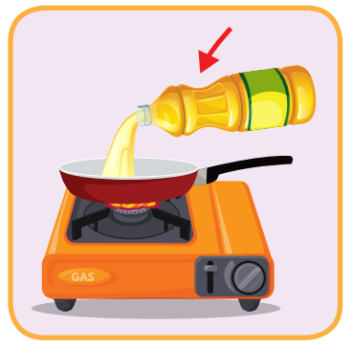

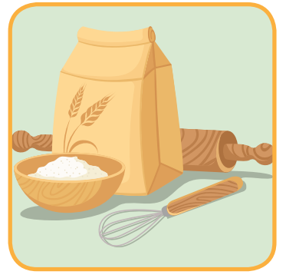
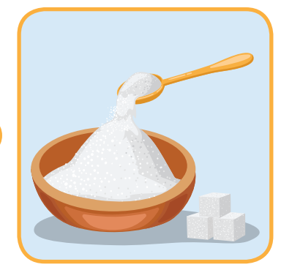

1
4
6
1
2
SPIN
5
5
2
3
4
3
6

Slide 10

Presentation

Slide 11

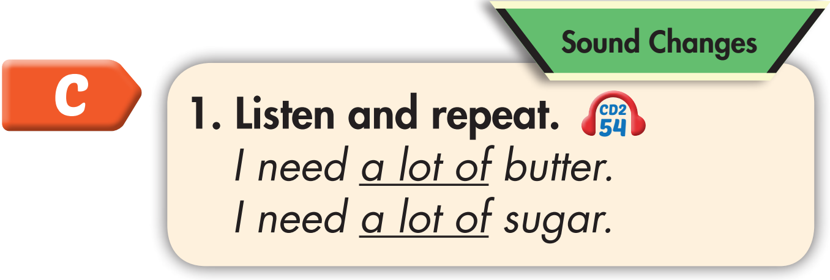

Click on C to hear the sound.

Slide 12
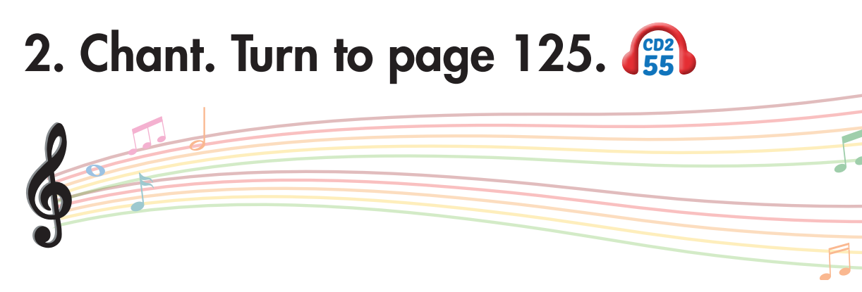
Click on C to hear the sound.

Slide 13

Structure
I need a lot of butter.

Slide 14
Presentation

Slide 15

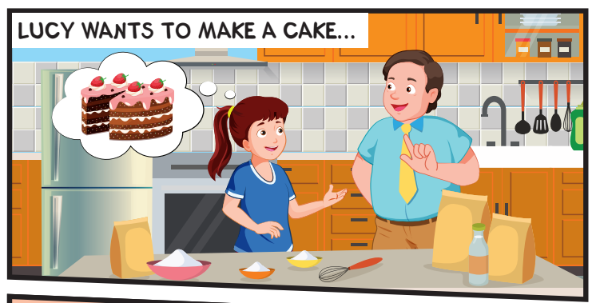
She wants to make a cake.
What does Lucy want to do?

Slide 16
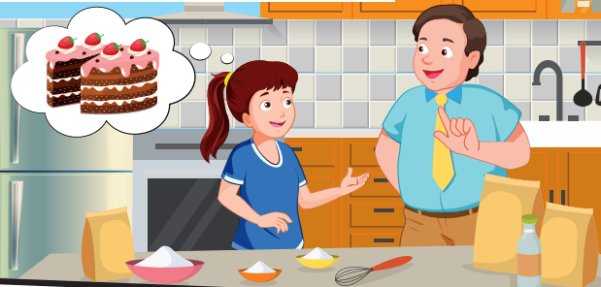
They need flour, milk, sugar, butter and eggs.
What do they need to make a cake?

Slide 17

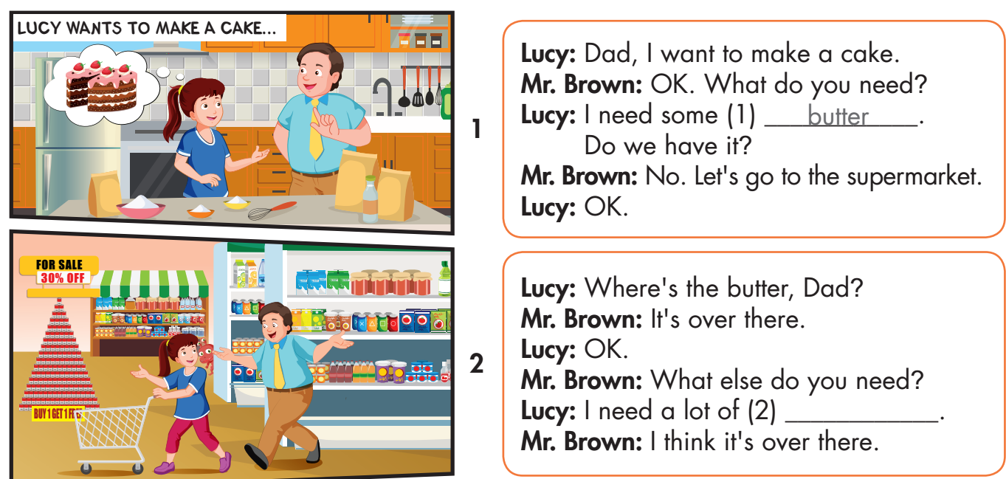

Slide 18
flour

Slide 19
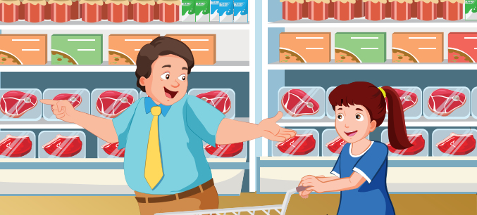
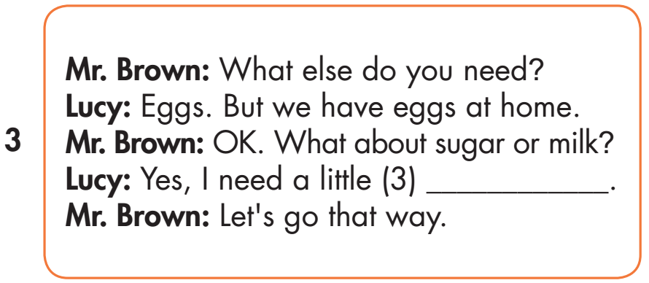
milk

Slide 20
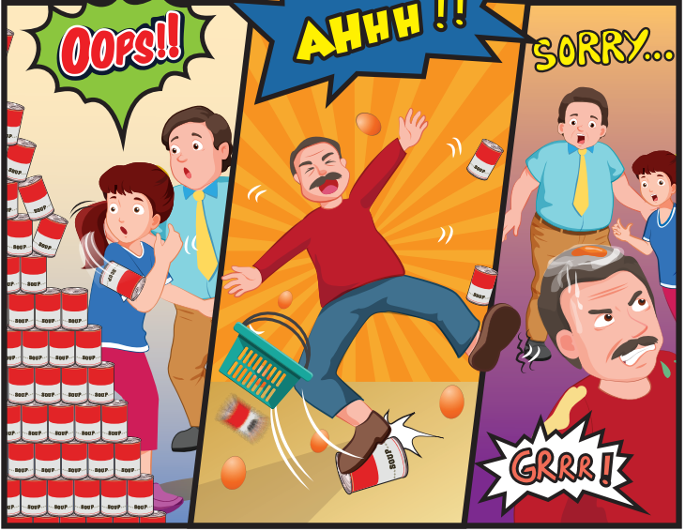
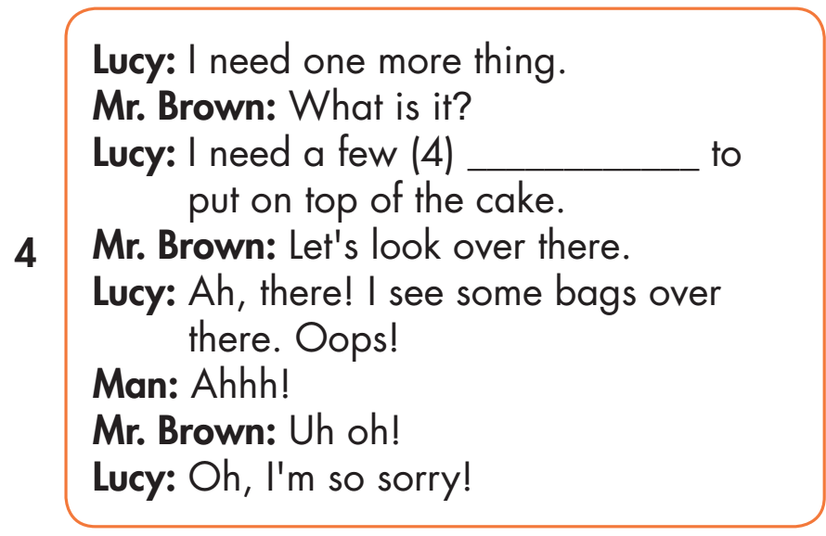
chocolate chips

Slide 21

Practice

Slide 22
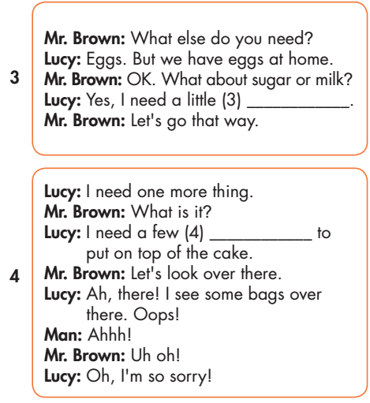
Listen and write.
milk
Chocolate chips
flour

Slide 23



Slide 24

milk
Chocolate chips
flour

Slide 25

Production

Slide 26
MAKE YOUR OWN STORY

Slide 27

CONSOLIDATION

Slide 28


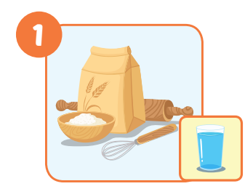


Click on the right word
some sugar
a little milk
a lot of flour

Slide 29
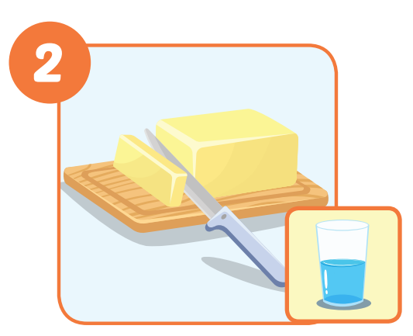
Click on the right word
a few chocolate chips
some butter
a little oil

Slide 30
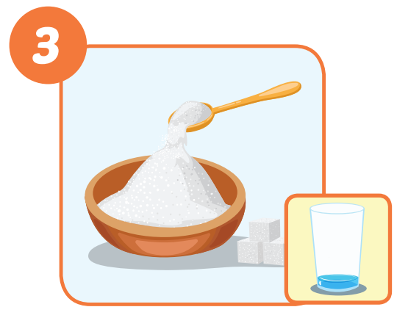
Click on the right word
some flour
a lot of milk
a little sugar

Slide 31
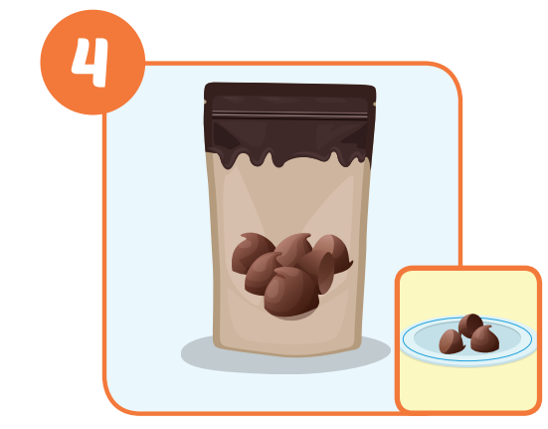
Click on the right word
a little oil
a few chocolate chips
a lot of milk

Slide 32
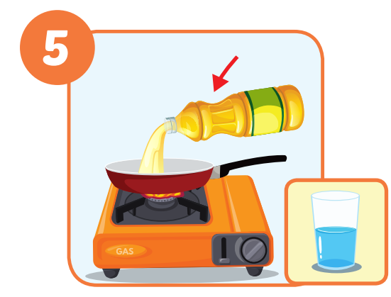
Click on the right word
a little oil
some oil
a lot of milk

Slide 33
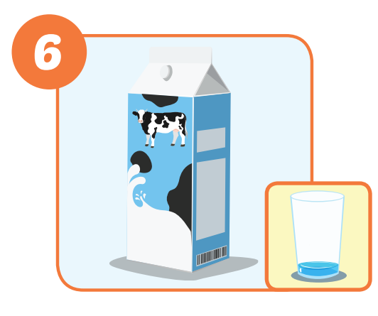
Click on the right word
a little milk
a little sugar
a lot of flour

Slide 34

WRAP-UP

Slide 35
Today’s lesson
Structures/ Sentence patterns
I want to make a cake.
I need a lot of flour.
Pronunciation
Sound changes
I need a lot of butter.

Slide 36
Homework
Practice the vocabulary and structure, and make sentences using them.
Do the exercises in Tiếng Anh 5 i-Learn Smart Start WB (page 53).
Do the exercises in Tiếng Anh 5 i-Learn Smart Start Notebook.
Prepare the next lesson (page 80 SB).
Play the consolidation games in Tiếng Anh 5 i-Learn Smart Start DHA App on www.eduhome.com.vn

Slide 37

Enjoy your day!

