Slide 1

Unit 4: Travel
Lesson 1.1
Page 48

Slide 2
Objectives
By the end of this lesson, students will be able to…
Vocabulary: Pronounce and use the words related to the topic properly: mountain, lake, river, beach, ocean, forest New Year (Tết), Christmas, Teachers' Day, Children's Day.
Structure: Practise
I didn't go to the river. I went to the beach.

Slide 3
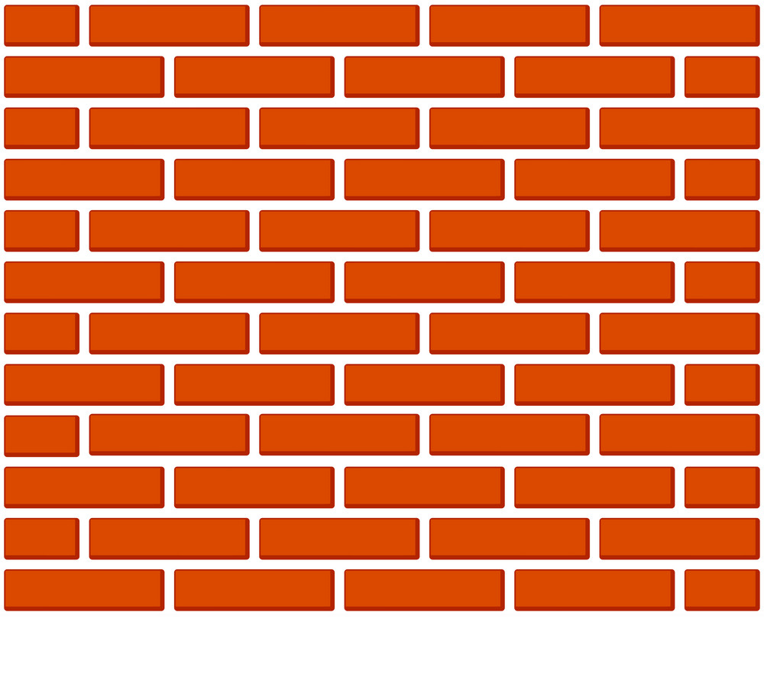


Slide 4

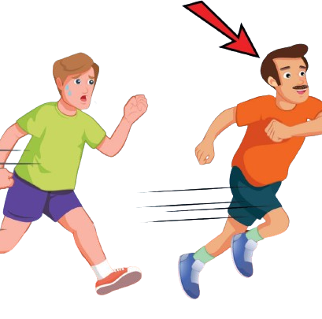
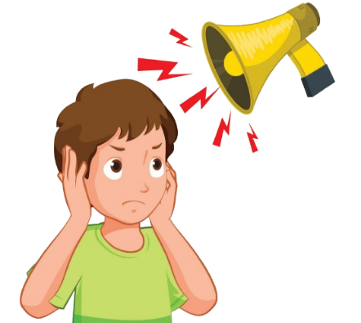
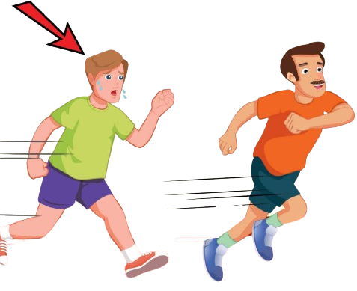

Click on the right option
slowly

Slide 5

New words
mountain, lake, river,
beach, ocean, forest

Slide 6

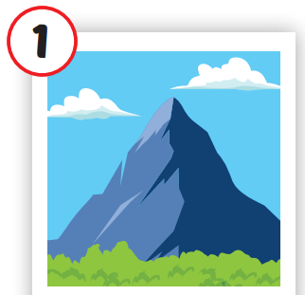
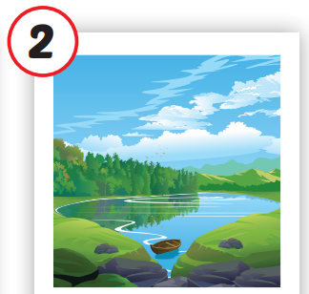
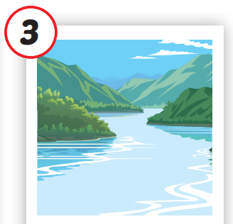
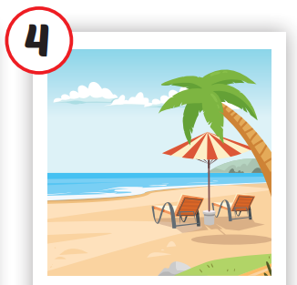
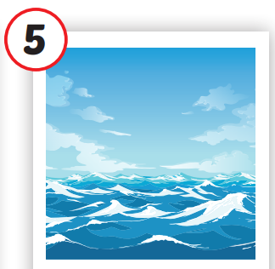
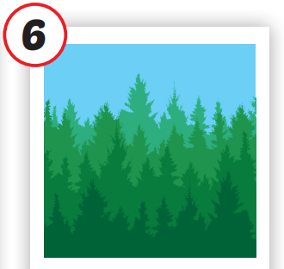






/ˌmaʊntən/
ngọn núi
/leɪk/
hồ
/ˈrɪvər/
sông
/biːtʃ/
bãi biển
/ˈoʊʃən/
đại dương
/ˈfɔrəst/
rừng
Notes:
Click vào hình A. 1. Listen and point. Repeat để cho cả audio full chạy

Slide 7
Check your memory

Slide 8




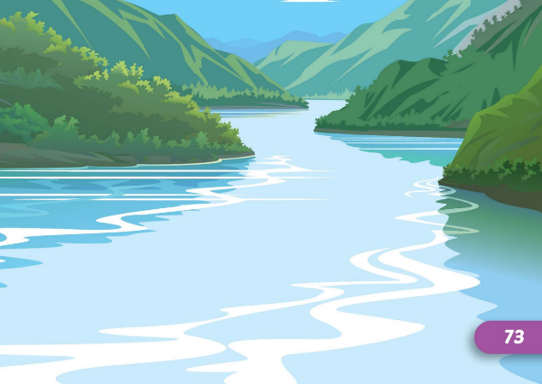

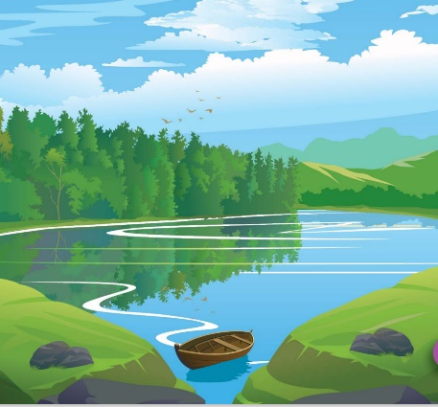


Find the best picture
Next
moutain

Slide 9


Find the best picture
Next
lake

Slide 10
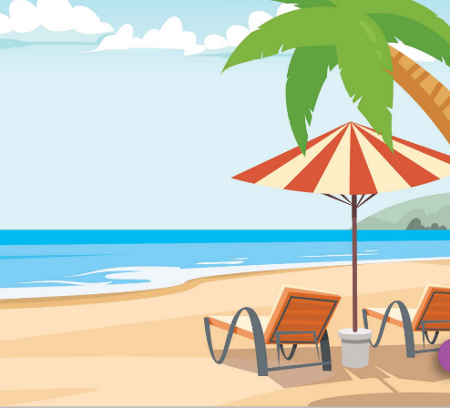
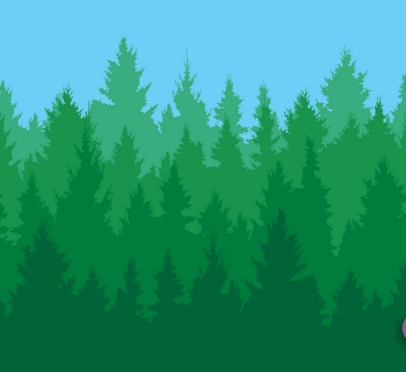
Find the best picture
Next
river

Slide 11

Find the best picture
Next
beach

Slide 12

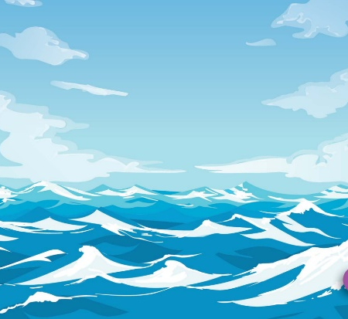
Find the best picture
Next
ocean

Slide 13


Find the best picture
Next
forest

Slide 14

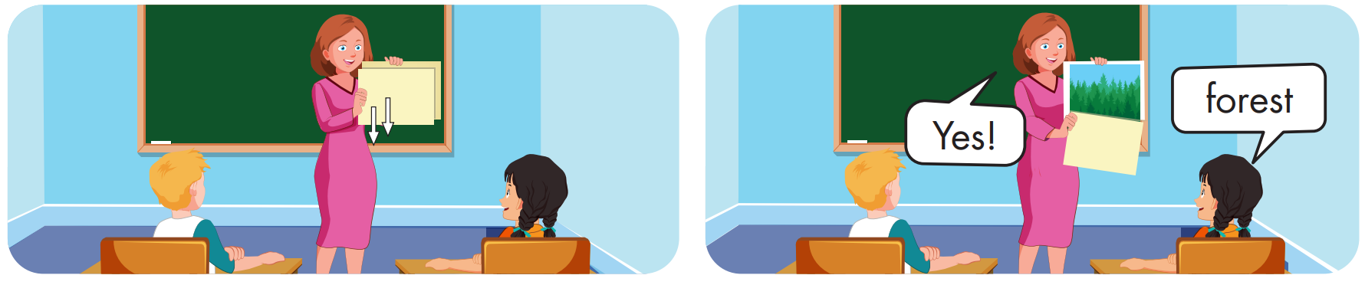

Slide 15

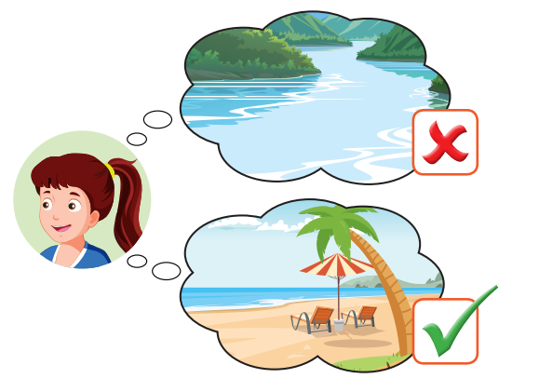
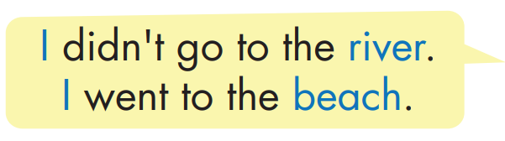
Structure

Slide 16

Practice

Slide 17


Slide 18

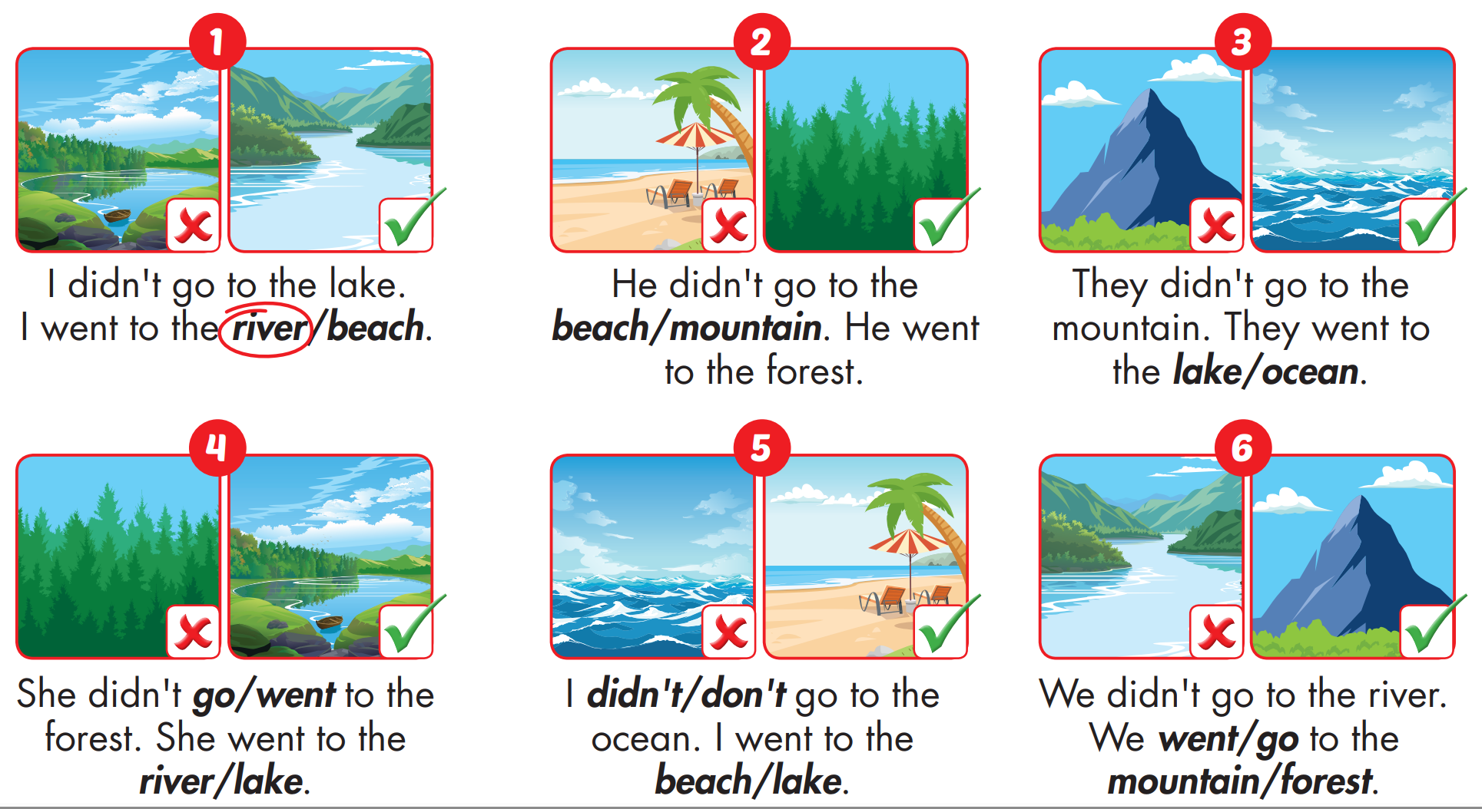


Slide 19

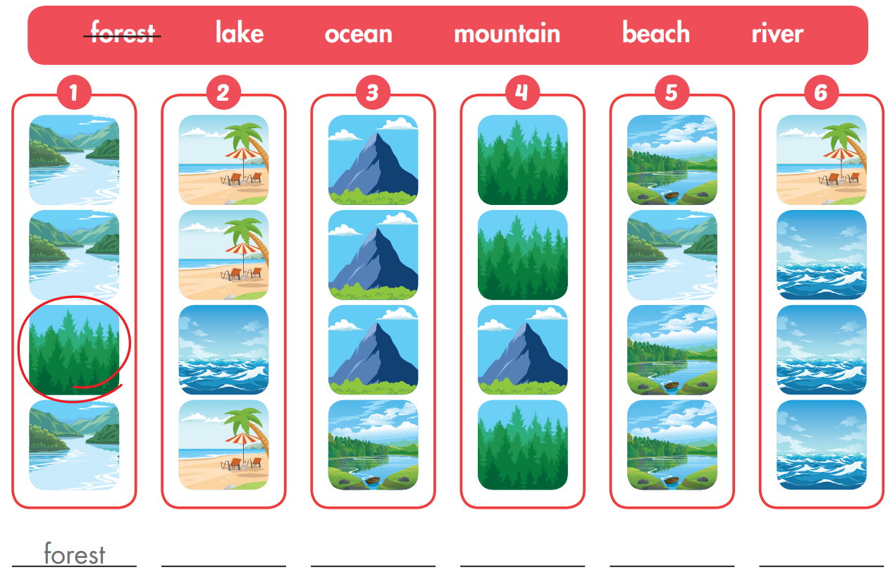
Extra Practice
WB, page 32
ocean
lake
moutain
river
beach

Slide 20

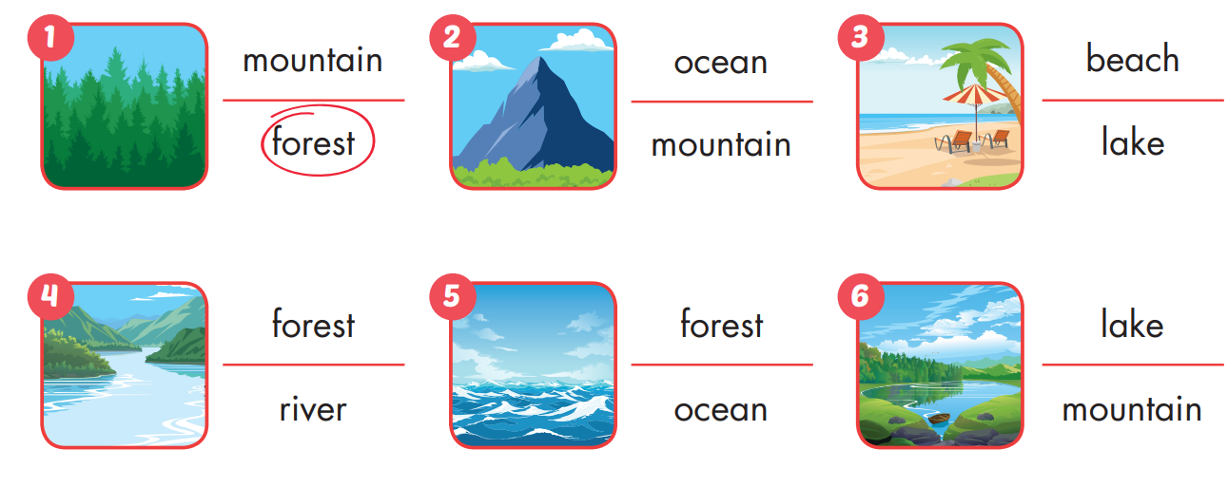
Extra Practice
WB, page 32

Slide 21
Homework
Practice the vocabularies and structure, and make sentences using them.
Do the exercises in Tiếng Anh 5 i-Learn Smart Start WB (page 32)
Do the exercises in Tiếng Anh 5 i-Learn Smart Start Notebook (page 22)
Prepare the next lesson (page 49 SB)
Play the consolidation games in Tiếng Anh 5 i-Learn Smart Start DHA App on www.eduhome.com.vn

Slide 22

Enjoy your day!

