Slide 1

Unit 3: MY FRIENDS AND I
Lesson 1.3
Page 36

Slide 2




Slide 3
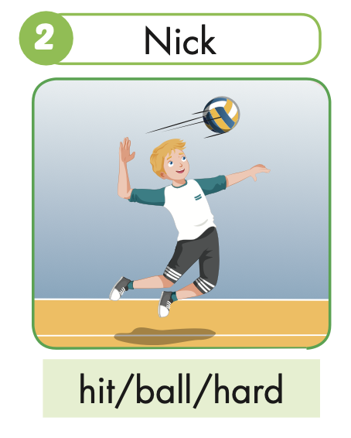
Nick hits the ball hard.

Slide 4
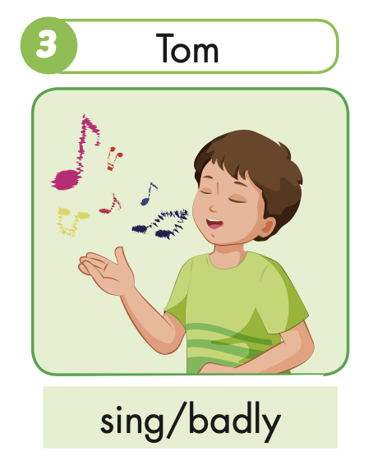
Tom sings badly.

Slide 5
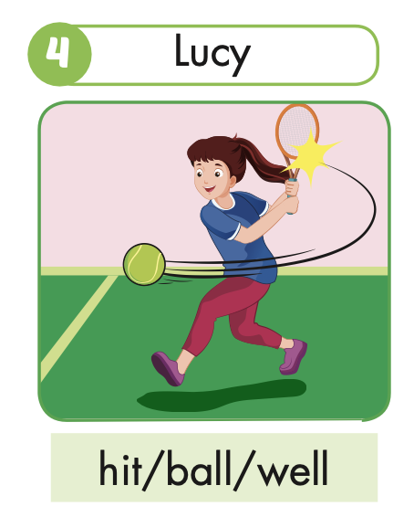
Lucy hits the ball well.

Slide 6
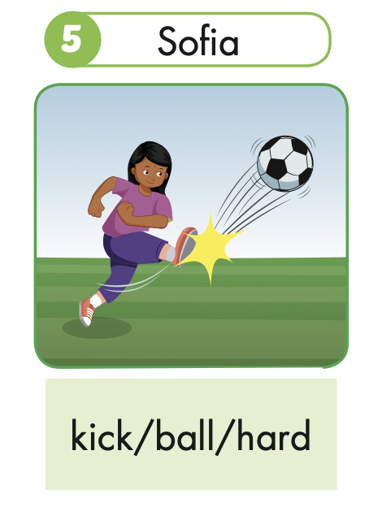
Sofia kicks the ball hard.

Slide 7
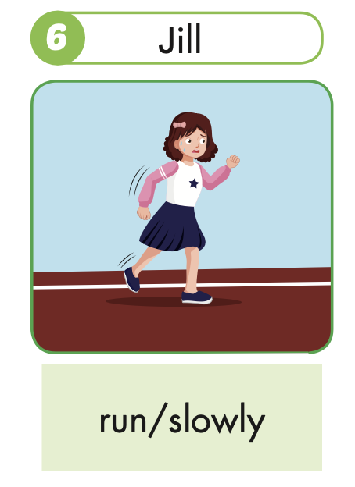
Jill runs slowly.

Slide 8
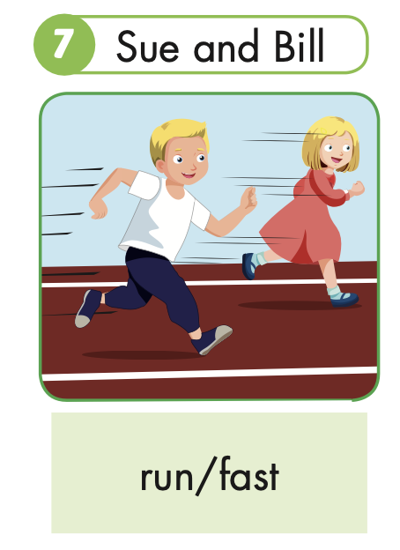
Sue and Bill run fast.

Slide 9
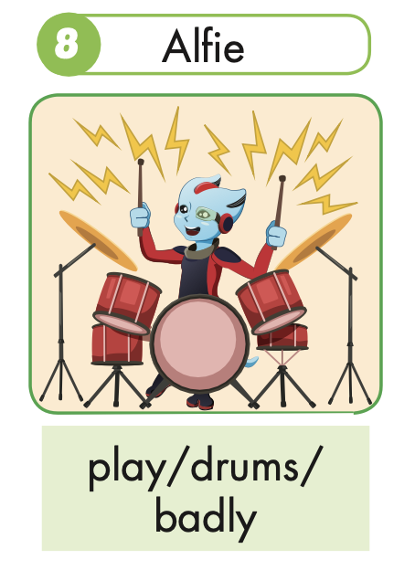
Alfie plays the drums badly.

Slide 11

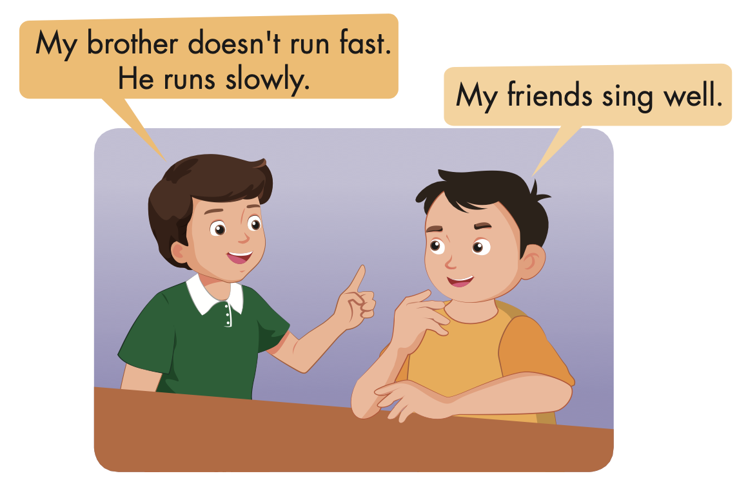

Slide 12

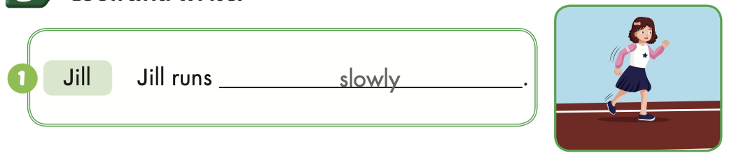
Extra Practice
WB, page 23

Slide 13
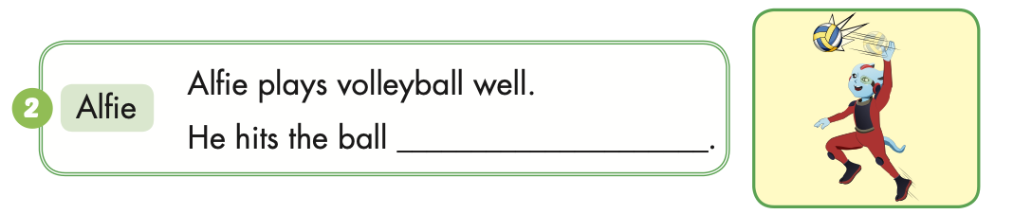
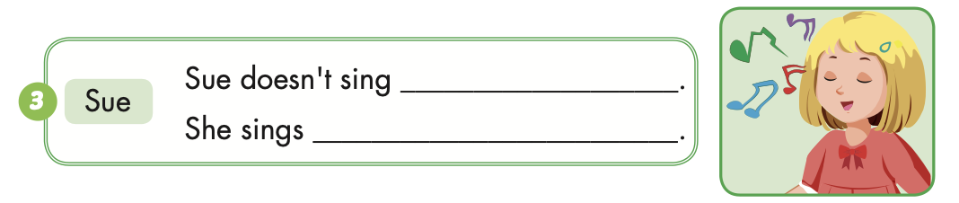
Extra Practice
WB, page 23
hard
well
badly

Slide 14
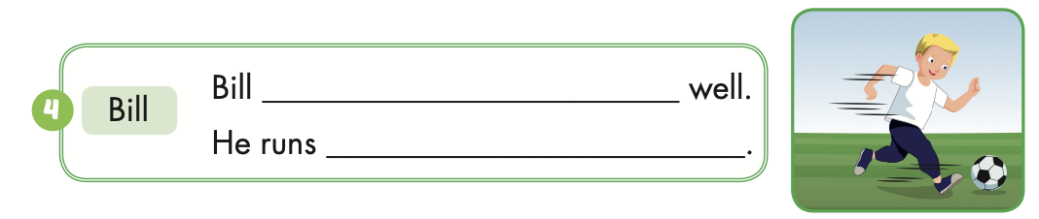
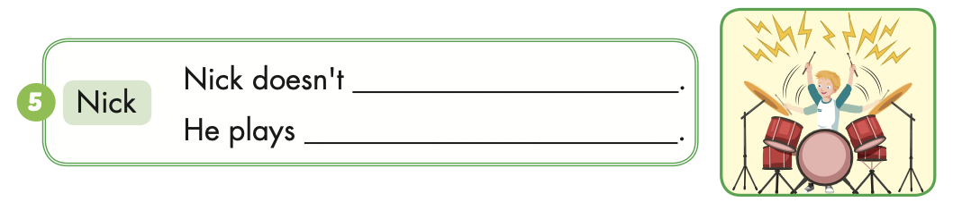
Extra Practice
WB, page 23
plays soccer
fast
play the drums well
the drums badly

Slide 15

Correct the mistakes!
GO!

Slide 16
play
Bill play the drums well.
NEXT

Slide 17
Bill plays the drums well.
NEXT

Slide 18
Sue runs slow.
slow
NEXT

Slide 19
Sue runs slowly.
NEXT

Slide 20
She doesn’t sing good.
She sing badly.
good
NEXT
sing

Slide 21
She doesn’t sing well.
She sings badly.
NEXT

Slide 22
Tom and Tim doesn’t kick the ball hard.
doesn’t
NEXT

Slide 23
Tom and Tim don’t kick the ball hard.
END

Slide 24
Homework
Practice the vocabularies and structure, and make sentences using them.
Do the exercises in Tiếng Anh 5 i-Learn Smart Start WB (page 23).
Do the exercises in Tiếng Anh 5 i-Learn Smart Start Notebook.
Prepare the next lesson (page 37 SB).
Play the consolidation games in Tiếng Anh 5 i-Learn Smart Start DHA App on www.eduhome.com.vn

Slide 25

Enjoy your day!

