Slide 1

Unit 2: MY FRIENDS AND I
Lesson 1.2
Page 35

Slide 2
Listen and choose. Then say.

Slide 3


Listen and choose
slowly
fast
badly
A
B
C

Slide 4
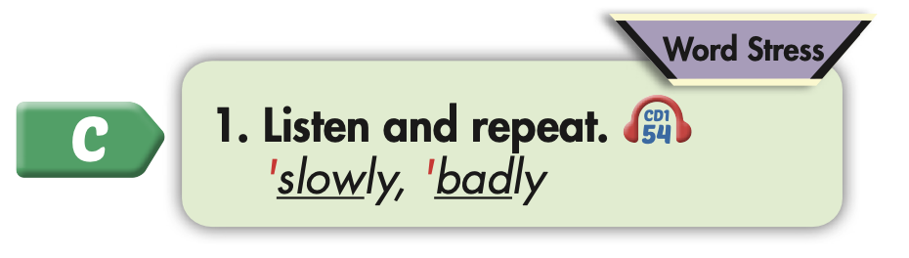
Click on the picture to hear the sound.

Slide 5

Practice

Slide 6



Slide 7
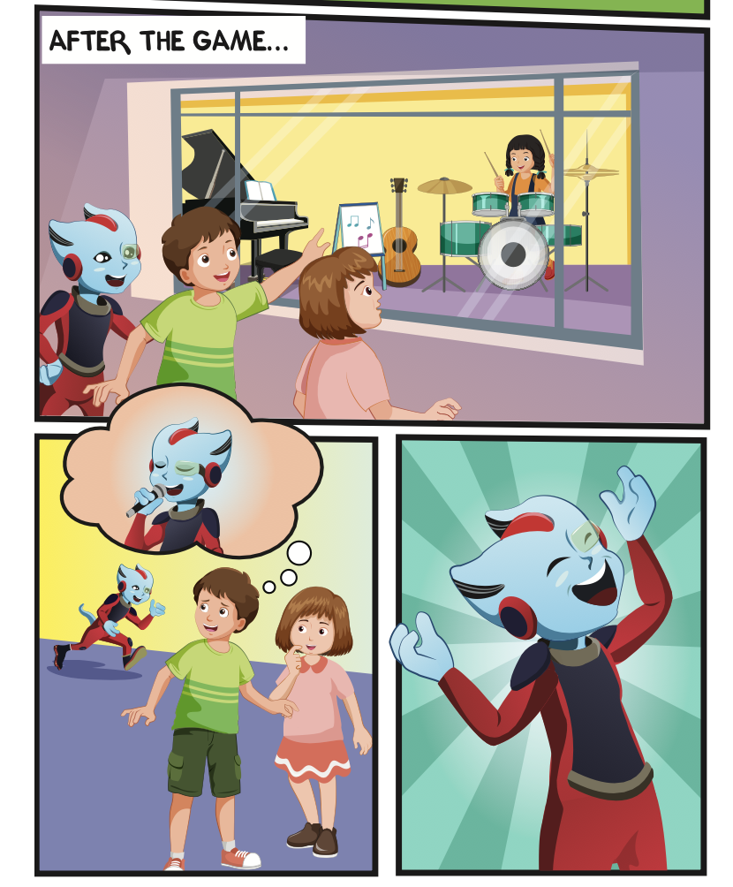
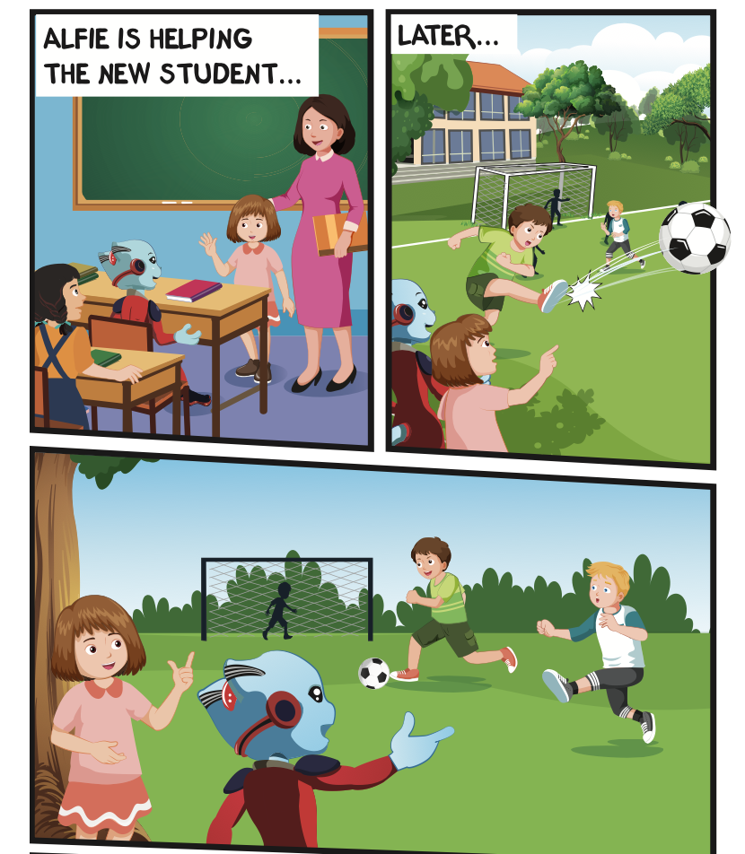
Where are they?
Who is talking?

Slide 8


Slide 9

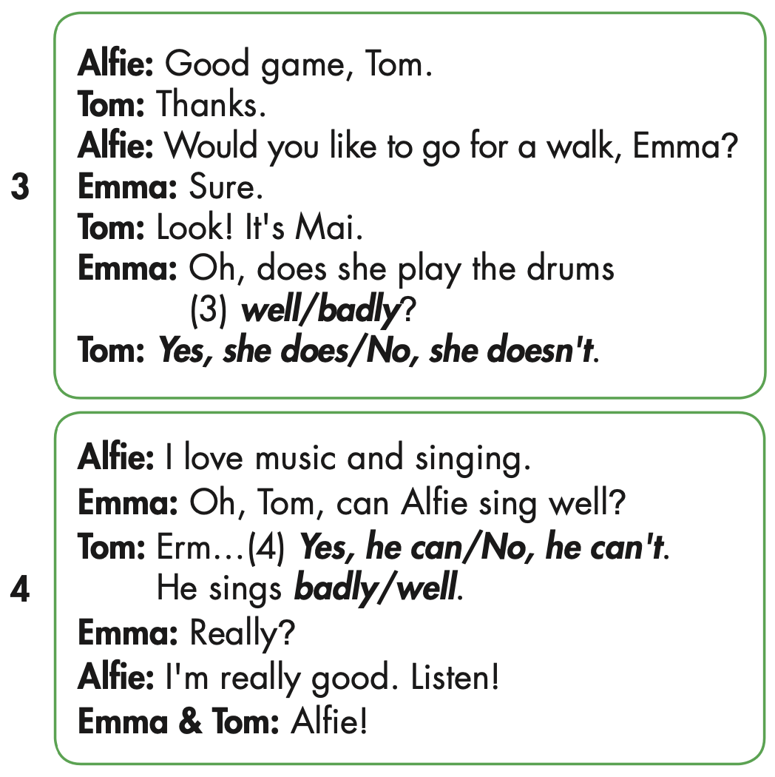
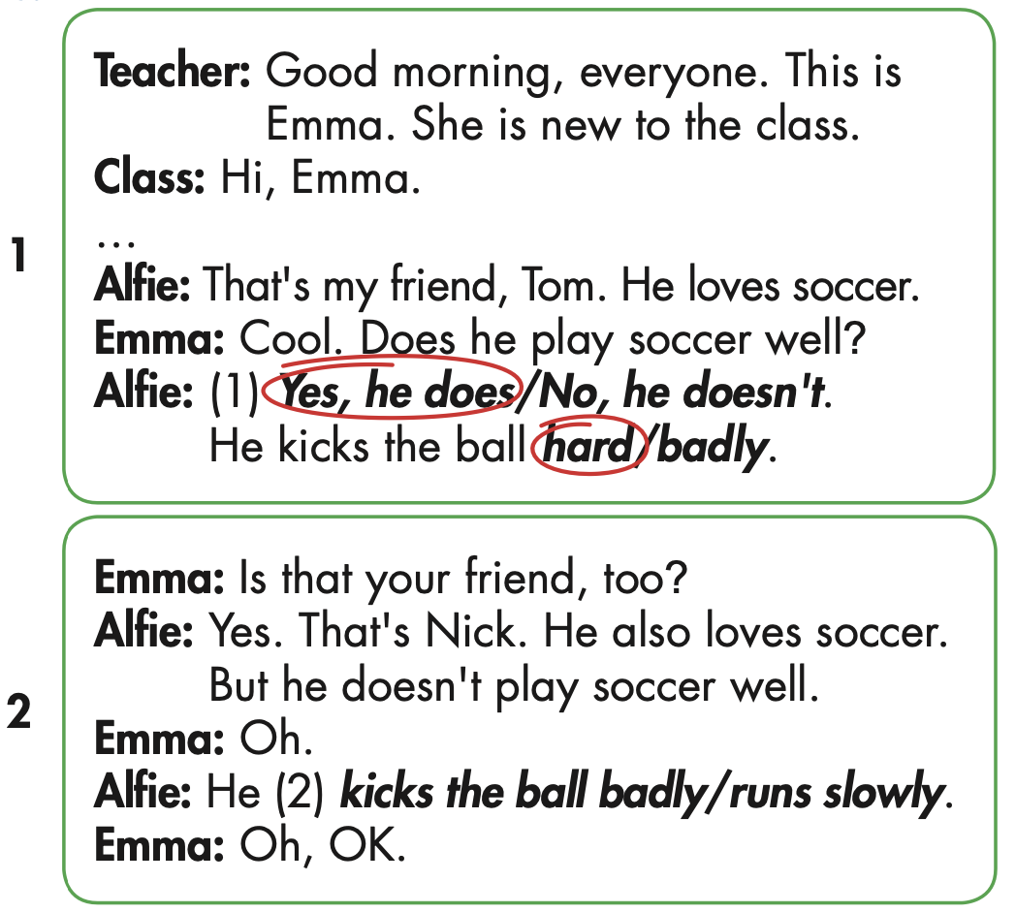

Slide 10
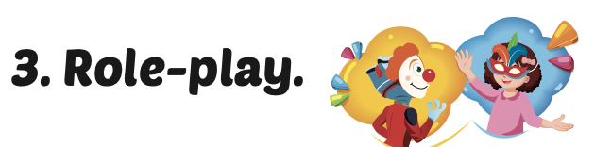
Role-play the conversation. Mind your word stress.

Slide 11
MAKE YOUR OWN STORY

Slide 12

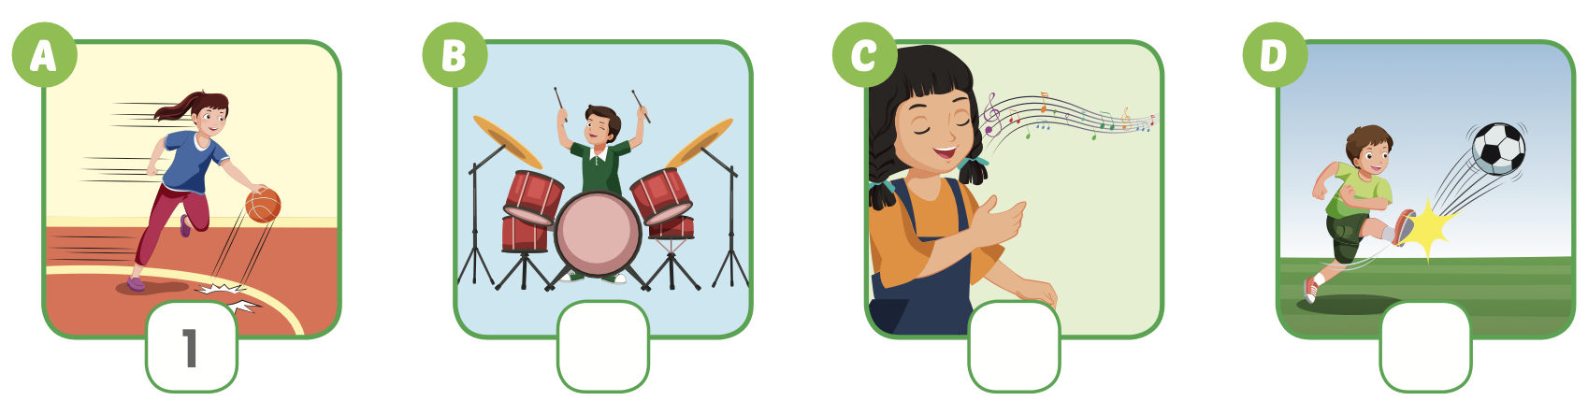
Extra Practice
WB, page 23
4
3
2

Slide 13
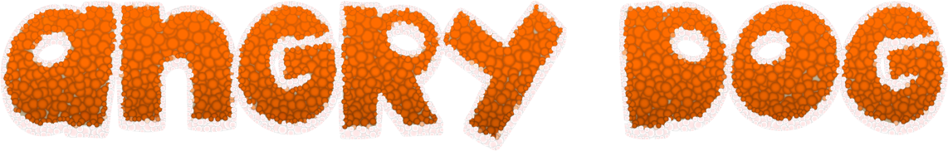
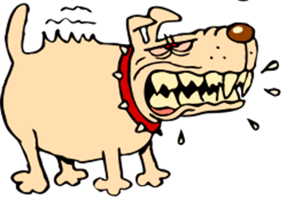


GAME
GAME ON ADVERBS OF MANNER
Notes:
13

Slide 14
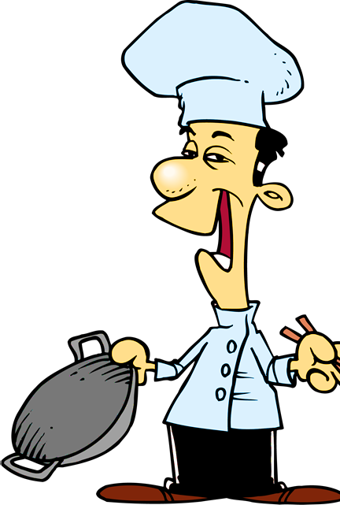

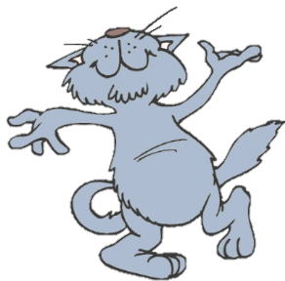
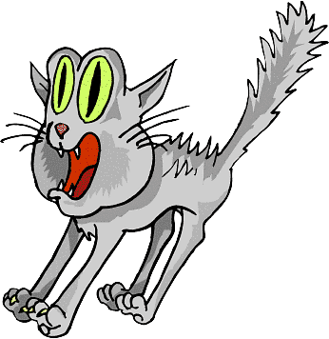
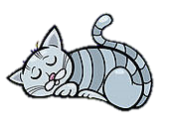
He sings ____________.
You got it!
badly
bad
NEXT
Notes:
14

Slide 15
She sings beautifully.
She is a _________ singer.
You got it!
good
well
NEXT

Slide 16
This bus is too _______ .
We will be late for school.
You got it!
slow
slowly
NEXT
Notes:
16

Slide 17
They are fantastic dancers.
They dance really _______.
You got it!
well
badly
NEXT
Notes:
17

Slide 18
I don’t want to go with him.
He drives too ________ .
You got it!
fast
slow
END

Slide 19
Today’s lesson
Pronunciation
Word stress
Structures/ Sentence patterns
Tom kicks the ball hard.

Slide 20
Homework
Practice the vocabularies and structure, and make sentences using them.
Do the exercises in Tiếng Anh 5 i-Learn Smart Start WB (page 23).
Do the exercises in Tiếng Anh 5 i-Learn Smart Start Notebook.
Prepare the next lesson (page 36 SB).
Play the consolidation games in Tiếng Anh 5 i-Learn Smart Start DHA App on www.eduhome.com.vn

Slide 21

Enjoy your day!

